Slide 1
JMX Programming for Weblogic Server Performance Tuning and Monitoring
Takyiu Liu
Education Service
BEA Systems
June 2002

Slide 2
MBeans
MBeans (managed beans) are the JMX constructs that represent managed resources. Each managed resource in WebLogic Server (an API, service, or application component) uses one or more MBeans to provide an interface for modifying or monitoring the resource.
3 types of Mbeans:
  Administration Mbeans represent domain-wide configuration parameters read from config.xml.
  Configuration Mbeans are the per-server copies of administration MBeans that a server uses to configure itself.
  Runtime Mbeans represent the run-time state of various WebLogic Server components and subsystems.
We’ll concentrate only on Runtime MBeans.

Slide 3
MBean Server
MBean Server (MBean registry)
  Each WL server in a WebLogic administration domain contains its own MBean Server. Each MBean Server registers only those MBeans that apply to the local WebLogic Server instance. The administration server's MBean server is unique in that it hosts domain-wide administration MBeans as well as the server's own configuration and runtime MBeans.

Slide 4
MBean Home
MBean Home
  The JMX 1.0 specification does not provide guidelines for making the MBean server interface available to management clients outside of the Mbean server's JVM. An MBeanHome is simply a wrapper around an MBean server interface which can be accessed via a JNDI lookup, and has a strongly-typed interface.
  In addition to providing a standard MBeanHome interface, the administration server provides an additional, domain-wide MBeanHome interface. This interface does not have an associated MBean server, but it operates in the same manner as a server-specific MBeanHome. It accesses another server's MBeans using the respective server's MBeanHome interface.

Slide 5
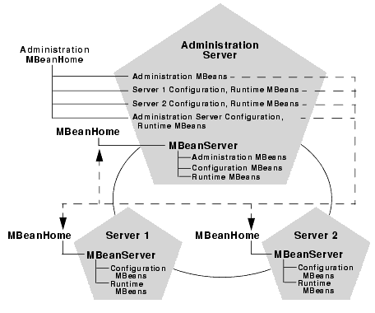
WLS Management System

Slide 6
MBean Naming Convention
All WebLogic Server MBeans have a name, a type and a domain. These attributes are reflected in the MBean's JMX Object Name. The Object Name is the unique identifier for a given MBean across all domains, and has the following structure:
  Domain_name:Name=name,Type=type[,attr=value]...
Type is also used to distinguish between administration, configuration, and runtime MBeans by appending the following standard suffixes:
<no suffix> indicates an Administration MBean
Config indicates a configuration MBean
Runtime indicates a runtime MBean
Example:
  JDBCConnectionPool for an Administration MBean
  JDBCConnectionPoolConfig for a Configuration MBean
  JDBCConnectionPoolRuntime for a runtime MBean
All runtime and configuration MBeans have a Location component that uses the name of the server on which that MBean is located as its value: mydomain:Name=myServlet,Type=ServletRuntime,Location=myserver

Slide 7
Some useful EJB runtime MBeans for performance tuning/monitoring
EJBCacheRuntimeMBean
  long getActivationCount()
  long getCacheAccessCount()
  int getCachedBeansCurrentCount()
  long getCacheHitCount()
  long getPassivationCount
EJBPoolRuntimeMBean
  int getBeansInUseCount()
  int getIdleBeansCount()
  long getWaiterTotalCount()
EJBTransactionRuntimeMBean
  long getTransactionsCommittedTotalCount()
  long getTransactionsRolledBackTotalCount()
  long getTransactionsTimedOutTotalCount()

Slide 8
Some useful server runtime MBeans for performance tuning/monitoring
JVMRuntimeMBean (Javadocs not available)
  long getHeapFreeCurrent()
ExecuteQueueRuntimeMBean
  int getExecuteThreadCurrentIdleCount()
  int getPendingRequestCurrentCount()
  int getServicedRequestTotalCount()
JTARuntimeMBean
  long getTransactionTotalCount()
  long getTransactionCommittedTotalCount()
  long getTransactionRolledBackTotalCount()
  long getTransactionRolledBackSystemTotalCount()
  long getTransactionRolledBackTimeoutTotalCount()

Slide 9
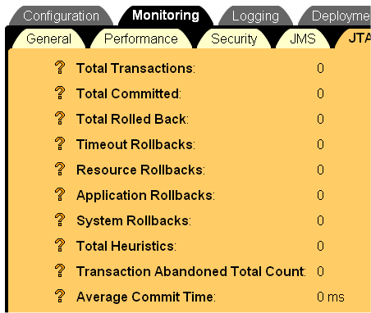
WLS Admin Console
JTARuntimeMBean
  long getTransactionTotalCount()
  long getTransactionCommittedTotalCount()
  long getTransactionRolledBackTotalCount()
  long getTransactionRolledBackSystemTotalCount()
  long getTransactionRolledBackTimeoutTotalCount()

Slide 10
Some useful JDBC runtime MBeans for performance tuning/monitoring
JDBCConnectionPoolRuntimeMBean
  int getActiveConnectionsCurrentCount()
  int getActiveConnectionsHighCount()
  int getConnectionDelayTime() // average
  int getConnectionsTotalCount()
  int getFailuresToReconnectCount() // failures to refresh a connection
  int getLeakedConnectionCount()
  JDBCStatementProfile[] getStatementProfiles(int index, int count)
  int getWaitingForConnectionCurrentCount()
  int getWaitingForConnectionHighCount()
  int getWaitSecondsHighCount()
  boolean poolExists(String poolName)

Slide 11
Some useful JMS runtime MBeans for performance tuning/monitoring
JMSDestinationRuntimeMBean
  long getBytesCurrentCount()
  long getBytesHighCount()
  long getBytesPendingCount()
  long getBytesReceivedCount()
  long getConsumersCurrentCount()
  long getConsumersHighCount()
  long getConsumersTotalCount()
  long getMessagesCurrentCount()
  long getMessagesHighCount()
  long getMessagesPendingCount() // pending message is one that has either been sent in a trasaction and not committed, or that has been received and not committed/acknowledged.
  long getMessagesReceivedCount()

Slide 12
Some useful WebApp runtime MBeans for performance tuning/monitoring
ServletRuntimeMBean
  int getExecutionTimeAverage
  int getExecutionTimeHigh()
  int getExecutionTimeLow()
  int getInvocationTotalCount()
  int getPoolMaxCapacity() // for single thread model servlets only
WebAppComponentRuntimeMBean
  int getOpenSessionsCurrentCount()
  int getOpenSessionsHighCount()
  ServletRuntimeMBean[] getServlets()
  ServletSessionsRuntimeMBean[] getServletSessions()
  int getSessionsOpenedTotalCount()

Slide 13
General Approach in Using JMX for Performance Monitoring and Tuning
Apply increasing levels of excitation to SUT (system under test). Warmups may be required.
Periodically log Mbean attributes of the relevant sub-systems to a persistence store (typically a flat file). The sampling frequency should be high enough to achieve the required level of resolution but low enough to be non-intrusive.
Analyze the collected data. Derived system parameters may help in understanding the data.
Change a WLS system parameter and repeat with step 1 (in tuning).

Slide 14
(Cont’d)
Response time/latency provides macroscopic view of system performance but,
WLS sub-system MBean attributes provides detailed server behavior on a microscopic level.
Application Profiler which provides profiling information on the application level can provide complementary information.

Slide 15
Logger Design
MBeanLogger
MBeanHome lookup,
prepare PrintStream,…
ServerLogger
EJBLogger
override log() and setMBeans() methods
override log() and setMBeans() methods
JDBCConnectionPoolLogger
override log() and setMBeans() methods

Slide 16
Looking up the MBeanHome
The MBeanHome of any server is available from the relevant server's JNDI tree at:
  weblogic.management.MBeanHome.JNDI_NAME.relevantserverName
The administration server also publishes an MBeanHome for each server in the domain in its JNDI tree (using the same JNDI name). This domain-wide MBeanHome is available only from the JNDI tree of the administration server, and is published at:
  weblogic.management.MBeanHome.ADMIN_JNDI_NAME

Slide 17
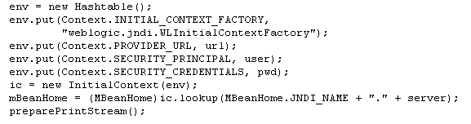
MBeanLogger

Slide 18
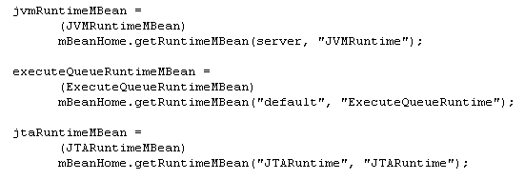
Sub-system Logger: setMBeans()
MBean Name

Slide 19
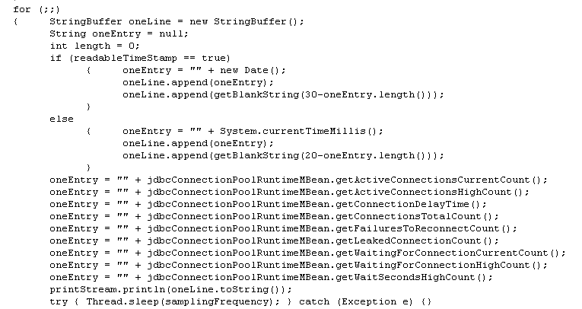
Sub-system Logger: log()

Slide 20
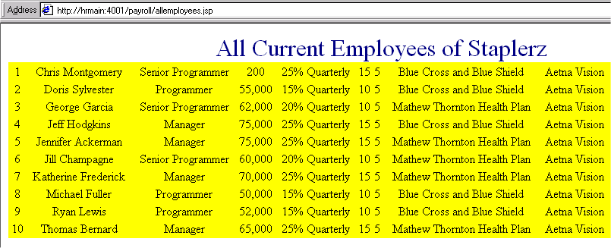
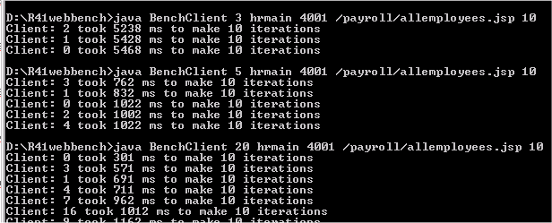
Case Study 1: JDBC
Stress a JDBC operation with:
And log with JDBCConnectionPoolRuntimeMBean:

Slide 21
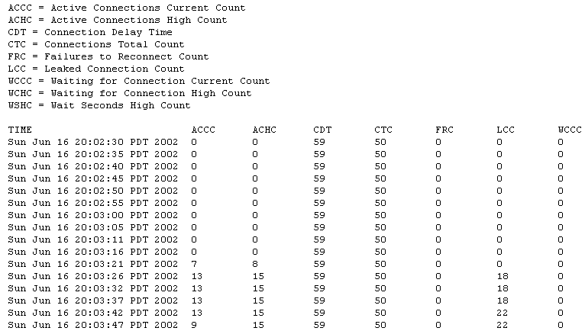
Case Study 1: JDBC

Slide 22
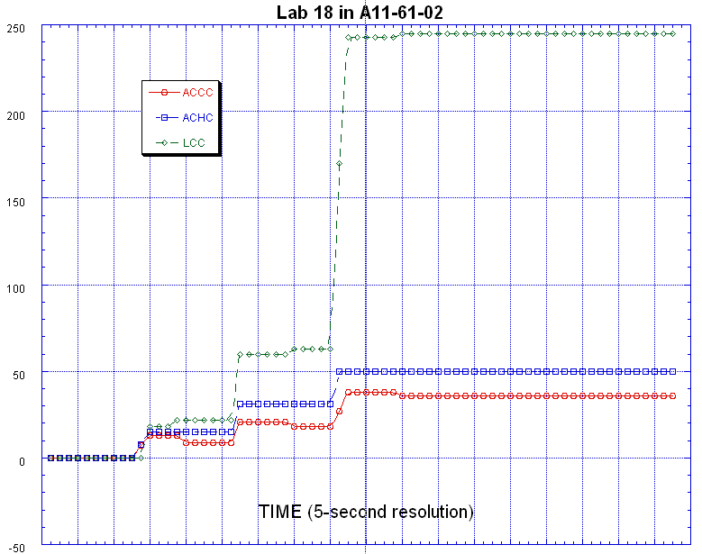
Case Study 1: JDBC
20 concurrent clients
ACCC Active Connections Current Count
ACHC Active Connections High Count
LCC Leaked Connections Count
5 concurrent clients
3 concurrent clients
Notes:
A wait period of ~50 seconds (10 sampling points) was used between the end of an excitation and the introduction of a new excitation.

Slide 23
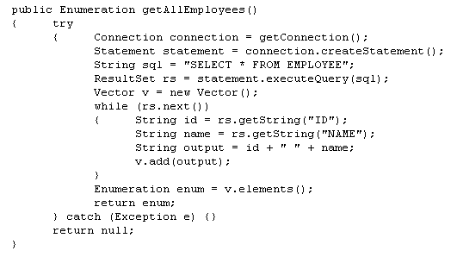
Case Study 1: JDBC
Reason: Connection never closed.

Slide 24
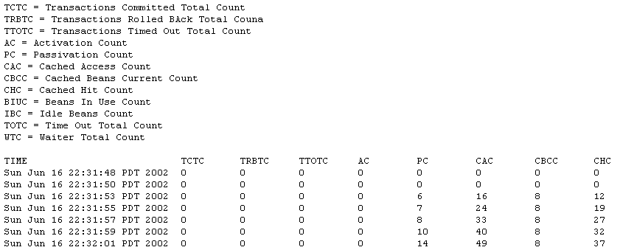
Case Study 2: Stateful Session Bean Cache Size
The Passivation Lab in D21 is used to look at the
effects of cache size on a stateful session bean.

Slide 25
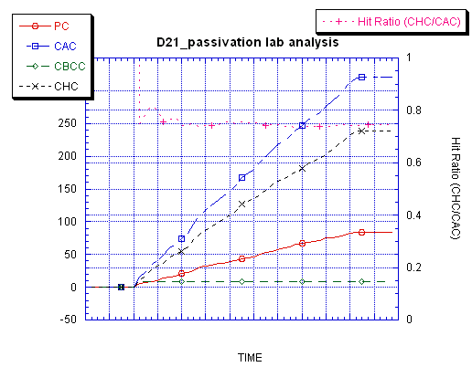
Case Study 2: Stateful Session Bean Cache Size
PC Passivation Count
CAC Cached Access Count
CBCC Cached Beans Current Count
CHC Cached Hit Count
Stateful Session Cache = 8
Concurrent Clients = 10
Hit Ratio = 0.74

Slide 26
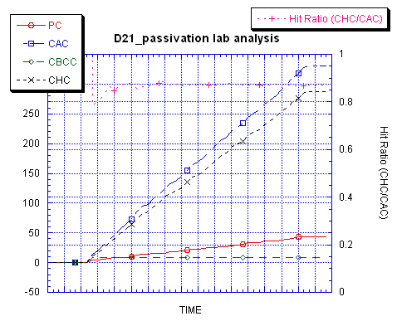
Case Study 2: Stateful Session Bean Cache Size
PC Passivation Count
CAC Cached Access Count
CBCC Cached Beans Current Count
CHC Cached Hit Count
Stateful Cache Size = 9
Concurrent Clients = 10
Hit Ratio = 0.87

Slide 27
Case Study 3: Petstore (J2EE App)
Monitor both server characteristics and JDBC Connection Pool Behavior.
Petstore stressed with Web Bench Kit with 3, 10, and 20 concurrent clients.
A JDBC Connection Pool of initial/max pool size of 15 configured.
Pointbase 4.2 running with WLS 6.1.
Sampling rate of 1 sample every 2 seconds.
Low sampling rate has no impact on actual system throughput.

Slide 28
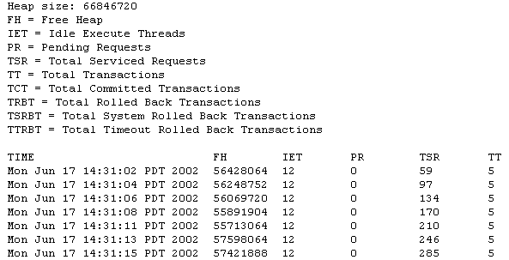
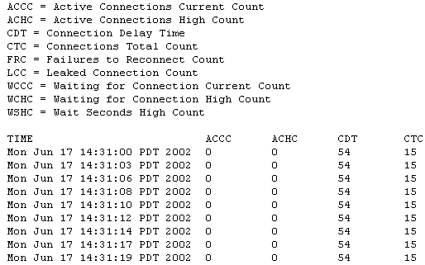
Case Study 3: Petstore

Slide 29
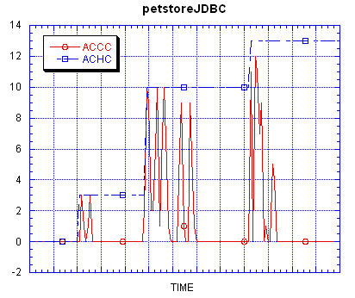
Case Study 3: Petstore
JDBC Connection Pool Monitoring
ACCC Active Connections Current Count
ACHC Active Connections High Count
Not restricted by a max pool size of 15

Slide 30
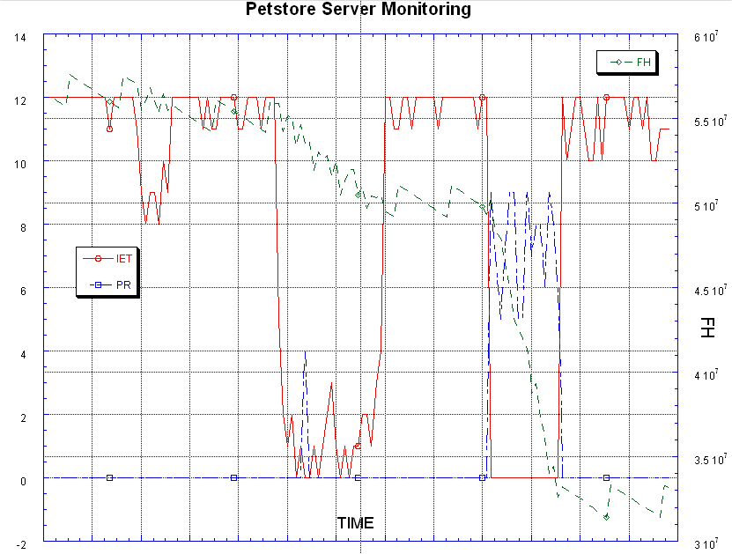
Case Study 3: Petstore
Server Monitoring
Some pending requests
IET
Idle
Execute
Threads
PR
Pending
Requests
FE
Free
Heap
Few pending requests
Running out of execute threads

Slide 31
Alternative to the Admin Console
For WLS monitoring, one can write his own console with just 2 JSPs:
listMBeans.jsp
  MBeanHome home = (MBeanHome)ctx.lookup("weblogic.management.adminhome");
  Set mBeanList = home.getAllMBeans();
  Set mBeanList = home.getMBeansByType(mBeanTypeParm);
showMBean.jsp
  MBeanHome home = (MBeanHome)ctx.lookup("weblogic.management.adminhome");
  WebLogicMBean mbean =
  home.getMBean(new WebLogicObjectName(mbeanName));
  MBeanInfo info = mbean.getMBeanInfo();
  MBeanAttributeInfo[] attInfo = info.getAttributes();
  MBeanOperationInfo[] operationInfo = info.getOperations();

Slide 32
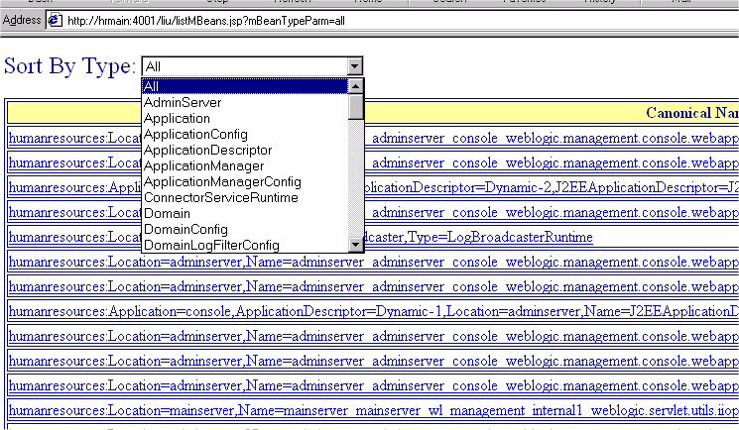
Viewing all MBeans on a server

Slide 33
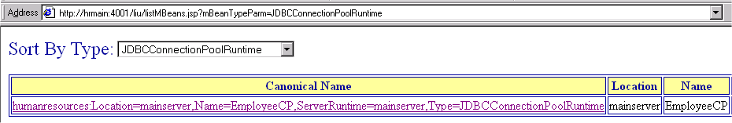
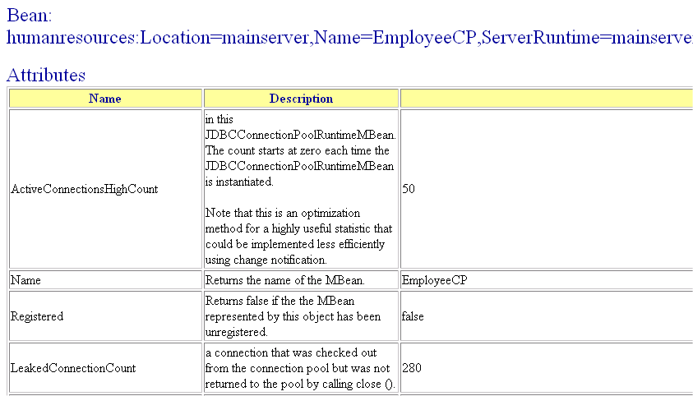
Viewing a specific MBean

