Slide 1

JMX MBeans for
System Resource Configuration and
Monitoring
Takyiu Liu & Balamurali Kothandaraman
BEA Systems Inc.,
www.bea.com

Slide 2
  Learn the power of Java Management Extensions™ (JMX™) MBeans for Configuring system resources, Monitoring and Deploying applications
  Unveil the power of MBeans

Slide 3
Agenda
JMX Introduction
Management & Deployment API
JMX in BEA WebLogic Server
Road to MBeans
BEA WebLogic Server built-in JMX Tools
Other Tools

Slide 4
Agenda
JMX Introduction
Management & Deployment API
JMX in BEA WebLogic Server
Road to MBeans
BEA WebLogic Server built-in JMX Tools
Other Tools

Slide 5
J2EE APPLICATION MANAGEMENT
With the growing installation base for J2EE applications, the need for management tools is becoming increasingly apparent
Developing and Packaging of J2EE applications have been standardized with various J2EE standards but other lifecycle management actions like deploying, managing and monitoring those applications are not standardized yet
Also the resources required by J2EE applications are also configured and deployed outside the context of J2EE enterprise application

Slide 6
NEED FOR AUTOMATION
Automating the system resource configuration and application lifecycle management is also a growing need for J2EE application deployment platforms
Today the management of J2EE servers, applications and resources outside the management console can only be full-filled by vendor specific management APIs
Automating system resource configuration, application deployment, system recovery processes etc demands building custom solutions based on vendor specific technologies and tools.

Slide 7
JAVA MANAGEMENT EXTENSIONS (JMX)
JMX
  Is a management architecture
  Is a set of APIs
  Is an open technology for management and monitoring
JMX Specification defines Management Beans (MBeans), which are the building blocks of JMX
http://java.sun.com/products/JavaManagement

Slide 8
JMX ARCHITECTURE
Management
Applications
The Manager Level: A JMX manager provides an interface for management applications to interact with the agent, distribute or consolidate management information, and provide security
The Agent Level: The MBean server is a registry for MBeans in the agent. All management operations performed on the MBeans are done through Java technology-based interfaces on the MBean server
Instrumentation Level: A managed bean, or MBean for short, is a Java object that represents a JMX manageable resource. MBeans provide instrumentation of managed resources in a standardized way, they can be plugged into any JMX agent
Manager Level
Agent Level
Instrumentation
Level
Managed
Resource

Slide 9
JMX GOALS
The JMX intends to provide
  Java developers across all industries with the means to instrument Java code, create smart Java agents, implement distributed management middleware and managers, and smoothly integrate these solutions into existing management systems
  Tools for managing Java environments
  A decoupling of application enabling from management solution
  Portability for management applications

Slide 10
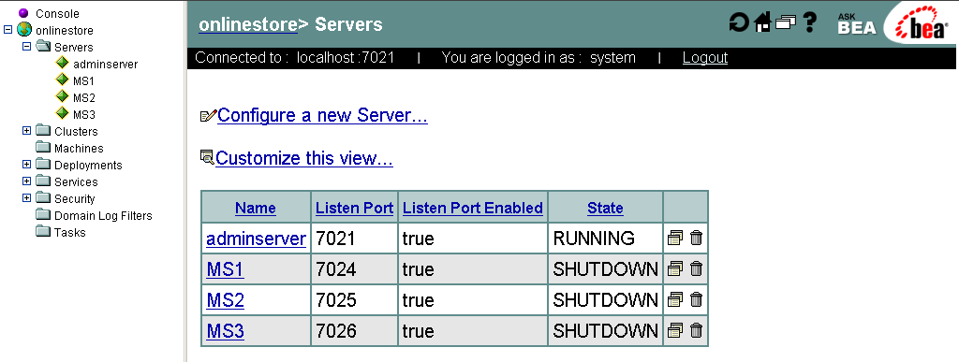
TODAY’S MANAGEMENT TOOLS
The current selection of J2EE management tools are implementation-specific
Today the Lifecycle management of J2EE applications and system resource configuration are done with vendor-specific Administration Consoles

Slide 11
Agenda
JMX Introduction
Management & Deployment API
JMX in BEA WebLogic Server
Road to MBeans
BEA WebLogic Server built-in JMX Tools
Other Tools

Slide 12

EMERGING TECHNOLOGIES
The growing need for open, standards-based management solutions are directly addressed by the following standards in J2EE 1.4
1
  J2EE Management API (JSR 77)
2
  J2EE Deployment API (JSR 88)

Slide 13
Agenda
JMX Introduction
Management & Deployment API
JMX in BEA WebLogic Server
Road to MBeans
BEA WebLogic Server built-in JMX Tools
Other Tools

Slide 14
JMX IN WEBLOGIC SERVER
WebLogic Server implement JMX 1.0 to provide extensible management services
WebLogic Server resources can be managed through JMX-based management applications
Management solutions provided by WebLogic Server
  Administration Console
  Command-line Utilities
  SNMP Adaptor
  Third-party JMX-based Management Consoles
  Custom build JMX-based applications

Slide 15
MBEANS
MBeans are JavaBeans that :
  represent a JMX manageable resource
  expose configuration information
  can be an application, device or service
  have attributes/properties
  can generate notifications
  building blocks of WebLogic Server architecture

Slide 16
WEBLOGIC MBEAN EXTENSIONS
All WebLogic Server MBeans are dynamic MBeans
Provides typesafe interfaces
Provides remote access
Provides persistence through configuration XML file
Type of WebLogic Server MBeans
  Admin MBeans
  Config MBeans
  Runtime MBeans

Slide 17
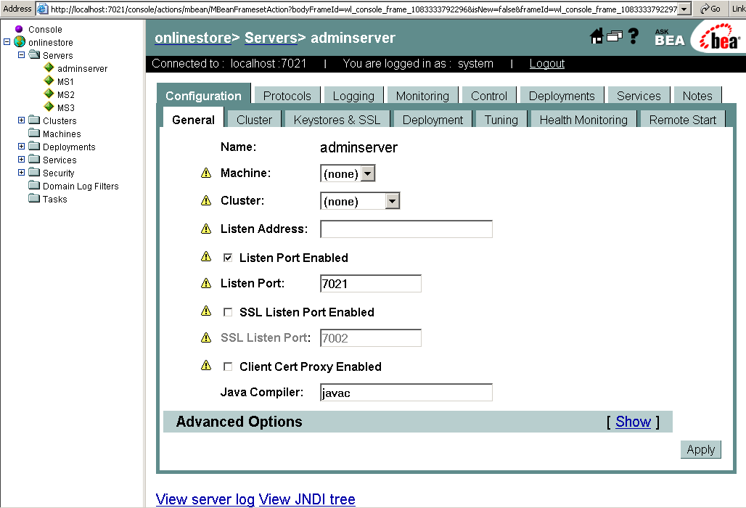
WEBLOGIC DOMAIN ARCHITECTURE
Admin
Server
Managed
Server A
Managed
Server B
XML
Configuration
repository
(config.xml)
Managed
Server C
Cluster

Slide 18
A PICTURE IS WORTH A THOUSAND WORDS
Administration Server
MBean Server (Agent)
Managed Server A
Configuration MBeans
Run-time MBeans
MBean Server (Agent)
Administration MBeans
Configuration MBeans
Run-time MBeans
Administration MBeans
Administration MBeans
Administration MBeans
Managed Server B
MBean Server (Agent)
Configuration MBeans
Run-time MBeans
XML
Managed Server C
Configuration
repository
(config.xml)
MBean Server (Agent)
Configuration MBeans
Run-time MBeans

Slide 19
ACCESSING AND CHANGING MBEANS
Administration MBeans represents the configuration of managed resources in a WebLogic Domain
Local Configuration MBeans are local replicas of the Administration MBeans
Runtime state of the managed resources are provided by Runtime MBeans
BEA recommends changing Administration MBeans for changing configuration information of managed resources. Replicas will automatically be refreshed.

Slide 20
Agenda
JMX Introduction
Management & Deployment API
JMX in BEA WebLogic Server
Road to MBeans
BEA WebLogic Server built-in JMX Tools
Other Tools

Slide 21
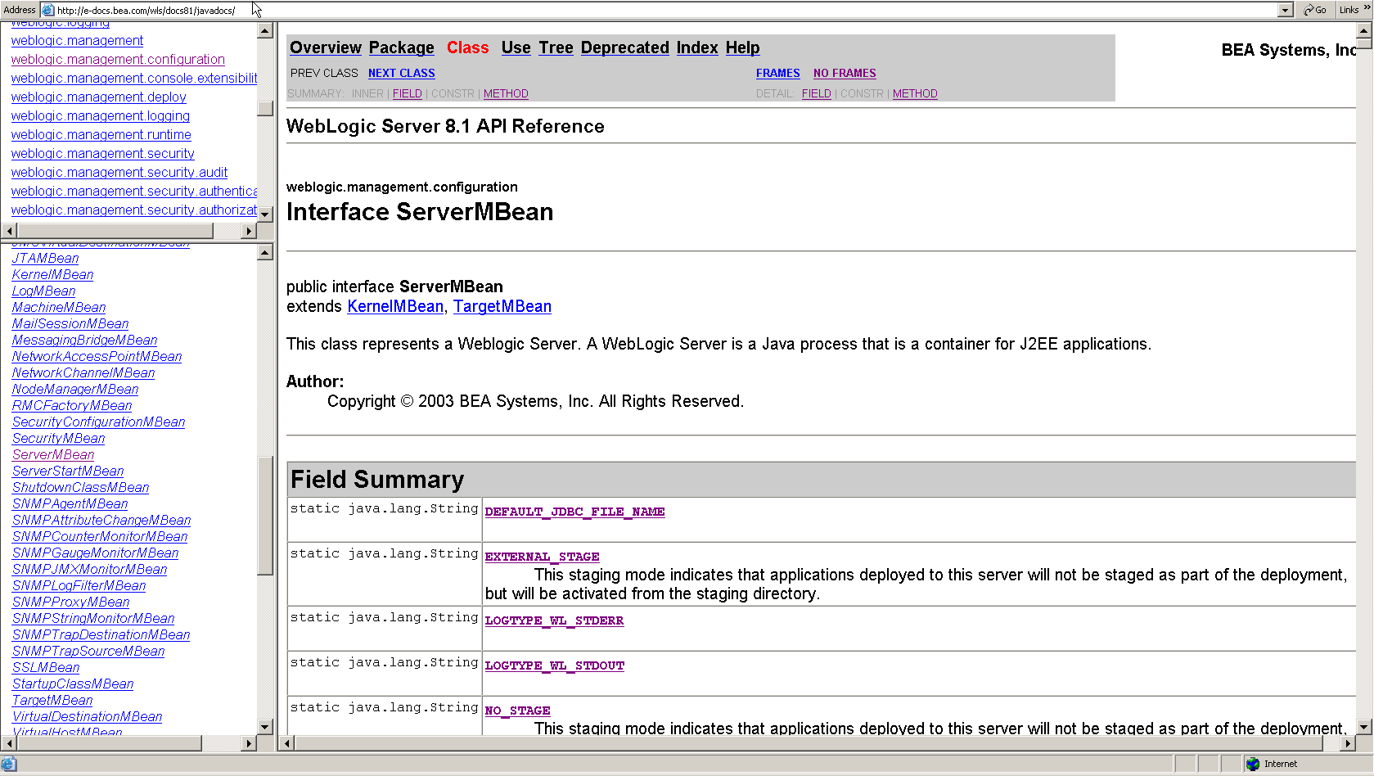
WLS MBEAN JAVA DOC

Slide 22
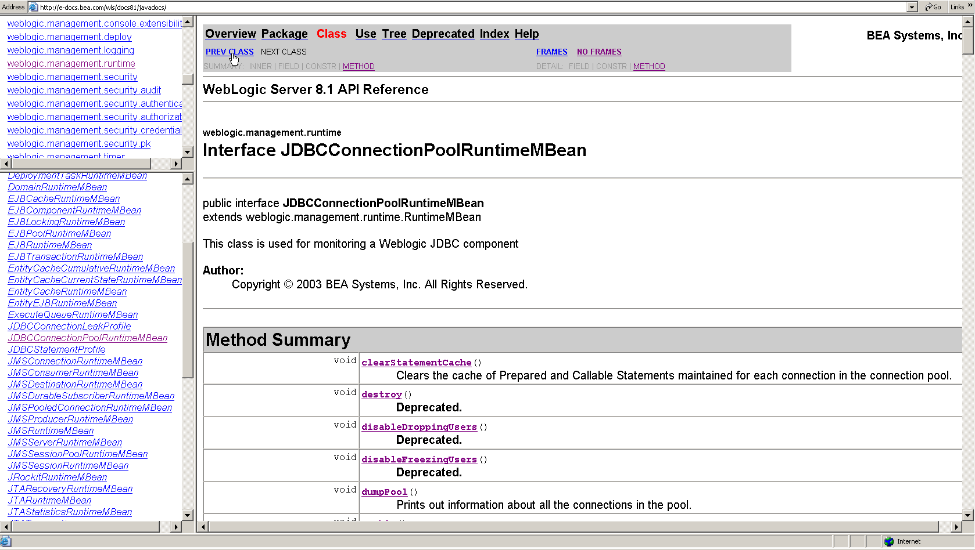
WLS MBEAN JAVA DOC

Slide 23
MANAGEMENT TOOLS
1
Manager looks up the MBeanHome object from JNDI (and gets a specific MBean from MBeanHome)
WLS
Management Tool
(Ex. WLSHELL, WLST, command-line tools)
JNDI
MBean Server (Agent)
2
Manager uses the MBean to access state and configuration information
Configuration MBeans
Run-time MBeans

Slide 24
RETRIEVING MBEANHOME FROM JNDI
To retrieve the local MBeanHome for the current context
  javax.naming.Context.lookup(MBeanHome.LOCAL_JNDI_NAME)
If the current context is an Administration Server
  javax.naming.Context.lookup(MBeanHome.ADMIN_JNDI_NAME)
If the current context is an Administration Server, to retrieve the local MBeanHome of any server instance
  javax.naming.Context.lookup("weblogic.management.home.relevantServerName")

Slide 25
CHANGING MBEANS
Enabling WebLogic Server to send log notification to stdout and setting the level of logging severity to information (INFO)
  …
  MBeanHome home = (MBeanHome) ctx.lookup(MBeanHome.ADMIN_JNDI_NAME);
  ServerMBean server = ServerMBean)home.getMBean(“MS1","Server");
  server.setStdoutEnabled(true);
  // INFO=64, WARNING=32, ERROR=16
  server.setStdoutSeverityLevel(64);
  …

Slide 26
MONITORING RUNTIME MBEANS
Runtime state of the managed resources are provided by Runtime MBeans
home.getMBeansByType(“ServerRuntime”) method can be used to retrieve the ServerRuntime MBeans in the domain
  …
  System.out.println(serverRuntime.getHealthState());
  jvmRuntime = serverRuntime.getJVMRuntime();
  System.out.println(jvmRuntime.getHeapSizeCurrent());
  …

Slide 27
USEFUL RUNTIME MBEANS
Some useful runtime MBeans for performance monitoring WebLogic Server during load testing:
  WebAppComponentRuntimeMBean
  ServletRuntimeMBean
  JDBCConnectionPoolRuntimeMBean
  JMSDestinationRuntimeMBean
  EJBCacheRuntimeMBean
  EJBPoolRuntimeMBean
  EJBTransactionRuntimeMBean
  JTARuntimeMBean
  ExecuteQueueRuntimeMBean
  JVMRuntimeMBean

Slide 28
MBEAN NOTIFICATIONS
All WebLogic Server MBeans emit notifications to report changes in configuration and runtime information
WebLogic Server supports listener that runs in the same VM or in a remote VM as the server
The listener class should implement javax.management.NotificationListener

Slide 29
REGISTERING A CUSTOM LISTENER
Listener can be added to the MBean Server using addNotificationListener method
Filters can be defined to limit the notifications your listener class receives
  …
  MBeanHome home = (MBeanHome) ctx.lookup(MBeanHome.ADMIN_JNDI_NAME);
  RemoteMBeanServer rmbs = home.getMBeanServer();
  rmbs.addNotificationListener(mbeanName, listener, filter, null);
  …

Slide 30
Agenda
JMX Introduction
Management & Deployment API
JMX in BEA WebLogic Server
Road to MBeans
BEA WebLogic Server built-in JMX Tools
Other Tools

Slide 31
ADMINISTRATION CONSOLE
MBean Attributes

Slide 32
WEBLOGIC.ADMIN
weblogic.Admin is a command-line utility provided by WebLogic Server for manipulating WebLogic MBeans from command-line or a batch script
MBean-specific commands provided by weblogic.Admin utility:
  CREATE: instantiate a configuration MBean
  DELETE: removes a configuration MBean
  GET: return one attribute of a run-time MBean
  SET: set one attribute of a configuration MBean
  INVOKE: call a method of a run-time MBean
  QUERY: searches for MBean with matching pattern

Slide 33
USING COMMAND-LINE
Creating a JMS Connection Factory in WebLogic domain
java weblogic.Admin -adminurl localhost:7021 -username weblogic –password weblogic CREATE -mbean mydomain:Name=myQueueFactory,Type=JMSConnectionFactory
java weblogic.Admin -adminurl localhost:7021 -username weblogic –password weblogic INVOKE -mbean mydomain:Name=myQueueFactory,Type=JMSConnectionFactory -method addTarget "mydomain:Name=MS1,Type=Server"
Creating a user in WebLogic embedded LDAP Server java weblogic.Admin -adminurl localhost:7021 –username weblogic –password weblogic INVOKE -mbean Security:Name=myrealmDefaultAuthenticator -method createUser mickey pAsSwOrD “application user"

Slide 34
USING ANT TASK
New Ant task wlconfig allows you to dynamically configure the WebLogic Server
Does not require the knowledge of MBean syntax
Commands supported by wlconfig ant task
  create
  delete
  get
  set
  query

Slide 35
WLCONFIG ANT TASK
Example wlconfig ant script to change the Log filename of a managed server
  …
  <wlconfig url="t3://localhost:7021" username="abc" password=“xyz">
  <query domain=“mydomain" type="WebServer" name=“MS1">
  <set attribute="LogFileName“ value="logs/MS1_server.log"/>
  </query>
  </wlconfig>
  …

Slide 36
SNMP ADAPTOR
WebLogic Server also provides an SNMP Adaptor for MBeans
MBeans can use SNMP protocol to communicate with enterprise-wide management systems
WebLogic Server provides a unique Object Identifier (OID) to its MBean attributes in its Management Information Base (MIB)
Each MBean attribute in the MIB is an SNMP managed object and can be polled by an SNMP management system
Standard SNMP trap notifications(V1/V2) can also be sent to the SNMP management server

Slide 37
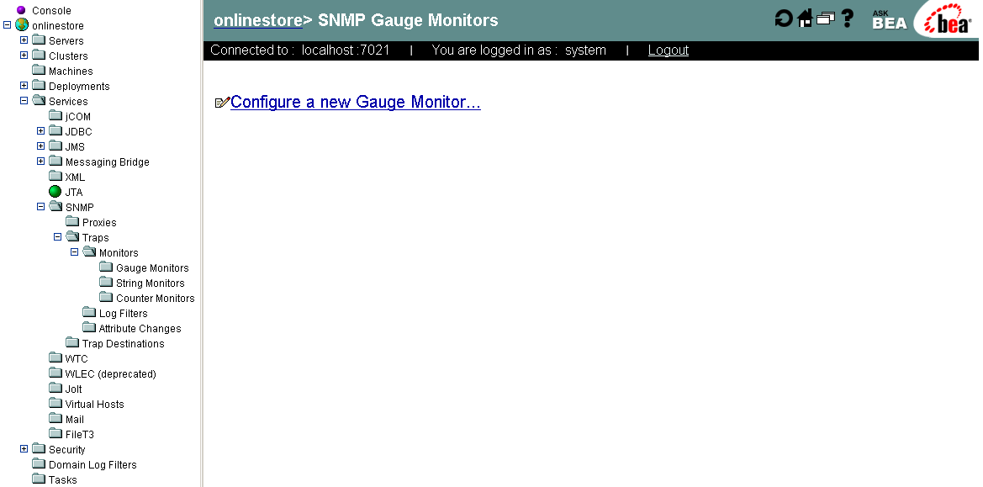
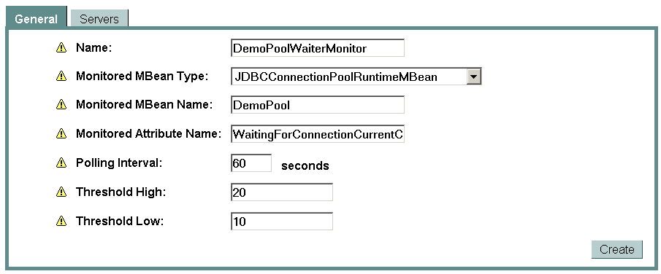
SNMP TRAPS

Slide 38
Agenda
JMX Introduction
Management & Deployment API
JMX in BEA WebLogic Server
Road to MBeans
BEA WebLogic Server built-in JMX Tools
Other Tools

Slide 39

WLST
WebLogic Scripting Tool
Manage & configure WebLogic Server (online/offline)
Built on Jython
  100% pure Java Implementation of Python
  Simple & clear syntax
  Use existing java classes from within jython
  Proven to be Fast & Reliable compared to other tools
With offline mode you can make reliable changes to config.xml without a running server
http://dev2dev.com/codelibrary/code/wlst.jsp

Slide 40
WLST COMMANDS
browse
  cd, ls, config, runtime, custom
control
  connect, disconnect, exit
edit
  create, delete, get, set, invoke, configToScript (converts config.xml to WLST scripts)
deploy
  deploy, undeploy, redeploy
lifecycle
  shutdown, suspend, resume, start

Slide 41
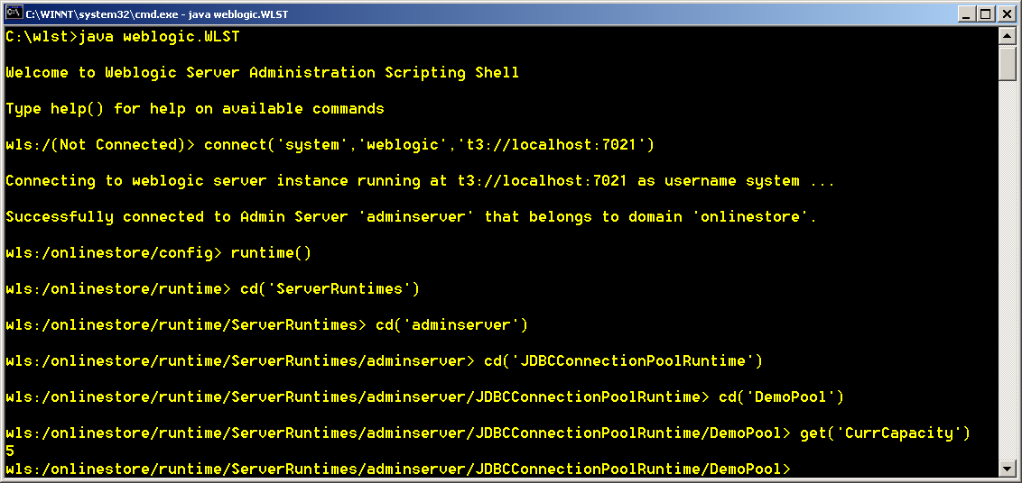
WLST

Slide 42
SCRIPTING WITH WLST
sample_wlst.py
# #
# WLST script for creating JDBC Connection Pool #
# #
connect('system','weblogic','t3://localhost:7021')
pool="DemoPool_WLST"
server=“MS1"
cd("Servers/"+server)
target=cmo
cd("../..")

Slide 43
SCRIPTING WITH WLST (Contd.)
sample_wlst.py
# start creation
create(pool,"JDBCConnectionPool")
cd("JDBCConnectionPool/"+pool)
cmo.setDriverName("com.pointbase.jdbc.jdbcUniversalDriver")
cmo.setURL("jdbc:pointbase:server://localhost:9092/HRDATABASE")
props = makePropertiesObject("user=PBPUBLIC")
cmo.setProperties(props)
cmo.setPassword("PBPUBLIC")
cmo.addTarget(target)

Slide 44
WLST ROADMAP
BEA WebLogic Workshop extension for WLST is available for download from http://dev2dev.bea.com
BEA will include and support WLST as part of standard WebLogic Server distribution with Diablo
Current releases WLS7.0 & WLS8.1 will include and support WLST with future service packs

Slide 45

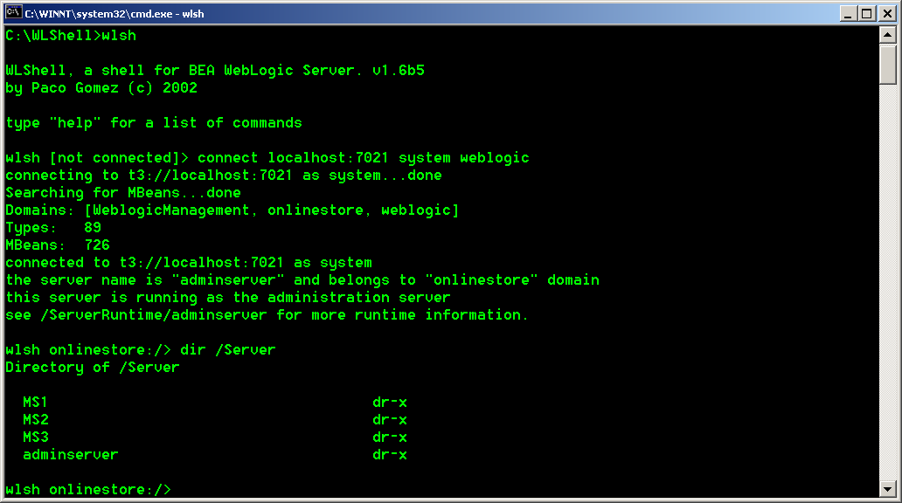
WLSHELL
WLShell is a command-line shell for BEA WebLogic Server administration
Works like a simple telnet application for WebLogic server
Provides simplified directory like access for WebLogic MBeans
www.wlshell.com

Slide 46
FILE SYSTEM ANALOGY FOR MBEANS
WLShell uses file system analogy for MBeans.
MBeans look like directories.
Can use the dir or ls command to list the Mbeans:
  dir [-l] [<directory>]
  ls [-l] [<directory>]
WLShell also provides graphical tools WLShell Explorer and WLShell Monitor for managing and monitoring weblogic server MBeans.

Slide 47
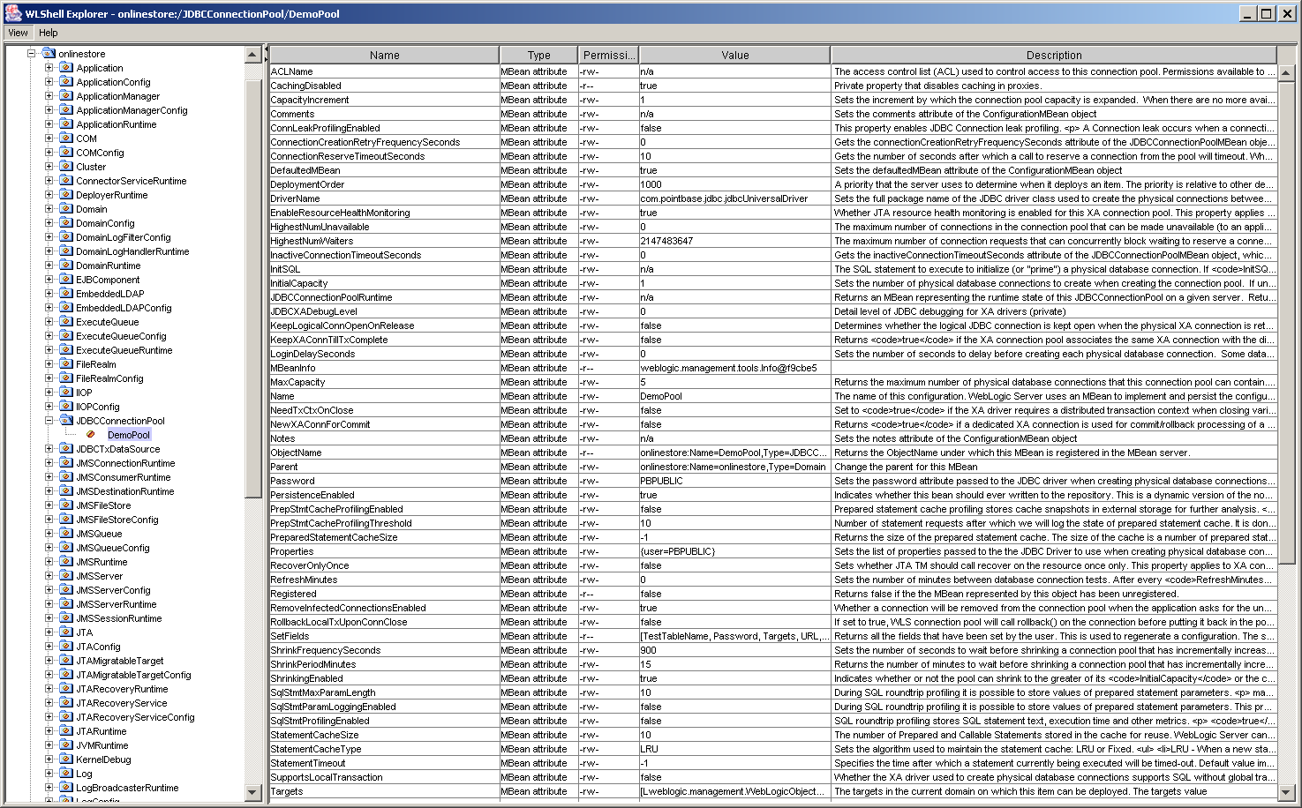
WLSHELL MBEAN EXPLORER

Slide 48
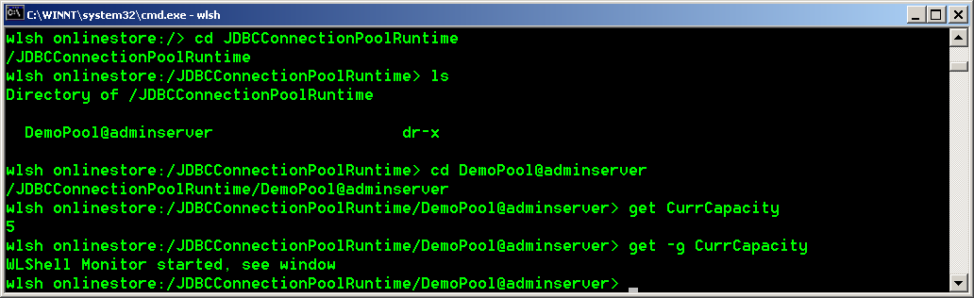
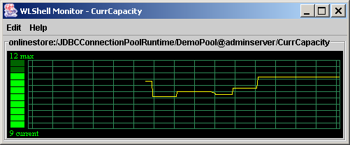
MONITORING USING WLSHELL

Slide 49
WLSHELL COMMANDS
browse
  cd, ls, dir, pwd, get, explore, ping, ver, echo
control
  connect, disconnect, exit
edit
  mkdir, rmdir, get, set, invoke
expressions
  if, while
scripts
  read, c2w (converts config.xml to wlshell scripts)

Slide 50
SCRIPTING WITH WLSHELL
sample.wlsh
# #
# WLShell script for creating JDBC Connection Pool #
# #
connect localhost:7021 system weblogic
server=adminserver
pool=DemoPool_WLSH
datasource=DemoDataSource
md /JDBCConnectionPool/$pool
cd /JDBCConnectionPool/$pool

Slide 51
SCRIPTING WITH WLSHELL (Contd.)
sample.wlsh
set DriverName "com.pointbase.jdbc.jdbcUniversalDriver"
set URL "jdbc:pointbase:server://localhost:9092/HRDATABASE"
set Properties (java.util.Properties) "user=PBPUBLIC"
set Password "PBPUBLIC"
set MaxCapacity 5
set TestConnectionsOnReserve true
set TestTableName EMPLOYEE
invoke addTarget /Server/$server

Slide 52
XtremeJ
XtremeJ is a management console for JMX based applications.
XtremeJ client for BEA WebLogic Server can be used to:
  Browse the WebLogic MBeans
  View MBean attribute values
  Change MBean attribute values
  Invoke MBean operations
Based on eclipse open platform.

Slide 53
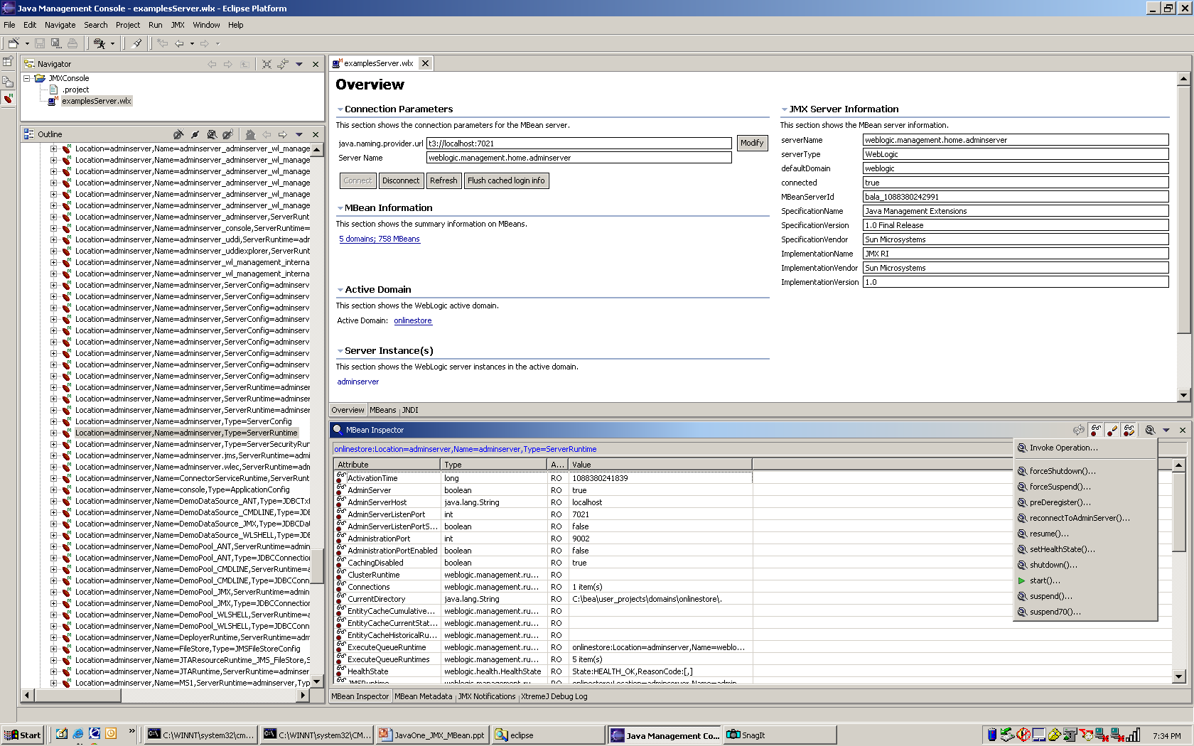
XtremeJ

Slide 54
Demo
JMX MBeans in Action using:
Custom JMX Application
WLShell
WLST
ANT Script
Command line - weblogic.Admin

Slide 55
Summary
JMX Introduction
Management & Deployment API
JMX in BEA WebLogic Server
Road to MBeans
BEA WebLogic Server built-in JMX Tools
Other Tools

Slide 56
For More Information
Contact info
  takyiu.liu@bea.com
  bala@bea.com
References
  http://java.sun.com/products/JavaManagement
  http://edocs.bea.com
  http://dev2dev.bea.com/codelibrary/code/wlst.jsp
  www.wlshell.com
  www.xtremej.com

