Slide 1










Meta-Analytic
Databases
Transform
Upload
Release
Update
Metapsy
Data Format
Github
Repository
Versioning
Digital Object Identifier
Documentation
docs.metapsy.org
Access in R
Analyze Online
metapsyData
metapsyTools
tools.metapsy.org
Meta-Analysis Tool
metapsy.org
Analyze in R

Slide 2




Meta-Research
Network Meta-analyses
Meta-Analyses (IPD, Living Systematic Reviews)
Umbrella Reviews
Meta-Analytic Research Domains (MARD)
Open Science
Evidence Maps
Meta-Science
Umbrella Reviews
Transparency &
Consistency
Comprehensive
Evidence
MARD
Re-Usability &
Accessibility
Up-to-date
Information
Statistical Software
Rapid Reviews
Research Synthesis
Methods
Living Systematic Reviews
Science Communication
Leif Michelsen, Gordo Ibáñez, Kemesh Maharjan, Popular from Noun Project

Slide 3
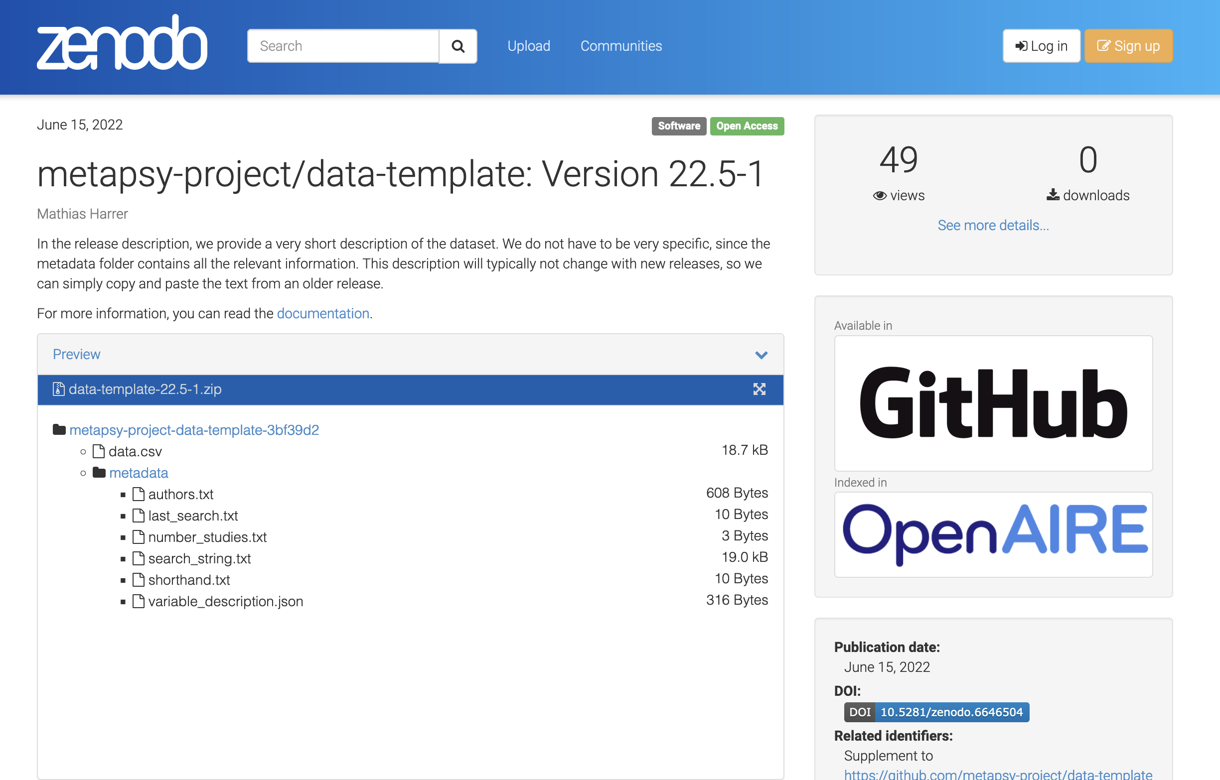
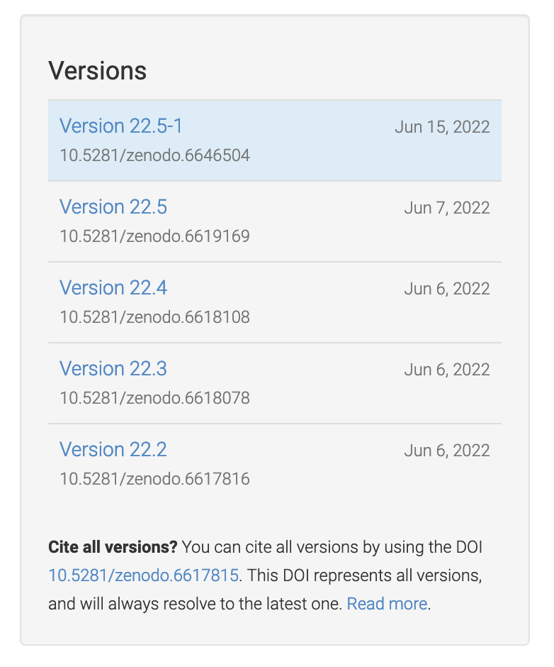
Link to the state of the GitHub repository at the latest release
Latest Database Version DOI
”Frozen” Database Repository Contents
Overall Database DOI
(Concept DOI)

