Slide 1
Rampage Texturing and Shading
Emmett Kilgariff, VP of Architecture
emmett@3dfx.com
3/9/00

Slide 2
Rampage
Next Generation Rendering Engine (VTA)
Next Generation Video Engine
16M tri/sec, 800MP/sec, Single textured.
Programmable Shading
Higher quality filtering
T-buffer based AA
  AA With 2 textures and Anisotropic with no performance hit.
  AA With 4 textures with no performance hit
Scalable Architecture
  Integrated Bridge functionality
  Full AGP Support in SLI
Notes:
Next Generation Video engine includes enhanced MPEG support, better Scaling, Flicker filtering, advanced deinterlaced filtering (above bob or weave), and temporal filtering.

Slide 3
Rampage Features
Massive Multitexturing: 8 textures each with different filtering: point, bilinear, trilinear, anisotropic (up to 128-tap).
Massive Iterators: 8 ARGBSTW iterators: one per texture.
Texture Recursion (Address ops) : recursion in parallel or series on up to 4 textures
  Any combination of 4 recursions on the 8 available textures)
  Recursion allows one texture to perturb the values of another texture
  Two recursion modes
    Before and after W divide
    Applicable for bump mapping and procedural textures
  Risc-like address op instruction model
Cubic Environment Mapping
Texture Compression
  DirectX/DXT (all formats) ,FXT1 compressed textures
  YUV Texture formats
Notes:
8 textures, completely independant, regardless of filtering type or number of pixel pipes, or whether AA is turned on or not.
Iterators. Multiple iterators used for iterating non-colors: Normals, transform matrices, etc.
Recursion means using output of pixel shader to modify texture address coordinates, similar to a cpu’s index addressing mode.

Slide 4
Rampage Features (Continued)
Texture Computer (Pixel Shader)
  Massive flexible math capability
  texture combine unit: (a+b)*c+d feeding...
  ...color combine unit: (A+B)*C+D where each abcd and ABCD can be:
    from any of iterator, texture, previous, registered and constant values.
    manipulated independently with: x, -x, 1-x and x-0.5.
  Compare based multiplexing:
    texture and color: combine unit: (a-b)? c:d and
texture combine unit output summing
    R+G+B may feed
    color combine unit: .(a+b)*c+d, alpha and/or color channels
    Useful for intensity ops, dot products.
Register based combiners
  Allows for Sum of products, products of sums, etc.
Notes:
Texture computer is our version of a pixel shader.
Basic philosophy: textures are multi-dimensional arrays, useful as surface data, light data,1D and 2D tables.
Build around quad operand : (A+/-B)*C+D. Can build blends, macs, other ops out of this basic fucntion.
Compare based multiplexing useful for clamping, piecewise linear functions, min/max, etc.
We’ll show off uses for the compare based multiplexing and output summing in demos later.

Slide 5
Rampage Features (Continued)
Larger color component precision
  13 bits per component
  Precision maintained through alpha blenders.
Alpha Blender Logic Ops
Quad pixel pipeline
  4 pixels-per-clock single textured (per chip)
  4/N pixels per clock for N textures (per chip)
Scalable rendering: Up to four chips ganged together. No bridge chip required.
Optimized Geometry Pipeline.
  Viewport Transforms and efficient host/graphics IO yield optimum performance
Works with (or without) Sage geometry co-processor

Slide 6
Why do we need massive multi-texturing if we have T&L?
Per pixel lighting
Shadows
Multiple light and surface maps
Modeling physical properties.

Slide 7
Programming Flexibility
Each texture has totally independent programming state.
STG: Recursion Data
  Before Perspective correct divide or after
  Recursive data can be scaled by a power of 2
    Address = Iterator + (offset << n)
  Recursion can be turned off.
Filter Control
  Mipmapping control
  Point sampled, bilinear, trilinear, anisotropic.
    One map of many can be anisotropic without slowing the other textures.
    4 through 128 tap filtering selectable per-texture.

Slide 8
Programming Flexibility (continued)
Per-texel operations (texture chroma)
  Chroma on value or range
  Flexible RGB controls.
  RGB compares can be replaced with Alpha (3 compares).
  “Traditional chroma (replace with black) Chroma Replace, Percentage passed modes.
  Useful for smooth chroma-key effects, shadows, etc.

Slide 9
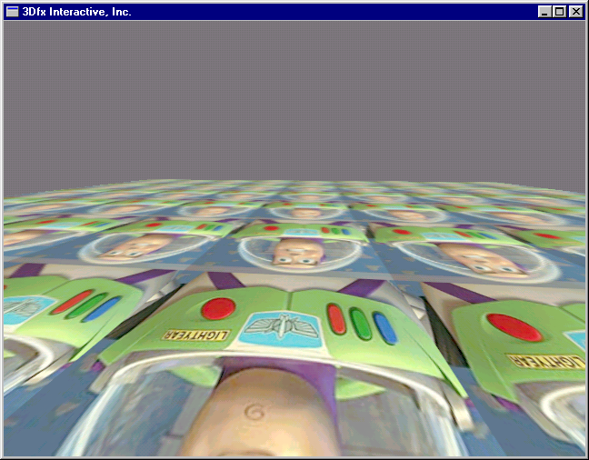
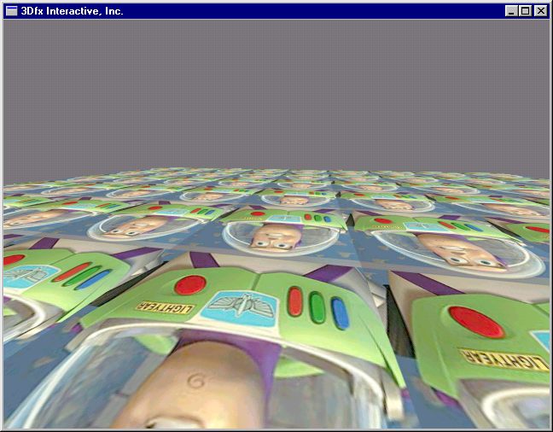
Anisotropic Filtering
Trilinear
Anisotropic
Rampage enables usable anisotropic filtering for the first time in a cost effective personal computer environment
Far superior to trilinear filtering
Notes:
Show movie loop at same time.
Useable Anisotropic means with enough precision and enough taps and precision to give the sharpest possible images possible, with no aliasing artifacts during motion.
Filtering type orthogonal to all other operations, number of texutres, shading modes, etc. Allows for easy integration into any application.
Up to 128 taps, real images show only a 50% performance drop from bilinear.
Superior to trilinear, since trilinear blurs image.

Slide 10
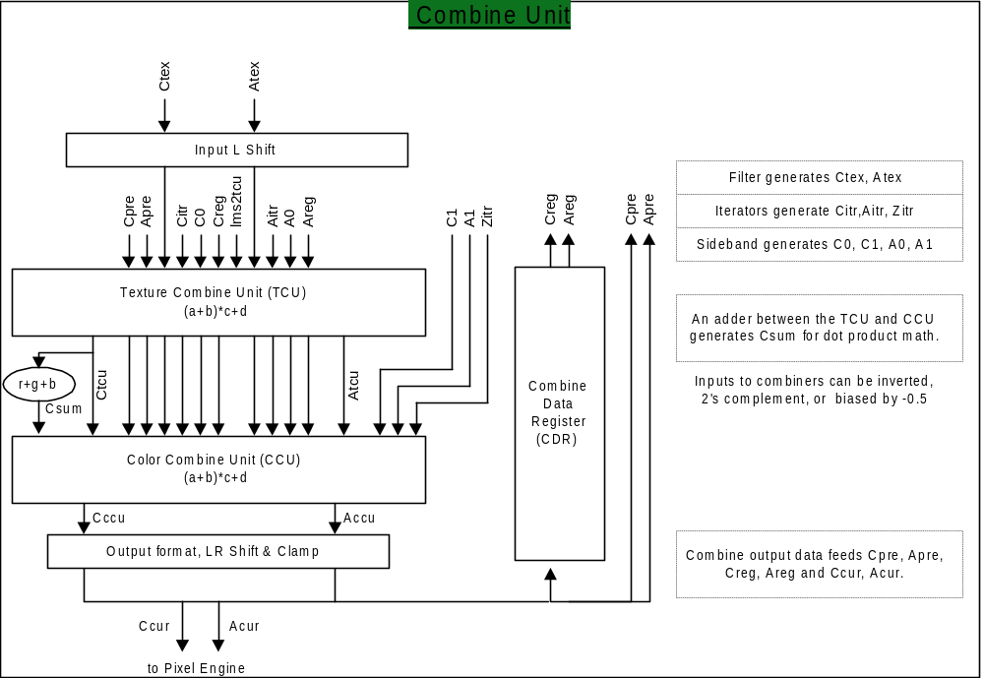
Texture Computer/Pixel Shader

Slide 11
Uses: Higher bit precision.
13 bit signed colors (overbright colors)
  Reduces darkening associated with multi-texturing
  Allows for “wash out” effect prevalent in cinema and video
    Surface attenuations goes from 0 to 1.0, but light intensity can go from 0 to infinity.
    Useful in scenes with sunlight or nighttime scenes.
  Higher precision for environment bump mapping matrix multiply.
Lighting engine could easily be changed to clamp from 0 - 16 instead of 0-1 giving overbright iterated lighting automatically
Notes:
13-bit signed format is in the form of one signed bit, four int bits, and eight fraction bits, giving a dynamic range of +- 16.0, where a current card has a range of 0-1.0
Following slides show how clampling to 0-16 enhances image quality without much work.

Slide 12
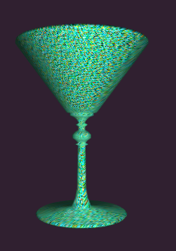
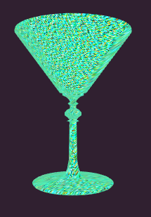
Vertex Ligting:
Green Textured Martini Glass
Lit with White Light
  (230,230,230)
Notes:
Diffuse iterated light.

Slide 13
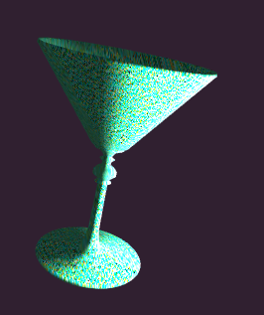
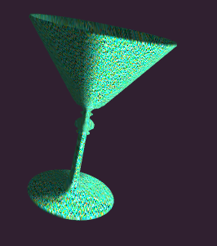
Bright Lights- 4x brighter
Light clamped to 1.0
Light Clamped to 16.0
Notes:
Overbright lighting used with only one texture. Iterated diffuse color is clamped to a larger range through rampage pipeline.
Really bright lights turn most objects, white (wash out), almost regardless or surface color or light color.
Exceptions: Surfaces/lights that are pure Red, Green or Blue. Police car lights are an example here. (Cops)

Slide 14
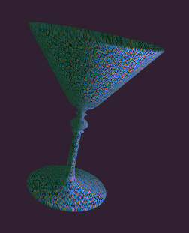
Colored Lights
Green Textured Martini Glass
“Purple” Light
  (230,75,230)
Notes:
Purple light:
Ambient light is still green.
Obviously a purple light turns an object Purple.

Slide 15
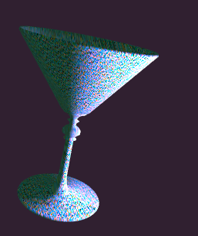
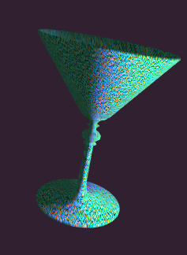
Quiz Question
The light gets much brighter (4x)
Which image does traditional HW generate?
Follow up question: How many lines of code changed in the Lighting engine to generate the other image?
Notes:
Stealing Gary’s idea of giving away big money prizes to keep people interested in the talk.
The right image is created by traditional hardware. Overbright purple light gets clamped at 1.0, creating a non-overbright white light, causing the object to appear green instead of purple.
From an astetic point of view, Left image is the “right one”.
Follow up: Four lines of code. One enabling larger clamp range in hardware,
the other three for changing the clamp value to 0-15.ff instead of 0-1.0

Slide 16
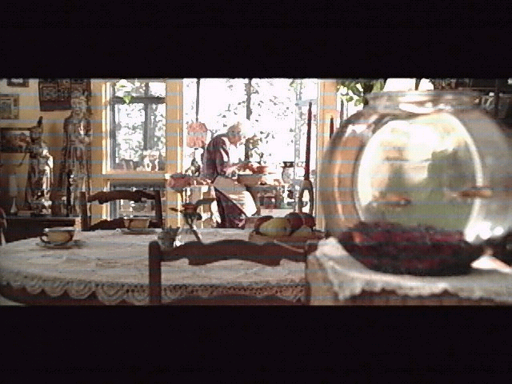
Overbright Lighting
Notes:
Scene from a top-selling movie,
Not computer generated.
Noticed washed-out area in the background. Notice blurring of detail because of the high intensity light.
Play Halo Demo now. Point out key features. Mentioned “exaggerated effect” to be noticable on a low-res projection monitor.
Start HALO DEMO.

Slide 17
Uses: Massive Multi-texturing.
Multiple light maps:
  (Diffuse surface * diffuse light) + (specular surface * specular light)
  Specular surface * iterated specular + (diffuse light * diffuse surface)
  Multiple specular maps and properties (water on pavement at night 6 textures).
Multiple projected textures
  Each possibly with its own shadow map.
Noise functions, other methods of combining textures to simulate physical motion
  water, fire, clouds, etc.

Slide 18
The Borg
Quiz Question:
  How Many textures are used the surface of the cube?
Follow up question:
  At which year’s total immersion, was this demo first shown?
Follow-up Follow-up question
  What is resistance?
Notes:
Borg running four-pass, voodoo3, eight textures total.
Step through each of the textures, one by one.
1 Surface Texture
2 Detail
3 Detail
4 Detail
5 Light Map
6 Light Map
7 Reflection map/gloss map
8 Environment map.
Follow up: This was shown at TI 1998 (Verify with Gary).
Resistance is Futile.
Put multiple lightmap demo here?

Slide 19
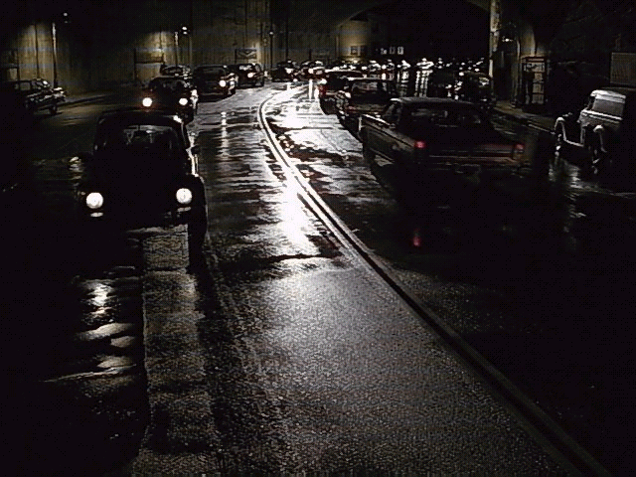
Massive Multi-texturing
Notes:
This scene (not a CGI scene), shows how to use the borg effect on a more day to day scene:
Look at the pavement. Wet pavement at night is used a lot in moves: it looks a lot better than dry pavement.
Diffuse surface
Projected diffuse light map (optional)
Gloss map, for moist areas. Alpha channel could indicate where puddles are...
Specular environment map. May also need a detail map. Could be a bump env. Map.
Reflection map, applied to puddles. areas.
May need multiple projection/ reflection maps, for all the lights at different locations.

Slide 20
Uses: Advanced Recursion
Diffuse bump , specular bump, reflective bump maps combined
  Each bump map disturbs coordinates of a different texture.
Use scaling of recursive data to make for subtle bump maps
  Uneven tile floor, slightly distorted glass, etc.
Combine bump maps together then recurse.
  Ripples on water.
Bump maps affecting other bump maps
  2, 3 or 4 sets of recursions; fluids, turbulence, etc.
Non-photo realistic rendering
Notes:
Start running predator demo, then NPR rendering demos, while showing this slide.
Matrox G400 already does 1-level recursion, for environment bump mapping. Rampage’s much more flexible. BumpEnv mapping is a subset of recursive texturing.
Show original npr.zip

Slide 21
Uses: Multiple Shadows.
Shadow lights, Sum lights together, then modulate surface
Modified stencil buffer trick.
  Use Pe’s Xor function, and ARGB channels to model up to four shadow sources.
  Texture chroma compare w/percentage passed used to identify when pixel is lit by light.
Object ID based shadowing
  Shadow map projected from light source
  contains object ID of lit object in RGB channel.
  Use percentage passed to select in/out
Advanced Object ID shadowing.
  Projected texture: RGB contain light, Alpha Object ID of surface lit
  Alpha channel used to compare against Object ID, along with “never shadowing objects”
  Traditional chroma used to let light through or set to zero on a per-texel basis.
Notes:
Show soft shadow demo during this slide, to show what single-light source shadows can look like.

Slide 22
Shadow Demo

Slide 23
Uses: Miscellaneous.
The Iris effect.
  Do all lighting /texturing in 13 bit space, then use a constant color register to scale the range based on the average intensity of the image.
Dot Product
  Three term (R0*R1 + G0*G1 + B0*B1)
  Four term (A0*A1 + R0*R1 + G0*G1 + B0*B1)
Min/Max affects
  Used in Halo Demo

Slide 24
Summary
Flexible combinations of up to eight textures
Flexible selection of filtering modes
per-texel operations
flexible texture computer with higher bit precision
Simple address ops based on texture computer output
  Of course, this adds “flexibility”

Slide 25
Thanks for the images & Demos
Denis Amselem
Hubert Nguyen
Houman Meshkin
Jeff White
Gary Tarolli

