Slide 1
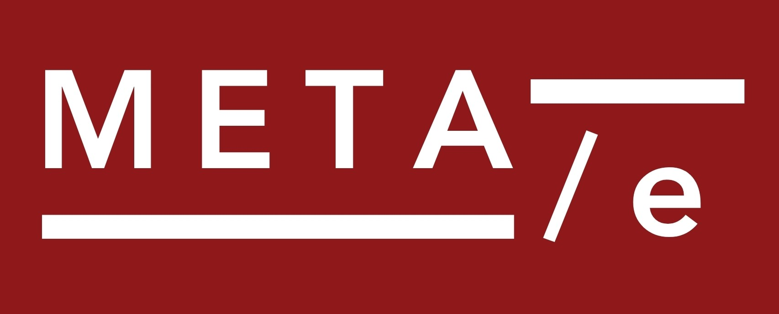




How to Improve Our Science: Lessons from the Replication Crisis in Psychology Daniel Lakens

Slide 2
1. You don’t know if a field is problematic, until you meta-scientifically examine whether there are problems in a field

Slide 3
2. Many serious problems in a field have already been pointed out by peers, but researchers ignore them if that is less work.

Slide 4
3. You need disagreeable people to instigate change, because you will hurt the feelings of your peers and you should not care.

Slide 5
4. Science does not so much have an incentive problem, as that it has a problem attracting people with principles.

Slide 6
5. Progress is limited by how competent scientists are. The organization within fields limits how competent you can become.

Slide 7
Twice in the history of social psychology has there been a crisis of confidence.
The reasons behind these crises are not specific to psychology. Psychologists just question their science a lot.

Slide 8
Elms (1975, p. 967) writes “many social psychologists appear to have lost not only their enthusiasm but also their sense of direction and their faith in the discipline's future. Whether they are experiencing an identity crisis, a paradigmatic crisis, or a crisis of confidence, most seem agreed that a crisis is at hand.”

Slide 9
“The history of social psychology illustrates the importance of the replication of findings in that many of its initial results have not been confirmed by later investigations.”
Festinger & Katz, 1953

Slide 10
“By seemingly conservative estimates, the probability that a finding (reported at p = .05) is a result of chance is not .05, but is closer to .50. That is, were these estimates approximately correct, they would indicate that about one-half of the original findings reported at this level in behavioral science journals could have resulted solely from chance variations.”
Neher, 1967

Slide 11
“As a science directly concerned with behavioral and social processes, psychology might be expected to provide intellectual leadership in the search for new and better personal and social arrangements. In fact, however, we psychologists have contributed relatively little of real importance —even less than our rather modest understanding of behavior might justify.”
Miller, 1969

Slide 12
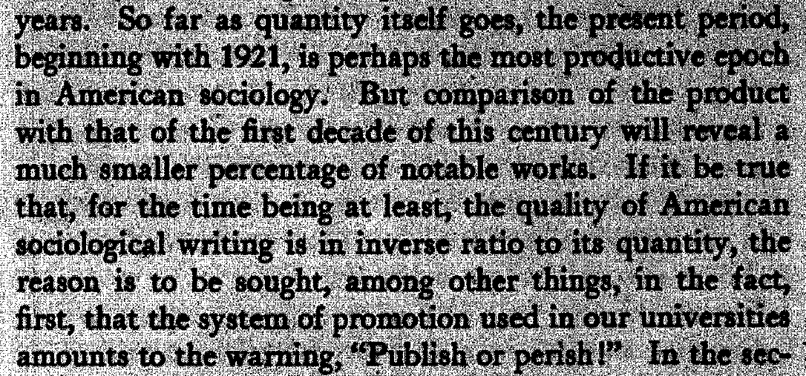
Bad incentives.
Clark,1927

Slide 13
Jones (1985, p. 100) remarks: “The crisis of social psychology has begun to take its place as a minor perturbation in the long history of the social science. The intellectual moment of the field has not been radically affected by crisis proclamations”.

Slide 14
And of course, some disagreed there was a crisis at all. Deutsch (1976, p. 134): “Were I to engage in a polemic about theorizing in social psychology, my inclination would be to attack the “doom-criers”, those who assert that social psychology is in a "crisis which it must overcome if it is to survive."“

Slide 15
So did we solve any of the problems from the previous crisis?
Yes, we solved concerns about research ethics. It is worth reflecting on how we did this.

Slide 16
Questions were raised regarding the acceptability of deception, and whether the negative consequences for subjects were balanced by the positive consequences of the knowledge that was gained.

Slide 17
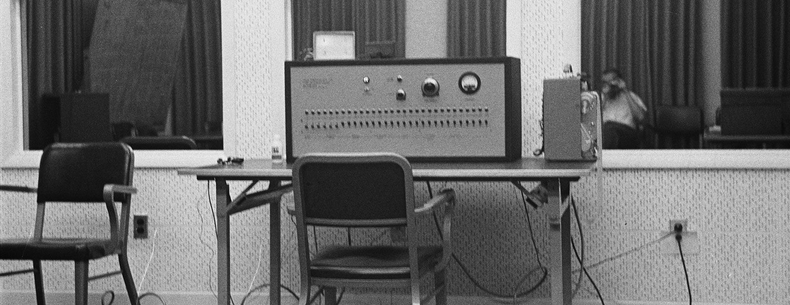

Slide 18
The Cook Committee surveyed 18000 APA members, and in 1973 the APA published ‘Ethical Principles in the Conduct of Research with Human Participants’. This led to ethical review boards.
Stark, 2010

Slide 19
The APA took action, because they feared that if they would not, action would be forced upon them.

Slide 20
Will Open Science Solve the Crisis of Confidence?

Slide 21
Transparency helps to make it possible to identify opportunistic behavior.

Slide 22
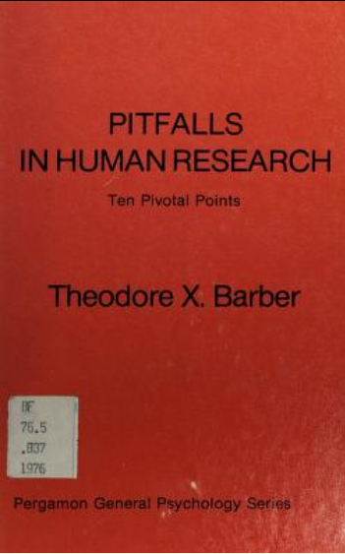
performing unplanned analyses,
hypothesizing after results are known
performing a large number of tests and only reporting significant results
cutting and slicing data in originally unintended ways
not correcting for multiple comparisons
selectively reporting significant results,
not reporting non-significant results,
checking for errors after negative results, but not checking for errors after positive results
reporting statistically significant but practically insignificant effects
Notes:
And we see many scientists make mistakes in basic things – measurement, preregistration, etc.

Slide 23
This is arguably the area where most progress has been made this crisis – high awareness, preregistration, Registered Reports, bias detection.

Slide 24
But opportunistic behavior is only one underlying cause of the reasons for the crisis of confidence. I want to highlight problems due to the lack of coordination.

Slide 25


Sajedeh Rasti Krist Vaesen
Rasti, S., Vaesen, K., & Lakens, D. (2025). A systemic approach to better coordination in science. Nature Human Behavior.

Slide 26
1. Coordination is necessary to answer complex questions.
The more interdependencies exist between the work that needs to be done to answer a question, the more we need to coordinate.

Slide 27
2. Coordination increases quality through specialization.
Given a fixed amount of time, the expertise that any single researcher can develop is limited.

Slide 28
3. Coordination enables research prioritization.
We might be trying to examine too many things, in a too distributed manner. Maybe we need to prioritize which questions to address and tackle them in order.

Slide 29
Originally organized by the NIH to promote coordination among researchers in a specific field, consensus conferences are now self-organized by researchers in health research.

Slide 30
4. Coordination creates careers for team players.
People want to do work that matches their values. A competitive system turns people away from academia (regrettably, not all places in academia work like Psicostat!).

Slide 31
5. Coordination can help to resolve longstanding disagreements.
Adversarial collaborations, Red Teams, actually engaging with criticism.

Slide 32
6. Coordination can create a more cumulative science.

Slide 33
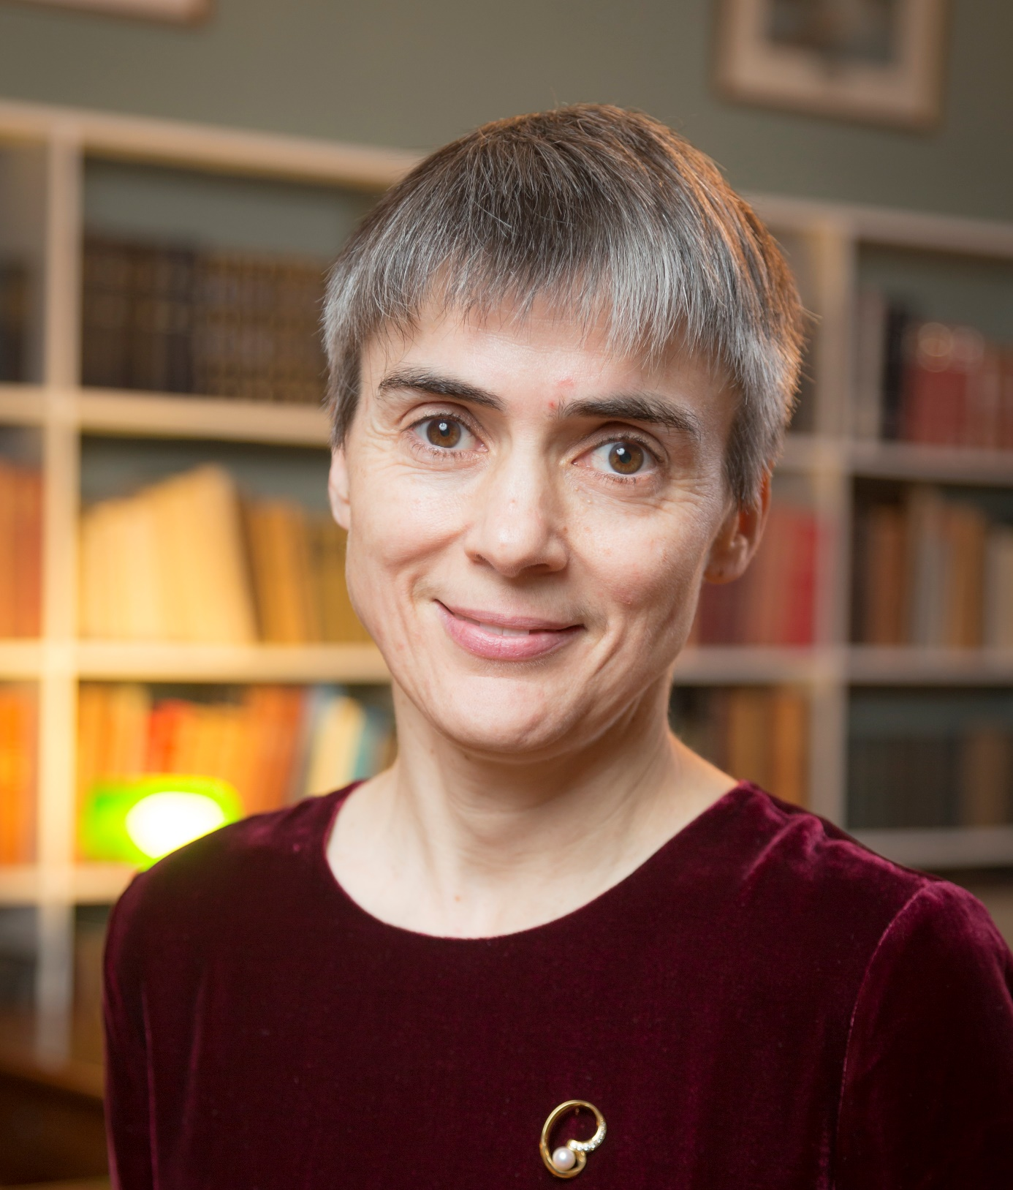
“There is an awful lot of talk about ground breaking research, which I find an interesting comparison. Because ground breaking is what you do when you start a building. You go into a field and you dig a hole into the ground. If you are only rewarded for ground breaking research there is going to be an awful lot of fields with a small hole in, and no buildings.”
Ottoline Leyser

Slide 34
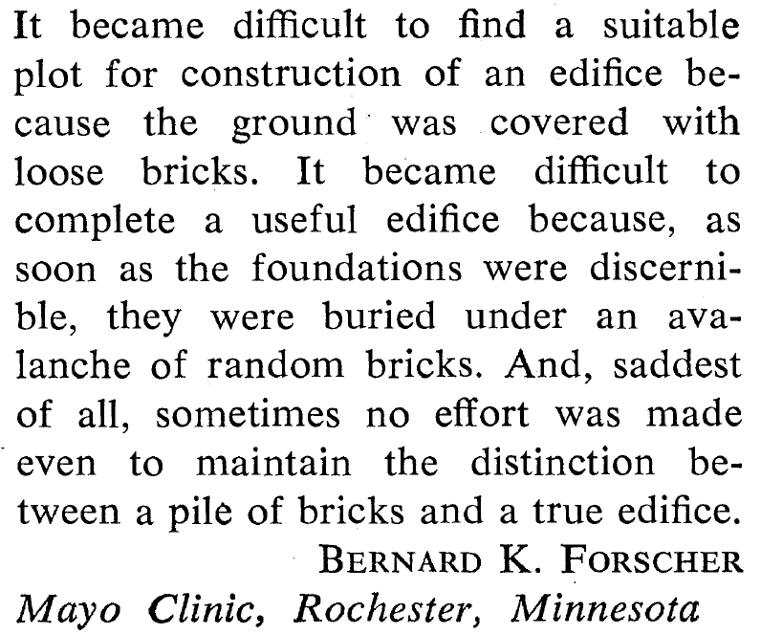

Forscher, 1963, Chaos in the Brickyard

Slide 35
Building an edifice requires a research line, not a study, which requires that a concept is defined well, a good measure is developed, a larger set of moderators and boundary conditions is explored, the generalizability of the effect is established, and perhaps even some applied research to demonstrate that the theoretical knowledge can be used to generate useful interventions.

Slide 36
Thanks!

