Slide 1


Philosophy of Science as a Tool for Scientific Practice
Abigail Nieves Delgado
Associate Professor History and Philosophy of the Life Sciences
December 5, 2025
Third Metascience for Machine Learning Workshop, TU Delft

Slide 2

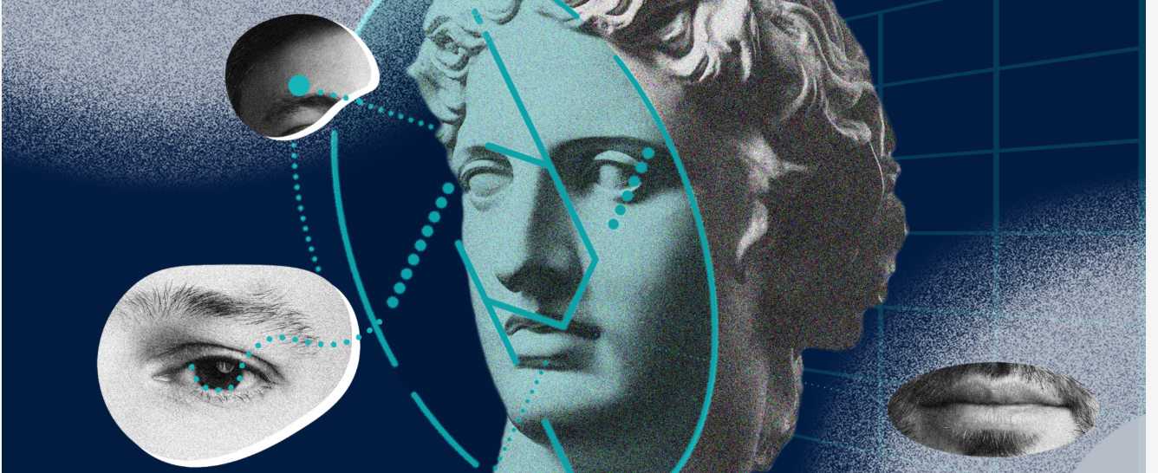
Content
Philosophy of science
History of science
2 cases: FERET and Microbiome Research

Slide 3
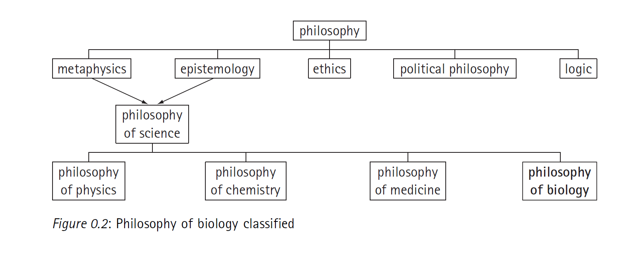
Notes:
Are you familiar with any of those names?

Slide 4
Metaphysics: Concerns aspects of reality that transcend experience, what kind of things there are.
Epistemology: Concerns knowledge, how it is obtained, what is the difference between true knowledge and opinion.
Ethics: Normativity that prescribes human behavior usually in terms of rights, obligations, benefits to society, fairness, or specific virtue.
Political philosophy: “Philosophical reflection on how best to arrange our collective life - our political institutions and our social practices, such as our economic system and our pattern of family life” (Routledge Encyclopedia of Philosophy).
Logic: Aims to distinguish good from bad reasoning by using symbols and logical rules. Premises must lead to logical conclusions.

Slide 5


Slide 6
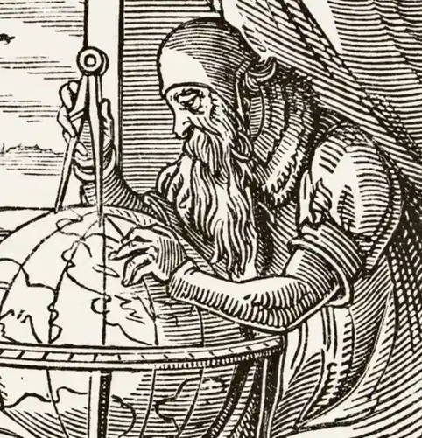
Philosophy of science
It studies science and its components, such as theories, models, laws of nature, empirical evidence and the relation of scientific knowledge to "truth".
Epistemology, metaphysics, logics and ethics.
Causality, realism, antirealism, truth, laws of nature...
How can we distinguish science from non-science or pseudoscience? What is scientific knowledge? What constitutes good evidence?

Slide 7
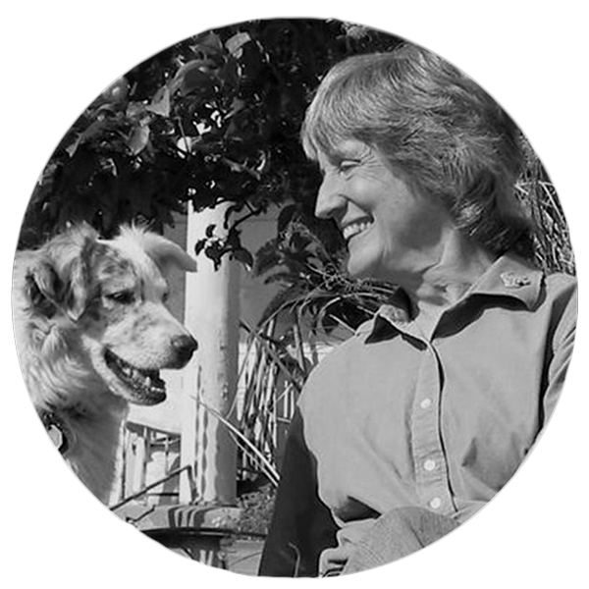
Philosophy of science
From universal truth to situated knowledge
Situated knowledges are about communities, not about isolated individuals. The only way to find a larger vision is to be somewhere in particular (…)
Its images are not the products of escape and transcendence of limits (the view from above) but the joining of partial views and halting voices into a collective subject position. (Haraway 1988, 590)

Slide 8

Philosophy of science in practice
Pays attention to how science is done in day to day (not idealized scenarios)
Relies on empirical data gathered through observation, surveys, interviews…
Acknowledges social actors and communities as important in defining scientific agreements in different disciplines: social epistemology
Knowledge produced by groups of experts
Groups of experts share theories, methods, practices and values

Slide 9

Philosophy of science in practice
Investigates epistemic and non-epistemic values intrinsic to science
Epistemic values: simplicity vs complexity, reproducibility, coherence, clarity, completeness, empirical adequacy Non-epistemic values: equity, justice, marketability, translatability to applications, aesthetic values

Slide 10
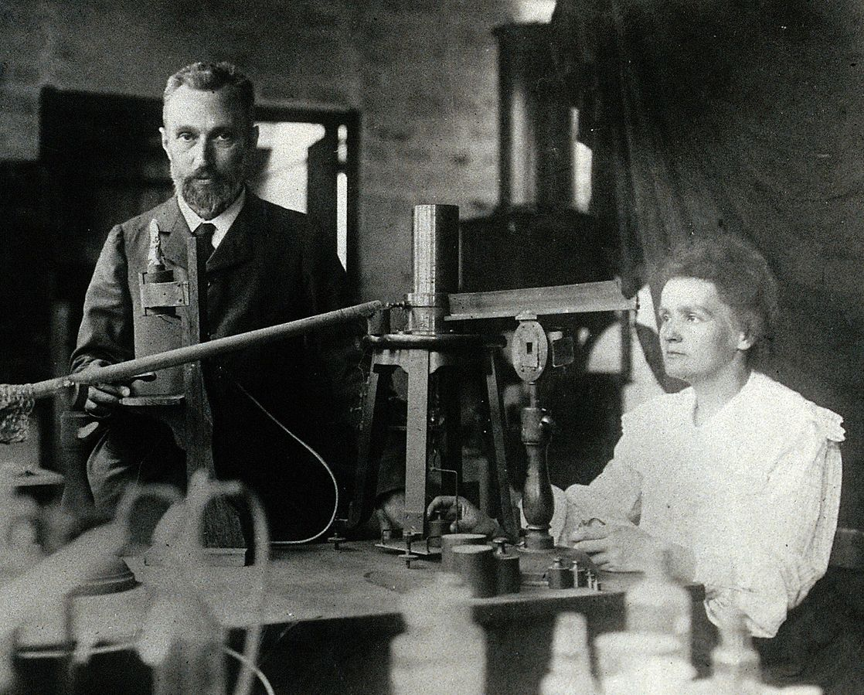
History of science
Studies the emergence of systematic knowledge (Daston 2001)
Became institutionalized in the 20th century
Early historiographies were progressive (past failures led to current success). In contrast historians try to understand scientific developments within their historical, political and social context.
Avoids presentism: understanding the past through ideas of the present.
Notes:
What is the difference between scientific knowledge and other kinds of knowledge?
Big philosophical debate how to demarcate these knowledges

Slide 11
What can history and philosophy do for science?
To identify implicit assumptions in theories
For conceptual clarification (what is fitness, what is a species, what is a cause)
To identify epistemic and non-epistemic values or commitments
To understand the effects of such values in knowledge
To generate new research questions

Slide 12




Many thanks!

