Slide 1
What makes for valid insights?
Cynthia Liem

Slide 2
Data-driven / ML-based work has become very popular
Good news for us, right?
But does the common way in which we perform research meet the needs we encounter in broader society?
And do the current trends allow for us to sufficiently consider academic rigor?

Slide 3
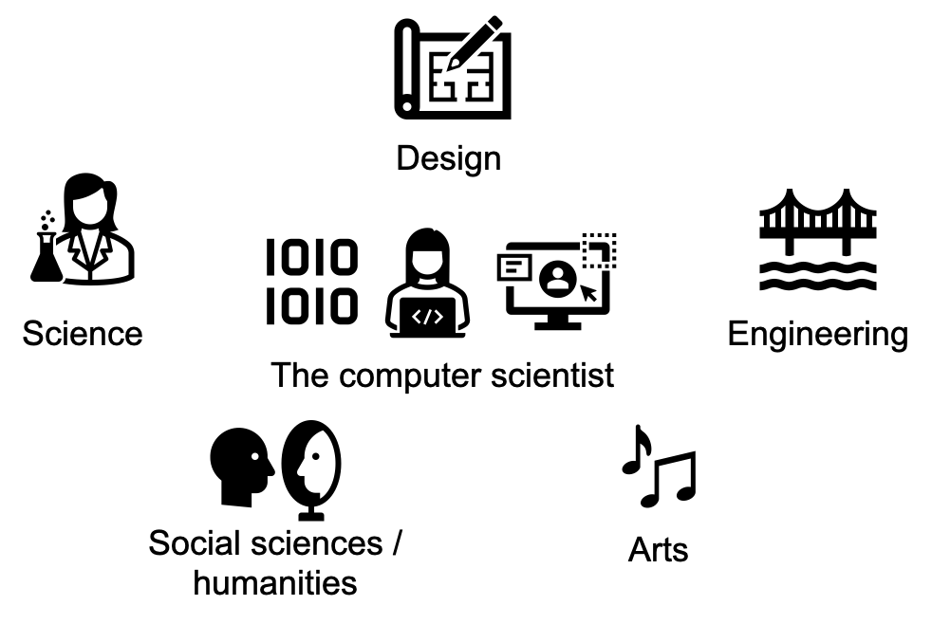
Methodological schools of thought

Slide 4
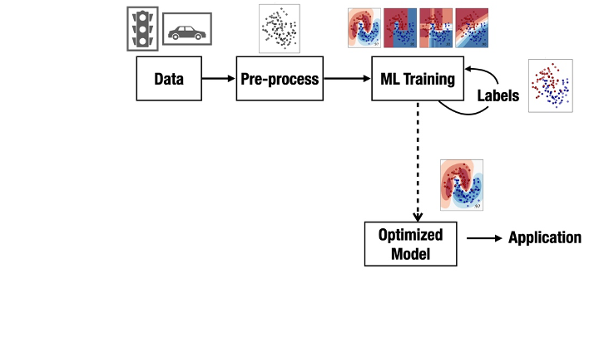
We are used to this

Slide 5
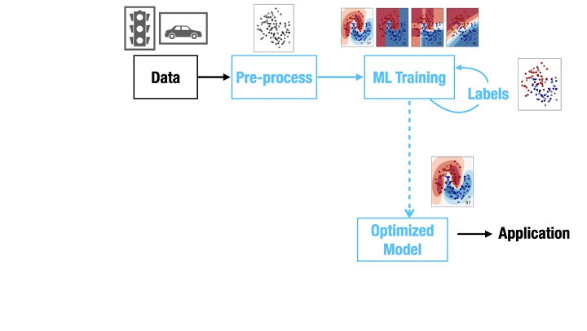
We are used to this

Slide 6
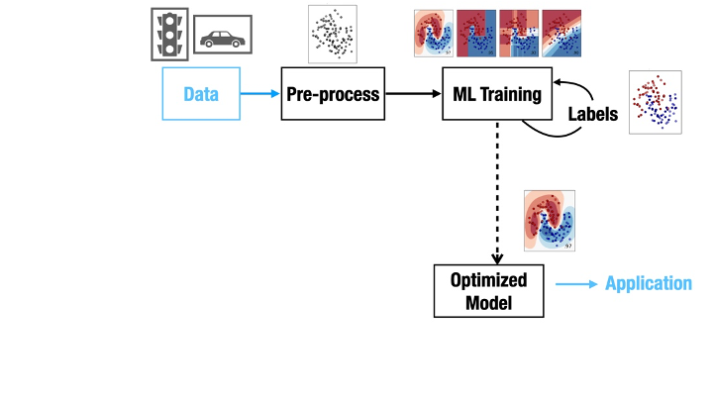
But what about this?

Slide 7
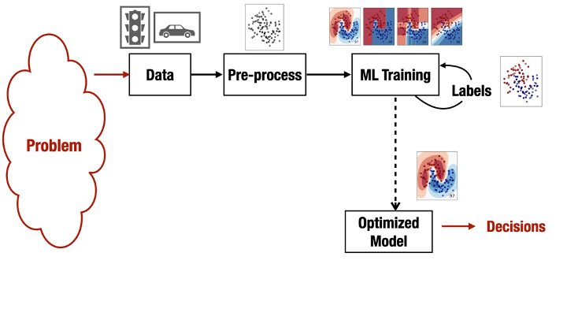
But what about this?

Slide 8
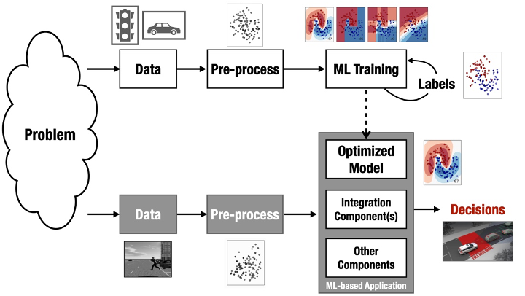
But what about this?

Slide 9
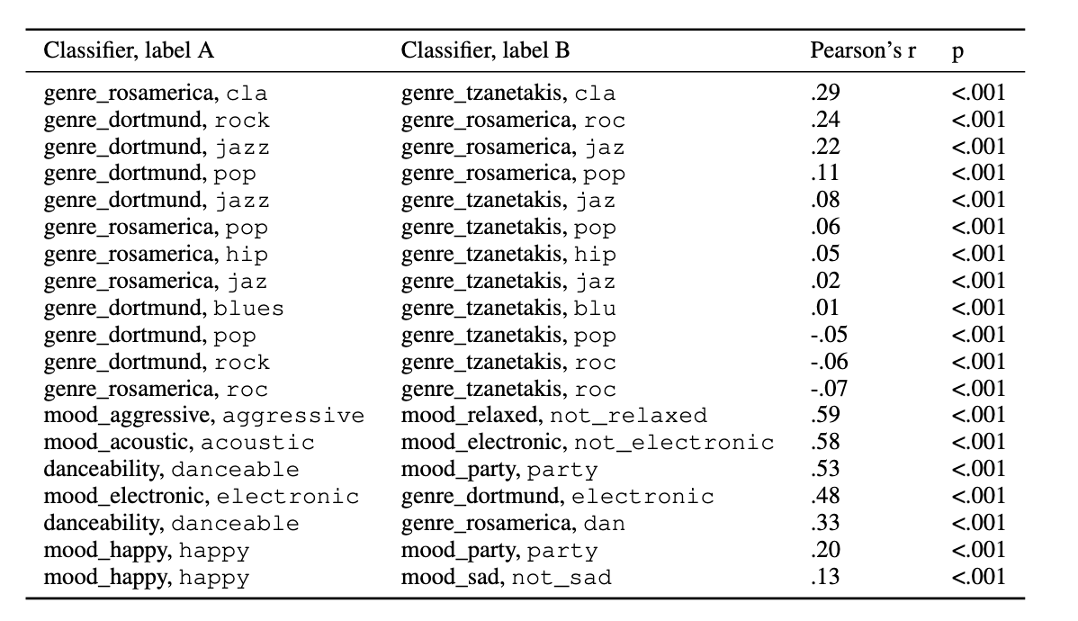
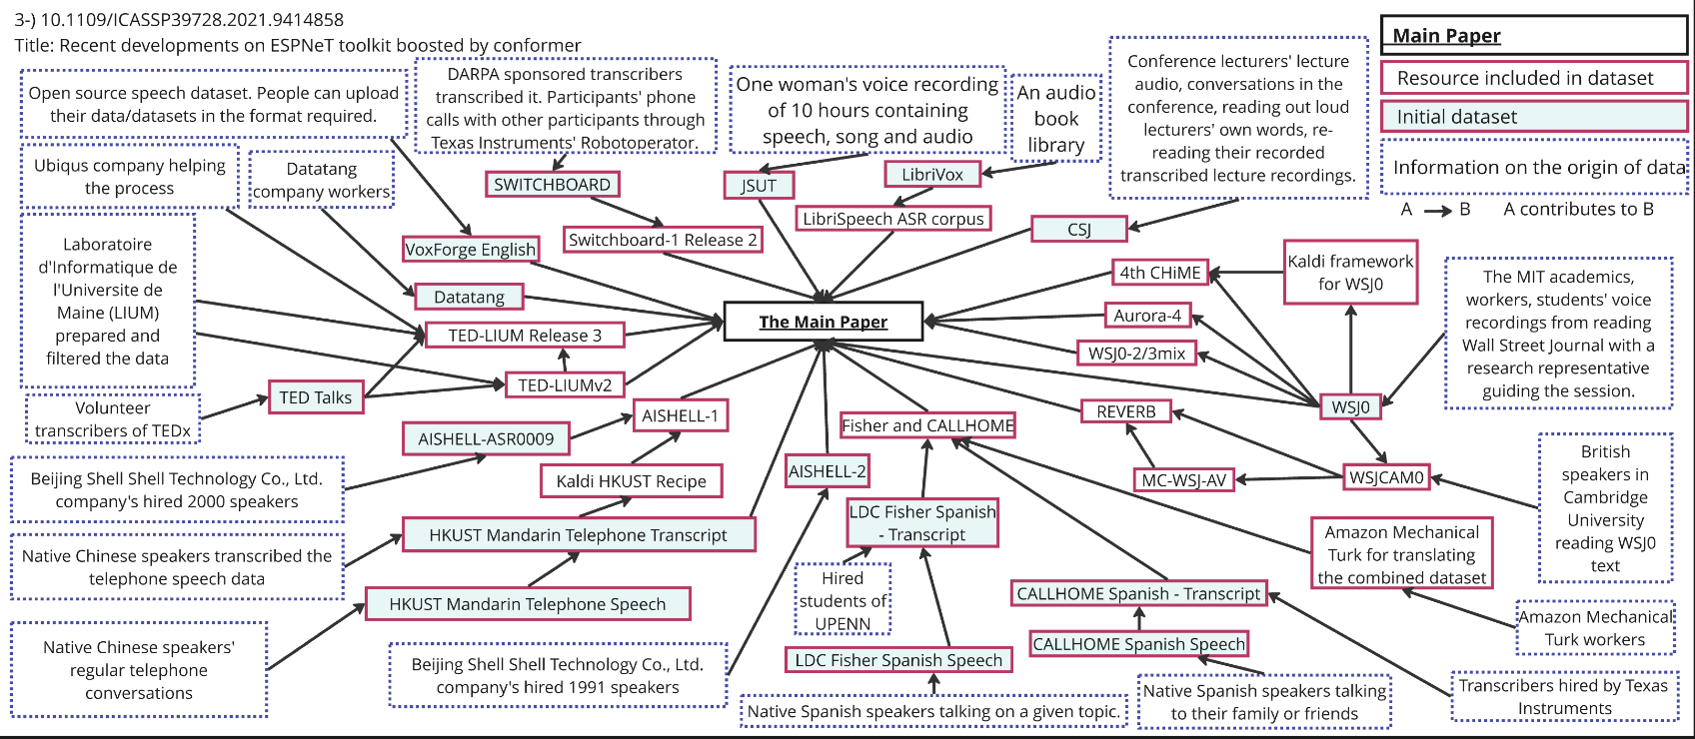
We hardly ever talk about validity and quality of data
The way we typically acquire and annotate data would not meet social science standards
Dataset annotation protocols are often incompletely and poorly documented (work-in-progress of current research project group)
Liem & Mostert 2020
Liem, Taşcılar & Demetriou 2024

Slide 10
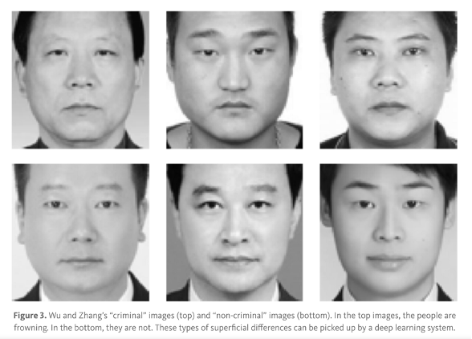
We hardly ever talk about validity and quality of data
Wu & Zhang 2016

Slide 11
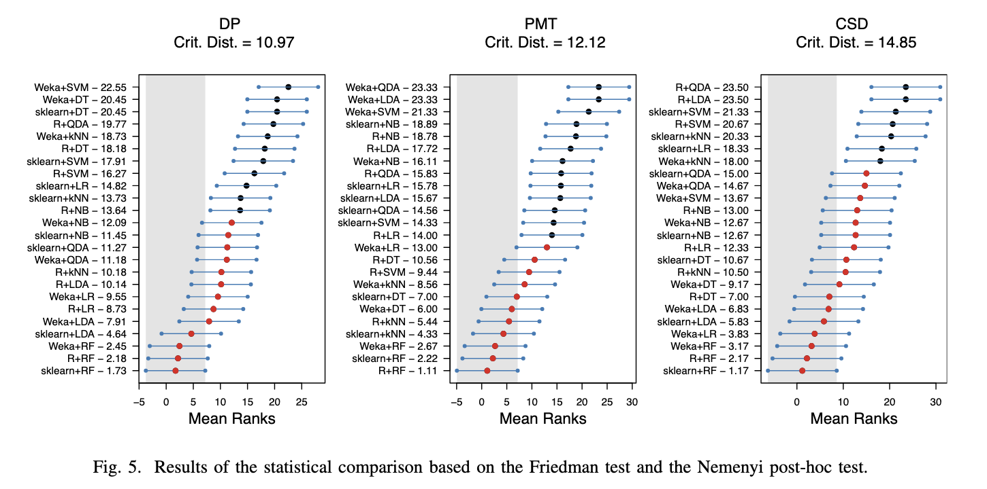
Implementation details and randomization matters
Liem & Panichella 2020

Slide 12
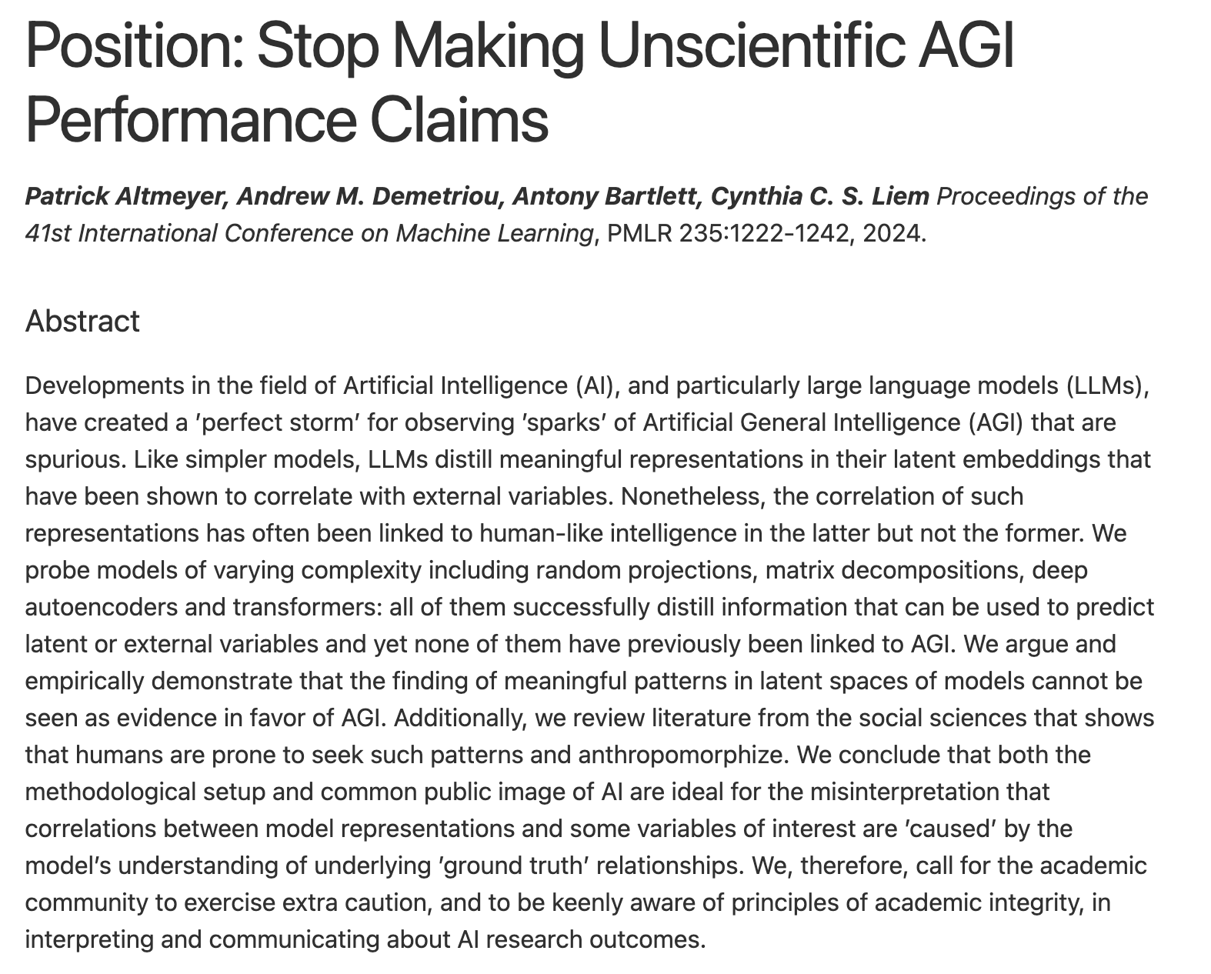
Hypes and incentives are detrimental to academic rigor
Altmeyer, Demetriou, Bartlett & Liem 2024

Slide 13
What to do?
I really think our academic publication model has stretched beyond its limits, and needs considerable revision
Can we create spaces incentivizing reflection and learning, while still upholding forms of quality control? (can we draw inspiration from open-source software development?)
Can we more explicitly teach our students awareness of different methodological schools of thought and questions of data/ground truth quality?
Can we slow down?

