Slide 1
From meta-learning to meta-science and back
20-6-2025
Douwe den Blanken
Cognitive Sensor Nodes & Systems
Notes:
My name is Douwe and the title of my pitch is: from meta-learning to meta-science and back

Slide 2
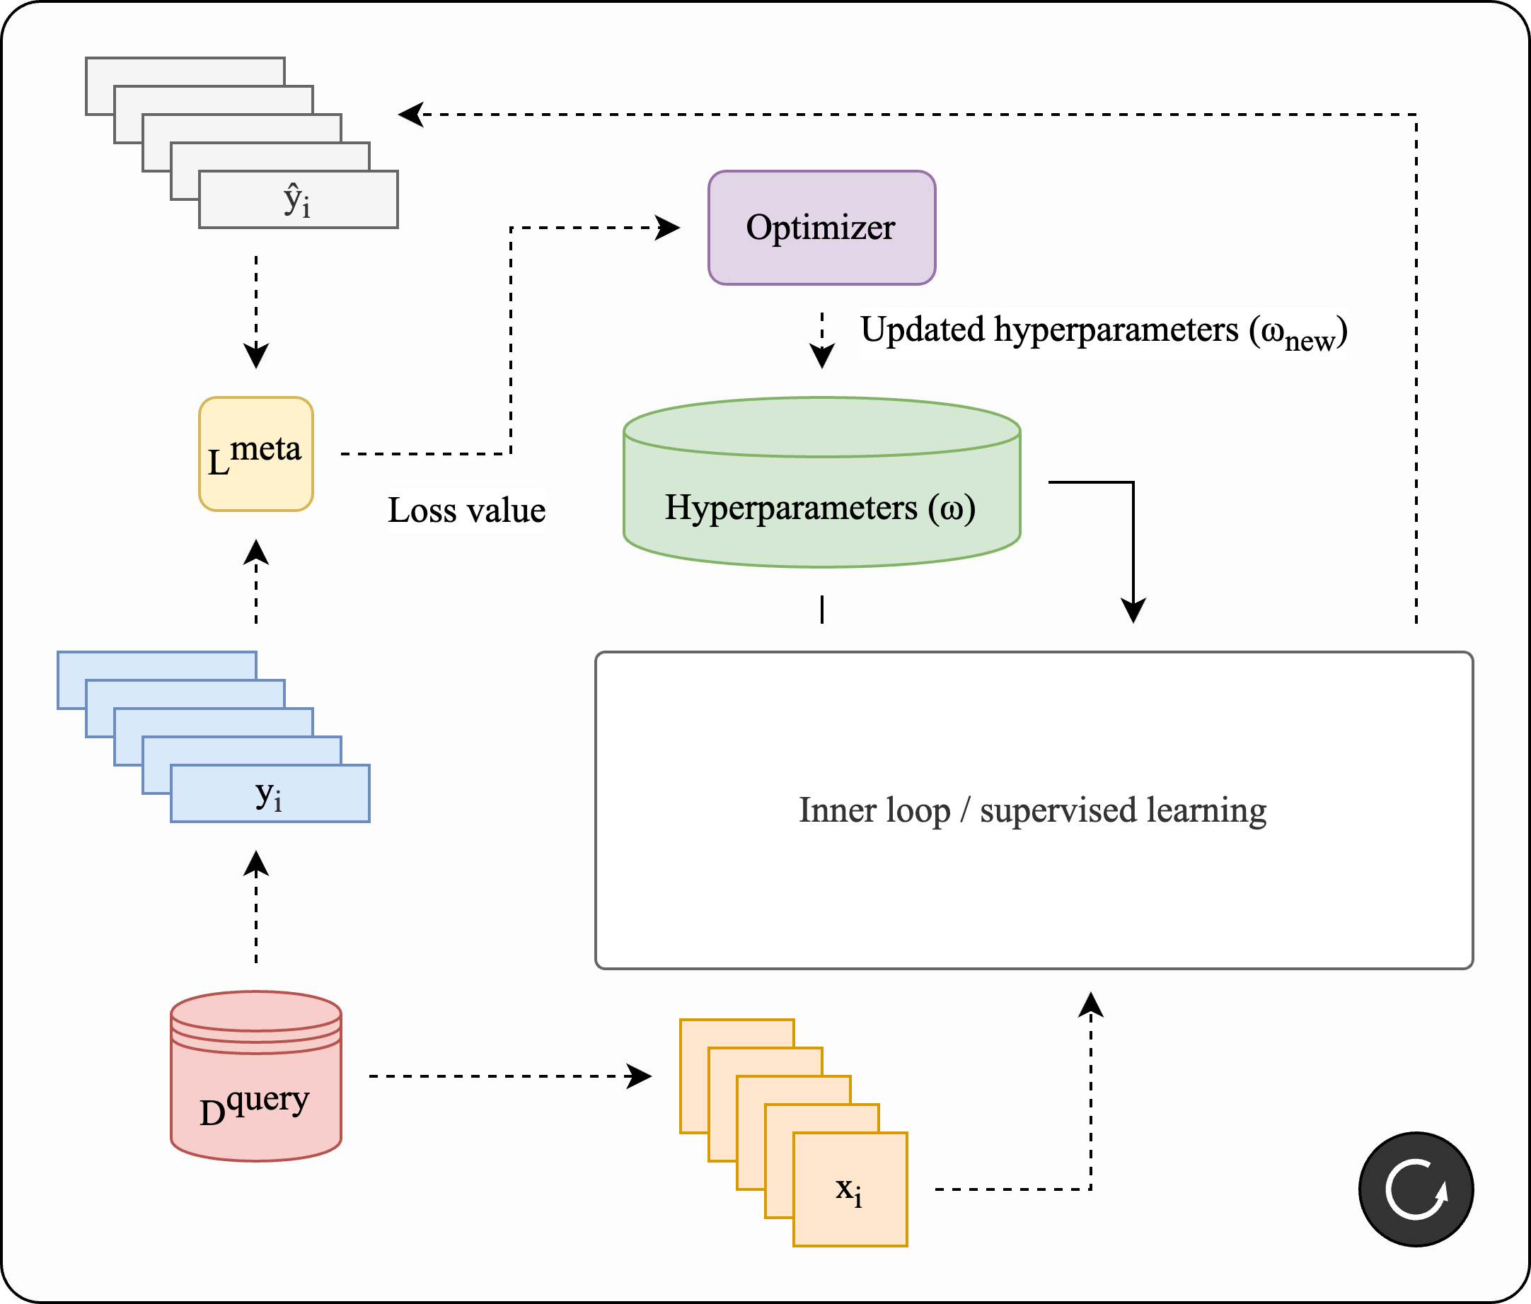
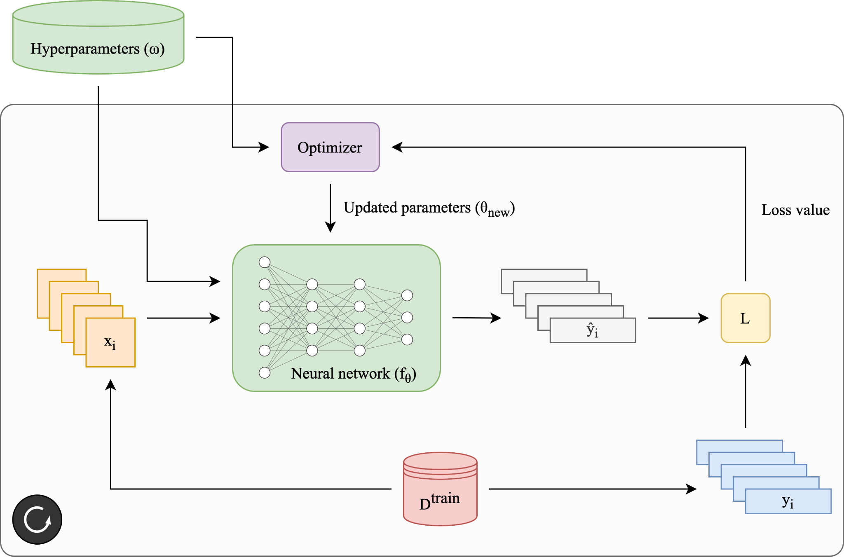
Definition of MetaScience4ML (1)
An analogy: worked with meta-learning, “learning to learn”
Meta-learning has two loops:
Outer loop
Optimal conditions for science
Optimal parameter initialization
Inner loop
Supervised learning
Machine learning science
Ext. conditions
You
Ext. conditions
Your experiment
Your result
Us
Inner loop / machine learning science
Existing data
Margin
SotA work
Existing results
Notes:
First wanted to talk about the definition of meta-science
Immediately, an analogy came to mind
External conditions or hyperparameters
Instead of optimizer funcitons, its you that has to puzzle together right side of ingredients to make sure your experiment work
But how well you can do this process depends on some hyperparmeters, I would like to refer to them as external conditions
Here today to understand what are the right external conditions from all of our separate inner loop machine learning science

Slide 3
Definition of MetaScience4ML (2)
Meta-learning:
“learning to learn”
Meta-science for machine learning:
“science of machine learning science”

Slide 4
Definition of MetaScience4ML (3)
For me, MetaScience4ML is about understanding and improving how machine learning science (inner loop) is performed
In particular:
How can we improve the external conditions to improve ML science?
Notes:
…with that definition in mind, I wanted take a look at some of the practical problems that meta-science could address

Slide 5
Some practical problems
In our lab, we design chips that run (deep) neural networks
Our students are great chip designers but novice DL practitioners
Common in other fields too as DL is becoming ubiquitous
Difficulty with setting up DL experiments
Hard to validate the correctness of results
Tricky to iterate on DL experiments
What I noticed for myself:
Trouble keeping track of all experiments
Often come across ML code from interesting work that is either:
Hard to run/ablate
Hard to to adapt or combine with my work
Notes:
Next I wanted to touch om some practical problems that demonstrate a need for metascience for ml
So for example, in our lab

Slide 6
What do we need to do?
External conditions have to be right
Increase awareness for good ML practices
Lower barriers for reusability & extensibility → shared code in a lab
Write clear documentation (can be concise!)
Work together
Standardize (where possible)
Notes:
Working together forces you to improve your code and clarity and makes sure it maintainable by someone else other than yourelf
For the standardization of the ML workflow and to improve the external, I have actually attempted to build a framework for thi

Slide 7
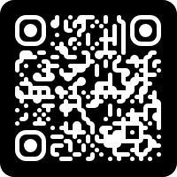
autolightning
Inspired by “infrastructure as code” for cloud computing, to enable “experiment as code (config).”
Based on PyTorch Lightning
Key features:
CLI for running experiments (but also notebook-friendly!)
Fully config-defined experimentation
Support for comprehensive transform pipelines
Hyperparam. sweeps with ext. frameworks
Set of standardized training methods
Infinitely flexible data and model definition through PT
Originally developed for meta-learning, but now more generalist
(link to Github repo)
Notes:
Differences from other tools:
Other tools do not have their own cli, so you would have to manually create a cli for each new project; for autolightning, only a config file is required
Alternatives are based on Hydra and require you to learn another framework, while autolightning builds directly on lightnings CLI
Or they require a code template
Ours requires zero-code
Others do not have support for advanced configurations like parts of network frozen or model compilation
And most importantly: do not have equivalent code for Jupyter notebooks
Lightning itself does not have strong support for configurations that extend other configurations, solved that via Python configuration files

Slide 8
Summary & next steps
Metascience4ML is about finding right ext. conditions for science
DL is field-pervasive → need for awareness of good practices
autolightning is an attempt to standardize some of these
Can be used as starting point for varying levels of experience
To do: better understand needs across research domains
…to improve the hyperparameters of machine learning science
Notes:
I guess the autolightning key points have been filled in since then, just don't forget to loop back to the big picture on how autolightning (has) served the greater goal you have talked about, and what needs to be done to take it to the next step, which will then nicely close your pitch and open for questions

Slide 9
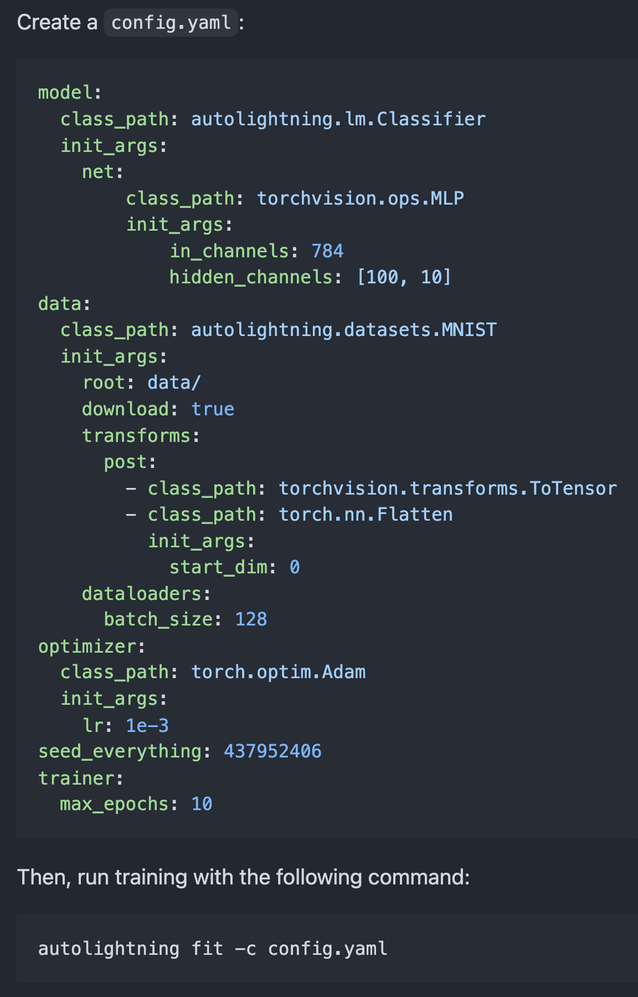
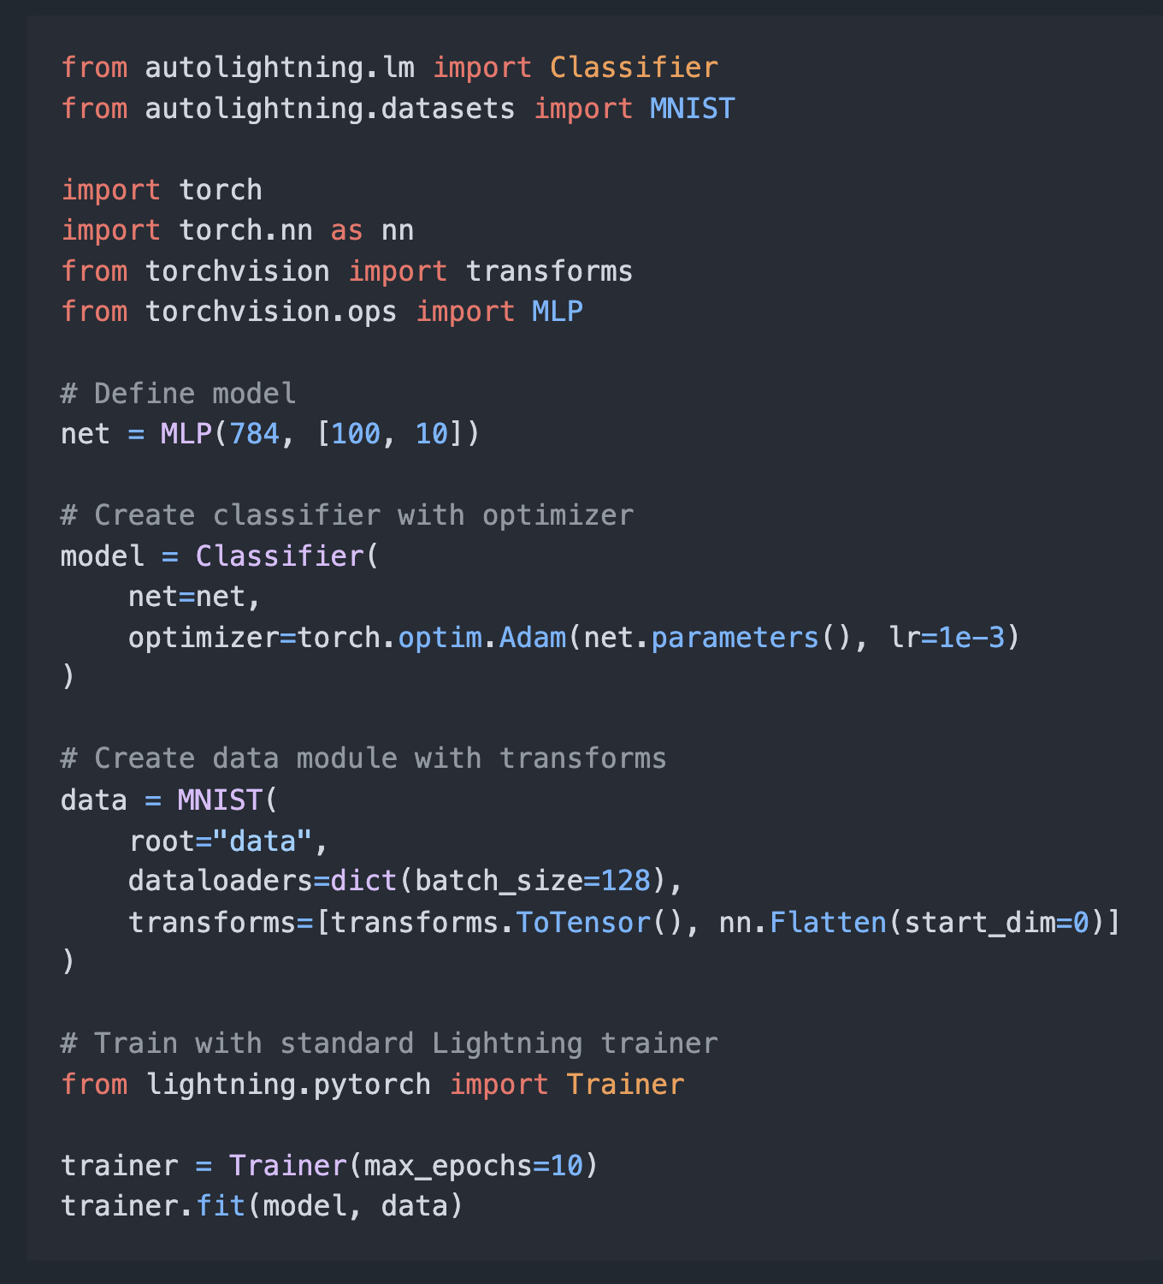
CLI
Python REPL / Jupyter notebook

