Slide 1
Metascience for Machine Learning
What is the problem and what do we need to do?

Slide 2
Good science is about embedding
Career success
International embedding
National embedding
Local embedding (group, teaching)
Science

Slide 3
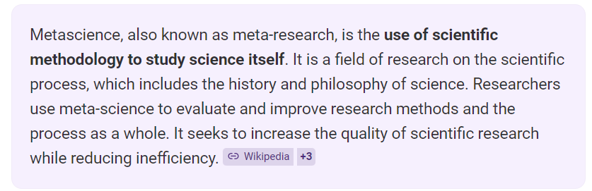
What is Metascience?

Slide 4
Metascience for Machine Learning
Meta science for ML refers to activities that describe the process of doing science. What and where is the process? This could span multiple levels of granularity from…
…research design methodology across one or more projects
… to how we educate the next generation
… to how we organise scientific connection and collaboration
… to reward structures to enable good scientific practice.

Slide 5
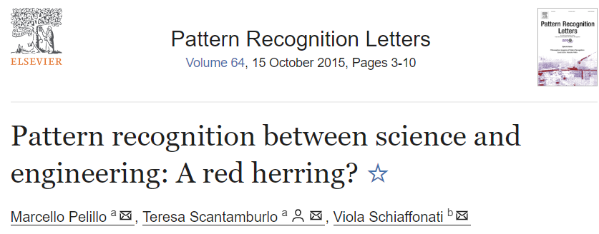
ML is the How vs. the Why?
This identity crisis has led fractures in the community :
What is a good research process for scientific engineers / engineering scientists?

Slide 6

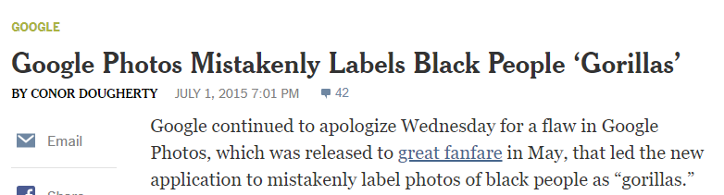
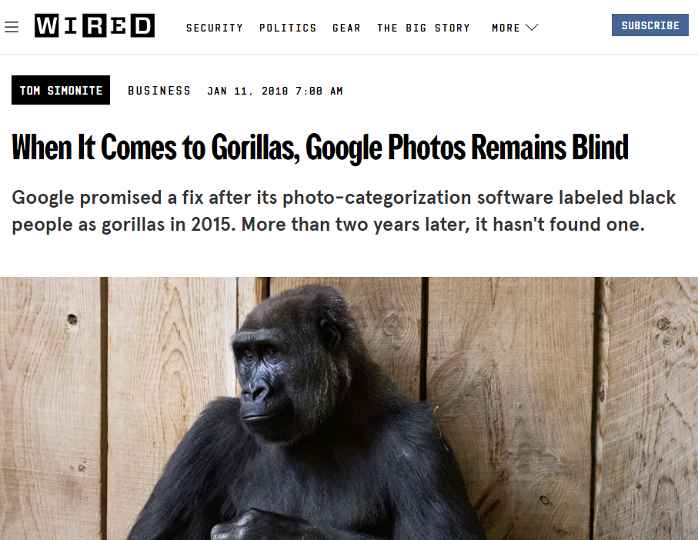
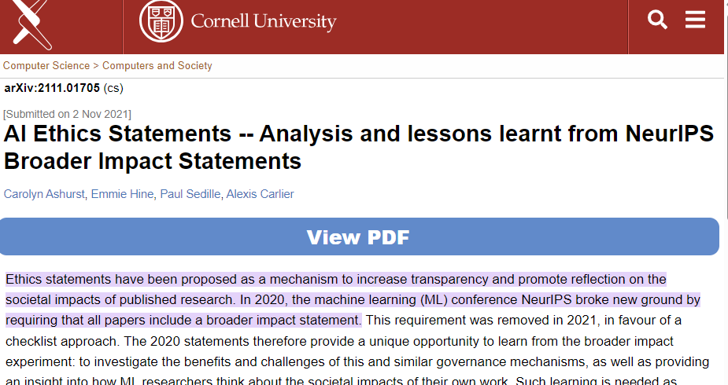
Science and Society is suffering
Posthoc fixes; data, model, consequences not considered at paper writing time.
Review process dictates ML research process
Ethics Statements as posthoc lipservice?

Slide 7
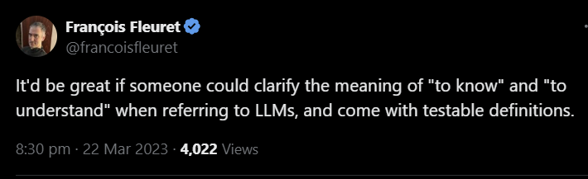
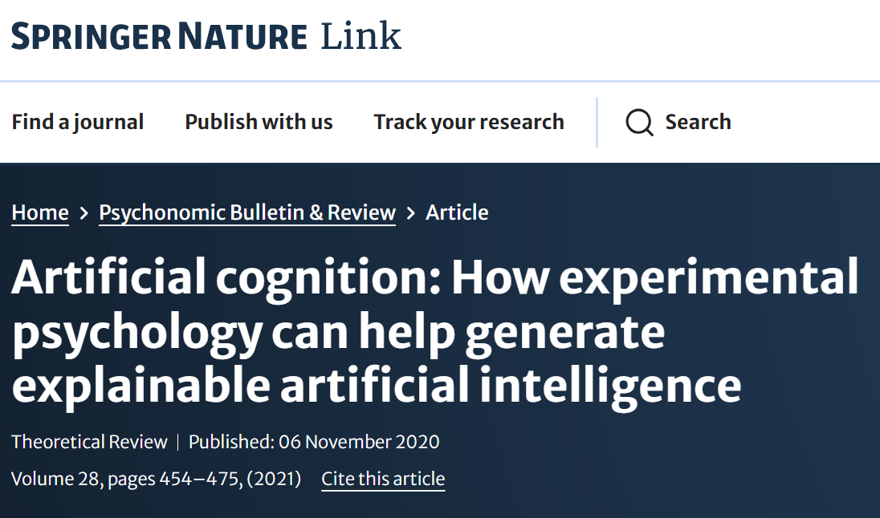
New scientific methods are needed!
Borrowing methodologies from other disciplines
E.g. Statistics, Social Science, Neuroscience…

Slide 8
Machine Learning is becoming more interdisciplinary
Rise of LLMs pushes us closer to human-like black box models but with increasingly human-like conversational properties
Understanding the development (and evaluation) of LLMS needs different research processes
Alot of flawed ML research design could have been resolved by borrowing tried and tested research processes from other disciplines
Interdisciplinary ML teams make for better research
Facilitate and nurture interdisciplinary collaborations as part of a larger scientific optimization process

Slide 9
What should we do?
Find ways to bring these issues to a broad audience
Educate (BSc…. to professor)
Facilitate, encourage, teach how to do research about the scientific process
Write position papers to discuss metascientific issues
Develop Technology to help us get better at doing science in ML
Have a clear message: grow the community!
Find resources to continue beyond 2025…
Change the international narrative (e.g. datasets and Benchmarks)

Slide 10
What should we do? What am I doing?
Find ways to bring these issues to a broad audience
Educate (BSc…. to professor)
Facilitate, encourage, teach how to do research about the scientific process
Write position papers to discuss metascientific issues
Develop Technology to help us get better at doing science in ML
Have a clear message: grow the community!
Find resources to continue beyond 2025…
Podcast!
Teach scientific process in all BSc and MSc courses that I teach
Handbook with guidelines on how to facilitate scientific process in interdisciplinary setting
ConfFlow : Tool to help conference-goers to browse other conference goers and their research interests.
Write position papers to discuss metascientific issues on how we approach research (e.g. reproducibility, SCRAN method)
Develop technology to support researchers to find each other and have better outcomes.
Encouraging critical thinking (Lab Talks, Coffee Talks) in PhD and Postdocs in PRCVHOMI
Initiating the new movement called Metascience for Machine Learning!

