Slide 1

Angelhackathon – Berlin – 05/05/2012
Notes:
Powerweb introducing an search algorithm to categorise, make relationships visible and visualise information in raw text for stressed people, who don‘t have the time to read a long text and make sense of it.

Slide 2
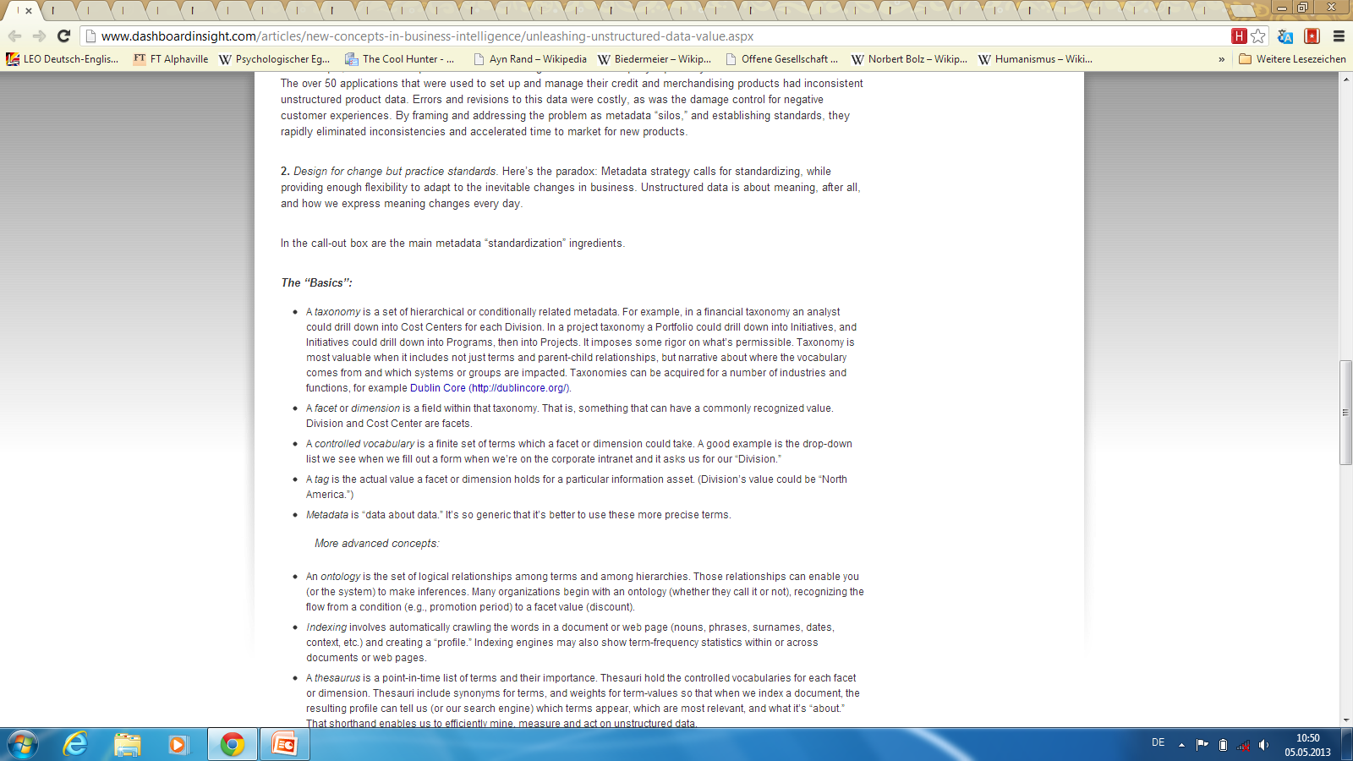
Do you know one of these problems?

Slide 3
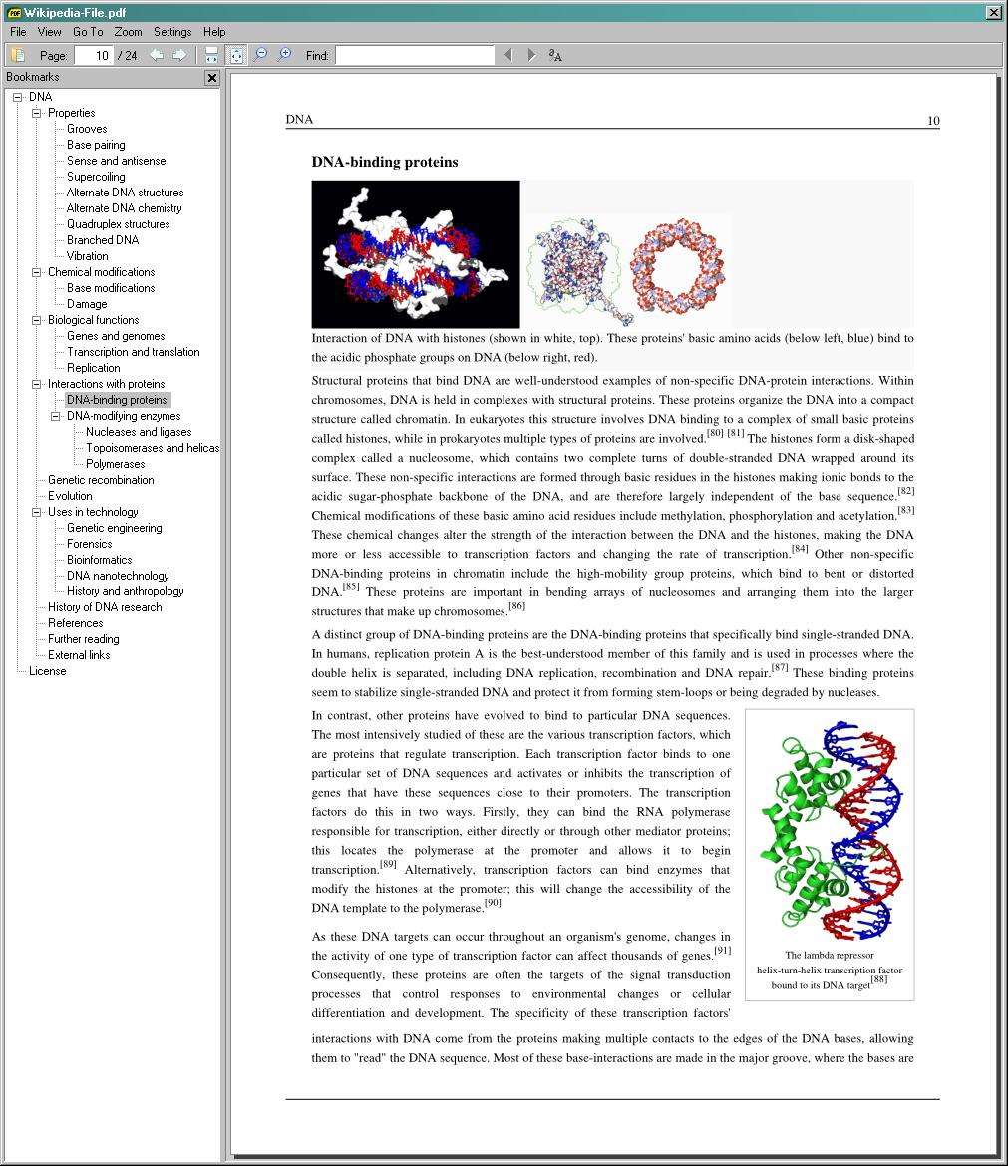
Do you know one of these problems?

Slide 4
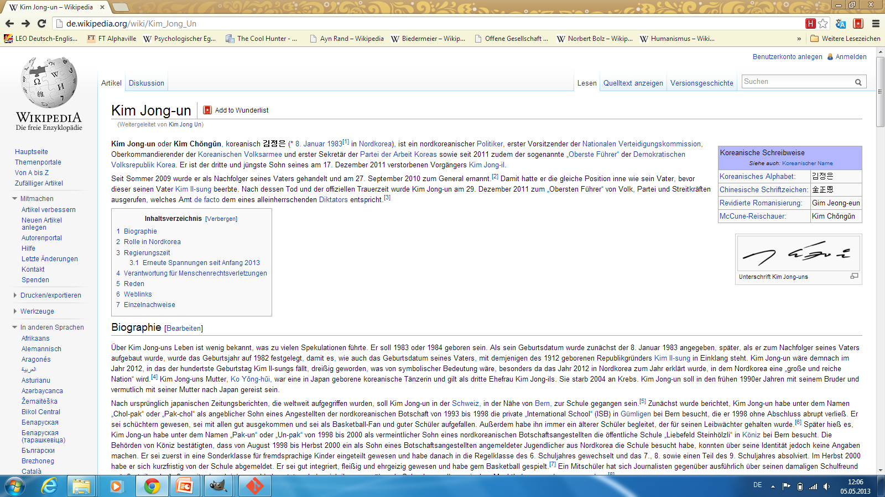
Do you know one of these problems?
Notes:
Information Overload
Need clear view of sight

Slide 5
Do you know one of these problems?
TL;DR
Notes:
Information Overload
Need clear view of sight

Slide 6
Our first step towards minimising this problem
Search engine for politicians and companies to reveal hidden relationships and cluster information.

Slide 7
DEMO

Slide 8
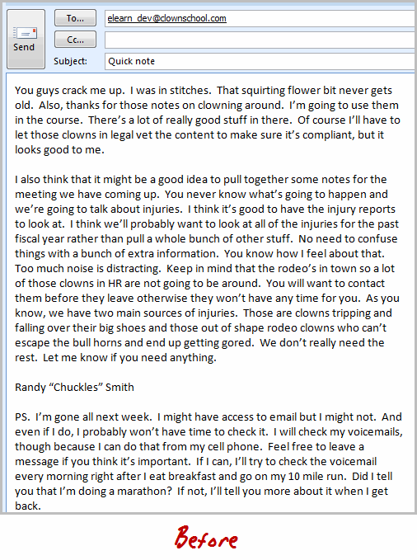
Do you know one of these problems?

Slide 9
Do you know one of these problems?
TL;DR

Slide 10
Making emails easier to read and reply!
Email-Analysis: Extracting the information out of your normal 500 daily tl;tr emails and help you to identify the relevant emails to deal with.
Offering an Addin for Gmail/Outlook to analyse incoming emails: recommendations what to read and additional informations about the text.
and outgoing emails: giving automatic advice how to shorten information.

Slide 11
The team
Peter: one-liner
Maja: xxx
Niklas: xxx
Moritz: xxx
Alex: xxx

Slide 12
BACKUP

Slide 13
Possible use cases
Better Google Alert search: precise alerts for structured entities.
Automatically inserts links to raw text with valuable information – in your email text you get automatically information about cities, related terms, people etc
On-the-Fly text analysis of documents and websites, providing them with additional informations about cities, events and people
Who-Is-Who of an article: How is that CEO connected in the industry? How is the celebrity connected to other stars?
Notes:
“Structured alerts. Modern alert systems are keyword based and suffer from false positives. Using Calais it is possible to build precise alerts for people, companies, places and events like corporate acquisitions. With the flood of junk in our RSS readers this is rather welcomed news.”

Slide 14
What are we doing?
Extracting and categorising relevant information (People, Companies, Places, and Events) from raw text (HTML, DOCS, PDFs etc).

Slide 15
What exactly are we doing?
Using the Bing Search API to get the relevant first 50 pages to a search query.
With the Open Calais API (by Thomson Reuters) those 50 pages are categorised in entities (people, countries, cities, events etc) and counted.
Finally, through the D3.js (library for manipulating documents based on data) visualisation of the connections of one person plus specific information of available data to connections.

