Slide 1

USING PYTHON & MACHINE LEARNING ALGORITHMS TO PREDICT MARKET VALUE & PERFORMANCE OF FOOTBALL PLAYERS
BY
EVANS AMOAH

Slide 2
ABSTRACT
The market value and performance of footballers, is key in the football leagues due to the financial significance of player transfers.
It is important to understand how a player's market value correlates with their performance on the field.
In this project, we propose a new method to assess various soccer actions using play by play event data. We need advanced player performance metrics to better capture a footballer's playing ability.
Additionally, we use machine learning algorithms to determine prediction accuracy beyond traditional Linear regression methods.
This project focuses on determining the value of a football player to a club.

Slide 3


TABLE OF CONTENTS
CHAPTER 1:
Introduction.
Statement of the Problem.
Research Questions & Objectives.
CHAPTER 2:
Data Collection & Preparation, Exploratory Data Analysis, Feature Selection, Feature Engineering, Model Training.
CHAPTER 3:
Results & Discussion

Slide 4

CHAPTER 1
INTRODUCTION
Soccer poses unique challenges for analysis due to its large
field, numerous players and sparse scoring.
A major task of sports statistics is player evaluation, which provides insight into the performance of a player.
Nowadays, the value driver of transfer prices in football
in general, has gradually evolved from performance to popularity.
The overwhelming increase in transfers value of top
players has been recognized in recent years as the superstar phenomenon.

Slide 5

STATEMENT OF THE PROBLEM
The transfer fees of football players are getting higher and higher each year and getting a good valuation of footballers throughout the year is valuable.
It is relevant to consider how the market value of a player relates to the performance of that player.
Performance evaluation is important for team management and fan engagement.
Our main task is to find good regression models for both market value and performance.
The centre of our challenge lies in the development of a good regression model to predict market value and performance of a football player.

Slide 6

RESEARCH QUSTIONS
What are the major attributes to the players’ market value?
How to evaluate a players’ performance?
What machine learning is best to predict market value and performance?
AIMS AND OBJECTIVES
We require existing datasets containing a player’s basic information (name, team, Age, height, weight)
market information (transfer fee, former team, duration of the contract, when the player joined the team) and
performance information (on pitch time, actions at the ball, fouls, scores)

Slide 7
CHAPTER 2:
DATA COLLECTION & PREPARATION
Data was gathered from:
Kaggle:2008/2009 season to 2021/2022 season of the top European football leagues.
From the English premier league, Spanish La Liga, German Bundesliga,
French Ligue 1, Italian Seria A and so on.
Transfermarkt.com: Player information and attributes including
Name, Age, Position, Current Club, Citizenship, height, foot, Market Value.
Sofifa.com: Performance metrics for players including potential, work rate, finishing, passing, crossing, aggression, speed, accuracy, discipline and so on.

Slide 8
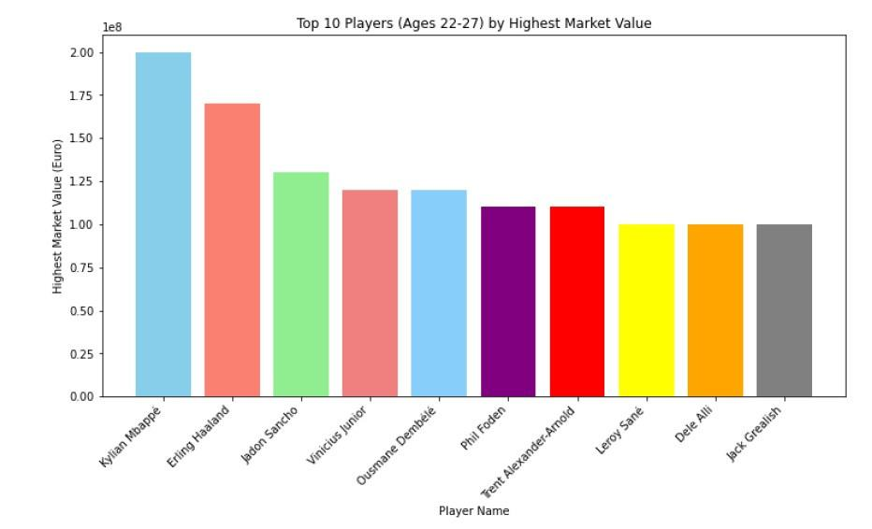
RELATIONSHIP BETWEEN ATTRIBUTES THAT AFFECT PLAYERS
MARKET VALUE
Age vs Market Value.
The player’s age is a key indicator of the market value.
Players’ value increases in their mid 20's and decreases as they age. Age reflects both experience and ability

Slide 9
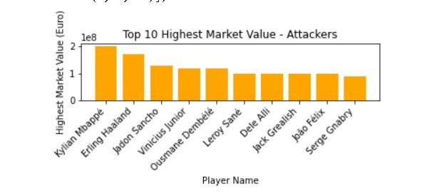
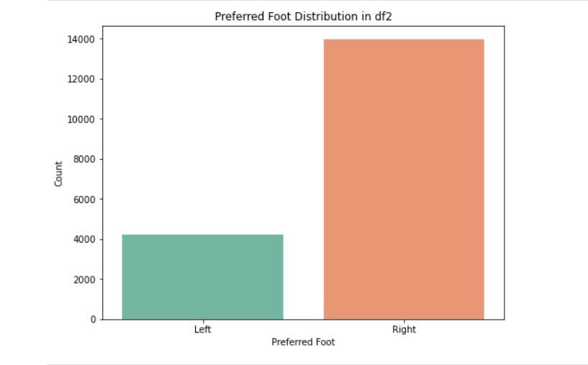
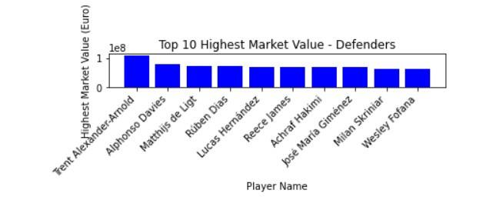
Position vs Market Value
Preferred Foot

Slide 10
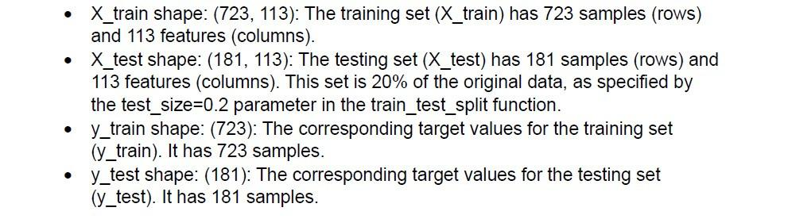
Feature Selection & Engineering
USING THE TRAIN_TEST_SPLIT METHOD AND 80 20 RULE TO PREPARE DATA
FOR TRAINING.
The dataset was split into a training set (with 80% of the data) and a
testing set (with 20% of the data), and each set includes the feature matrix (X)
and the target variable (y).
This is a common practice in machine learning to evaluate how well the model performs on unseen data.

Slide 11
CHOOSING AND BUILDING A PREDICTIVE MODEL.
The purpose of this test is to find a model that predict the market value of football players on unseen data.
REGRESSION MODELS TO BE TESTED.
Decision Trees
Lasso Regression
Ridge Regression
Support Vector Machines
Stacked Regression
Gradient Boosting
X = Features (Age, Position, Preferred foot, Finishing, Potential, work rate etc
Y = Target Variable (Market Value in Euro)

Slide 12
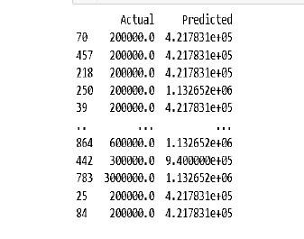
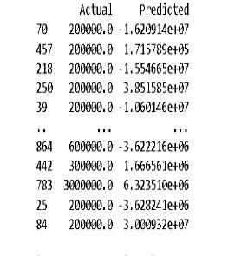
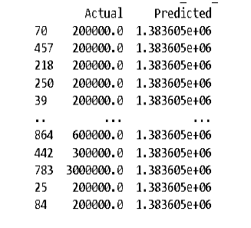
MODEL PREDICTION RESULTS
Decision Tree Regression
Lasso Regression
Gradient Boosting Regression
Wide range, considerable variations from actual values
Extremely negative predictions indicating potential issues
Prediction of same value for every instance indicating issues and limitation

Slide 13
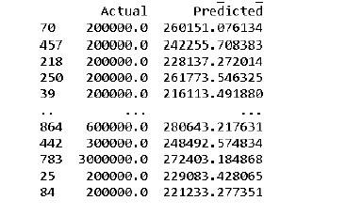
MODEL PREDICTION RESULTS
Support Vector Machines
SUCCESS.
The support vector machine model has succeeded in being the best model amongst all the models used for training and testing.
Prediction Results: The 'Actual' column represents the true market values of players, while the 'Predicted' column represents the values predicted by your SVM regression model.
The predicted values appear to be in the same order
of magnitude as the actual values, which is a positive sign.

Slide 14
CHAPTER 3:
RESULTS & DISCUSSION
KEY FINDINGS ON RESEARCH QUESTIONS.
What are the major attributes influencing a football player's market value?
Age as a Determining Factor: Age significantly influences a player's market value, with prices peaking early
in a player's career. Younger players, often considered hot prospects, command higher prices due to their
potential for improvement, prolonged influence on games, and higher return on investment (ROI).
Global Events and Shifting Valuations: Events like the World Cup can trigger shifts in players' valuations.
A nation's success in the World Cup attracts more interest from scouts and enhances the public perception
of the country as a producer of high-quality talent.

Slide 15
CHAPTER 3:
RESULTS & DISCUSSION
KEY FINDINGS ON RESEARCH QUESTIONS.
What are the factors contributing to effective player performance evaluation ?
Skill Correlation with Market Value: To differentiate between attackers and defenders, key skills like ball control and dribbling show the highest correlation with attackers' valuation.
For defenders, skills related to direct defensive actions, such as tackling and interceptions, hold the highest correlation.
Background and Belief in Success: A player's background, including the club, league, playing position, nationality, national team participation, and years left in the contract, contributes to the market belief in their likelihood of success.

Slide 16
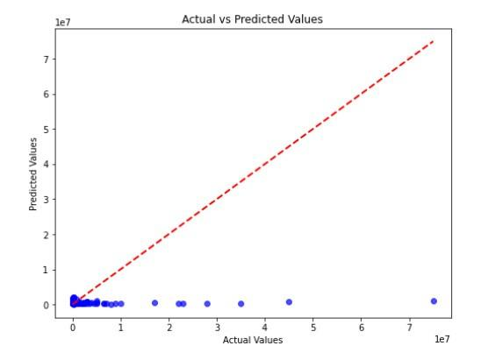
CHAPTER 3:
RESULTS & DISCUSSION
KEY FINDINGS ON RESEARCH QUESTIONS.
What machine learning is best to predict market value and performance?
The support vector machine model has succeeded in being the best model amongst
all the models used for training and testing.
The predicted values appear to be in the same order of magnitude as the actual values,
which is a positive sign.
The red dashed line represents perfect alignment. Points closer to the line represent better predictions.

Slide 17
CHAPTER 3:
RESULTS & DISCUSSION
LIMITATION
Decision Tree and Lasso models exhibit wide prediction ranges, indicating potential overfitting.
Same Value Predictions in Gradient Boosting Model.
Negative Predictions in Lasso Model.
Memory Issues: The “
Memory Error ” indicates that there is not enough memory and processor to
allocate for array with shape (515,310866) and higher.
I had to reduce the number of features in the models to remedy memory issues.

Slide 18
CHAPTER 3:
RESULTS & DISCUSSION
FUTURE DIRECTIONS
The football player market is dynamic, with player valuations changing over time.
The project's outcomes not only contribute to the advancement of predictive modeling in football player valuation but also provide actionable insights for stakeholders navigating the complex and dynamic world of professional football.
This project provides the following opportunities in the future:
Real-time Market Value Prediction Tools.
Collaboration with Industry Experts.
By pursuing these future directions, researchers can contribute to the continual improvement of football player market value prediction models, making them more accurate, interpretable, and adaptable to the dynamic nature of the football industry.

Slide 19
THANK YOU

