Slide 1
Program Overview
This short slide deck will walk you through the program structure. The final slides contain a high-level summary of the commitment and timeline.
Growth and Resilience in Tech
Microsoft Tech Resilience
Mentoring Program
Notes:
This short slide deck will walk you through the program structure. The final slides contain a high-level summary of the commitment and timeline.

Slide 2
Co-mentor model you + co-mentor
Let’s explain why we use this particular program model.
This program uses a co-mentor model. Many mentoring programs have a 1:1 structure, where one mentor works with one student.
While there are advantages of a 1:1 program model, there are also drawbacks. Few mentors have all of the characteristics that any one student seeks in mentoring. Having two mentors helps to broaden students’ access to mentoring by providing access to two mentors who have different and complementary qualities.
A co-mentor model also promotes learning and community-building among mentors. This is a great opportunity to strengthen and practice your own communication and teamwork skills. As co-mentors are matched to each other so that you deliberately complement each other, in terms of your role, your confidence, your backgrounds and experiences, we know that this is a challenge and opportunity for co-mentors. Our pilot mentors told us their work with a co-mentor, and as part of the larger mentoring community, was an enriching aspect of their Microsoft experience.
Notes:
Let’s explain why we use this particular program model.
This program uses a co-mentor model. Many mentoring programs have a 1:1 structure, where one mentor works with one student.
While there are advantages of a 1:1 program model, there are also drawbacks. Few mentors have all of the characteristics that any one student seeks in mentoring. Having two mentors helps to broaden students’ access to mentoring by providing access to two mentors who have different and complementary qualities.
A co-mentor model also promotes learning and community-building among mentors. This is a great opportunity to strengthen and practice your own communication and teamwork skills. As co-mentors are matched to each other so that you deliberately complement each other, in terms of your role, your confidence, your backgrounds and experiences, we know that this is a challenge and opportunity for co-mentors. Our pilot mentors told us their work with a co-mentor, and as part of the larger mentoring community, was an enriching aspect of their Microsoft experience.

Slide 3
Co-mentor model you + co-mentor Cohort of mentees
This program also includes the feature of a cohort of mentees. In total there will be 12-16 student mentees in each cohort.
By having a cohort of mentees working together, this program model encourages students to connect to each other. This is intentional, to reduce isolation and promote a sense of connection. All too often, students believe they are the only one who feels a sense of uncertainty, lack of confidence, or that they don’t belong. The program sessions are designed to get students interacting with each other.
There is enough time in the program for the group to connect to one another.
Notes:
This program also includes the feature of a cohort of mentees. In total there will be 12-16 student mentees in each cohort.
By having a cohort of mentees working together, this program model encourages students to connect to each other. This is intentional, to reduce isolation and promote a sense of connection. All too often, students believe they are the only one who feels a sense of uncertainty, lack of confidence, or that they don’t belong. The program sessions are designed to get students interacting with each other.
There is enough time in the program for the group to connect to one another.

Slide 4
Co-mentor model you + co-mentor Cohort of 12-16 mentees
For those who really seek the 1:1 nature of traditional mentoring, we have included this within the program model. You will connect 1:1 with half of the mentees. You will divide up the mentees with your co-mentor; half of the mentees we can think of as “your” mentees. You will schedule a 1:1 meeting with each of “your” mentees after Program Session 1 during Week 1 and during Week 6.
“Your” half of the mentees
Notes:
For those who really seek the 1:1 nature of traditional mentoring, we have included this within the program model. You will connect 1:1 with half of the mentees. You will divide up the mentees with your co-mentor; half of the mentees we can think of as “your” mentees. You will schedule a 1:1 meeting with each of “your” mentees after Program Session 1 during Week 1 and during Week 6.

Slide 5
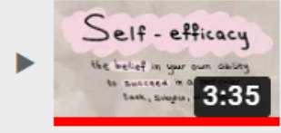
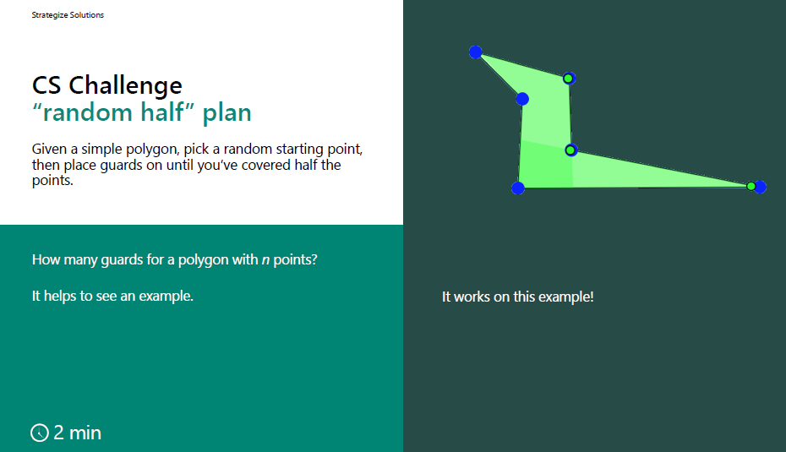
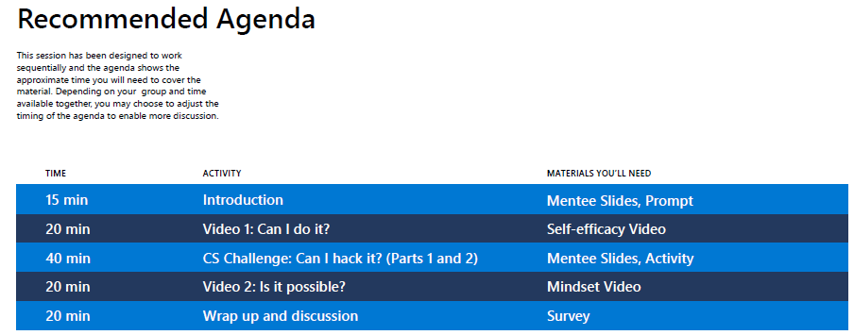
Mentoring Curriculum
A distinctive feature in this program is that there is a mentoring curriculum. We designed these activities deliberately to provide opportunities for engagement and conversation in the mentoring program. Remember this program is designed to help college students as they start their tech journey. They will grow and practice their tech resilience through the mentoring program’s learning labs -- with your coaching.
While many like to believe that mentoring conversations come naturally, the research (and our experience) suggests that some structure and activity can help those authentic, natural conversations and interactions to emerge. This structure is helpful for mentors and students who do not know each other yet, and to prompt conversations around some challenges students may face but might not feel they can share just yet.
Each Learning Lab the same pattern with a recommended agenda. You have the agency to follow the agendas as recommended, or as you get to know your cohort better, you can adapt the agenda in a way that will make sense for what your cohort needs.
Notes:
A distinctive feature in this program is that there is a mentoring curriculum. We designed these activities deliberately to provide opportunities for engagement and conversation in the mentoring program. Remember this program is designed to help college students as they start their tech journey. They will grow and practice their tech resilience through the mentoring program’s learning labs -- with your coaching.
While many like to believe that mentoring conversations come naturally, the research (and our experience) suggests that some structure and activity can help those authentic, natural conversations and interactions to emerge. This structure is helpful for mentors and students who do not know each other yet, and to prompt conversations around some challenges students may face but might not feel they can share just yet.
Each Learning Lab has a recommended agenda. The sessions are designed to run for 2 hours, with about 1.5 hours of structured engagement provided to you, leaving some open, flexible time at the end. You have the agency to follow the agendas as recommended, or as you get to know your cohort better, you can adapt the agenda in a way that will make sense for what your cohort needs.
Each Learning Lab has a theme, posed as a question for the cohort (for example: “Can I hack it?”) with topics to structure the discussions.
To introduce the topics (such as self-efficacy and mindset), there will be links to two videos, each lasting about 3 minutes. These are designed to provide the basis for a mentor to share a story and offer opportunities for mentees to resonate or share their stories.
Each Learning Lab also contains a CS Challenge activity. The CS challenge activities are designed to promote communication and engagement with their fellow mentees around a key skill that will help them to grow and practice their tech resilience. They provide a shared experience to serve as a starting point for conversation around the topics. We chose not to use programming challenges as those could overlap with what they are seeing in class; we want to avoid confusion with what they are learning.

Slide 6
To give you a better idea of how a session flows, here is a sample agenda. The sessions are designed to run for 2 hours, with about 1.5 hours of structured engagement provided to you, leaving some open, flexible time at the end.
Each Learning Lab has a theme, posed as a question.
Two videos introduce topics (such as self-efficacy and mindset), each lasting about 3 minutes. These are designed to provide the basis for a mentor to share a story and offer opportunities for mentees to resonate or share their stories.
Embedded CS challenge activities are designed to promote communication and engagement with their fellow mentees around a key skill that will help them to grow and practice their tech resilience. They provide a shared experience to serve as a starting point for conversation around the topics. We chose not to use programming challenges as those could overlap with what they are seeing in class; we want to avoid confusion with what they are learning.
Recommended Agenda
This session has been designed to work sequentially and the agenda shows the approximate time you will need to cover the material. Depending on your group and time available together, you may choose to adjust the timing of the agenda to enable more discussion.
: Can I hack it?
15 min | Introduction | Worksheet
15 min | Can I do it? [self-efficacy] | Video
35 min | CS Challenge: Can I hack it? | Slide deck, Worksheet
15 min | Is it possible? [mindset] | Video
15-30 min | Wrap up and discussion | Post-survey
Notes:
To give you a better idea of how a session flows, here is a sample agenda. Each Learning Lab the same pattern.
Typically, you or your co-mentor will welcome students to the session.
There is a worksheet (which can be viewed as a set of poll questions) to prompt reflection; the reason for this is to help mentees individually think about the theme to settle into the session.
Then you or your co-mentor will share a story with the students before showing one of the videos. In doing so, you open up the topic and also model some vulnerability. This encourages the mentees to share, too, if they are willing.
Then the students have a chance to break off into smaller pairs/trios to discuss what resonated with them, and you will ask some to share back with the group what they talked about in their pairs/trios. In this way, students can share their perspective and hear from others. This is often where students realize that they have more in common with others than they previously thought. Or, they may realize there is a wide variety of perspectives and experiences.
You’ll then move into the CS challenge activity, which is intended to give a concrete experience to anchor the discussion related to that Learning Lab’s theme and the videos they watch. The CS challenge is also an opportunity for students to practice teamwork and communication skills, and connect the topics to challenges they may face in tech. For example, in one activity, students try to engage with Vim commands and in another session, they strategize on where to place LiDAR scanners in the right places to protect valuables from an archaeological dig. The goal is not to master the CS challenge. In fact some students won’t find the activity to be “challenging” at all. It is meant to provide a glimpse into how they think, strategize, cope with discomfort or ambiguity, and how they communicate and articulate their problem-solving process.
After the CS challenge, you or your co-mentor (probably whomever did not do the first story share) will share a story to set up the second video. After this, we encourage a “round robin” where each student has a chance to share in the closing round (or they can pass). This brings many voices into the space before opening it up to more informal Q and A or discussion. You will learn more about what your mentees are interested in, whether some feature of your job, something about their classes, a tech topic, or something else entirely. You have the flexibility to adapt the end of the session to make sense for you, your co-mentor, and your cohort.
Many mentors in the pilot found that they address all of the structured content in the first 75-90 mins, leaving a half hour for open questions or topics that they want to discuss. You might know from the mentee 1:1s some things that students want to hear more about, or you might find that something came up in the group session that people want to delve into more depth. You may choose to share where the topics have played a role in your own experiences (e.g., during an interview or collaboration in your current role), which can open up the conversation. Or, you may choose to end the session early; there is no pressure to “fill the time”.

Slide 7
Typically, you or your co-mentor will welcome students to the session.
There is a worksheet (which can be viewed as a set of poll questions) to prompt reflection; the reason for this is to help mentees individually think about the theme to settle into the session.
Recommended Agenda
This session has been designed to work sequentially and the agenda shows the approximate time you will need to cover the material. Depending on your group and time available together, you may choose to adjust the timing of the agenda to enable more discussion.
15 min | Introduction | Worksheet
15 min | Can I do it? [self-efficacy] | Video
35 min | CS Challenge: Can I hack it? | Slide deck, Worksheet
15 min | Is it possible? [mindset] | Video
15-30 min | Wrap up and discussion | Post-survey
Notes:
To give you a better idea of how a session flows, here is a sample agenda. Each Learning Lab the same pattern.
Typically, you or your co-mentor will welcome students to the session.
There is a worksheet (which can be viewed as a set of poll questions) to prompt reflection; the reason for this is to help mentees individually think about the theme to settle into the session.
Then you or your co-mentor will share a story with the students before showing one of the videos. In doing so, you open up the topic and also model some vulnerability. This encourages the mentees to share, too, if they are willing.
Then the students have a chance to break off into smaller pairs/trios to discuss what resonated with them, and you will ask some to share back with the group what they talked about in their pairs/trios. In this way, students can share their perspective and hear from others. This is often where students realize that they have more in common with others than they previously thought. Or, they may realize there is a wide variety of perspectives and experiences.
You’ll then move into the CS challenge activity, which is intended to give a concrete experience to anchor the discussion related to that Learning Lab’s theme and the videos they watch. The CS challenge is also an opportunity for students to practice teamwork and communication skills, and connect the topics to challenges they may face in tech. For example, in one activity, students try to engage with Vim commands and in another session, they strategize on where to place LiDAR scanners in the right places to protect valuables from an archaeological dig. The goal is not to master the CS challenge. In fact some students won’t find the activity to be “challenging” at all. It is meant to provide a glimpse into how they think, strategize, cope with discomfort or ambiguity, and how they communicate and articulate their problem-solving process.
After the CS challenge, you or your co-mentor (probably whomever did not do the first story share) will share a story to set up the second video. After this, we encourage a “round robin” where each student has a chance to share in the closing round (or they can pass). This brings many voices into the space before opening it up to more informal Q and A or discussion. You will learn more about what your mentees are interested in, whether some feature of your job, something about their classes, a tech topic, or something else entirely. You have the flexibility to adapt the end of the session to make sense for you, your co-mentor, and your cohort.
Many mentors in the pilot found that they address all of the structured content in the first 75-90 mins, leaving a half hour for open questions or topics that they want to discuss. You might know from the mentee 1:1s some things that students want to hear more about, or you might find that something came up in the group session that people want to delve into more depth. You may choose to share where the topics have played a role in your own experiences (e.g., during an interview or collaboration in your current role), which can open up the conversation. Or, you may choose to end the session early; there is no pressure to “fill the time”.

Slide 8
Then you or your co-mentor will share a story with the students before showing one of the videos. In doing so, you open up the topic and also model some vulnerability. This encourages the mentees to share, too, if they are willing.
Then the students have a chance to break off into smaller pairs/trios to discuss what resonated with them, and you will ask some to share back with the group what they talked about in their pairs/trios. In this way, students can share their perspective and hear from others. This is often where students realize that they have more in common with others than they previously thought. Or, they may realize there is a wide variety of perspectives and experiences.
Recommended Agenda
This session has been designed to work sequentially and the agenda shows the approximate time you will need to cover the material. Depending on your group and time available together, you may choose to adjust the timing of the agenda to enable more discussion.
15 min | Introduction | Worksheet
15 min | Can I do it? [self-efficacy] | Video
35 min | CS Challenge: Can I hack it? | Slide deck, Worksheet
15 min | Is it possible? [mindset] | Video
15-30 min | Wrap up and discussion | Post-survey
Notes:
To give you a better idea of how a session flows, here is a sample agenda. Each Learning Lab the same pattern.
Typically, you or your co-mentor will welcome students to the session.
There is a worksheet (which can be viewed as a set of poll questions) to prompt reflection; the reason for this is to help mentees individually think about the theme to settle into the session.
Then you or your co-mentor will share a story with the students before showing one of the videos. In doing so, you open up the topic and also model some vulnerability. This encourages the mentees to share, too, if they are willing.
Then the students have a chance to break off into smaller pairs/trios to discuss what resonated with them, and you will ask some to share back with the group what they talked about in their pairs/trios. In this way, students can share their perspective and hear from others. This is often where students realize that they have more in common with others than they previously thought. Or, they may realize there is a wide variety of perspectives and experiences.
You’ll then move into the CS challenge activity, which is intended to give a concrete experience to anchor the discussion related to that Learning Lab’s theme and the videos they watch. The CS challenge is also an opportunity for students to practice teamwork and communication skills, and connect the topics to challenges they may face in tech. For example, in one activity, students try to engage with Vim commands and in another session, they strategize on where to place LiDAR scanners in the right places to protect valuables from an archaeological dig. The goal is not to master the CS challenge. In fact some students won’t find the activity to be “challenging” at all. It is meant to provide a glimpse into how they think, strategize, cope with discomfort or ambiguity, and how they communicate and articulate their problem-solving process.
After the CS challenge, you or your co-mentor (probably whomever did not do the first story share) will share a story to set up the second video. After this, we encourage a “round robin” where each student has a chance to share in the closing round (or they can pass). This brings many voices into the space before opening it up to more informal Q and A or discussion. You will learn more about what your mentees are interested in, whether some feature of your job, something about their classes, a tech topic, or something else entirely. You have the flexibility to adapt the end of the session to make sense for you, your co-mentor, and your cohort.
Many mentors in the pilot found that they address all of the structured content in the first 75-90 mins, leaving a half hour for open questions or topics that they want to discuss. You might know from the mentee 1:1s some things that students want to hear more about, or you might find that something came up in the group session that people want to delve into more depth. You may choose to share where the topics have played a role in your own experiences (e.g., during an interview or collaboration in your current role), which can open up the conversation. Or, you may choose to end the session early; there is no pressure to “fill the time”.

Slide 9
You’ll then move into the CS challenge activity, which is intended to give a concrete experience to anchor the discussion related to that Learning Lab’s theme and the videos they watch. The CS challenge is also an opportunity for students to practice teamwork and communication skills, and connect the topics to challenges they may face in tech. For example, in one activity, students try to engage with Vim commands and in another session, they strategize on where to place LiDAR scanners in the right places to protect valuables from an archaeological dig. The goal is not to master the CS challenge. In fact some students won’t find the activity to be “challenging” at all. It is meant to provide a glimpse into how they think, strategize, cope with discomfort or ambiguity, and how they communicate and articulate their problem-solving process.
Recommended Agenda
This session has been designed to work sequentially and the agenda shows the approximate time you will need to cover the material. Depending on your group and time available together, you may choose to adjust the timing of the agenda to enable more discussion.
15 min | Introduction | Worksheet
15 min | Can I do it? [self-efficacy] | Video
35 min | CS Challenge: Can I hack it? | Slide deck, Worksheet
15 min | Is it possible? [mindset] | Video
15-30 min | Wrap up and discussion | Post-survey
Notes:
To give you a better idea of how a session flows, here is a sample agenda. Each Learning Lab the same pattern.
Typically, you or your co-mentor will welcome students to the session.
There is a worksheet (which can be viewed as a set of poll questions) to prompt reflection; the reason for this is to help mentees individually think about the theme to settle into the session.
Then you or your co-mentor will share a story with the students before showing one of the videos. In doing so, you open up the topic and also model some vulnerability. This encourages the mentees to share, too, if they are willing.
Then the students have a chance to break off into smaller pairs/trios to discuss what resonated with them, and you will ask some to share back with the group what they talked about in their pairs/trios. In this way, students can share their perspective and hear from others. This is often where students realize that they have more in common with others than they previously thought. Or, they may realize there is a wide variety of perspectives and experiences.
You’ll then move into the CS challenge activity, which is intended to give a concrete experience to anchor the discussion related to that Learning Lab’s theme and the videos they watch. The CS challenge is also an opportunity for students to practice teamwork and communication skills, and connect the topics to challenges they may face in tech. For example, in one activity, students try to engage with Vim commands and in another session, they strategize on where to place LiDAR scanners in the right places to protect valuables from an archaeological dig. The goal is not to master the CS challenge. In fact some students won’t find the activity to be “challenging” at all. It is meant to provide a glimpse into how they think, strategize, cope with discomfort or ambiguity, and how they communicate and articulate their problem-solving process.
After the CS challenge, you or your co-mentor (probably whomever did not do the first story share) will share a story to set up the second video. After this, we encourage a “round robin” where each student has a chance to share in the closing round (or they can pass). This brings many voices into the space before opening it up to more informal Q and A or discussion. You will learn more about what your mentees are interested in, whether some feature of your job, something about their classes, a tech topic, or something else entirely. You have the flexibility to adapt the end of the session to make sense for you, your co-mentor, and your cohort.
Many mentors in the pilot found that they address all of the structured content in the first 75-90 mins, leaving a half hour for open questions or topics that they want to discuss. You might know from the mentee 1:1s some things that students want to hear more about, or you might find that something came up in the group session that people want to delve into more depth. You may choose to share where the topics have played a role in your own experiences (e.g., during an interview or collaboration in your current role), which can open up the conversation. Or, you may choose to end the session early; there is no pressure to “fill the time”.

Slide 10
After the CS challenge, you or your co-mentor (probably whomever did not do the first story share) will share a story to set up the second video. After this, we encourage a “round robin” where each student has a chance to share in the closing round (or they can pass). This brings many voices into the space before opening it up to more informal Q and A or discussion. You will learn more about what your mentees are interested in, whether some feature of your job, something about their classes, a tech topic, or something else entirely. You have the flexibility to adapt the end of the session to make sense for you, your co-mentor, and your cohort.
Recommended Agenda
This session has been designed to work sequentially and the agenda shows the approximate time you will need to cover the material. Depending on your group and time available together, you may choose to adjust the timing of the agenda to enable more discussion.
15 min | Introduction | Worksheet
15 min | Can I do it? [self-efficacy] | Video
35 min | CS Challenge: Can I hack it? | Slide deck, Worksheet
15 min | Is it possible? [mindset] | Video
15-30 min | Wrap up and discussion | Post-survey
Notes:
To give you a better idea of how a session flows, here is a sample agenda. Each Learning Lab the same pattern.
Typically, you or your co-mentor will welcome students to the session.
There is a worksheet (which can be viewed as a set of poll questions) to prompt reflection; the reason for this is to help mentees individually think about the theme to settle into the session.
Then you or your co-mentor will share a story with the students before showing one of the videos. In doing so, you open up the topic and also model some vulnerability. This encourages the mentees to share, too, if they are willing.
Then the students have a chance to break off into smaller pairs/trios to discuss what resonated with them, and you will ask some to share back with the group what they talked about in their pairs/trios. In this way, students can share their perspective and hear from others. This is often where students realize that they have more in common with others than they previously thought. Or, they may realize there is a wide variety of perspectives and experiences.
You’ll then move into the CS challenge activity, which is intended to give a concrete experience to anchor the discussion related to that Learning Lab’s theme and the videos they watch. The CS challenge is also an opportunity for students to practice teamwork and communication skills, and connect the topics to challenges they may face in tech. For example, in one activity, students try to engage with Vim commands and in another session, they strategize on where to place LiDAR scanners in the right places to protect valuables from an archaeological dig. The goal is not to master the CS challenge. In fact some students won’t find the activity to be “challenging” at all. It is meant to provide a glimpse into how they think, strategize, cope with discomfort or ambiguity, and how they communicate and articulate their problem-solving process.
After the CS challenge, you or your co-mentor (probably whomever did not do the first story share) will share a story to set up the second video. After this, we encourage a “round robin” where each student has a chance to share in the closing round (or they can pass). This brings many voices into the space before opening it up to more informal Q and A or discussion. You will learn more about what your mentees are interested in, whether some feature of your job, something about their classes, a tech topic, or something else entirely. You have the flexibility to adapt the end of the session to make sense for you, your co-mentor, and your cohort.
Many mentors in the pilot found that they address all of the structured content in the first 75-90 mins, leaving a half hour for open questions or topics that they want to discuss. You might know from the mentee 1:1s some things that students want to hear more about, or you might find that something came up in the group session that people want to delve into more depth. You may choose to share where the topics have played a role in your own experiences (e.g., during an interview or collaboration in your current role), which can open up the conversation. Or, you may choose to end the session early; there is no pressure to “fill the time”.

Slide 11
Many mentors in the pilot found that they address all of the structured content in the first 75-90 mins, leaving a half hour for open questions or topics that they want to discuss. You might know from the mentee 1:1s some things that students want to hear more about, or you might find that something came up in the group session that people want to delve into more depth. You may choose to share where the topics have played a role in your own experiences (e.g., during an interview or collaboration in your current role), which can open up the conversation. Or, you may choose to end the session early; there is no pressure to “fill the time”.
Recommended Agenda
This session has been designed to work sequentially and the agenda shows the approximate time you will need to cover the material. Depending on your group and time available together, you may choose to adjust the timing of the agenda to enable more discussion.
15 min | Introduction | Worksheet
15 min | Can I do it? [self-efficacy] | Video
35 min | CS Challenge: Can I hack it? | Slide deck, Worksheet
15 min | Is it possible? [mindset] | Video
15-30 min | Wrap up and discussion | Post-survey
Notes:
To give you a better idea of how a session flows, here is a sample agenda. Each Learning Lab the same pattern.
Typically, you or your co-mentor will welcome students to the session.
There is a worksheet (which can be viewed as a set of poll questions) to prompt reflection; the reason for this is to help mentees individually think about the theme to settle into the session.
Then you or your co-mentor will share a story with the students before showing one of the videos. In doing so, you open up the topic and also model some vulnerability. This encourages the mentees to share, too, if they are willing.
Then the students have a chance to break off into smaller pairs/trios to discuss what resonated with them, and you will ask some to share back with the group what they talked about in their pairs/trios. In this way, students can share their perspective and hear from others. This is often where students realize that they have more in common with others than they previously thought. Or, they may realize there is a wide variety of perspectives and experiences.
You’ll then move into the CS challenge activity, which is intended to give a concrete experience to anchor the discussion related to that Learning Lab’s theme and the videos they watch. The CS challenge is also an opportunity for students to practice teamwork and communication skills, and connect the topics to challenges they may face in tech. For example, in one activity, students try to engage with Vim commands and in another session, they strategize on where to place LiDAR scanners in the right places to protect valuables from an archaeological dig. The goal is not to master the CS challenge. In fact some students won’t find the activity to be “challenging” at all. It is meant to provide a glimpse into how they think, strategize, cope with discomfort or ambiguity, and how they communicate and articulate their problem-solving process.
After the CS challenge, you or your co-mentor (probably whomever did not do the first story share) will share a story to set up the second video. After this, we encourage a “round robin” where each student has a chance to share in the closing round (or they can pass). This brings many voices into the space before opening it up to more informal Q and A or discussion. You will learn more about what your mentees are interested in, whether some feature of your job, something about their classes, a tech topic, or something else entirely. You have the flexibility to adapt the end of the session to make sense for you, your co-mentor, and your cohort.
Many mentors in the pilot found that they address all of the structured content in the first 75-90 mins, leaving a half hour for open questions or topics that they want to discuss. You might know from the mentee 1:1s some things that students want to hear more about, or you might find that something came up in the group session that people want to delve into more depth. You may choose to share where the topics have played a role in your own experiences (e.g., during an interview or collaboration in your current role), which can open up the conversation. Or, you may choose to end the session early; there is no pressure to “fill the time”.

Slide 12
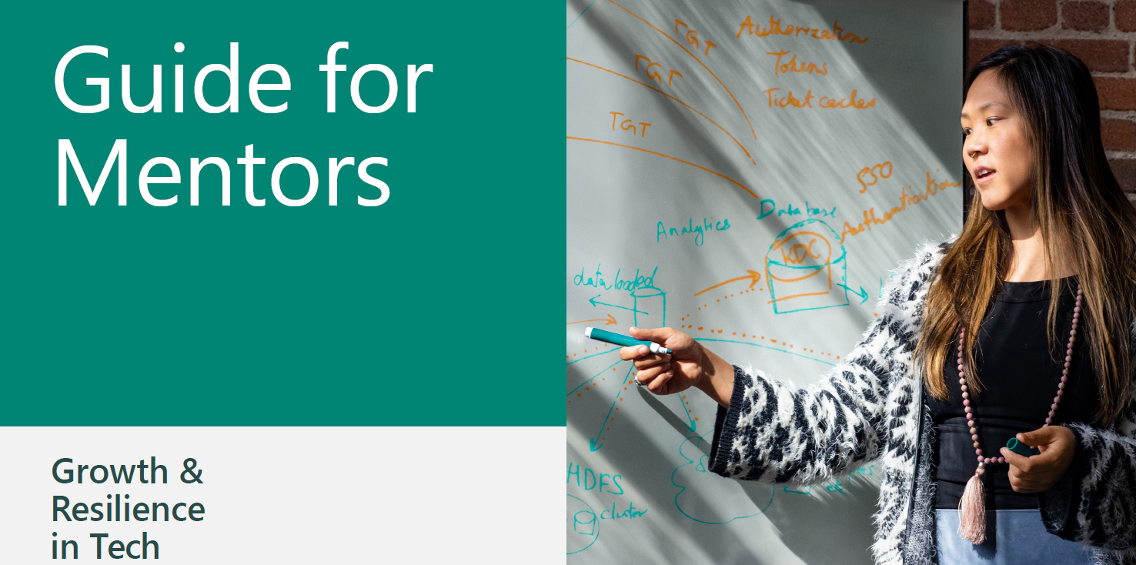
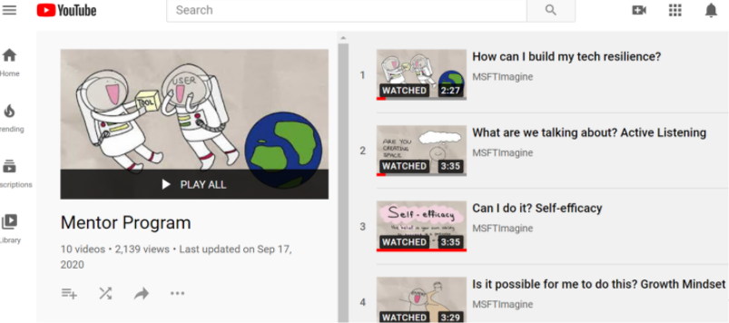

Three Resources
You are provided with everything you need to run the program.
The Mentor Guide includes information for Learning Labs and suggested structure for your 1:1 meetings. You’ll also find facilitation tips specific to the various activities and topics.
The Tech Resilience Video pack includes the entire set of videos you will be showing across the sessions. Again, each session centers two video clips, each video is about 3 minutes long and were developed specifically for this program.
The Mentee Slides are intended to be mentee-facing; you may choose to screen share and display them as you move through the sessions.
Easy On-Line Access
Tech Resilience Video Pack
For you
To display during program sessions
Notes:
You are provided with everything you need to run the program.
The Mentor Guide includes information for Learning Labs and suggested structure for your 1:1 meetings. You’ll also find facilitation tips specific to the various activities and topics.
The Tech Resilience Video pack includes the entire set of videos you will be showing across the sessions. Again, each session centers two video clips, each video is about 3 minutes long and were developed specifically for this program.
The Mentee Slides are intended to be mentee-facing; you may choose to screen share and display them as you move through the sessions.

Slide 13
7
Let’s review the timeline. Your commitment to the program is for 7 weeks.
Growth and Resilience in Tech
The Commitment
~2 hr/
weeks
week
Welcome 1:1’s with mentees
1:1’s with mentees
0
1
2
3
4
5
6
Prep and logistics
Weekly Learning Labs
Group mentoring sessions
Notes:
Let’s review the timeline. Your commitment to the program is for 7 weeks.
First, there is a prep session, prior to the program, when you and your co-mentor meet on your own to review the toolkit. You schedule this meeting with your co-mentor at your own convenience.
You’ll talk about which parts each of you want to lead within the sessions. You’ll also send out an invite to your mentees inviting them to the first group session. Many mentors divide up their mentees, each mentor taking half. Mentors then send emails to “their” mentees to invite them to the meeting. Other mentors may do this differently and send one collective email from both mentors to the entire cohort. It is your choice how to do this logistically.
You see this prep week on the schedule as Week 0.
The program itself runs for 6 weeks. Students are told this is a 6 week program. You will hear us talk about Program Session 1 or Program Session 5. This language keeps us all on the same page.
In week 1, you’ll welcome your 12-16 mentees in a group session. This first session is only 1 hour long.
At the end of this first session, you’ll each invite 6-8 mentees to schedule with you individually for a short one-on-one meeting to get to know them a bit better. Each student will have filled out an info sheet already, and you’ll have this to work from, and that will make an initial conversation easier to start. You can offer the meeting times at your convenience. Since the first session is only one hour, some mentors decide to offer 1:1s immediately after the group session out of convenience for them. If you decide to go this route, be sure to alert the students to your plan.
In weeks 2, 3, 4, and 5 you will continue to meet as a group. These sessions are scheduled for 2 hours.
Week 5’s group session is when the group portion of the program ends. When this session has concluded that, mentors will invite 1:1s with “their” half of the mentees to close out the program. We anticipate that this might happen in Week 6, so we have asked mentees to commit to a 6 week program.

Slide 14
7
First, there is a prep session, prior to the program, when you and your co-mentor meet on your own to review the toolkit. You schedule this meeting with your co-mentor at your own convenience.
You’ll talk about which parts each of you want to lead within the sessions. You’ll also send out an invite to your mentees inviting them to the first group session. Many mentors divide up their mentees, each mentor taking half. Mentors then send emails to “their” mentees to invite them to the meeting. Other mentors may do this differently and send one collective email from both mentors to the entire cohort. It is your choice how to do this logistically.
You see this prep week on the schedule as Week 0.
Growth and Resilience in Tech
The Commitment
~2 hr/
weeks
week
Welcome 1:1’s with mentees
1:1’s with mentees
0
1
2
3
4
5
6
Prep and logistics
Weekly Learning Labs
Group mentoring sessions
Notes:
Let’s review the timeline. Your commitment to the program is for 7 weeks.
First, there is a prep session, prior to the program, when you and your co-mentor meet on your own to review the toolkit. You schedule this meeting with your co-mentor at your own convenience.
You’ll talk about which parts each of you want to lead within the sessions. You’ll also send out an invite to your mentees inviting them to the first group session. Many mentors divide up their mentees, each mentor taking half. Mentors then send emails to “their” mentees to invite them to the meeting. Other mentors may do this differently and send one collective email from both mentors to the entire cohort. It is your choice how to do this logistically.
You see this prep week on the schedule as Week 0.
The program itself runs for 6 weeks. Students are told this is a 6 week program. You will hear us talk about Program Session 1 or Program Session 5. This language keeps us all on the same page.
In week 1, you’ll welcome your 12-16 mentees in a group session. This first session is only 1 hour long.
At the end of this first session, you’ll each invite 6-8 mentees to schedule with you individually for a short one-on-one meeting to get to know them a bit better. Each student will have filled out an info sheet already, and you’ll have this to work from, and that will make an initial conversation easier to start. You can offer the meeting times at your convenience. Since the first session is only one hour, some mentors decide to offer 1:1s immediately after the group session out of convenience for them. If you decide to go this route, be sure to alert the students to your plan.
In weeks 2, 3, 4, and 5 you will continue to meet as a group. These sessions are scheduled for 2 hours.
Week 5’s group session is when the group portion of the program ends. When this session has concluded that, mentors will invite 1:1s with “their” half of the mentees to close out the program. We anticipate that this might happen in Week 6, so we have asked mentees to commit to a 6 week program.

Slide 15
7
The program itself runs for 6 weeks. Students are told this is a 6 week program. You will hear us talk about Program Session 1 or Program Session 5. This language keeps us all on the same page.
In week 1, you’ll welcome your 12-16 mentees in a group session. This first session is only 1 hour long.
At the end of this first session, you’ll each invite 6-8 mentees to schedule with you individually for a short one-on-one meeting to get to know them a bit better. Each student will have filled out an info sheet already, and you’ll have this to work from, and that will make an initial conversation easier to start. You can offer the meeting times at your convenience. Since the first session is only one hour, some mentors decide to offer 1:1s immediately after the group session out of convenience for them. If you decide to go this route, be sure to alert the students to your plan.
Growth and Resilience in Tech
The Commitment
~2 hr/
weeks
week
Welcome 1:1’s with mentees
1:1’s with mentees
0
1
2
3
4
5
6
Prep and logistics
Weekly Learning Labs
Group mentoring sessions
Notes:
Let’s review the timeline. Your commitment to the program is for 7 weeks.
First, there is a prep session, prior to the program, when you and your co-mentor meet on your own to review the toolkit. You schedule this meeting with your co-mentor at your own convenience.
You’ll talk about which parts each of you want to lead within the sessions. You’ll also send out an invite to your mentees inviting them to the first group session. Many mentors divide up their mentees, each mentor taking half. Mentors then send emails to “their” mentees to invite them to the meeting. Other mentors may do this differently and send one collective email from both mentors to the entire cohort. It is your choice how to do this logistically.
You see this prep week on the schedule as Week 0.
The program itself runs for 6 weeks. Students are told this is a 6 week program. You will hear us talk about Program Session 1 or Program Session 5. This language keeps us all on the same page.
In week 1, you’ll welcome your 12-16 mentees in a group session. This first session is only 1 hour long.
At the end of this first session, you’ll each invite 6-8 mentees to schedule with you individually for a short one-on-one meeting to get to know them a bit better. Each student will have filled out an info sheet already, and you’ll have this to work from, and that will make an initial conversation easier to start. You can offer the meeting times at your convenience. Since the first session is only one hour, some mentors decide to offer 1:1s immediately after the group session out of convenience for them. If you decide to go this route, be sure to alert the students to your plan.
In weeks 2, 3, 4, and 5 you will continue to meet as a group. These sessions are scheduled for 2 hours.
Week 5’s group session is when the group portion of the program ends. When this session has concluded that, mentors will invite 1:1s with “their” half of the mentees to close out the program. We anticipate that this might happen in Week 6, so we have asked mentees to commit to a 6 week program.

Slide 16
7
In weeks 2, 3, 4, and 5 you will continue to meet as a group. These sessions are scheduled for 2 hours.
Week 5’s group session is when the group portion of the program ends. When this session has concluded that, mentors will invite 1:1s with “their” half of the mentees to close out the program. We anticipate that this might happen in Week 6, so we have asked mentees to commit to a 6 week program.
Growth and Resilience in Tech
The Commitment
~2 hr/
weeks
week
Welcome 1:1’s with mentees
1:1’s with mentees
0
1
2
3
4
5
6
Prep and logistics
Weekly Learning Labs
Group mentoring sessions
Notes:
Let’s review the timeline. Your commitment to the program is for 7 weeks.
First, there is a prep session, prior to the program, when you and your co-mentor meet on your own to review the toolkit. You schedule this meeting with your co-mentor at your own convenience.
You’ll talk about which parts each of you want to lead within the sessions. You’ll also send out an invite to your mentees inviting them to the first group session. Many mentors divide up their mentees, each mentor taking half. Mentors then send emails to “their” mentees to invite them to the meeting. Other mentors may do this differently and send one collective email from both mentors to the entire cohort. It is your choice how to do this logistically.
You see this prep week on the schedule as Week 0.
The program itself runs for 6 weeks. Students are told this is a 6 week program. You will hear us talk about Program Session 1 or Program Session 5. This language keeps us all on the same page.
In week 1, you’ll welcome your 12-16 mentees in a group session. This first session is only 1 hour long.
At the end of this first session, you’ll each invite 6-8 mentees to schedule with you individually for a short one-on-one meeting to get to know them a bit better. Each student will have filled out an info sheet already, and you’ll have this to work from, and that will make an initial conversation easier to start. You can offer the meeting times at your convenience. Since the first session is only one hour, some mentors decide to offer 1:1s immediately after the group session out of convenience for them. If you decide to go this route, be sure to alert the students to your plan.
In weeks 2, 3, 4, and 5 you will continue to meet as a group. These sessions are scheduled for 2 hours.
Week 5’s group session is when the group portion of the program ends. When this session has concluded that, mentors will invite 1:1s with “their” half of the mentees to close out the program. We anticipate that this might happen in Week 6, so we have asked mentees to commit to a 6 week program.

Slide 17
Preparation
To prepare to lead a cohort, mentors must attend four training sessions (2 hours each in duration). Mentors will also complete approximately 2 hours of self-guided work, organized into smaller assignments (each 30-45 minutes). You complete these at your own convenience, after training sessions 1, 2, and 3. These short assignments are directly aligned with the next training session and they also provide important information that we use to match you to your co-mentor.
4 training sessions
2 hours per session
Self-guided work between sessions
3 self-guided modules, approximately 30-45 mins each
Complete after Session 1, 2, and 3
All efforts to match you to co-mentor will be made
In rare cases, a trio of mentors will work together
Notes:
To prepare to lead a cohort, mentors must attend four training sessions (2 hours each in duration). Mentors will also complete approximately 2 hours of self-guided work, organized into smaller assignments (each 30-45 minutes). You complete these at your own convenience, after training sessions 1, 2, and 3. These short assignments are directly aligned with the next training session and they also provide important information that we use to match you to your co-mentor.

Slide 18
Who makes a good mentor?
And who makes a good mentor?
This is just an initial list of the qualities that contribute to being a good mentor. We are confident that you have what you need inside of you, especially if you are willing to learn from the training and from your co-mentor, to be an effective mentor in this program.
Someone willing to share their experience with new college students
Someone who is interested in encouraging students to try new strategies for problem-solving and working in teams
Someone willing to collaborate, learn from, and share the space with a co-mentor
Someone interested in learning more about mentoring
Someone who wants to create a more inclusive tech environment
Someone willing to commit to the training and program dates
Notes:
And who makes a good mentor?
This is just an initial list of the qualities that contribute to being a good mentor. We are confident that you have what you need inside of you, especially if you are willing to learn from the training and from your co-mentor, to be an effective mentor in this program.

Slide 19
Thank you for stepping forward!
Finally, thank you for stepping forward. Students need mentors willing to step forward to make a difference.
Notes:
Finally, thank you for stepping forward. Students need mentors willing to step forward to make a difference.

