Slide 1
How to use Metavol
Kenji Hirata
July 27, 2017

Slide 2
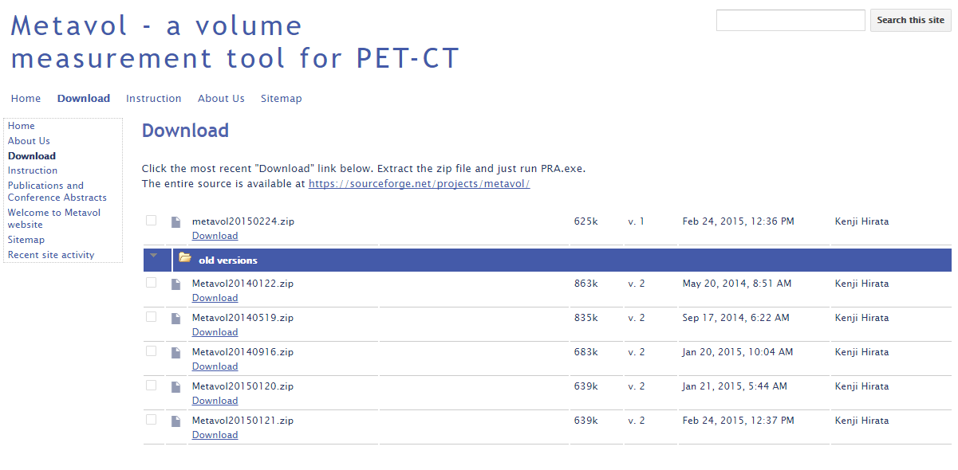
Get the newest version

Slide 3
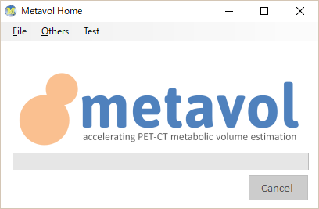

1. Run the application ‘Metavol.exe’
2. Drug and drop a DICOM folder that contains all the DICOM images
onto the application

Slide 4
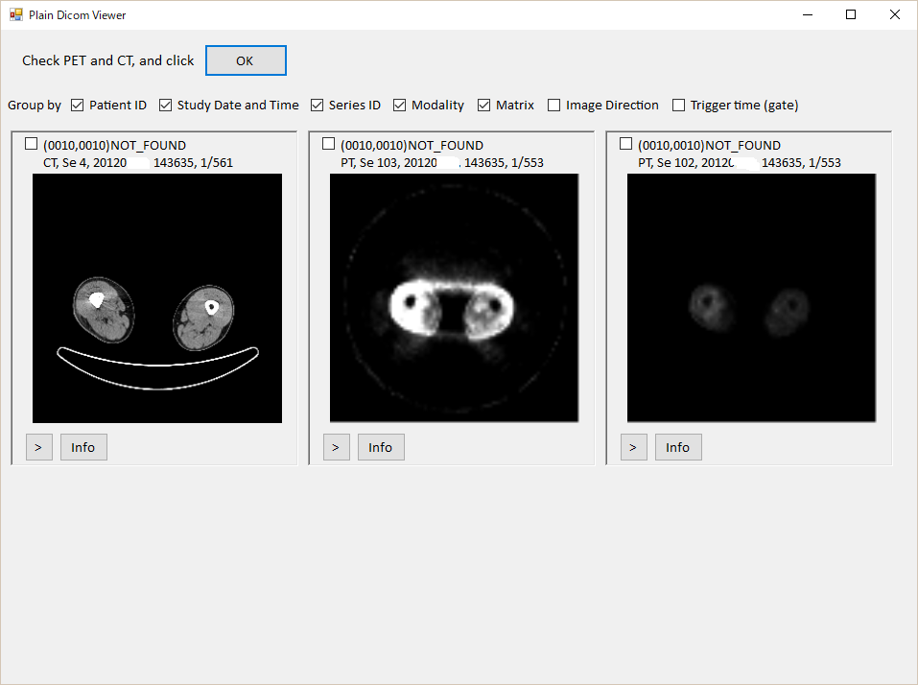
If you have 3 or more series,
then the window open for you
to choose PET and CT.
Please click 1 PET and 1 CT
and click ‘OK’.

Slide 5
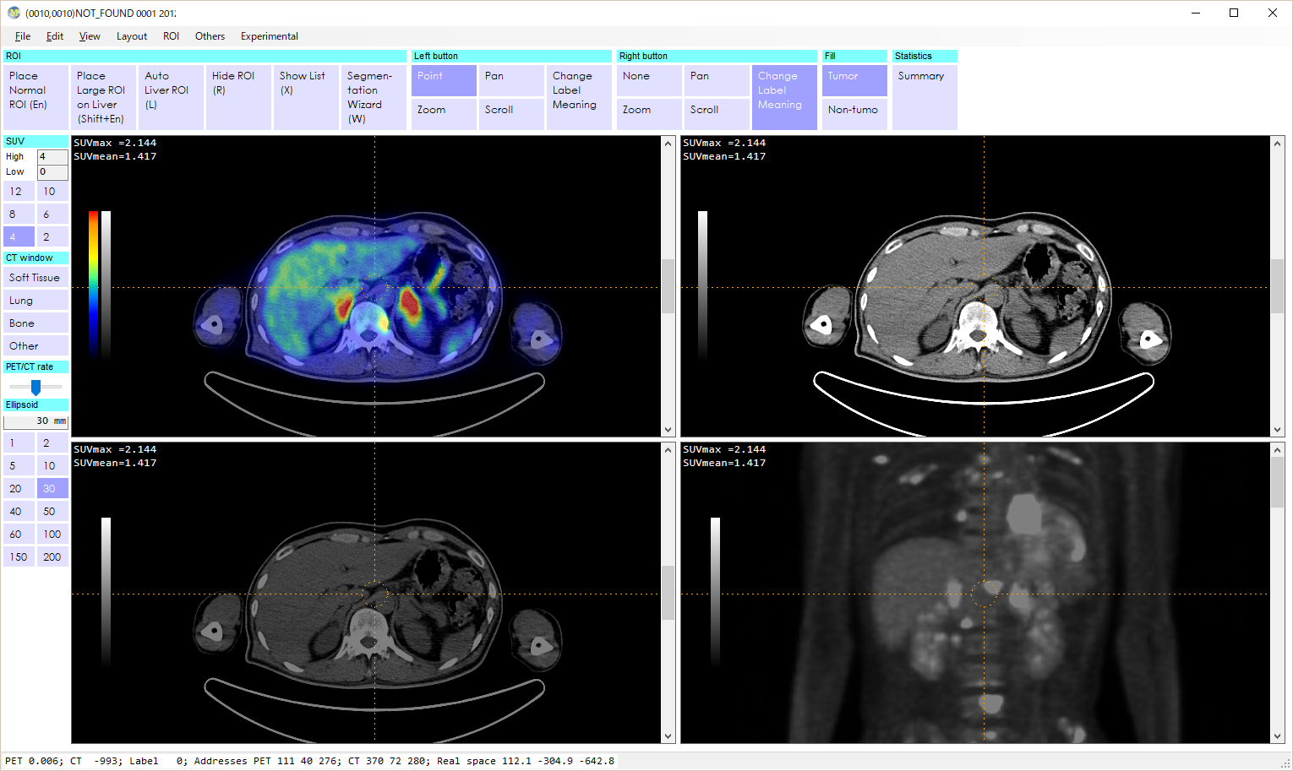
Files open.
Click ‘Segmentation
Wizard’

Slide 6
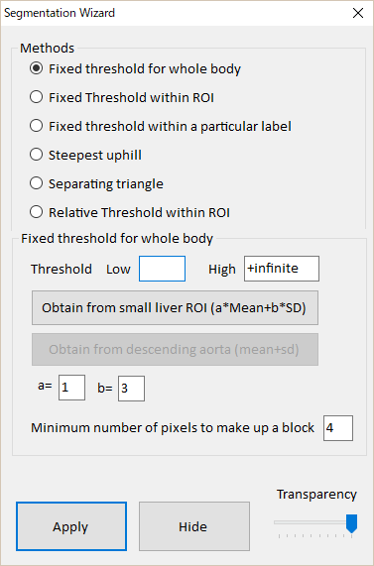
Give a threshold
For example, 3 as SUV.
Then, clicl ‘Apply’

Slide 7
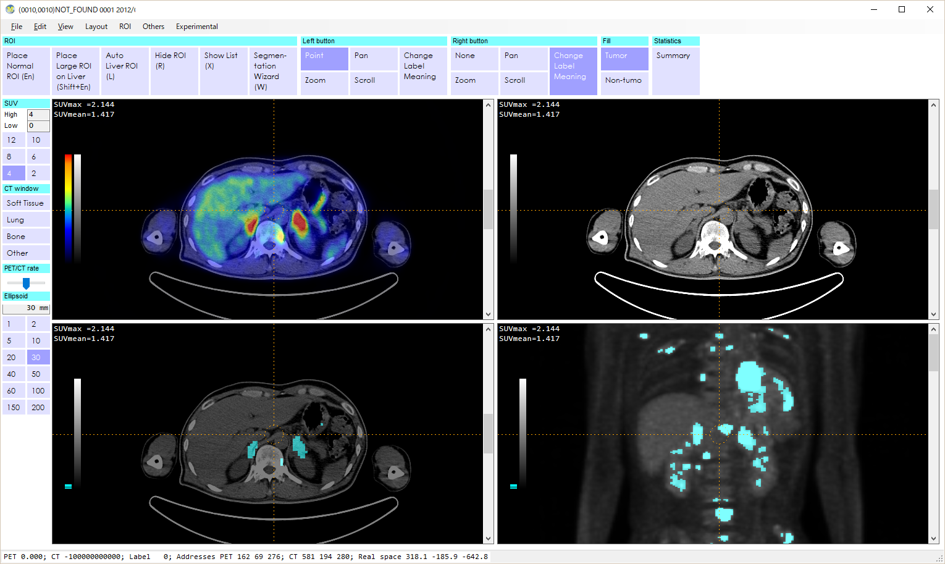
The uptake masses above the threshold are shown in blue.

Slide 8
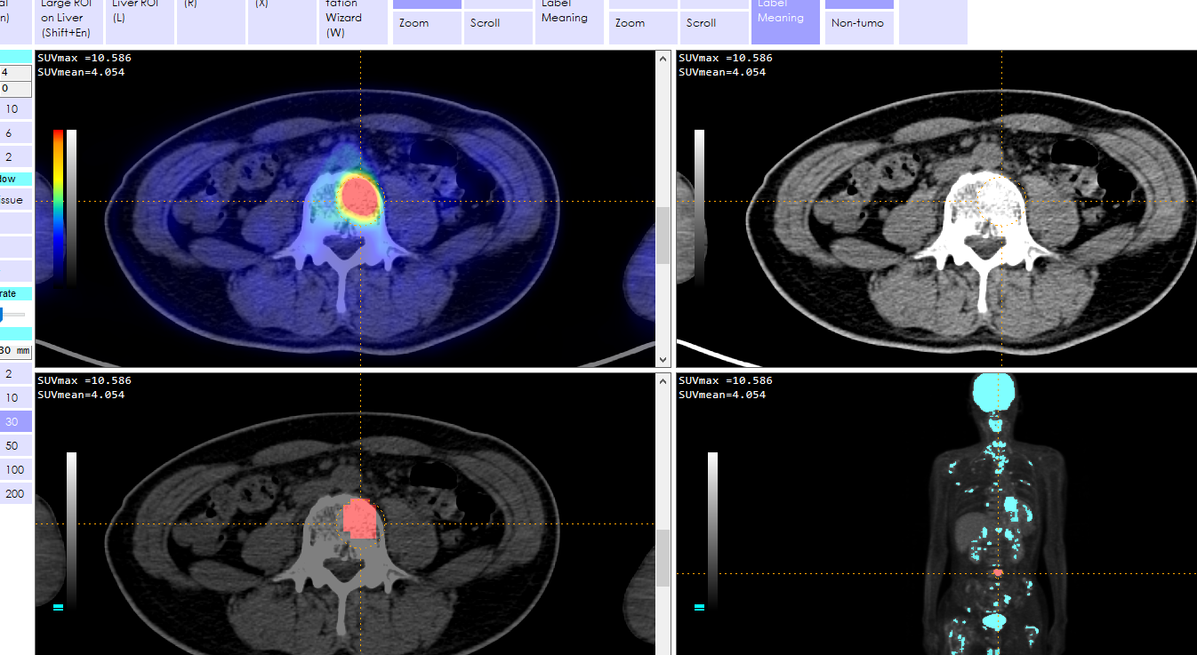
Please view the whole body, and discriminate tumor from normal uptakes.
Please right click on tumor mass to change the color into red.

Slide 9
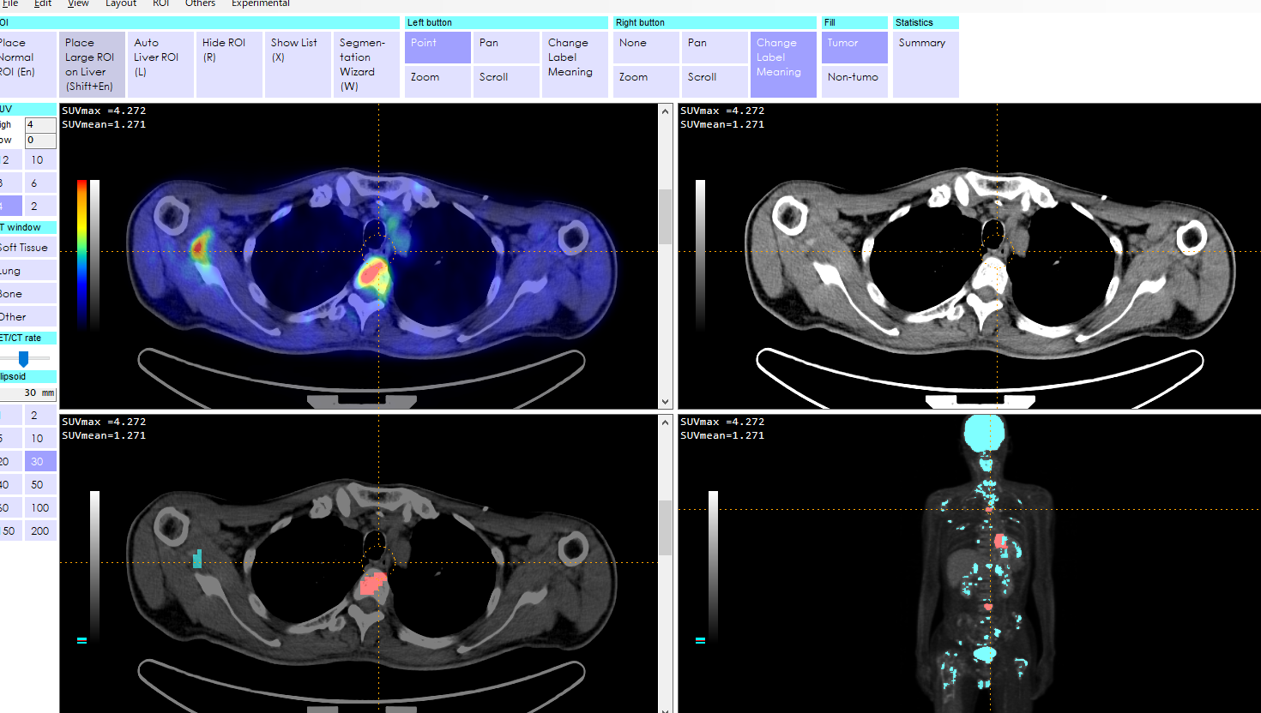
After you chose all the tumor masses, then click ‘Summary’ to open a summary window.
Copy and paste on Excel, and you can see the results in a better style.

