Slide 1
How to use Metavol Separating tumor from non-tumor
July 28, 2017

Slide 2
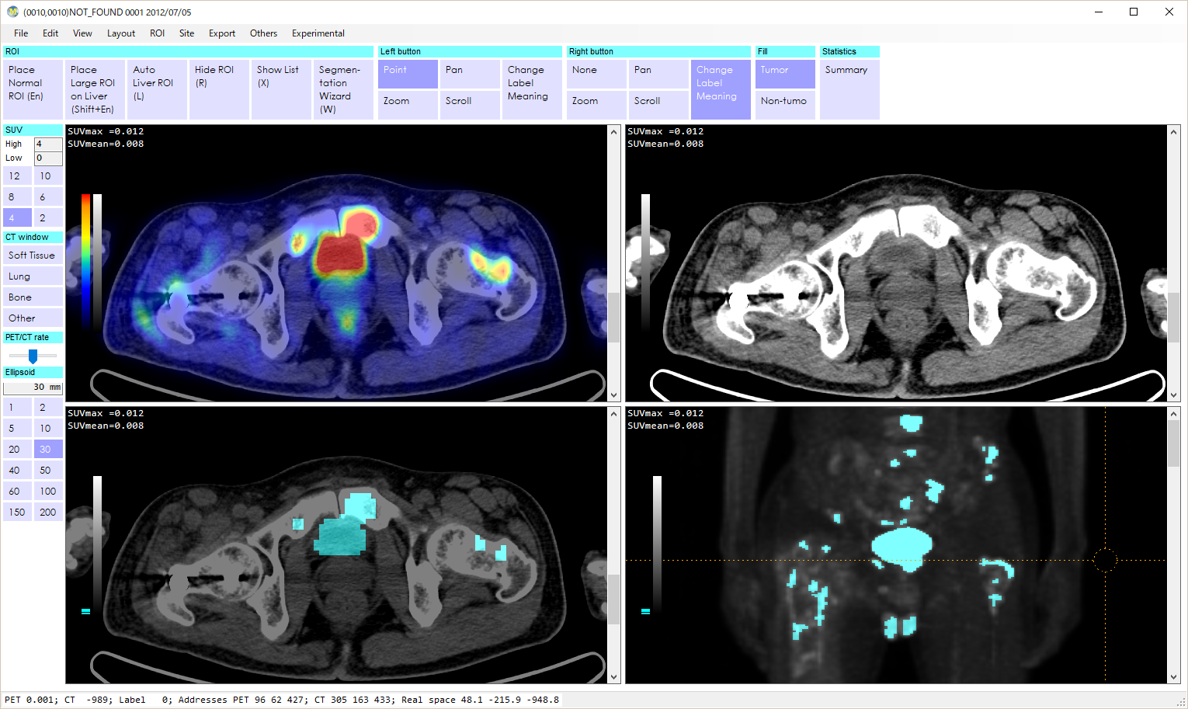
This case has metastatic bone tumor (green arrow) that is close to the bladder (yellow arrow).
Using SUV>3 as the threshold, these two parts make a big mass.
To separate them, try the following.
Click ‘1’ (in the red circle)
Click inside the bladder
Click ‘Place Normal ROI’ (in the yellow circle)
Click inside the bone meta lesion
Click ‘Place Normal ROI’ (in the yellow circle)
ROI Menu (blue circle) -> Auto separation

Slide 3
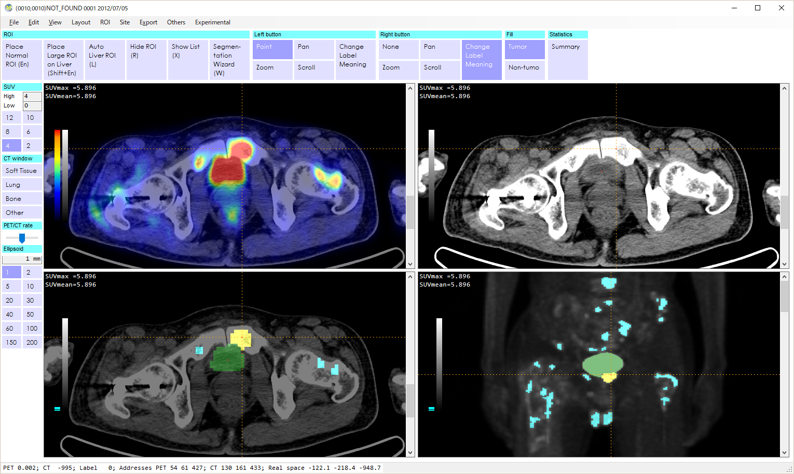

If successfully done, the computer colors bladder and bone meta lesion in different colors.
Then, right click them to change color into red (tumor) or blue (physiological).

