Slide 1

Metawidget
“UI Generation done right”
http://metawidget.org
Notes:
Hello everyone and thanks for coming to this presentation about Metawidget.
What is Metawidget? Well, as is rather boldly written there, Metawidget is 'UI generation done right'. And I guess over the next 20 minutes I'm going to try and convince you of that.

Slide 2
What we will cover
A common requirement
Current practices
A better way
Notes:
So, let's get started.
I'm going to briefly state what the problem is we're trying to solve - this common requirement that we all encounter.
Then I'll review what most of us do about it, how none of our existing approaches work very well in practice, and outline some common pain points.
Finally I'll show you what Metawidget is trying to do about each of those pain points, to try and make them all a little bit better.

Slide 3
Common Requirement
An everyday problem
Most enterprise applications require many different data entry forms, either for collecting
or displaying data
Notes:
Most of us building enterprise apps today need to build lots of screens that are basically data entry forms.
They're either collecting data or displaying data, and they're tied to some back-end POJO or other way of storing them.
Even if the heart of your application is not form-based, like Google Maps or something, you've still got all these periphery forms for profile screens, preferences screens, contact us pages, you know the sort of thing.

Slide 4
Current practices
Which one are you using?
Visual Form Designers
UI Languages
Code Generators
Notes:
So how do we build all these forms?
Well, there are three basic approaches that people use today, and all of them have some serious pain points.
Let's review those pain points.

Slide 5
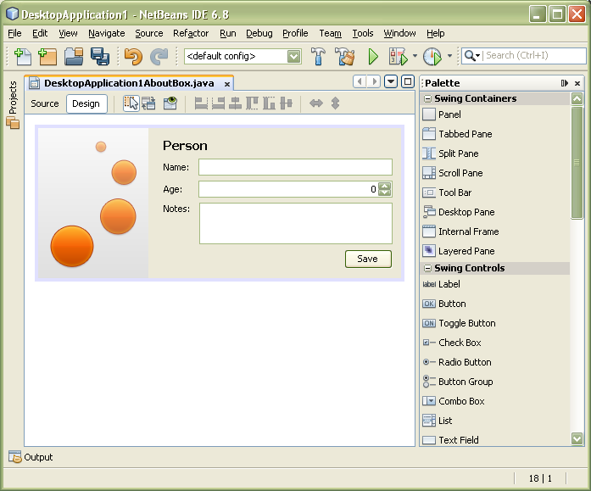
Current practices
Visual Form Designers
- Matisse
- JBoss Visual Page Editor
- etc
Notes:
Some people code their forms using 'visual form designers'.
By which I'm referring to something where you have a palette of widgets that you visually drag and drop into place. Things like Matisse for Swing, or the Visual Page Editor for JSF.

Slide 6
Current practices
UI Languages
- HTML/CSS
- Java Server Faces
- etc
<h:form>
<h:inputText value=”#{foo.name}”/>
<rich:inputSpinner value=”#{foo.age}”/>
</h:form>
Notes:
Other people use intermediate 'UI languages'. Things like JSP, or Facelets.
These are more 'declarative' than the visual tools – you're not directly positioning things down to the pixel.

Slide 7
Current practices
Is this you?
8 Time consuming
8 Duplicating definitions, error prone:
8 Too laborious to do properly:
public String getName();
public int getAge();
<h:inputText value=”#{foo.name}”/>
<rich:inputSpinner value=”#{foo.age}”/>
<h:inputText value=”#{foo.name}” maxlength=”30”/>
Notes:
But both visual form designers and UI languages share the same pain points.
For a start they are very fiddly, very time consuming. If you have a lot of forms you have to drag-and-drop, or write declarations for, every single widget and label.
And this is error-prone because each of those widgets and labels has to directly match up with definitions of things in the back-end: either in your POJOs, or in your database schema, or somewhere else
In fact, it's so fiddly and error-prone we generally don't even try to do it properly. For example, who here puts 'maxlength' on their text fields?

Slide 8
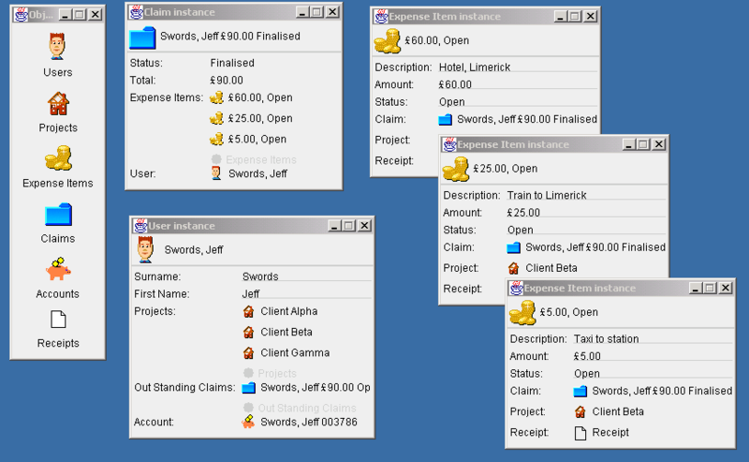
Current practices
Code Generators
- Naked Objects
- seam-gen
- etc
Notes:
Other developers use 'code generators' to automatically generate their forms.
By code generators I mean things like seam-gen, Naked Objects, OpenXava.

Slide 9
Current practices
Is this you?
8 Static code generation
- doesn't help much beyond early stages of development
8 Generic UI
- basic CRUD
- isn't enough metadata to do as good a job as a human designer
8 Dictate the architecture
- if you build your app our way, we'll generate a UI for you
Notes:
Code generators actually solve many of the problems of visual form designers and UI languages, but have some paint points of their own.
Not all of them use static code generation, but those that do suffer from the problem all static code generators have (not just UI generators): once you start working with the generated code, regeneration is never pretty.
Code generators also tend to generate very generic looking UIs. Too generic for most things beyond basic CRUD apps, and nowhere near as good as a human designer.
Finally, and really importantly, they tend to constrain the technologies you're allowed to work with. They say 'if you use JPA and Hibernate Validator we'll generate you a Web UI' or 'if you put all your business logic inside your POJOs we'll build you a Swing UI'. And that really limits where you can use them.

Slide 10
A better way
Metawidget
Designed to address each of these shortcomings
Notes:
But despite all the pain points of our current approaches, this common requirement of building lots of forms isn't going away. So what can we do?
Metawidget is different. It's specifically designed to address each one of the pain points I've outlined. It tries to be 'UI generation done right'.
So, if you had your ideal UI generator, what would it look like?

Slide 11
A better way
4 Uses your existing architecture
- your existing annotations, XML files, business rules
- your existing UI toolkit, third-party libraries, custom components
- easy to mix technologies, or plug-in your own
4 Doesn't try and 'own' the entire UI
- only tries to generate the 'inside' of forms
- doesn't hide your existing UI toolkit
- just another widget in your toolbox
4 No static code generation
- inspects business objects at runtime
Notes:
For starters it should work with whatever architecture you chose. Your combination of ORM, validation, business rules, app framework. It should have a bunch of plugins you can mix and match, or add your own. And this extends to your combination of UI toolkits, third party widget libraries, or custom components. It should be just another part of your EE stack, not try to dictate your whole architecture.
Second, it shouldn't try and generate the entire UI: shouldn't 'guess' some generic CRUD screens. It should stick to just building what is already tightly defined by the back-end, and not hide your existing UI tools or restrict you from developing the rest of your UI the way you normally do. You could develop a Word Processor, say, and use Metawidget just for the preferences screens. It's just another widget in your toolbox.
Third, there should no statically generated code. Everything should be runtime based, so it can change as your business objects change (and they change a lot!)

Slide 12
A better way
4 Automatically applies constraints
- existing validation libraries, easy to add your own
4 No duplicated definitions
- reads names, types, constraints already defined in your architecture
4 No time at all
- once configured, changes to screens are free
Notes:
Next, it should give you a better UI than you'd do by hand, by applying all those validation constraints that are too fiddly to do yourself.
And in doing this, it should avoid you duplicating any definitions from the rest of your code. If it's in your Bean Validation layer, or in your JPA layer, or in your BPM rules, it's in your UI. Your code is really D.R.Y.
Finally, it should do all this automatically. You can configure and tweak it like crazy initially, but once it's off and generating your forms it should update them for you with no additional work. This even extends to swapping out widget libraries across your entire app, for example changing from ICEfaces to RichFaces.

Slide 13
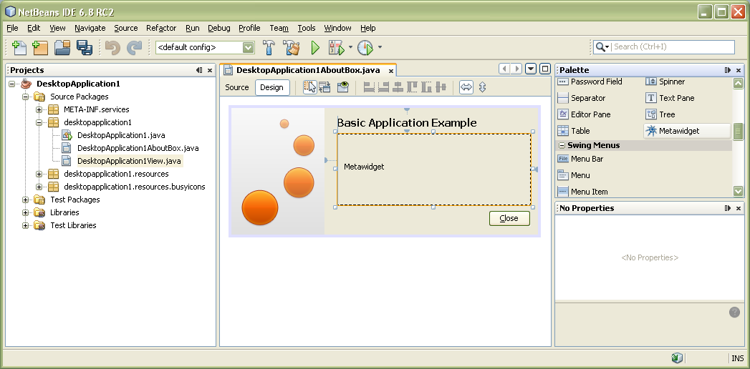
A better way
Doesn't 'own' the UI
Notes:
So, just to spend a little bit more time on one of those points.
Metawidget doesn't try and generate your whole UI. It's just a widget, and it presents itself in whatever way you're used to.
If you use a visual form designer, you can drag and drop a Metawidget from your palette just like any other widget. Except at runtime that widget will populate itself automatically.

Slide 14
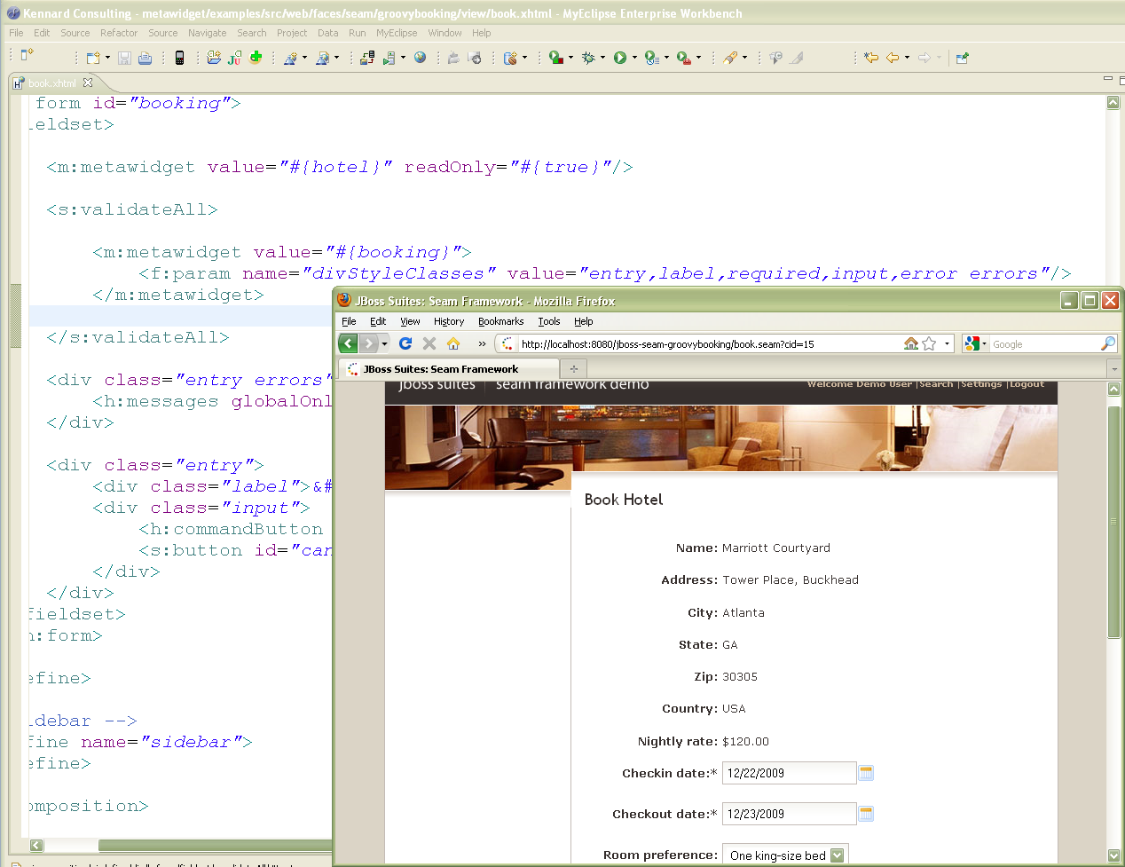
A better way
Doesn't 'own' the UI
Notes:
If you use a UI language, Metawidget is just another tag that you mix in amongst all your usual tags.

Slide 15
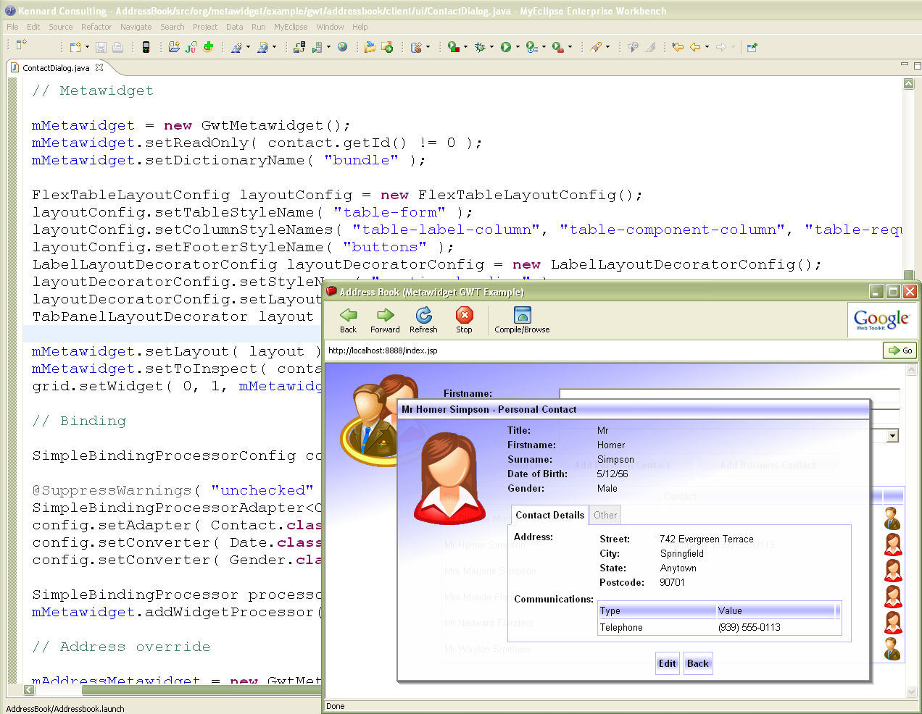
A better way
Doesn't 'own' the UI
Notes:
And of course if you build your UIs programmatically, Metawidget fits in that way too, with a nice fluent API.

Slide 16
Conclusion
Everyday requirement
Unsatisfactory current practices
A better way
Notes:
So, in conclusion, we have this common requirement of building forms that most of us wrestle with every day, and none of our existing practices are very satisfactory.
Visual form designers and UI languages are laborious and violate D.R.Y. Code generators tend to dictate how your applications are built, and give you very generic output.
Metawidget is specifically designed to address each of these pain points - to find a 'sweet spot' of generating just enough to be useful, not too much that it constrains you.
It's trying to make this something that's generally useful, that becomes an everyday part of your software development toolkit, so that we can save everybody a lot of time and a lot of pain.

Slide 17
Thank You!
Questions?
Notes:
Thanks for listening. I'd now like to throw it out to the floor for questions?

Slide 18
Appendix A
Notes:
This is an appendix with slides that may be helpful in answering a question.

Slide 19
A better way
Uses your existing architecture
Metawidget
Inspector
WidgetBuilder
WidgetProcessor
Layout
ask to inspect
return inspection
ask for widget
return widget
ask to process
return processed widget
ask to layout
laid out
Notes:
I wanted to talk a little about one of the other points: Metawidget works with whatever existing architecture you choose. It does this by having this a sort of 'pluggable pipeline'.

Slide 20
A better way
Uses your existing architecture
Metawidget
Inspector
WidgetBuilder
...
ask to inspect
return inspection
ask for widget
return widget
Notes:
At any point in the pipeline, you can plug in alternate implementations. For example the 'Inspector' is where you plug in what Metawidget inspects in order to determine your business object properties.

Slide 21
A better way
Uses your existing architecture
JavaBean
Metawidget
Inspector
WidgetBuilder
...
ask to inspect
return inspection
ask for widget
return widget
Notes:
So you can plug in a simple JavaBean inspector that will read names and types of properties from a POJO (this is the default)...

Slide 22
A better way
Uses your existing architecture
JPA
Metawidget
Inspector
WidgetBuilder
...
ask to inspect
return inspection
ask for widget
return widget
Notes:
...or a JPA Inspector that will read JPA annotations like @Column(nullable=false) or @Id

Slide 23
A better way
Uses your existing architecture
Composite
Inspector
Metawidget
Inspector
WidgetBuilder
...
ask to inspect
return inspection
ask for widget
return widget
Notes:
Now of course you can't generate an entire form based on JPA annotations! So you can instead plug in a composite Inspector...

Slide 24
A better way
Uses your existing architecture
JPA
JavaBean
Composite
Inspector
Metawidget
Inspector
WidgetBuilder
...
ask to inspect
return inspection
ask for widget
return widget
Notes:
...and use that to combine information from both JPA annotations and JavaBean properties.

Slide 25
A better way
Uses your existing architecture
= no duplicate definitions from other layers
= supports multiple/mixing back-end architectures
Bean Validation
JPA
JavaBean
Composite
Inspector
Metawidget
Inspector
WidgetBuilder
...
ask to inspect
return inspection
ask for widget
return widget
Notes:
And now you can start bringing in other sources too: Bean Validation annotations; Hibernate XML mapping files; JBPM rules.
You mine as much useful metadata from as many different existing sources as you can, so that you don't have to duplicate anything from your back-end in your front-end.
It's easy to add your own sources, and they can be really disparate: we've had people use database schemas, WSDL files, properties files, different JVM languages, you name it.

Slide 26
A better way
Uses your existing architecture
Bean Validation
= automatically applies proper constraints
JPA
JavaBean
Composite
Inspector
JSF
Metawidget
Inspector
WidgetBuilder
...
ask to inspect
return inspection
ask for widget
return widget
Notes:
Having gathered together all that useful metadata, we can use it to build our UI widgets.
Here again, Metawidget is really pluggable. So you can plug in a JSF 'widget builder' to build widgets using the standard JSF library...

Slide 27
A better way
Uses your existing architecture
Bean Validation
JPA
JavaBean
Composite
Inspector
Composite
WidgetBuilder
Metawidget
Inspector
WidgetBuilder
...
ask to inspect
return inspection
ask for widget
return widget
Notes:
...or you can plug in a composite WidgetBuilder...

Slide 28
A better way
Uses your existing architecture
= new widgets can be swapped in en masse
= supports multiple/mixing widget libraries
Bean Validation
JPA
JavaBean
ICEfaces
Composite
Inspector
Composite
WidgetBuilder
RichFaces
Metawidget
Inspector
WidgetBuilder
...
JSF
ask to inspect
return inspection
ask for widget
return widget
Notes:
...and use that to combine several widget libraries in the same application.
And you can order them too. So, in general, you might prefer ICEfaces components wherever possible. But for something like a colour field, ICEfaces doesn't have a colour picker so we'll fall back to RichFaces which does. And for something like a simple text field, we'll fall back to the standard JSF components.

Slide 29
A better way
Uses your existing architecture
Metawidget
WidgetProcessor
Layout
...
ask to process
return processed widget
ask to layout
laid out
Notes:
Once we've chosen the best widget for our field, we move on down the pipeline...

Slide 30
A better way
Uses your existing architecture
Validators
Data Binding
Converters
Metawidget
WidgetProcessor
Layout
...
ask to process
return processed widget
ask to layout
laid out
Notes:
...and process the widget to attach validators, converters, data bindings and so on.
Note that what you attach to a widget can come from a different library than the widget itself. So you can attach a JGoodies validator to a SwingX component, for example.

Slide 31
A better way
Uses your existing architecture
Validators
Data Binding
Converters
Table
Layout
Metawidget
WidgetProcessor
Layout
...
ask to process
return processed widget
ask to layout
laid out
Notes:
And finally you get to lay the widget out on the screen. Here you can not only plug in different layouts, such as laying the widgets out in a table, or in a row, or some other formation...

Slide 32
A better way
Uses your existing architecture
Validators
Data Binding
Converters
Heading
Decorator
Metawidget
WidgetProcessor
Layout
...
ask to process
Table
Layout
return processed widget
ask to layout
laid out
Notes:
...but you can also wrap one layout with another. So you can wrap a heading around a table...

Slide 33
A better way
Uses your existing architecture
= automatic consistency across forms
Validators
Data Binding
Converters
RichFaces Tab
Decorator
Metawidget
WidgetProcessor
Layout
...
ask to process
Heading
Decorator
return processed widget
ask to layout
Table
Layout
laid out
Notes:
...or a tab strip around the both of them.
Note again that the wrapping layout can come from a different widget library. So you can wrap ICEfaces widgets with a RichFaces tab control.
By being pluggable along all these stages of the pipeline, from inspecting your business objects to choosing your widgets to configuring your layout, you can make Metawidget generate your front-end the way you want it to, based on the back-end architecture you choose.

Slide 34
Appendix B
Notes:
This is an appendix with slides that may be helpful in answering a question.

Slide 35
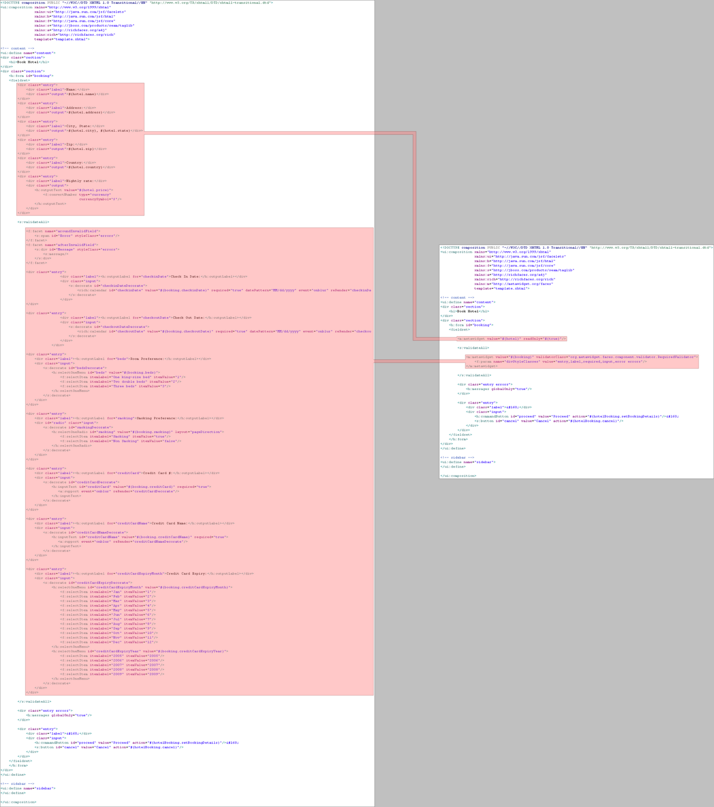
A better way
Acid Test:
Retrofitting
an existing app
Notes:
I wanted to just show this slide as a real-world, 'big picture' idea of what Metawidget can do.
On the left is some Facelets code from the Seam Groovy Booking example. On the right is the Metawidget equivalent. The red areas highlight the chunks of boilerplate that have been replaced.
We can replace this boilerplate, which amounts to about 70% of the file, because it's already defined in the back-end.
And note what we're doing here is retrofitting an existing application. This is not Metawidget telling you how to build your app. This is your app finding savings by using Metawidget.

