Slide 1
MAIL SERVER
MAIL SERVER TEST ON TWO VIRTUAL MACHINES

Slide 2
Overview:
This project demonstrates the setup of a fully functional mail server-client system using two Windows 10 virtual machines. The project showcases sending and receiving email between client and server using hMailServer and Thunderbird.

Slide 3
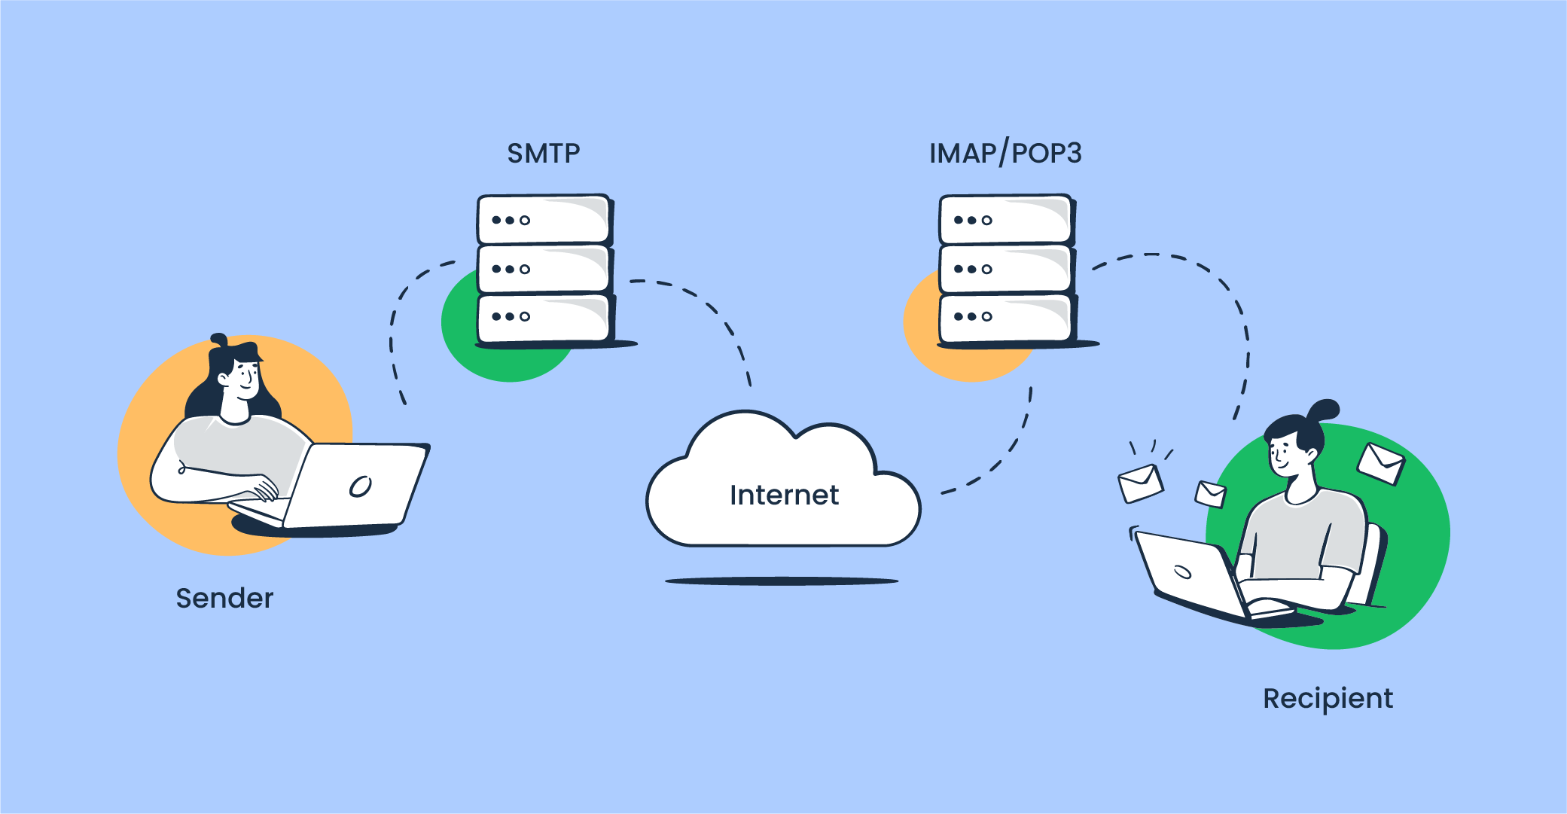
INTRODUCTION
First of all, we need to know how email works. Email is sent and received by using different protocols.
1.SMTP(simple mail transfer protocol) :- used for sending email.
2.IMAP/POP3 :- used for receiving email.
DNS(domain name system):- to locate recipient’s mail server.

Slide 4
PROJECT OBJECTIVES
To set up a mail server.
To simulate client-to-server and server-to-client email communication using two virtual machines(VMs).
To understand the roles of network configuration, ports, authentication, and protocols (SMTP, POP3/IMAP ) in data communication system (email systems).
To test and verify message delivery, reception, and mail server configuration using tools like powershell and thunder.

Slide 5
TOOLS AND SETUP
Software Used:
VirtualBox / VMware
Windows 10 (on both VMs)
hMailServer (Mail Server)
Thunderbird (Email Client)
Network Setup:
Internal Network configuration
Static IP addresses:
VM1 (Client): 192.168.100.1
VM2 (Server): 192.168.100.2

Slide 6
MAIL SERVER CONFIGURATION (SERVER SIDE)
1. Install hMailServer on VM2.
2. Add domain (e.g., smtp.local).
3. Create accounts:
user1@smtp.local
user2@smtp.local
4. Enable required protocols:
SMTP (Port 25)
IMAP (Port 143) or POP3 (Port 110)
5. Allow local IPs through Windows Firewall.

Slide 7
CLIENT CONFIGURATION (BOTH DIRECTIONS)
Client VM (VM1):
Install and configure Thunderbird.
Add account: user1@smtp.local
Incoming: IMAP/POP3 from 192.168.100.1
Outgoing: SMTP to 192.168.100.1
Server VM (VM2):
Thunderbird is also installed here to receive and respond from server pc.
Add account: user2@smtp.local
Send reply back to user1@smtp.local

Slide 8
EMAIL COMMUNICATION FLOW
1. Client to Server:
user1@smtp.local sends email to user2@smtp.local.
Mail is received by hMailServer on VM2.
2. Server to Client (Response):
user2@smtp.local replies using Thunderbird on VM2.
Mail is sent via hMailServer to user1@smtp.local on VM1.
Protocols Used:
SMTP for sending
IMAP for receiving

Slide 9
CONCLUSION & LEARNINGS
Successfully created a working mail system in a virtual network.
Understood server roles vs. client roles in email communication.
Demonstrated full bidirectional message flow using open-source tools.
Learned about network configuration, email protocols, and troubleshooting server-client communication.
Future Scope:
Add webmail support .
Implement spam filters and security (SSL/TLS).
Test with real DNS.

