Slide 1
Sentimental Analysis on Google Maps Reviews

Slide 2
Introduction
Sentiment analysis is crucial in business as it provides insights into customer emotions
and opinions, helping companies to refine their strategies and improve customer satisfaction. By
analyzing feedback from reviews, social media, and customer support interactions, businesses
can identify areas for product improvement, tailor marketing strategies, and better manage brand
reputation. This form of analysis allows companies to understand the emotional underpinnings of
consumer behavior, predict trends, and make more informed decisions. Ultimately, sentiment
analysis helps businesses stay responsive to customer needs and competitive in their markets

Slide 3
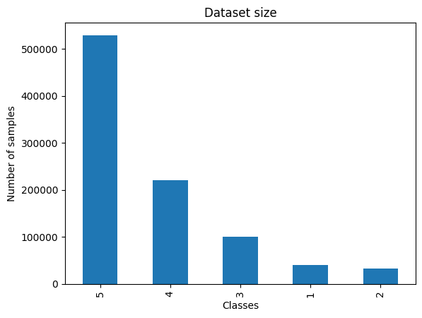
DATASET
We used Google Local Data (2021) on our project. This Dataset contains review information on Google map (ratings, text, images, etc.), business metadata (address, geographical info, descriptions, category information, price, open hours, and MISC info), and links (relative businesses) up to Sep 2021 in the United States. It contains 666M review from 113M user for 5M business. Because of dataset size we decided to use only small subset of it. In first step we download the review of Kansas that contains 3M row. After few experiment dataset size was still huge for our environment so we decided to take 30% using stratified train test split.

Slide 4
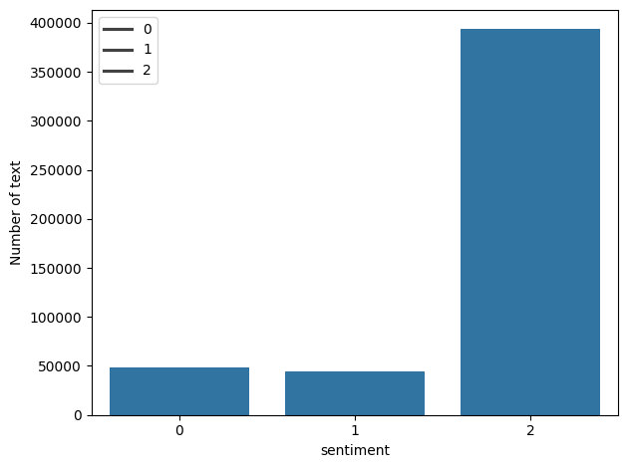
We categorize reviews into three sentiments: negative (ratings lower than 3), neutral (ratings equal to 3), and positive (ratings higher than 3).
We divide the dataset into three parts: 80% for training, 10% for validation, and 10% for testing.

Slide 5
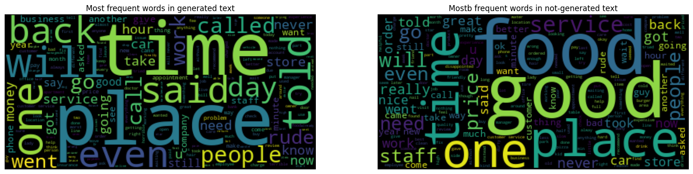

Most frequent words in 1 rating
Most frequent words in 2 rating
Most frequent words in 3 rating
Most frequent words in 4 rating

Slide 6
METHOD
For our project we employed pre-trained transforemer-based BERT (Bidirectional Encoder Representations from Transformers). We employed BERT to subset of Google Local Data (2021). After BERT we trained one LSTM model and one CNN model on our dataset too.

Slide 7
BERT
BERT (Bidirectional Encoder Representations from Transformers) is a cutting-edge natural language processing model developed by Google. Unlike previous models that read text sequentially, BERT is designed to understand language contextually by considering the full context of a word by analyzing the words that come before and after it. This bidirectional approach allows BERT to capture nuances in language structure and meaning, making it highly effective for a wide range of NLP tasks such as sentiment analysis, language translation, and question answering. BERT has achieved remarkable results in various benchmarks and has become a foundational model in the field of natural language processing.

Slide 8
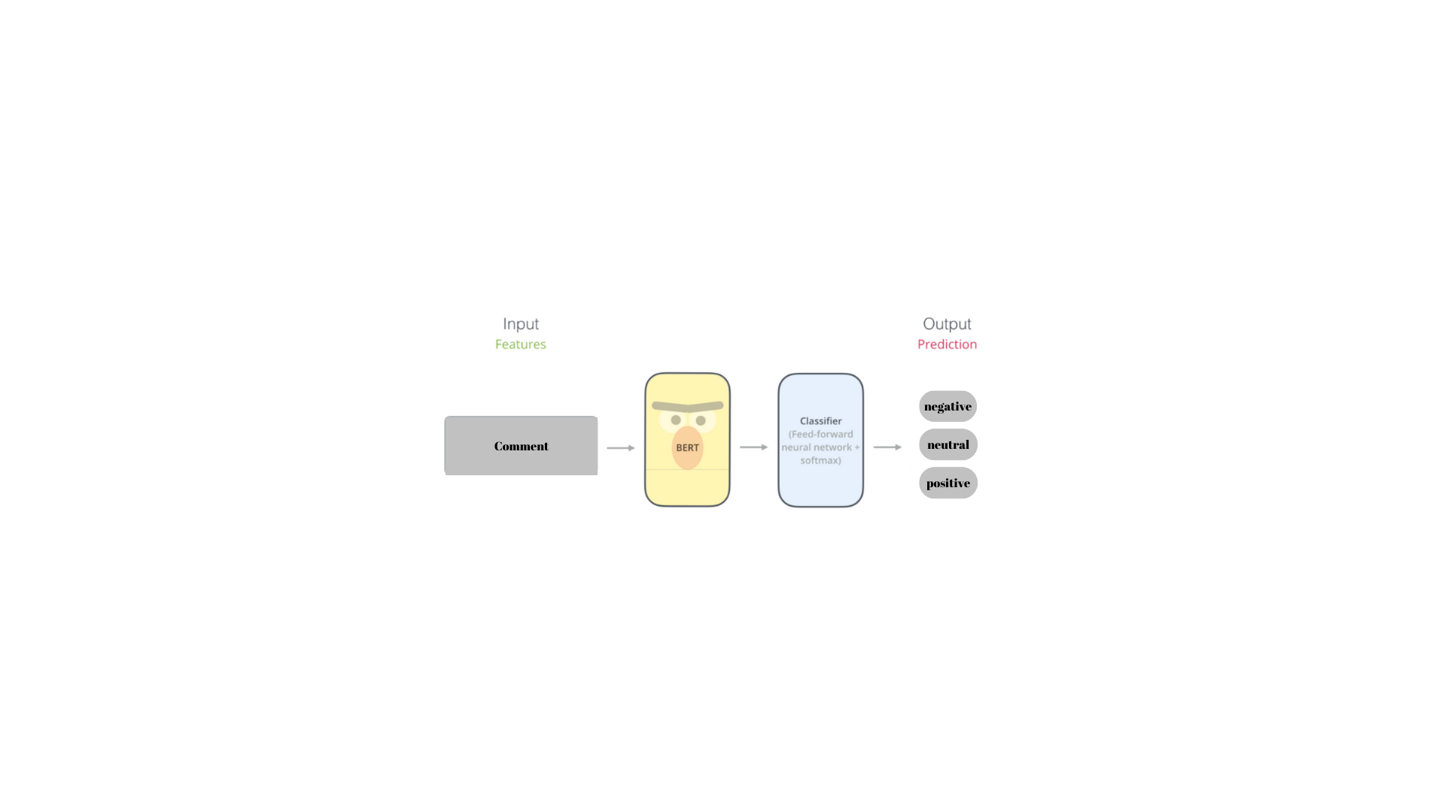
In first experiment we follow the given architecture above.

Slide 9
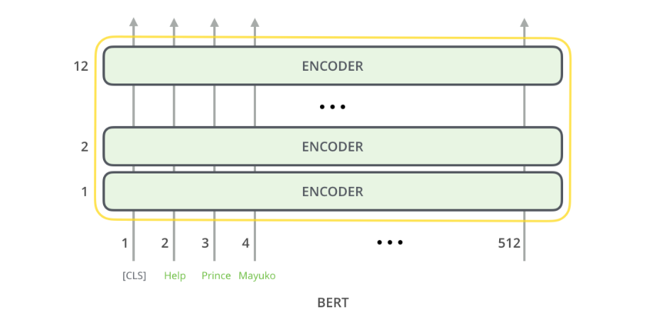
our max length of tokens is 150

Slide 10
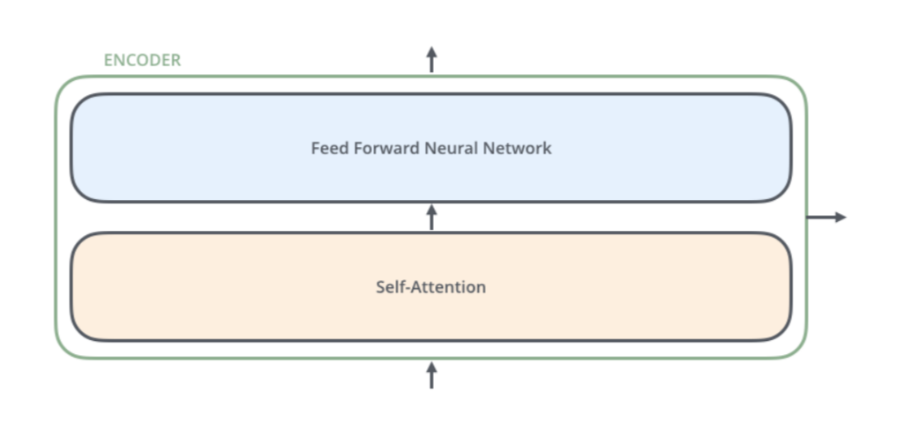

Slide 11
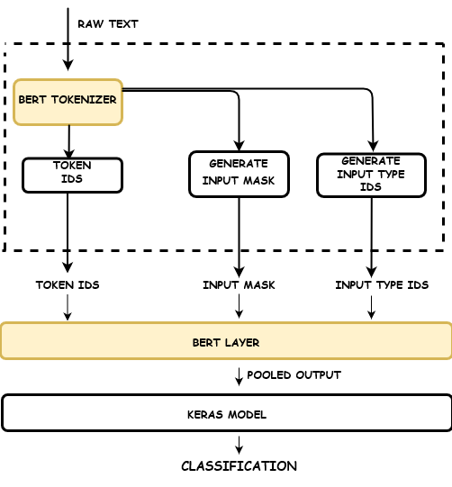
input_ids: These are the actual tokens for the input string.
attention_mask: These are a set of binary tokens indicating which tokens are the actual input tokens and which are the padding tokens.
token_type_ids: These are binary tokens specifying whether the token belongs to the first sentence or the second one in a sequence of twosentences.

Slide 12
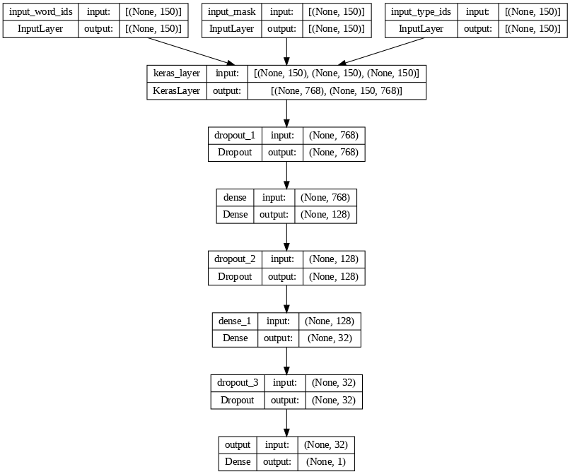

Slide 13
LSTM
Long Short-Term Memory (LSTM) is a type of recurrent neural network (RNN) architecture designed to address the vanishing gradient problem, which can occur when training traditional RNNs on long sequences of data. LSTMs are capable of learning long-term dependencies in sequential data by incorporating memory cells with gating mechanisms. These gates regulate the flow of information into and out of the cells, allowing LSTMs to selectively remember or forget information over time. This capability makes LSTMs well-suited for tasks involving sequential data, such as time series prediction, natural language processing, and speech recognition. They have been widely adopted in various applications due to their effectiveness in capturing temporal dependencies and mitigating the issues associated with training deep recurrent networks.

Slide 14
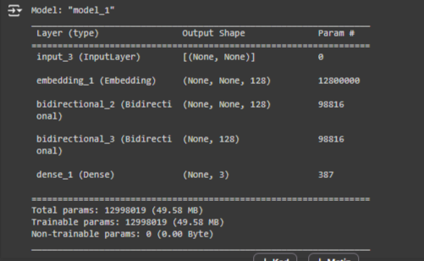
The first layer is Embedding layer. It representing words using a dense vector representation. The position of a word within the vector space is based on the words that surround the word when it is used. For eg. “king” is placed near “man” and “queen” is placed near “woman”. The vocabulary size is provided.
The next layer is an LSTM layer with 128 neurons. “embedded_docs” is the input list of sentences which is one hot encoded and every sentence is made of the same length. The activation function is rectified linear, which widely used. Any other relevant activation function can be used. “return_sequences=True” this is an important parameter while using multiple LSTM layer as it enables the output of the previous LSTM layer to be used as an input to the next LSTM layer. If it is not set to true, the next LSTM layer will not get the input.

Slide 15
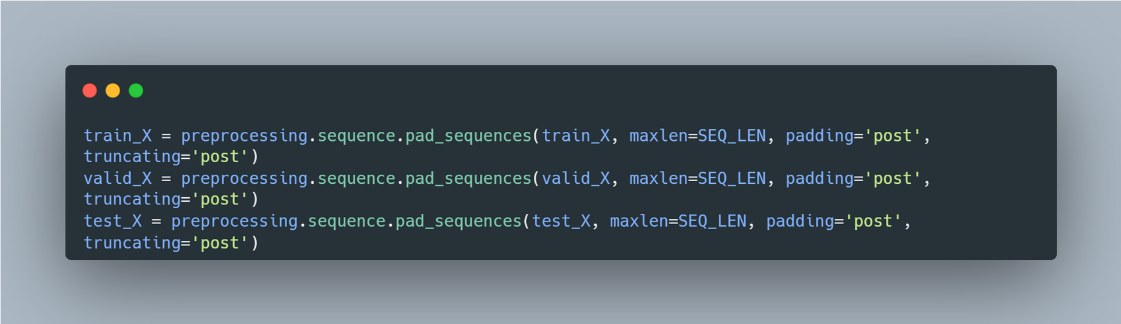
All sequences in train_X are either padded or truncated to a fixed length specified by SEQ_LEN, with padding added at the end and truncation occurring from the end if necessary.
maxlen=SEQ_LEN: This parameter specifies the maximum length to which sequences should be padded or truncated.
padding='post': This parameter indicates that padding should be added to the end (post) of the sequences.
truncating='post': This parameter specifies that if sequences exceed the maximum length, they should be truncated from the end (post).

Slide 16
The final Dense layer is the output layer which has 3 cells representing the 3 different categories in this case.
Compiling the model using adam optimizer and binary_crossentropy.
SEQ_LEN = 360
VOCAB_SIZE = 100000
EPOCHS = 10
BATCH_SIZE = 32

Slide 17
CNN
A Convolutional Neural Network (CNN) is a type of artificial neural network designed to analyze visual data, such as images. It's inspired by the human visual system and consists of multiple layers that learn to recognize patterns within the data. The key component of a CNN is the convolutional layer, which applies filters to input data to extract relevant features. These filters slide over the input, capturing spatial hierarchies of features, like edges, textures, and shapes. Pooling layers are often used to reduce the dimensionality of the data and make the learned features more invariant to variations in position and scale. CNNs are widely used in image recognition, object detection, and other tasks involving structured input data, due to their ability to automatically learn relevant features from raw data.

Slide 18
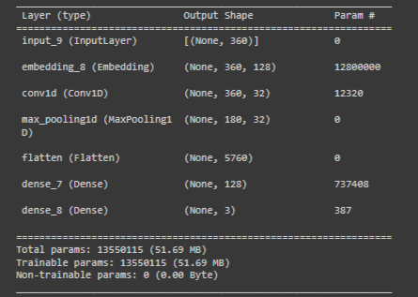
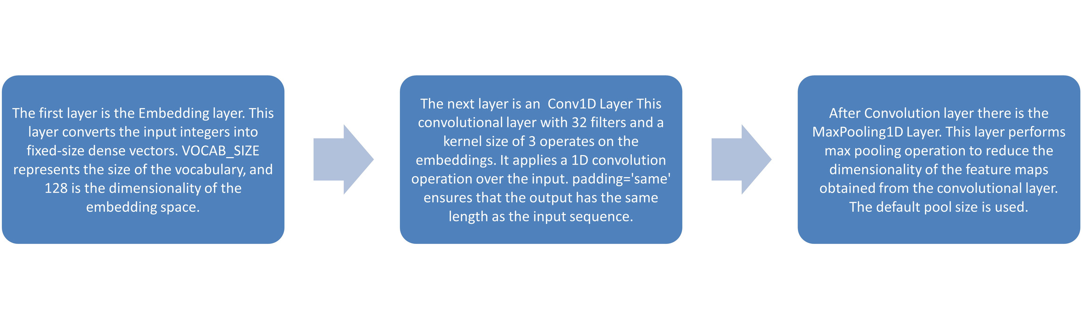
The first layer is the Embedding layer. This layer converts the input integers into fixed-size dense vectors. VOCAB_SIZE represents the size of the vocabulary, and 128 is the dimensionality of the embedding space.
The next layer is an Conv1D Layer This convolutional layer with 32 filters and a kernel size of 3 operates on the embeddings. It applies a 1D convolution operation over the input. padding='same' ensures that the output has the same length as the input sequence.
After Convolution layer there is the MaxPooling1D Layer. This layer performs max pooling operation to reduce the dimensionality of the feature maps obtained from the convolutional layer. The default pool size is used.

Slide 19
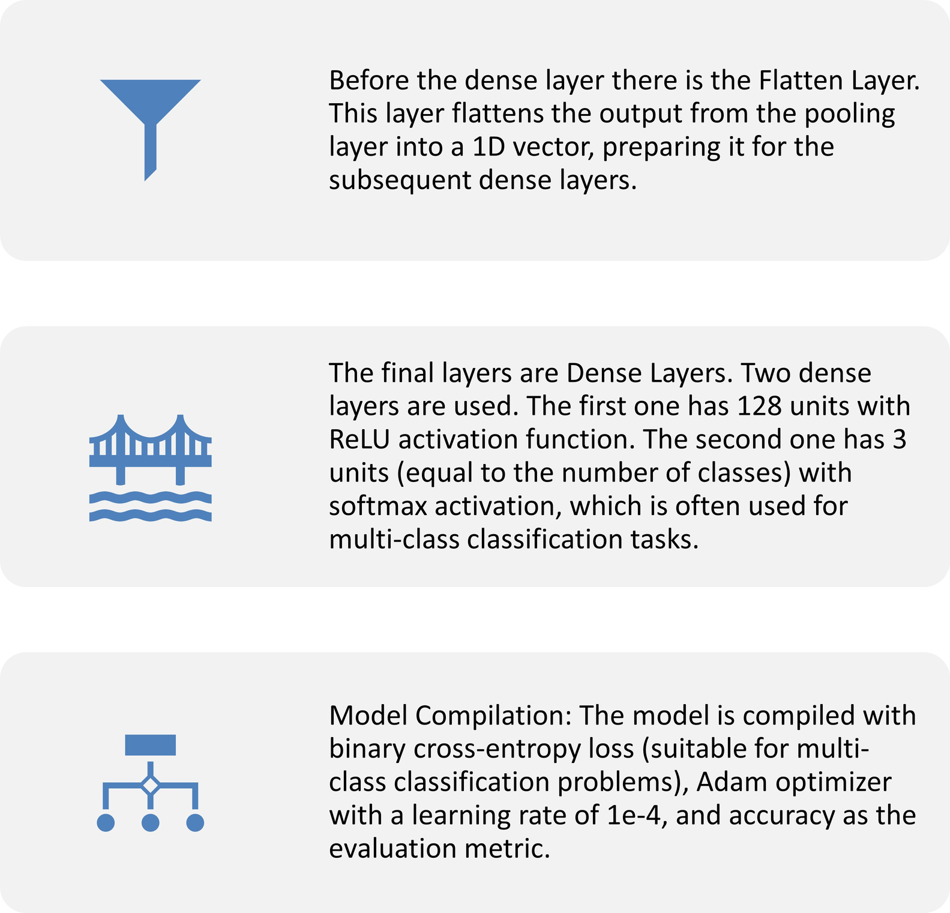

Slide 20
RESULTS
While evaluating the performance of our project, we employed several key metrics including precision, recall, F1 score, accuracy, and visual aids such as heatmaps, loss-epoch graphs, and accuracy-epoch graphs. Precision measures the accuracy of positive predictions, recall measures the ability to find all positive instances, and F1 score is the harmonic mean of precision and recall, providing a balance between them. Accuracy represents the overall correctness of the model's predictions. Additionally, the heatmap visualizations offered insights into the model's decision-making process, while the loss-epoch and accuracy-epoch graphs depicted the convergence behavior and performance trends over training epochs. These comprehensive metrics and visualizations allowed us to thoroughly assess the effectiveness and robustness of our project's implementation

Slide 21
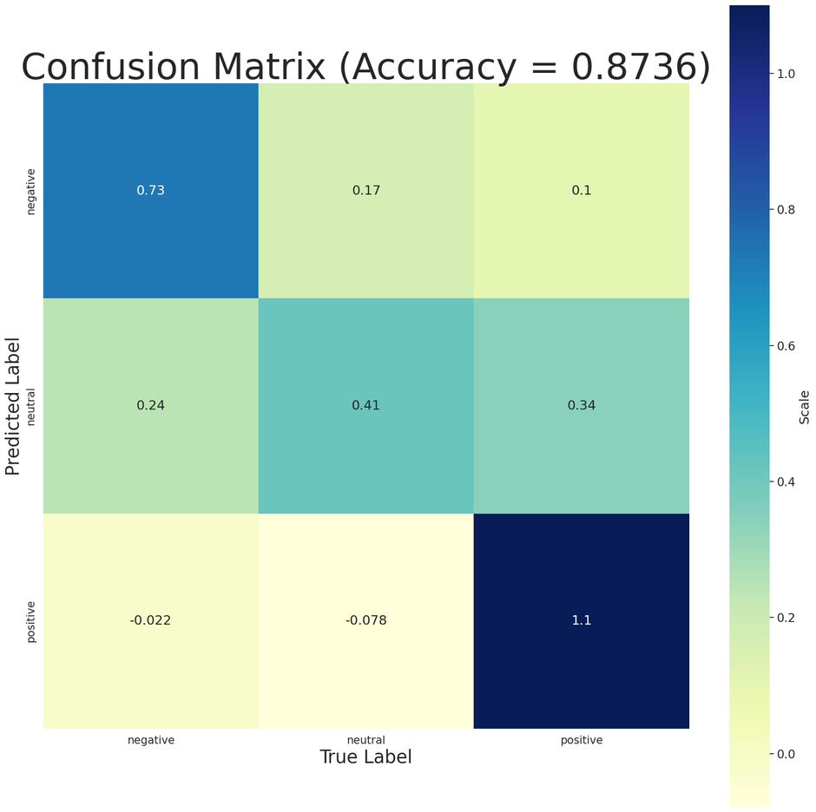
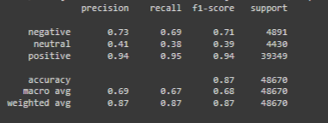
Results of LSTM

Slide 22
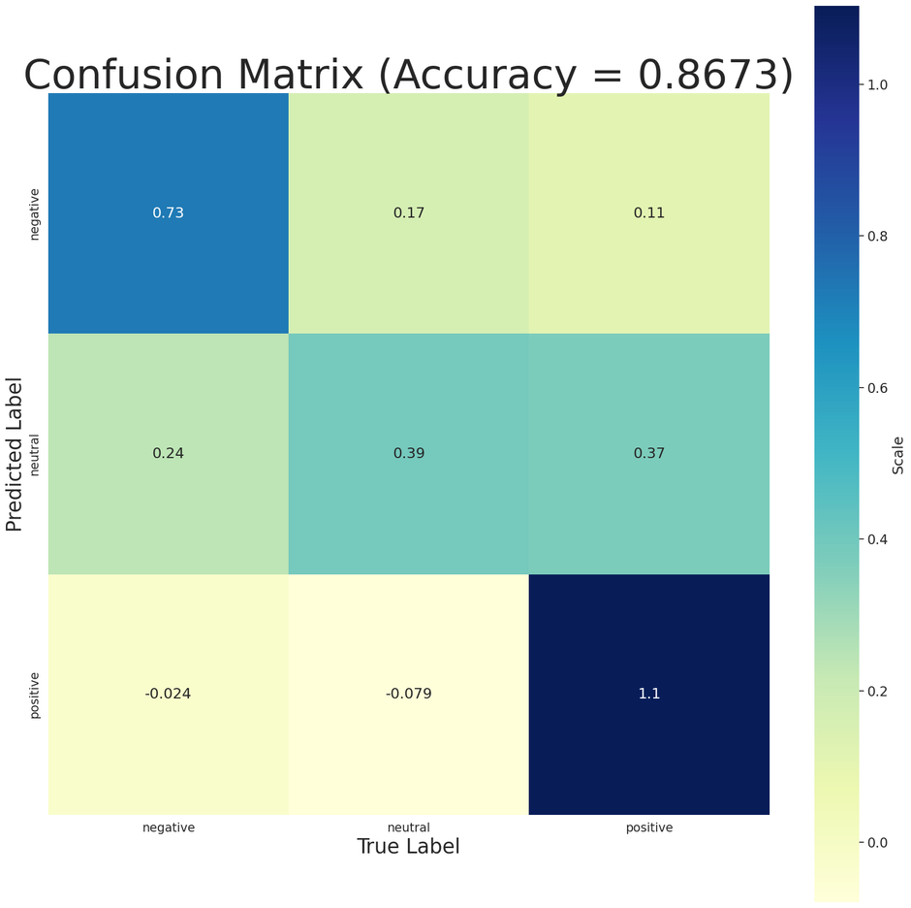
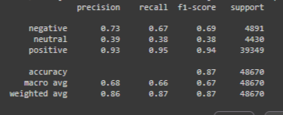
Results of CNN

Slide 23
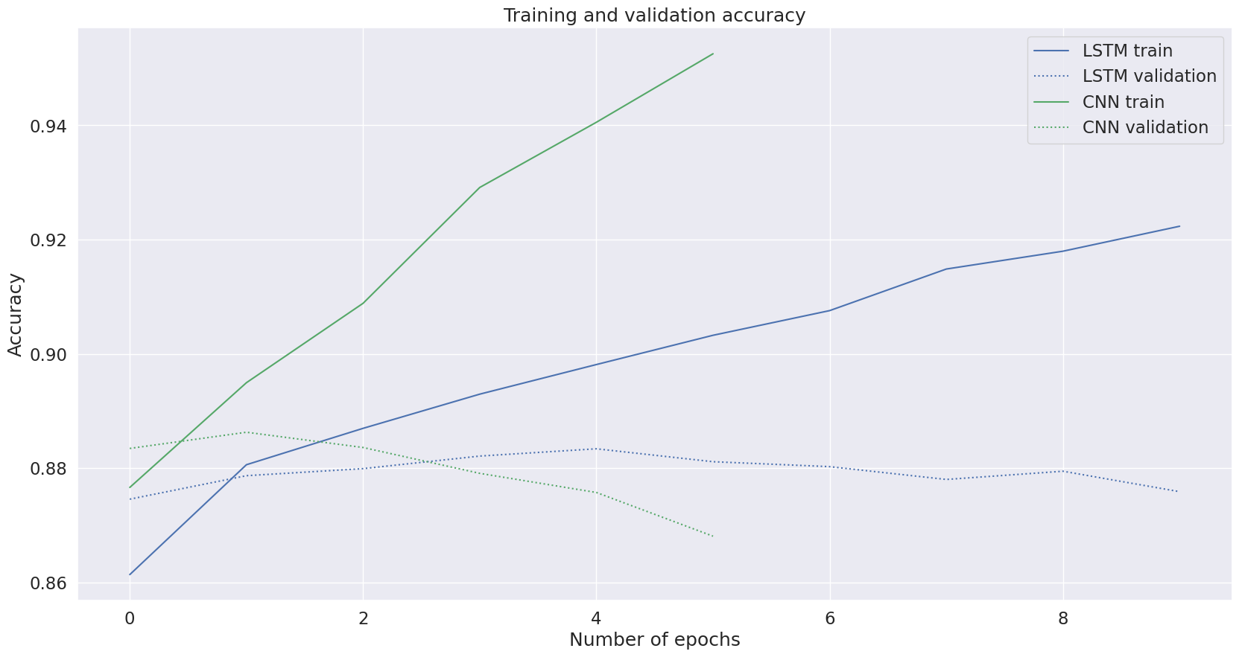

Slide 24
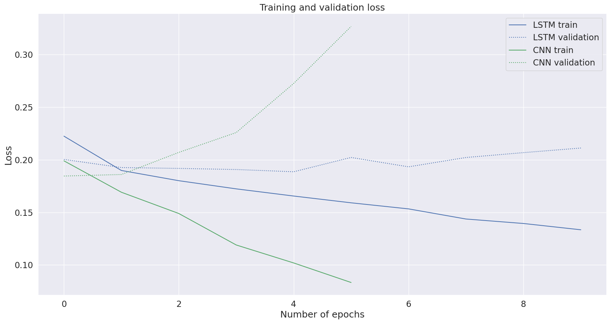

Slide 25

In BERT evaluation we faced unexpected results. We got negative loss value , which might indicate that something unusual is happening in your training process, possibly an issue with the scale of our loss or a problem with our network's architecture or training setup. Binary Accuracy is 0.0768, which is quite low, indicating that the model's predictions are not very accurate. Precision at recall 1 specifically measures precision when recall is at its maximum. A precision of 0.9023 here suggests that when the model does make a positive prediction, it's correct about 90% of the time.

