Slide 1


Bacchanal Buffet Review Analysis With NLP
Prepared by: METEHAN AYHAN

Slide 2

Project Description
The purpose of this project is to analyze customer reviews collected from platforms like Yelp, Foursquare, and Twitter, and provide suggestions to improve customer satisfaction for Bacchanal Buffet. To achieve this, sentiment analysis of the reviews will be conducted using natural language processing (NLP) techniques.

Slide 3
Project Steps
Data Collection and Preparation Exploratory Data Analysis Text Processing Sentiment Analysis Model Development and Evaluation
Visualization of Results Interpretation of Results

Slide 4
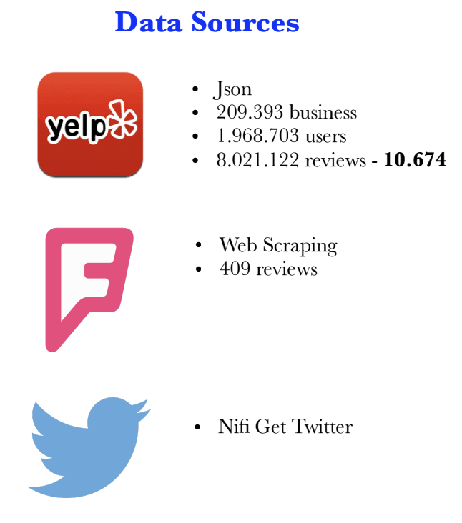
Data Collection and Preparation
Customer reviews for Bacchanal Buffet from Yelp were collected and cleaned using Python's pandas library. Missing or erroneous values were filtered out.

Slide 5
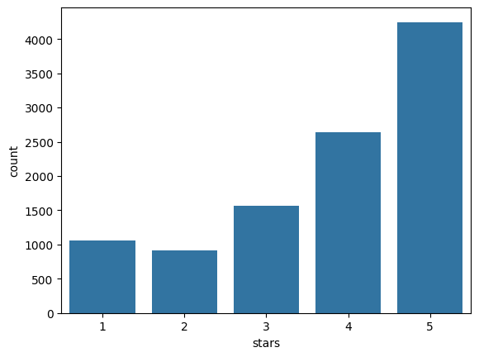
Exploratory Data Analysis
The distribution of reviews and overall trends were analyzed using matplotlib and seaborn libraries. This step involved examining the general structure of the data.

Slide 6

Text Processing
Removing Characters: Numbers (1-9), punctuation, and new line characters (\n) were removed.
Convert Lower Case: All text was converted to lower case for consistency.
Detecting Language: Using the langdetect library, non-English reviews were removed.
lemmatization: Applied text processing techniques such as lemmatization to reduce words to their root forms. Libraries like nltk and scikit-learn were used in this process.
Removing Stopwords: Common stopwords were removed to focus on meaningful words.

Slide 7
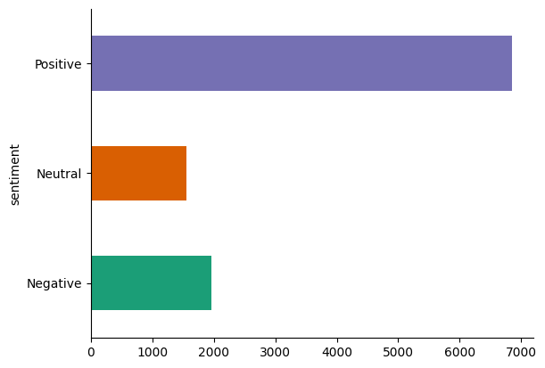
Sentiment Analysis
Reviews were classified as Positive, Negative, and Neutral using libraries like langdetect and TextBlob. Natural language processing techniques were applied at this stage.

Slide 8
Model Development and Evaluation
Model | Accuracy | Precision | Recall | F1 Score
Logistic Regression | 0.8048 | 0.7839 | 0.8048 | 0.7892
K-Nearest Neighbors (KNN) | 0.6723 | 0.6107 | 0.6723 | 0.5821
Decision Tree Classifier | 0.7012 | 0.6794 | 0.7012 | 0.6880
Random Forest Classifier | 0.6959 | 0.6928 | 0.6959 | 0.6006
AdaBoost Classifier | 0.7576 | 0.7205 | 0.7576 | 0.7243
Gradient Boosting Classifier | 0.7576 | 0.7353 | 0.7576 | 0.7110
Multinomial Naive Bayes | 0.7441 | 0.7108 | 0.7441 | 0.6780
Bernoulli Naive Bayes | 0.6554 | 0.5953 | 0.6554 | 0.5555
Logistic Regression
K-Nearest Neighbors (KNN)
Decision Tree Classifier
Random Forest Classifier
AdaBoost Classifier
Gradient Boosting Classifier
Multinomial Naive Bayes
Bernoulli Naive Bayes
Logistic Regression achieved the highest performance with an accuracy of approximately 80.5%.

Slide 9
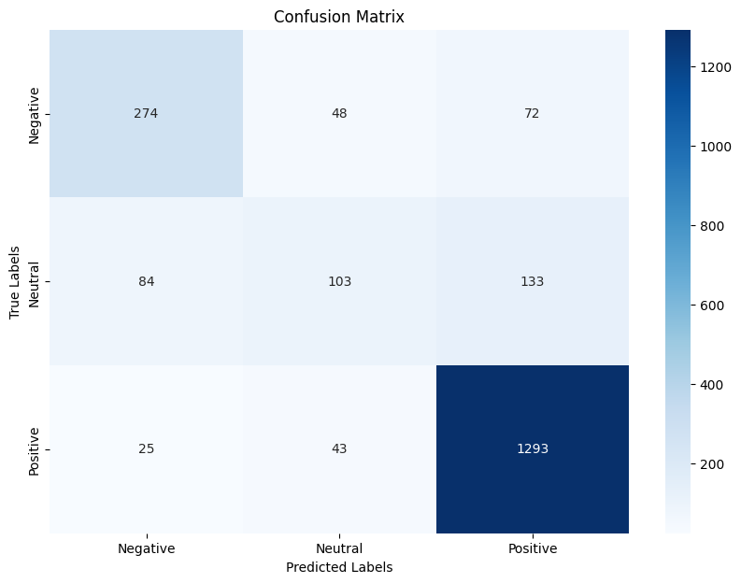
Visualization of Results
The results of the analysis were visualized using tools like matplotlib, seaborn, and plotly. This made the findings more understandable.

Slide 10

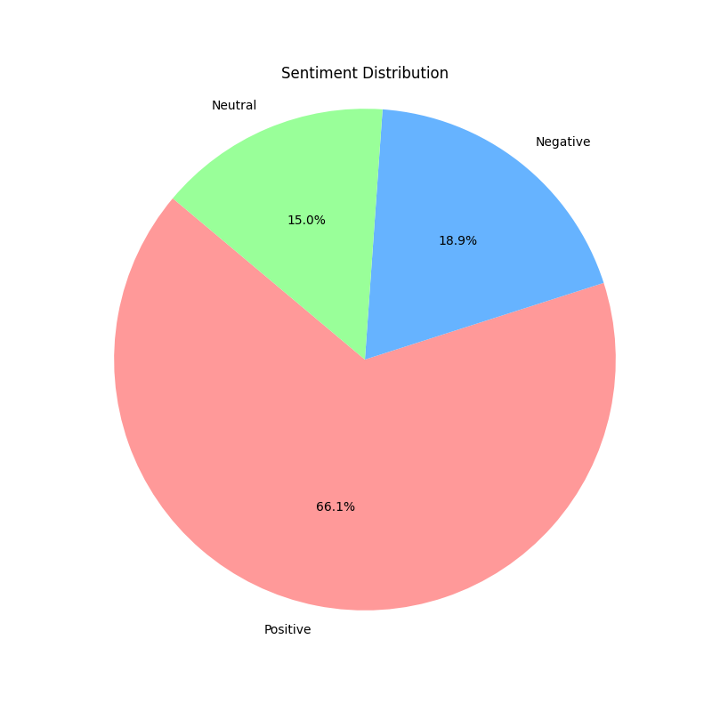



Visualization of Results

Slide 11
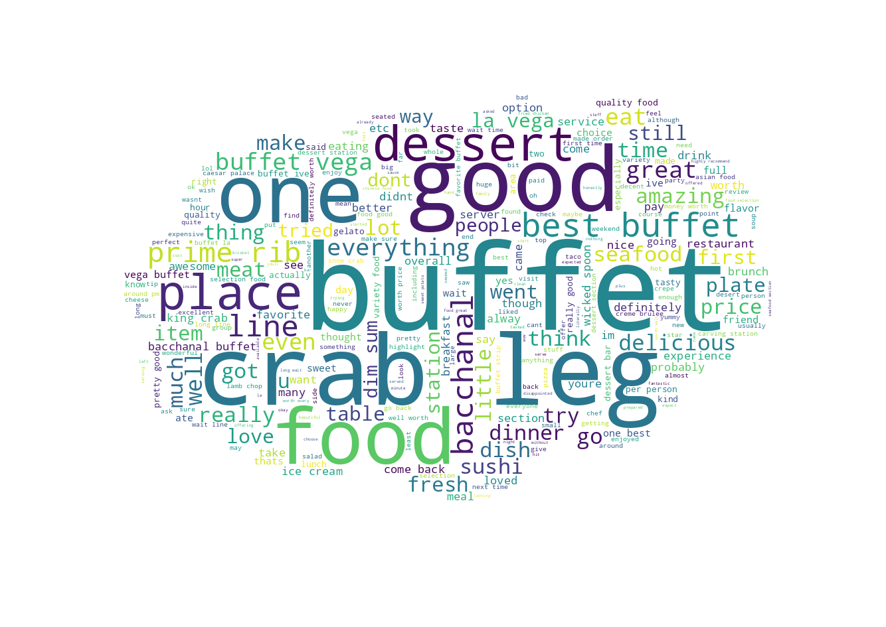
Pozitive Words

Slide 12
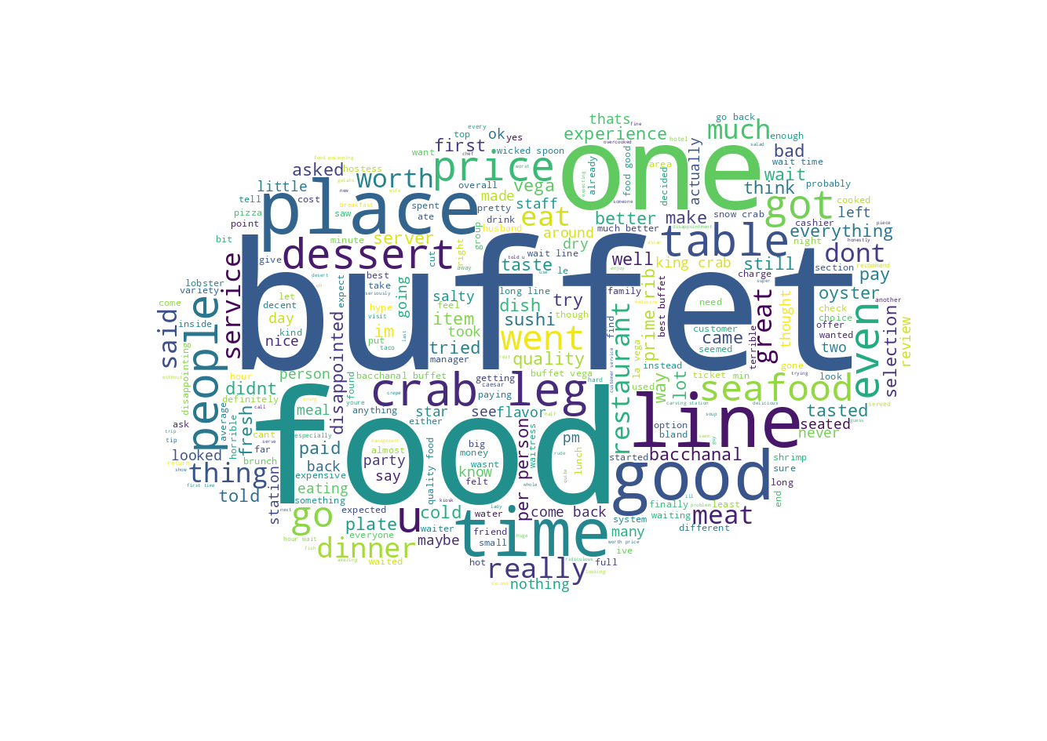
Negative Words

Slide 13
Thank You
Thank you for watching my presentation.
Contact Information:
Email: metehanayhan1213@gmail.com
LinkedIn: www.linkedin.com/in/metehan-ayhan-944405263

