Slide 1
Wınnıng space race
Wıth data scıence
Metehan Batı

Slide 2
OUTLINE
Executive Summary
Introduction
Methodology
Results
Conclusion
Appendix

Slide 3
Executive Summary
This report outlines the analysis of SpaceX data initially stored in a JSON file, which was then imported into a pandas DataFrame using Python. The dataset underwent rigorous cleaning and pre-processing to handle missing values, outliers, and inconsistencies.
After the data wrangling phase, exploratory data analysis (EDA) was carried out using a combination of visualizations and SQL queries to extract valuable insights.
The analysis culminated in the development of interactive visual analytics tools, leveraging Folium and Plotly Dash, to facilitate deeper exploration and effective presentation of the findings.

Slide 4
ENGAGING THE AUDIENCE
The commercial space industry, led by companies like SpaceX, is undergoing a transformative shift with innovations like reusable rocket technology. Our project aims to explore the feasibility of competing with SpaceX by analyzing publicly available data and leveraging data science techniques.
Problems you want to find answers
Can we predict SpaceX's success in recovering and reusing the first stage of its Falcon 9 rockets?
What factors influence SpaceX's decision to reuse or discard the first stage?
How does SpaceX's cost-saving strategy impact rocket launch pricing?
What challenges and opportunities exist for a new entrant like Space Y in competing with SpaceX?

Slide 5
METHODOLOGY
Sectıon 1

Slide 6
METHODOLOGY
Data collection methodology:
Combined data from SpaceX public API and SpaceX Wikipedia page
Perform data wrangling
Classifying true landings as successful and unsuccessful otherwise
Perform exploratory data analysis (EDA) using visualization and SQL
Perform interactive visual analytics using Folium and Plotly Dash
Perform predictive analysis using classification models
Tuned models using GridSearchCV

Slide 7
DATA COLLECTIONOVERVIEW
The data collection process involved a hybrid approach, combining API requests from Space X's public API with web scraping from a table within Space X's Wikipedia entry. The API provided information such as FlightNumber, Date, BoosterVersion, PayloadMass, Orbit, LaunchSite, Outcome, and various other parameters. Meanwhile, the web scraping extracted data such as Flight No., Launch site, Payload, PayloadMass, Orbit, Customer, Launch outcome, Version Booster, Booster landing, Date, and Time. Subsequent slides will illustrate the flowcharts depicting the distinct processes for API data collection and web scraping.

Slide 8
Data Collection – SpaceX API
Import Libraries and Define Auxiliary Functions
Request and parse the SpaceX launch data using the GET request
Filter the dataframe to only include Falcon 9 launches
Dealing with Missing Values
https://github.com/metehanbati/IBM_Final_Project-/blob/main/jupyter-labs-webscraping.ipynb

Slide 9
Data Collection - Scraping
Request the Falcon9 Launch Wiki page from its URL
Extract all column/variable names from the HTML table header
Create a data frame by parsing the launch HTML tables
https://github.com/metehanbati/IBM_Final_Project-/blob/main/jupyter-labs-webscraping.ipynb

Slide 10
Data Collection - ScrapingData Wrangling
Import Libraries and Define Auxiliary Functions
Calculate the number of launches on each site
Calculate the number and occurrence of each orbit
Calculate the number and occurence of mission outcome of the orbits
Create a landing outcome label from Outcome column
https://github.com/metehanbati/IBM_Final_Project-/blob/main/labs-jupyter-spacex-Data%20wrangling.ipynb

Slide 11
EDA with Data Visualization
I utilized scatter charts, line charts, and bar charts in my analysis:
Scatter chart: This type of chart is ideal for exploring relationships between variables. By plotting data points, it enabled me to identify correlations and trends effectively.
Line chart: Line charts are particularly useful for visualizing trends and changes over time. They allowed me to observe patterns and fluctuations in the data, providing valuable insights into temporal dynamics.
Bar chart: I employed bar charts to compare categorical or grouped data. This visual representation facilitated the comparison of values across different categories, enhancing the understanding of relative differences and distributions.
https://github.com/metehanbati/IBM_Final_Project-/blob/main/jupyter-labs-eda-dataviz.ipynb.jupyterlite.ipynb

Slide 12
FINAL TIPS & TAKEAWAYS
Consistent rehearsal
Strengthen your familiarity
Refine delivery style
Pacing, tone, and emphasis
Timing and transitions
Aim for seamless, professional delivery
Practice audience
Enlist colleagues to listen & provide feedback
Seek feedback
Reflect on performance
Explore new techniques
Set personal goals
Iterate and adapt

Slide 13
Build an Interactive Map with Folium
Markers: Markers were added to pinpoint specific locations on the map, such as significant landmarks, cities, or data collection points. These markers provide visual cues and help users identify and navigate to specific locations of interest easily.
Circles: Circles were used to represent areas of interest or influence, such as the radius around a particular location. These circles may denote regions of coverage, proximity, or impact and provide a visual representation of spatial relationships within the data.
Lines: Lines were added to connect points of interest or illustrate routes, pathways, or connections between different locations. These lines help users visualize spatial relationships and understand the connectivity between various geographical features or data points.
https://github.com/metehanbati/IBM_Final_Project-/blob/main/lab_jupyter_launch_site_location.jupyterlite.ipynb

Slide 14
Build a Dashboard with Plotly Dash
Dashboard includes a pie chart and a scatter plot.
Pie chart can be selected to show distribution of successful landings across all launch sites and can be selected to show individual launch site successrates.
Scatter plot takes two inputs: All sites or individual site and payload mass on a slider between 0 and 10000 kg.
The pie chart is used to visualize launch site success rate.
The scatter plot can help us see how success varies across launch sites, payload mass, and booster version category.

Slide 15
Predictive Analysis (Classification)
Split label column ‘Class’ from dataset
Fit and Transform features using Standart Scaler
Train_test_split Data
Use GridSearchCV on LogReg, SVM, Decision Tree and KNN models
Score Models on split test set
Confusion Matrix for all models
Barplot to compare scores fo models
GridSearchCV to find optimal parameters

Slide 16
Results
Exploratory data analysis results
Interactive analytics demo in screenshots
Predictive analysis results

Slide 17
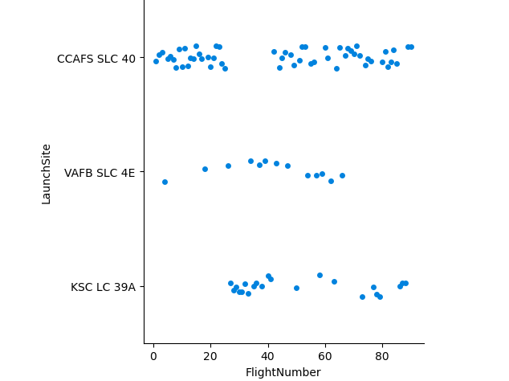
From the plot, we found that the larger the flight amount at a launch site, the greater the success rate at a launch site.

Slide 18
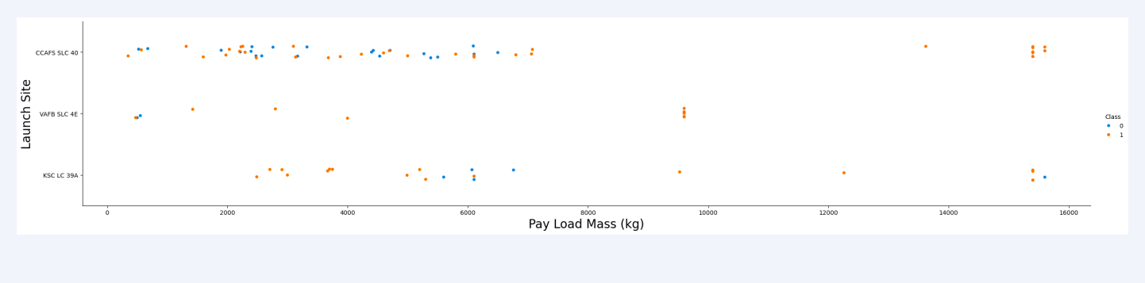
Payload vs. Launch Site
The greater the payload mass for launch site CCAFS SLC 40 the higher the success rate for the rocket.

Slide 19
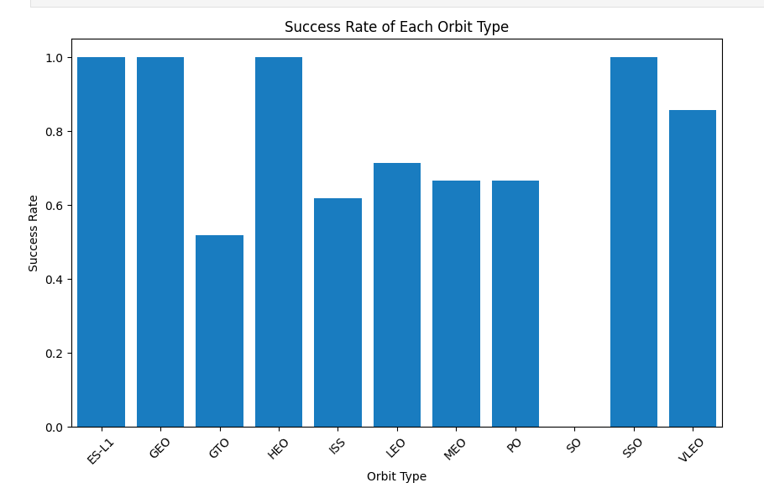
Success Rate vs. Orbit Type
From the plot, we can see that ES-L1, GEO, HEO, SSO, VLEO has the most success rate.

Slide 20
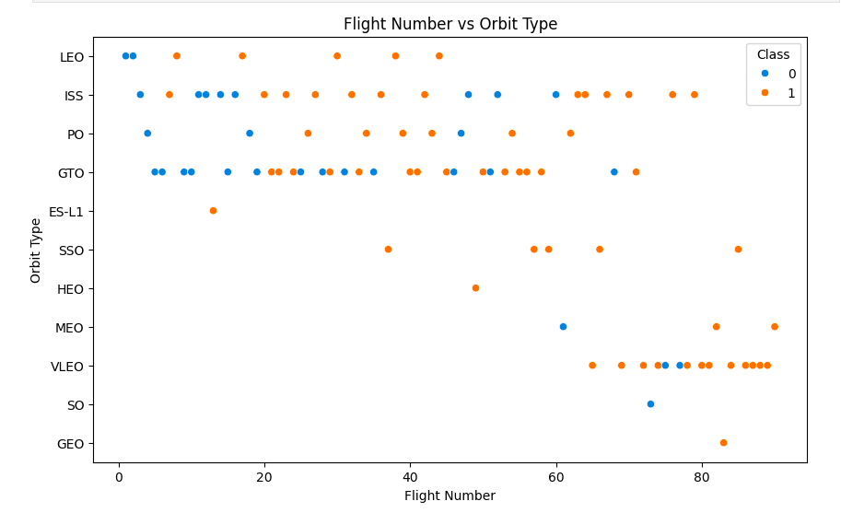
Flight Number vs. Orbit Type
The plot shows the Flight Number vs. Orbit Type. We observed that in the LEO orbit, success is related to the number of flights whereas in the GTO orbit, there is no relationship between flight number and the orbit.

Slide 21
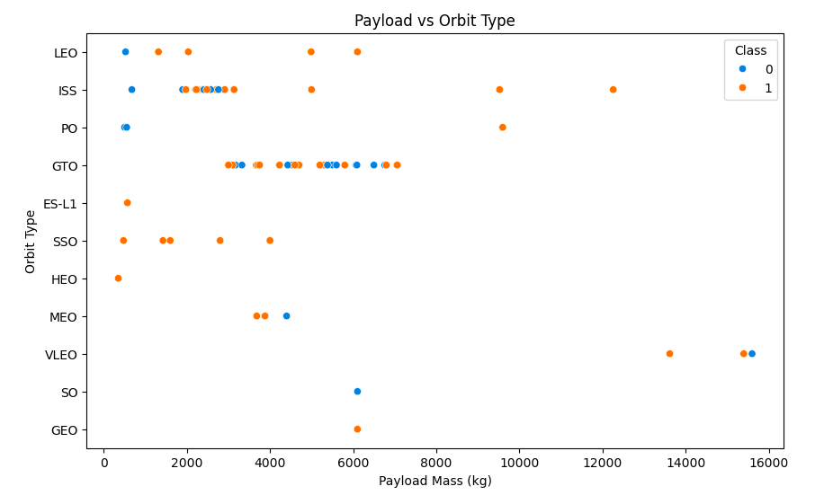
Payload vs. Orbit Type
• We can observe that with heavy payloads, the successful landing are more for PO, LEO, and ISS orbits.

Slide 22
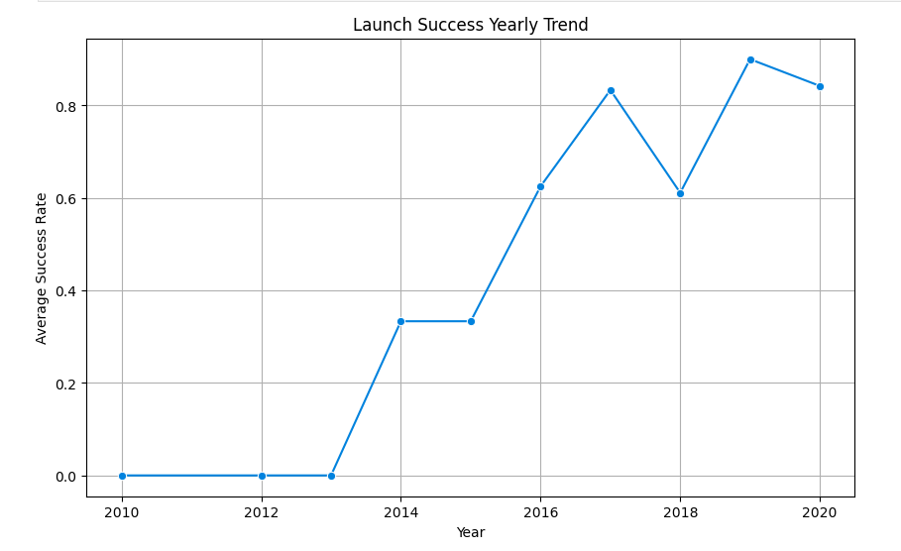
Launch Success Yearly Trend
From the plot, we can observe that success rate since 2013 kept on increasing until 2020.

Slide 23
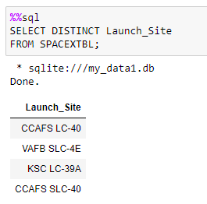
All Launch Site Names
We used the key word DISTINCT to show only unique launch sites from the SpaceX data.

Slide 24
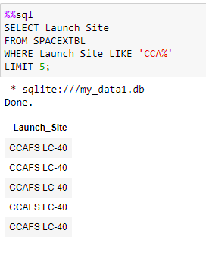
Launch Site Names Begin with 'CCA'
We used the query above to display 5 records where launch sites begin with ‘CCA’.

Slide 25
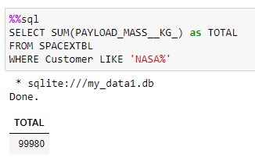
Total Payload Mass
We calculated the total payload carried by boosters from NASA as 99980 using the query below:

Slide 26
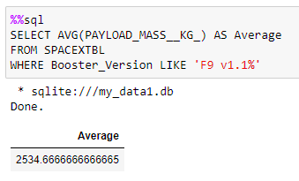
Average Payload Mass by F9 v1.1
We calculated the average payload mass carried by booster version F9 v1.1 as 2534.66666.

Slide 27
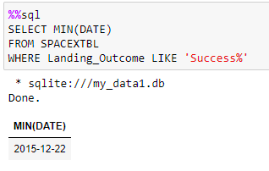
First Successful Ground Landing Date
• We observed that the dates of the first successful landing outcome on ground pad was 22nd December 2015.

Slide 28
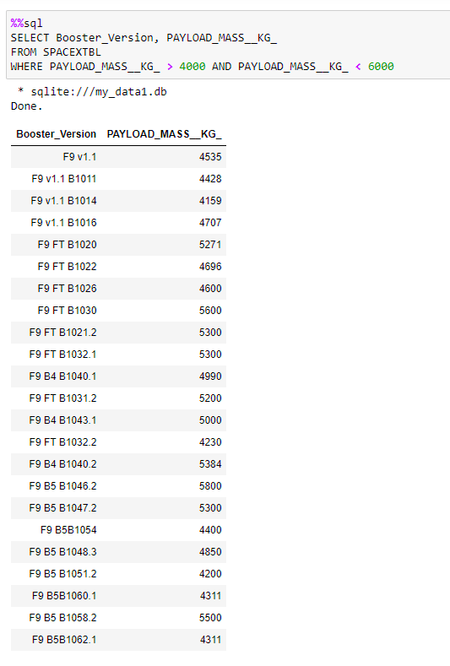
Successful Drone Ship Landing with Payload between 4000 and 6000
We used the WHERE clause to filter for boosters which have successfully landed on drone ship and applied the AND condition to determine successful landing with payload mass greater than 4000 but less than 6000.

Slide 29
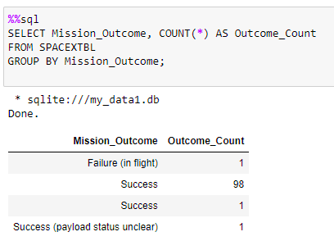
Total Number of Successful and Failure Mission Outcomes
We used GROUP BY to filter MissionOutcome was a success or a failure.

Slide 30
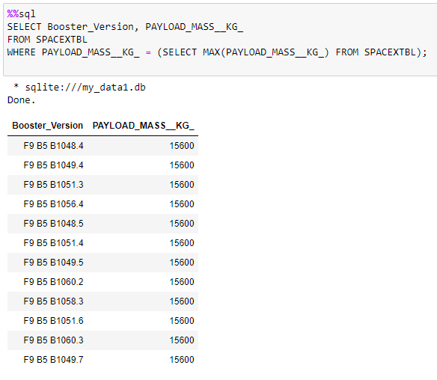
Boosters Carried Maximum Payload
We determined the booster that have carried the maximum payload using a subquery in the WHERE clause and the MAX() function.

Slide 31
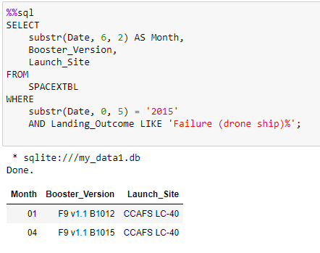
2015 Launch Records
We used a combinations of the WHERE clause, LIKE, AND, and BETWEEN conditions to filter for failed landing outcomes in drone ship, their booster versions, and launch site names for year 2015

Slide 32
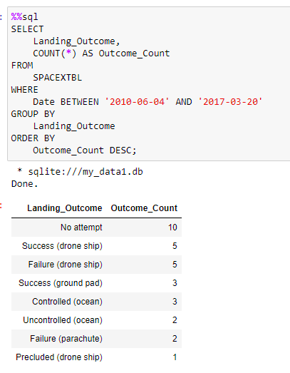
Rank Landing Outcomes Between 2010-06-04 and 2017-03-20
We selected Landing outcomes and the COUNT of landing outcomes from the data and used the WHERE clause to filter for landing outcomes BETWEEN 2010-06-04 and 2017- 03-20.
We applied the GROUP BY clause to group the landing outcomes and the ORDER BY clause to order the grouped landing outcome in descending order.

Slide 33
Launch sıtes proxımıtıes analysıs
Sectıon 3

Slide 34
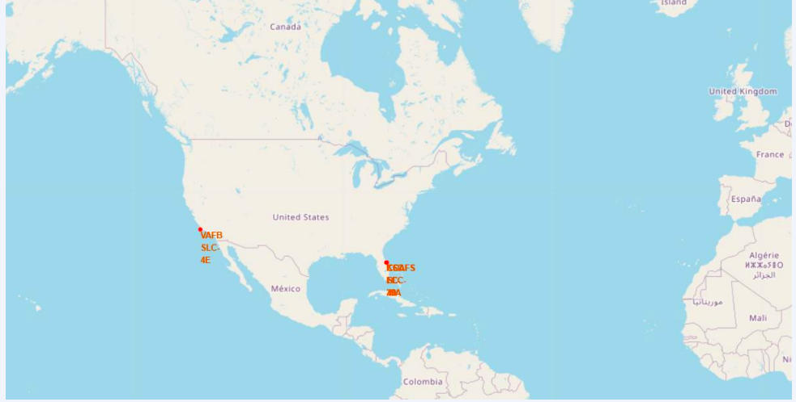
All launch sites global map markers
We can see that the SpaceX launch sites are in the United States of America Florida and California.

Slide 35
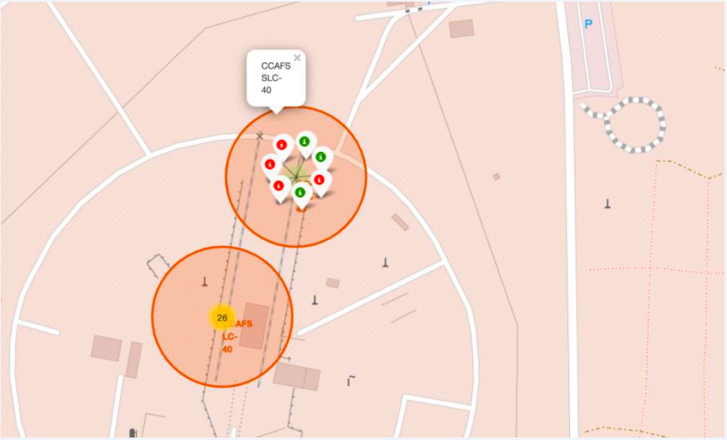
Markers showing launch sites with color labels
Green Marker shows successful launches and Red Marker shows Failures.

Slide 36
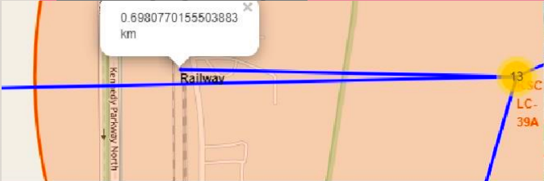
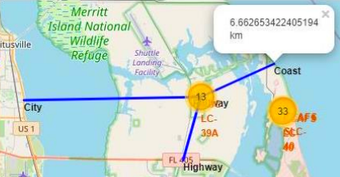
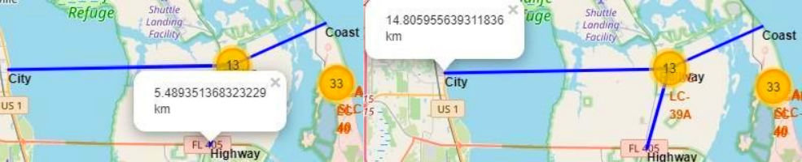
Launch Site distance to landmarks
Using KSC LC-39A as an example, launch sites are very close to railways for large part and supply transportation. Launch sites are close to highways for human and supply transport. Launch sites are also close to coasts and relatively far from cities so that launch failures can land in the sea to avoid rocketsfalling on densely populated areas

Slide 37
Buıld a dashboard wıth plotly dash
Sectıon 4

Slide 38
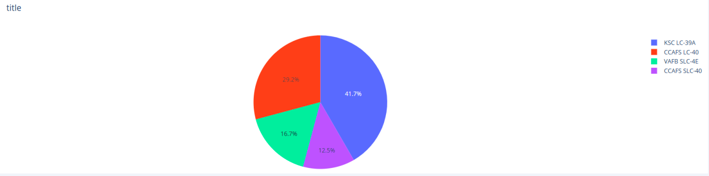
Pie chart showing the success percentage achieved by each launch site
We can see that KSC LC-39A had the most successful launches from all the sites.

Slide 39
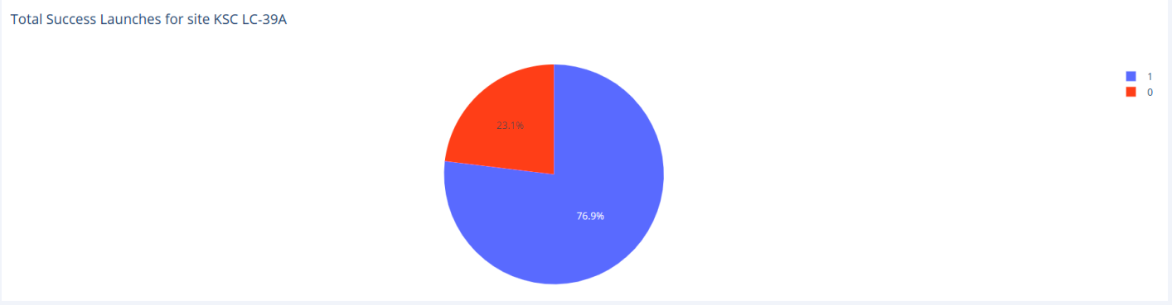
Pie chart showing the Launch site with the highest launch success ratio
KSC LC-39A achieved a 76.9% success rate while getting a 23.1% failure rate.

Slide 40
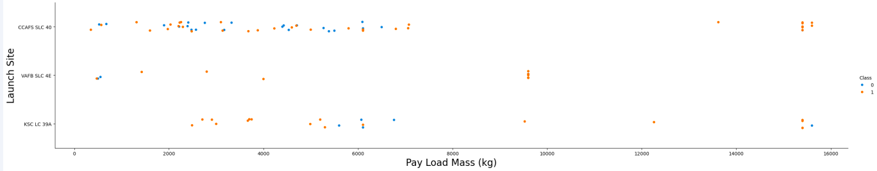
Scatter plot of Payload vs Launch Outcome for all sites, with different payload selected in the range slider
We can see the success rate for low weighted payloads is higher than the heavy weighted payloads.

Slide 41
Predıctıve analysıs (Classıfıcatıon
Sectıon 5

Slide 42
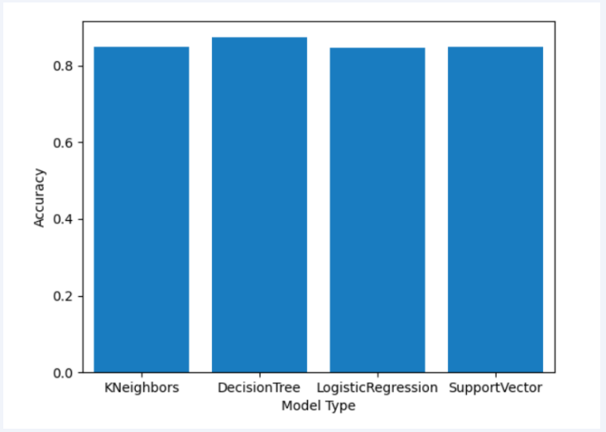
Classification Accuracy
From the right bar chart, we can see that the decision tree classifier is the model with the highest classification accuracy.

Slide 43
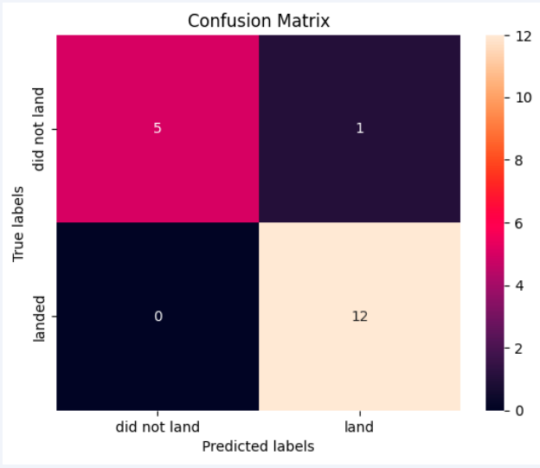
Confusion Matrix
The confusion matrix for the decision tree classifier shows that the classifier can distinguish between the different classes. The major problem is the false positives, for example, unsuccessful landing marked as successful landing by the classifier.

Slide 44
Conclusions
Based on our analysis, several conclusions can be drawn:
There appears to be a correlation between the number of flights conducted at a launch site and the success rate of launches at that site, with higher flight volumes correlating with greater success rates.
The success rate of launches exhibited an upward trend from 2013 to 2020.
Orbits such as ES-L1, GEO, HEO, SSO, and VLEO demonstrated the highest success rates.
Among all launch sites, KSC LC-39A boasted the highest number of successful launches.
Based on our findings, the Decision Tree Classifier emerged as the most suitable machine learning algorithm for this particular task.

Slide 45
Appendıx
Include any relevant assets like Python code snippets, SQL queries, charts, Notebook outputs, or data sets that you may have created during this project

Slide 46
THANK YOU
Metehan Bati
Github.com/metehanbati

