Slide 1
Reinforcement Learning for Turkish card game called “Batak”
Metehan Çekiç
Can Bakışkan

Slide 2
High Level Info
Teaching a network to play Turkish card game “Batak” by using Reinforcement Learning methods.
Asynchronous Advantage Actor Critic (A3C) algorithm is implemented for learning.
Game environment for agents is written from scratch.
LSTM based network model is used to capture temporal information.

Slide 3
Batak Description
Like “watered down” bridge or positive hands of king
4 person table
Dealer deals 13 cards to each
Each player bids on how many tricks they’re going to take in that play (consists of 13 tricks)
If no one bids, first player wins the auction by 5 by default
Winner determines trump suit
In each trick players try to up the cards on the table by following suit

Slide 4
Batak Description (Continued)
If player doesn’t have the suit they play from the trump suit.
If trump cards have been played in a trick, largest trump card wins the trick.
Trump suit cannot be played until someone “dropped” it i.e. a player played it on a different suit because they didn’t have that suit.
Players have to raise the preceding card if they can.

Slide 5

Batak Description
13 tricks
Auction
Trump
Scores
Winner: A
Winner: B
Winner: B Winner: C

Slide 6
Batak Description
13 tricks
Auction
Trump
Scores
Winner: A
Winner: B
Winner: B Winner: C
Determined randomly
Reward: 0 or 1
Reward: 0 or 1
Reward: 0 or 1
Reward: 0 or 1

Slide 7
Background Information

Slide 8
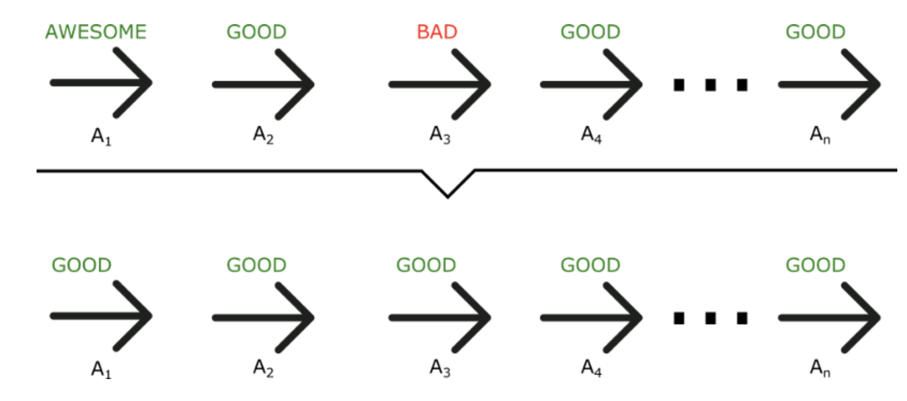
Value Based Methods
Vs.
Policy Based Methods
Tries to approximate Q function or Value Function
Finds policy by selecting actions that maximize Q
More sample efficient when it works
Directly optimizes policies
Can work well for continuous action spaces
Tends to be more popular these days
Notes:
Q-learning is a dynamic programming method where we try to get a self-consistent set of eqns satisfied (valid for Q or V values)
Requires a Q value to be calculated for every possible action! (how do that if in a continuous state?)

Slide 9
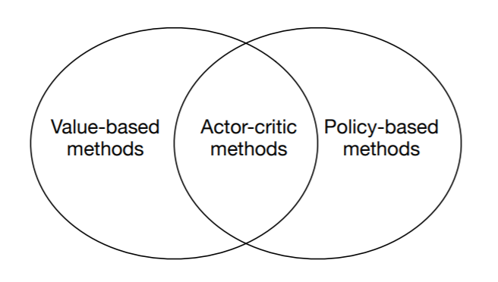
Advantage Actor-Critic (A2C) Agents
Actor-Critic combines the benefits of both value based and policy based approach.
A2C algorithm estimates both a value function V(s) (how good a certain state is to be in) and a policy π(s) (a set of action probability outputs).

Slide 10
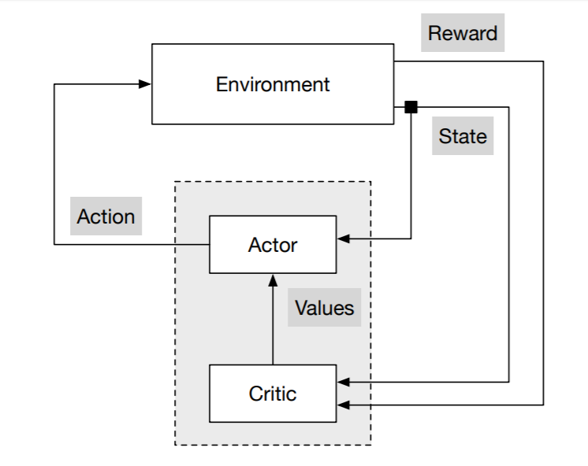


Advantage Actor-Critic (A2C) Diagram
Value function:
Q function:
Advantage function:

Slide 11
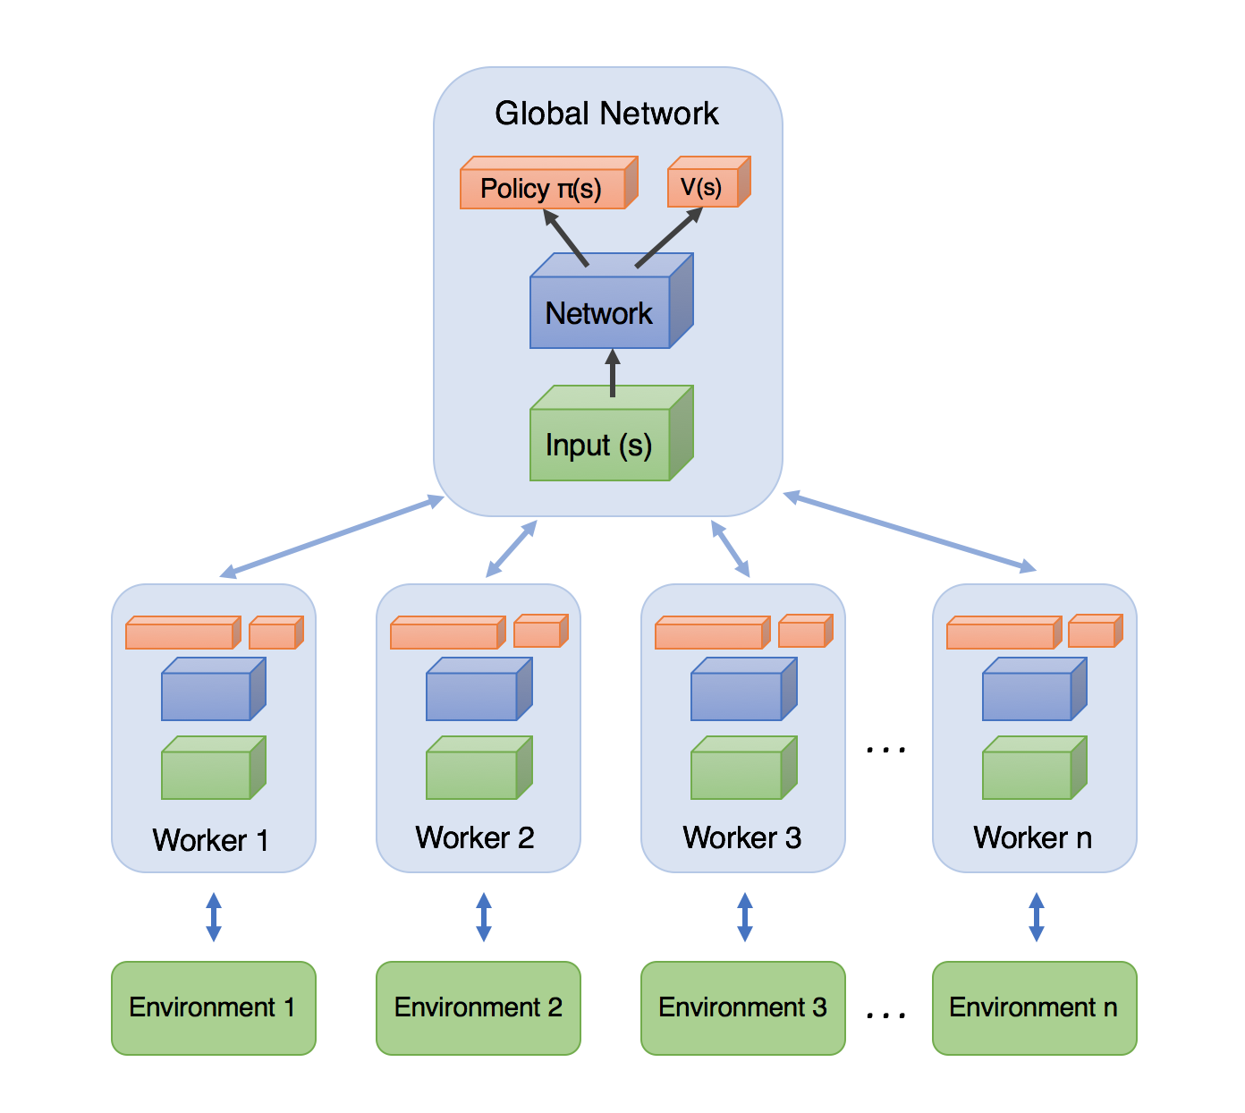
Asynchronous Advantage Actor-Critic (A3C)
In addition to stabilizing learning, using multiple parallel actor-learners has multiple practical benefits.
First, it reduces training time that is roughly linear in the number of parallel actor-learners.
Second, since we no longer rely on experience replay for stabilizing learning we are able to use actor-critic algorithm.

Slide 12
How A3C works?
We choose our actions using a conditional probability distribution P(a|x) over the possible actions, given the observation.
π(a|x ; θ) = P(a|x ; θ) Policy
Trajectory:
! Each worker has its own trajectory

Slide 13




How A3C works?
Empirical Reward:
Advantage :
Value Loss :
Policy Loss :
Compute gradient descent of losses for each worker neural net.
Accumulate gradient descent from each step neural network.
Update Master neural network according to accumulated updates
Update all worker networks with master network

Slide 14
A3C Algorithm
Play the game in each worker environment with current policies
Compute gradient descent of losses for each worker neural net at the end of game.
Accumulate gradient descent from each step neural network.
Update Master neural network according to accumulated updates
Update all worker networks with master network
Calculate expected reward.
Go back to step 1 until convergence

Slide 15
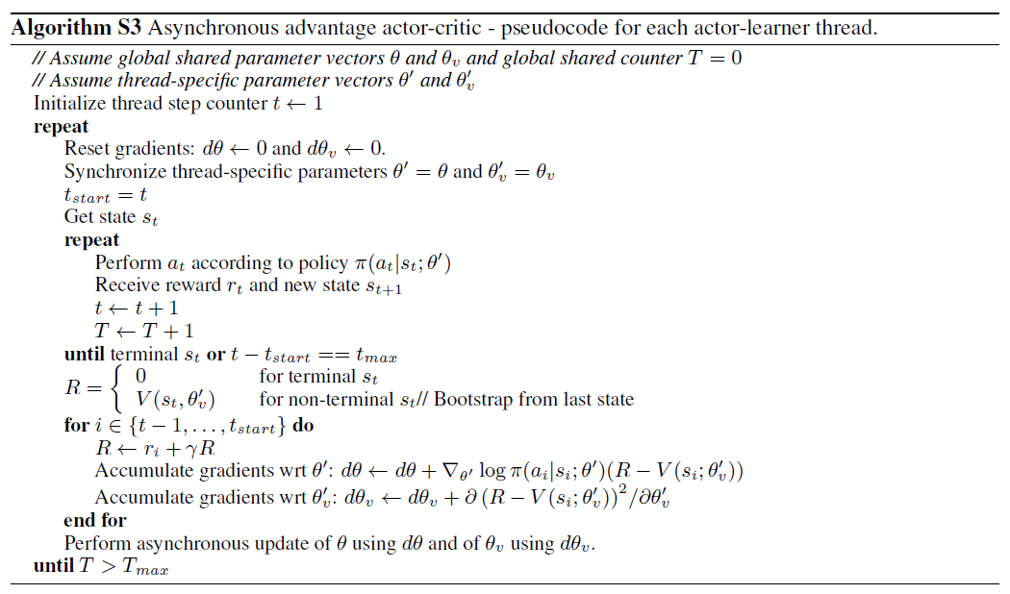
A3C Algorithm

Slide 16
Our Model Architecture
time
(Probabilistic)

Slide 17
Details
Each agent trains in a table with other players playing at random.
Test accuracy is averaged over 1000 plays
We trained three different versions

Slide 18
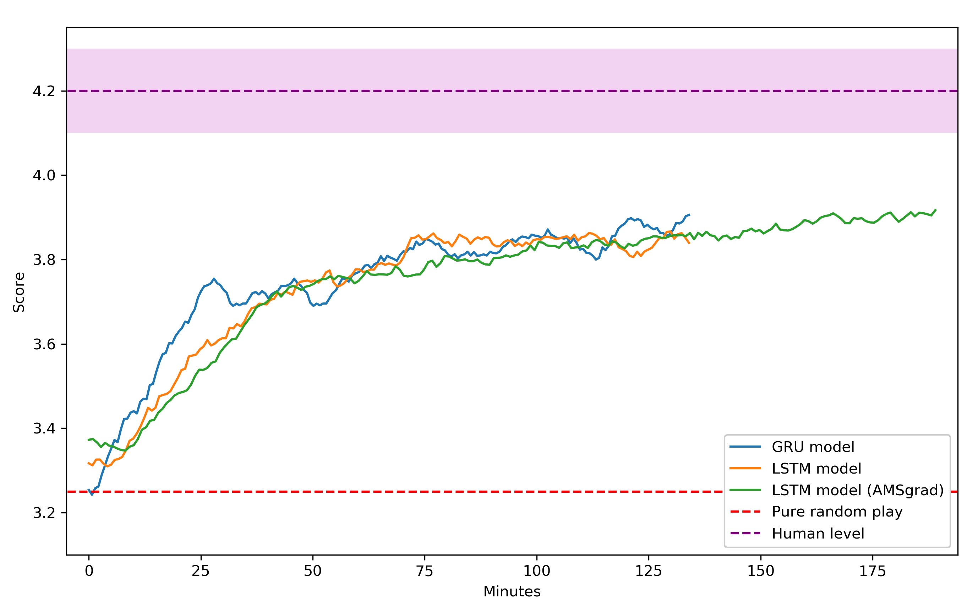
Results

Slide 19
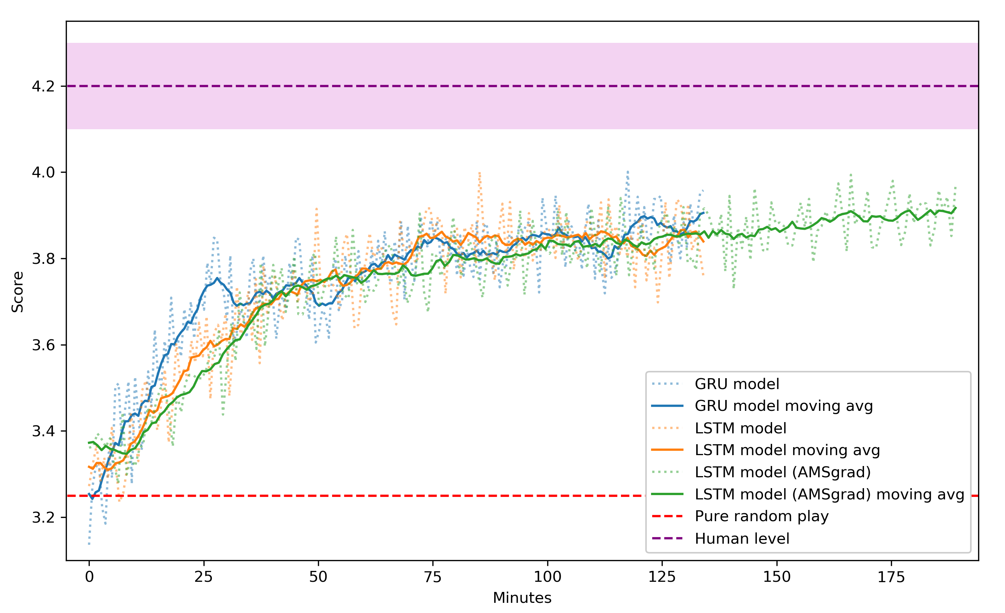
Results

Slide 20
Future work:
Self play
Full batak game
Other card or multiagent games

Slide 21
References
Asynchronous Methods for Deep Reinforcement Learning, Deepmind 2016
Schulman John et al. 2015, High-Dimensional Continuous Control Using Generalized Advantage Estimation
Amsgrad: Reddi S. et al. 2018, On The Convergence Of Adam And Beyond
Parts of code from: https://github.com/dgriff777/rl_a3c_pytorch
Bridge terms from: https://en.wikipedia.org/wiki/Glossary_of_contract_bridge_terms

Slide 22
Thank You for Listening

