Slide 1

Software Product Line Engineering
Term Project
OrderLine
Group: Seniors
Berat Biçer
Ezgi Çakır
Gülce Karaçal
Metehan Kaya
Seda Gülkesen

Slide 2
Outline
Introduction
Variants of OrderLine
Common, Variable and Product Specific Variants
Feature Model
Variability Configuration
High-Level Architecture
Software Reuse in Prototype
Discussion
Demo

Slide 3
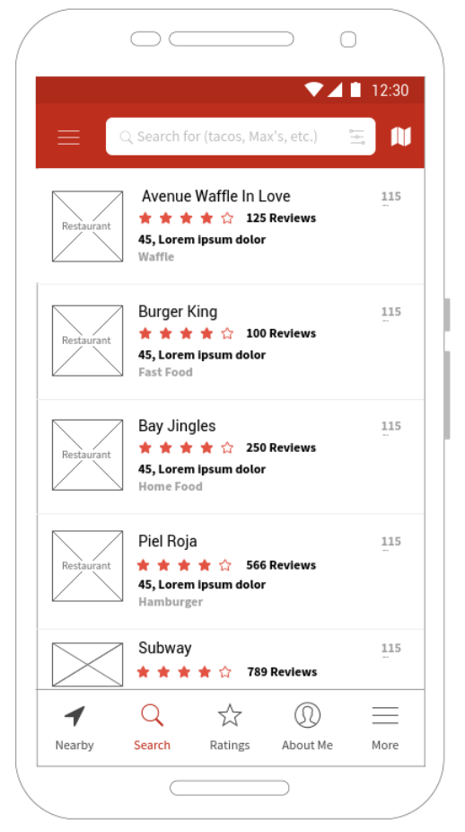
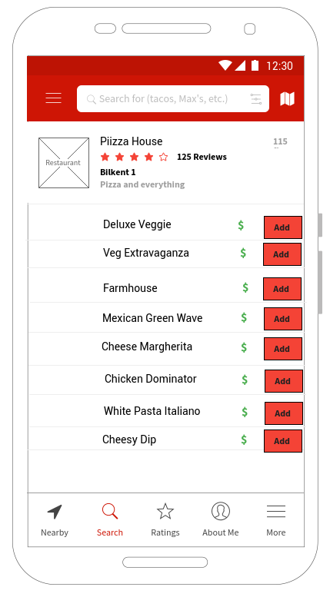
Applications of OrderLine
FeedMe
Two types of users: customer & restaurants
Customers: order food
Restaurants: upload menus and other information

Slide 4
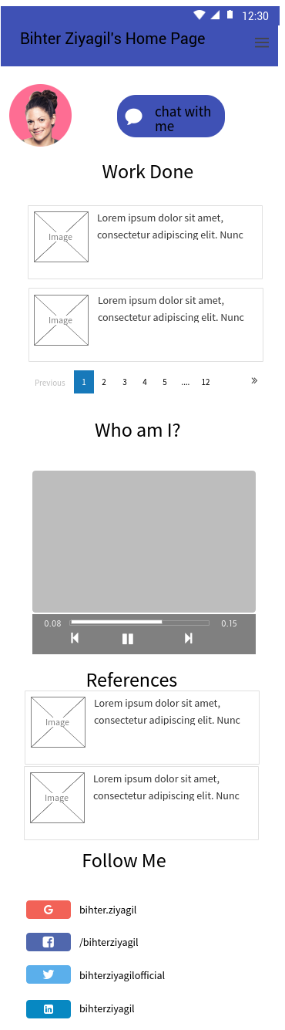
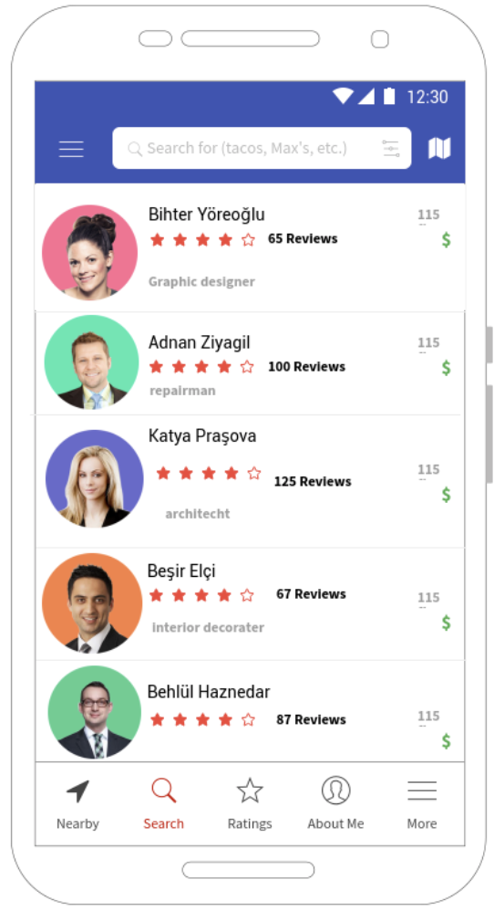
Applications of OrderLine
MaturePear
Two types of users: customer & service provider
Customers: Get service from technician, photographer, designer, cleaning lady etc.
Service Providers: Create profile, share his/her portfolio

Slide 5
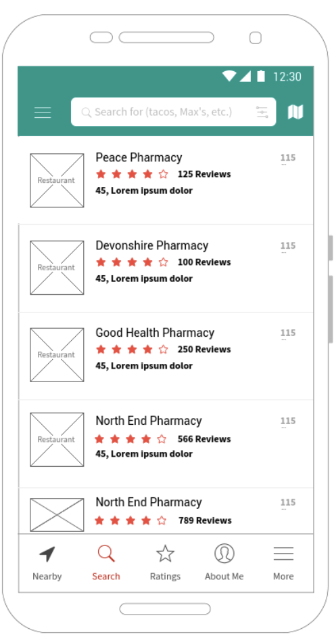
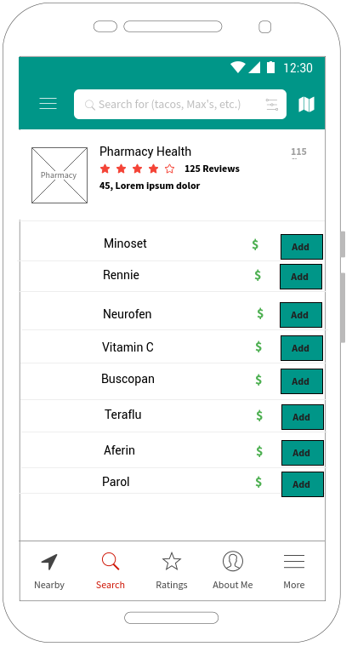
Applications of OrderLine
HealthyLife
Two types of users: customer & pharmacy
Customers: order medicine
Two types of subscribers for customers: free & premium
Pharmacy: share information about medicines, set campaigns and special deals

Slide 6
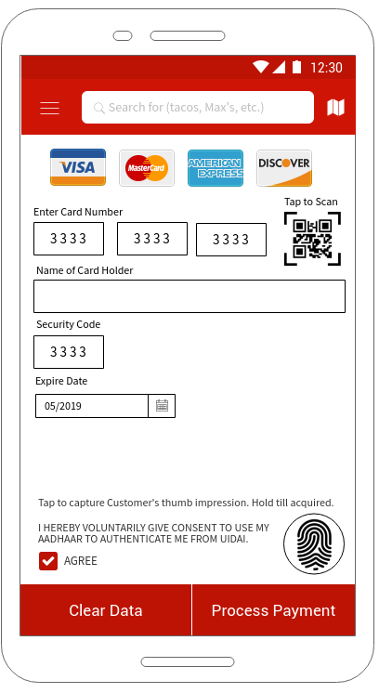
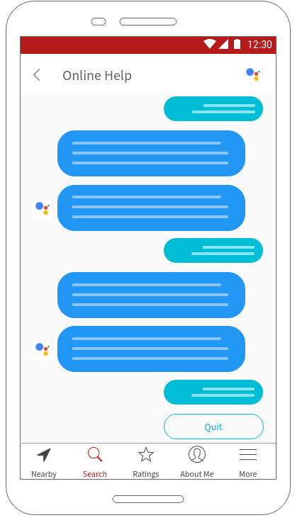
Common Prototypes
Figure 4: Online payment with credit card
Figure 5: Online help

Slide 7
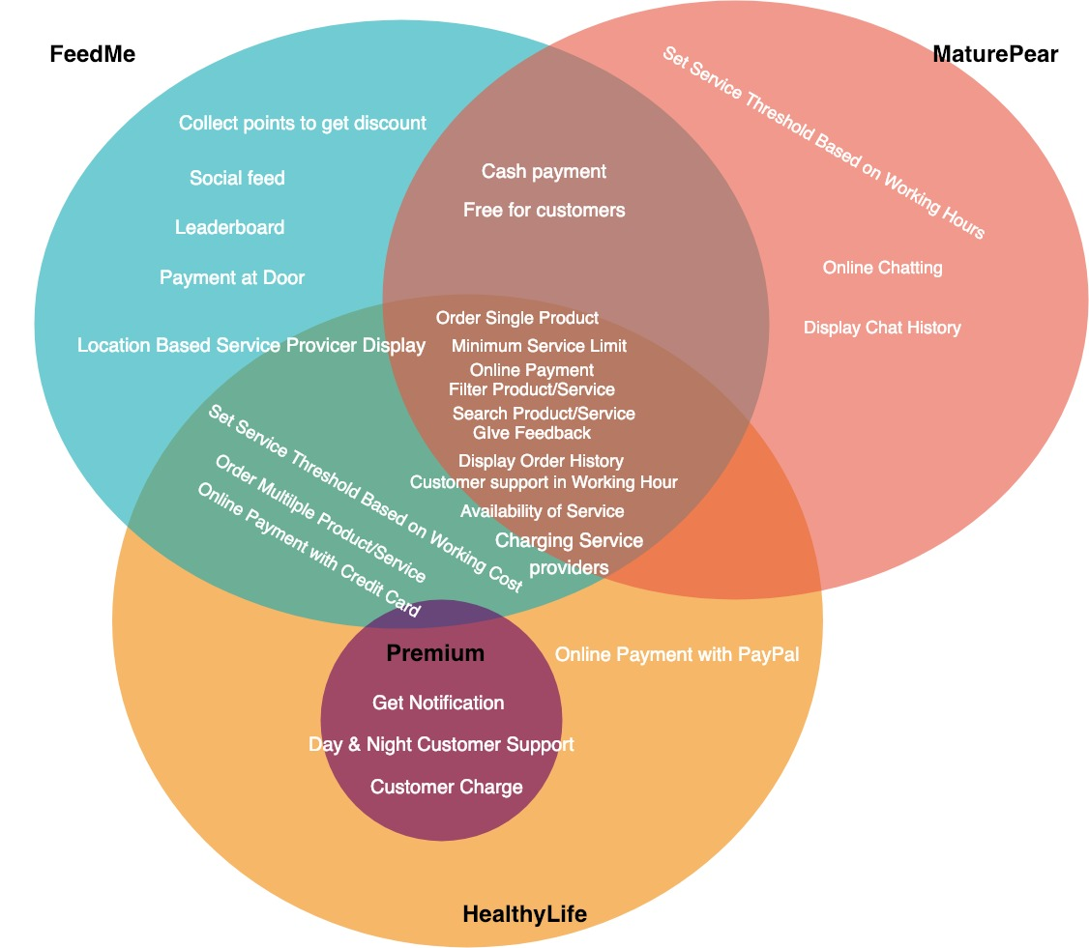
Venn Diagram

Slide 8
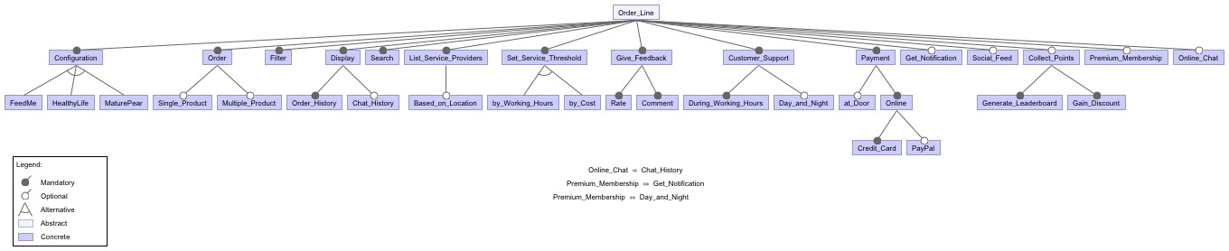
Feature Model

Slide 9
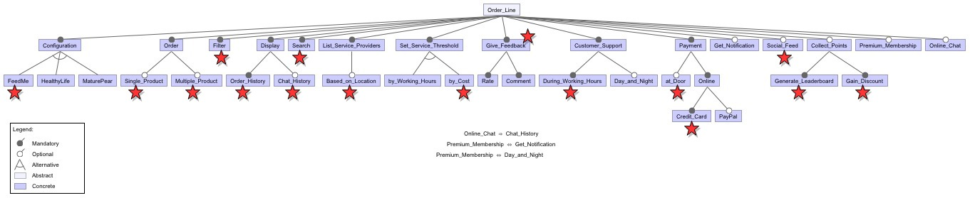
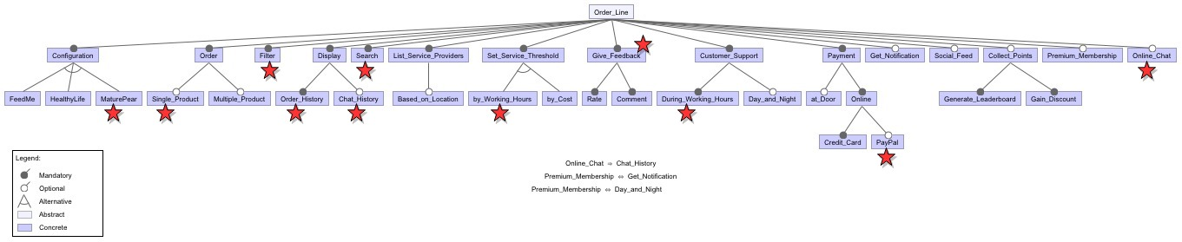
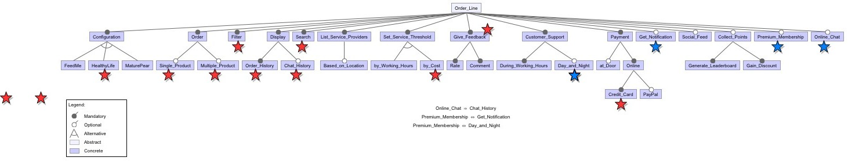
Feature Model of FeedMe, MaturePear and HealthyLife

Slide 10
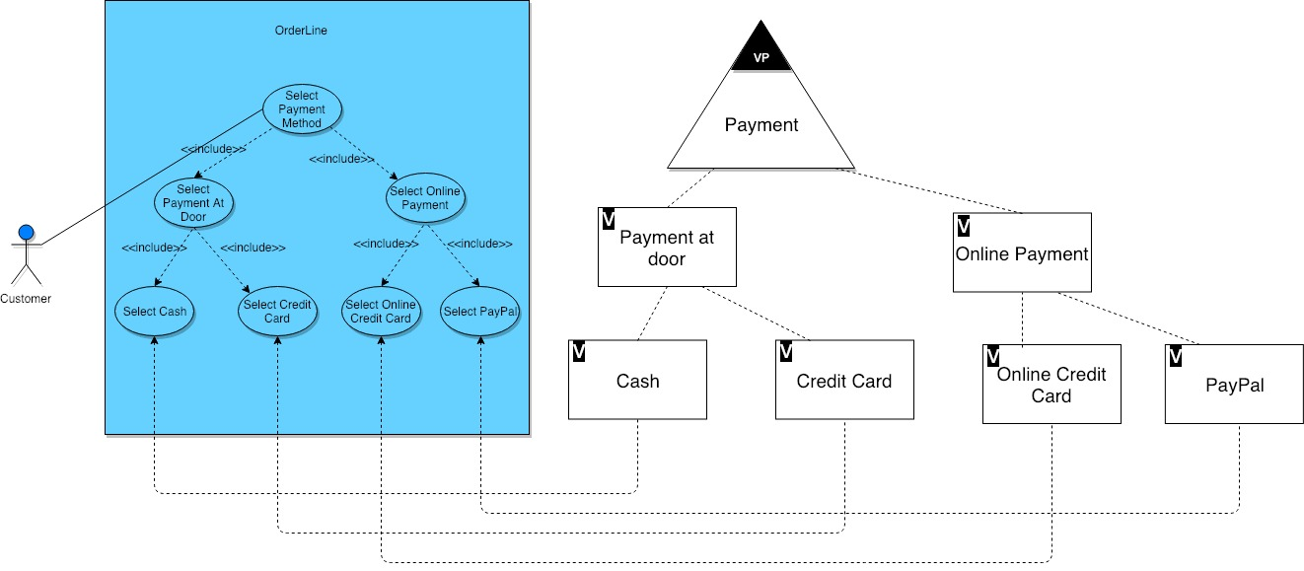
Payment Method Use Case Model

Slide 11
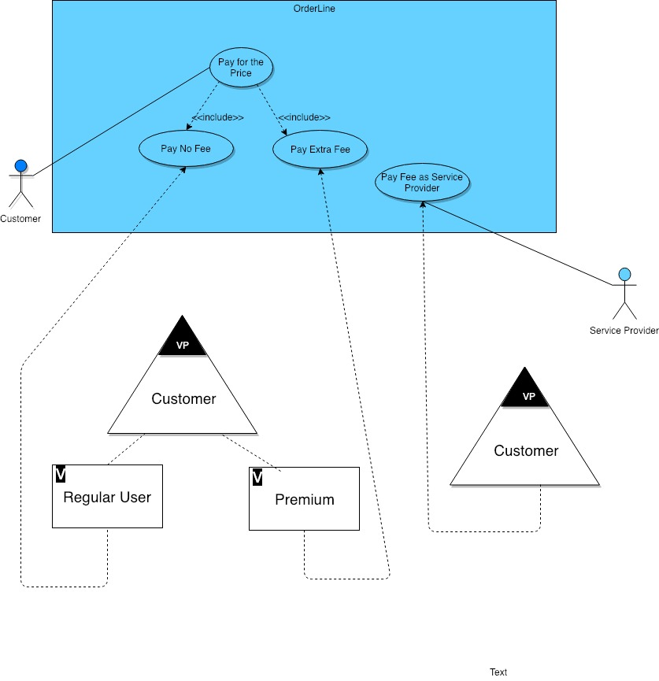
Pricing Use Case Model

Slide 12
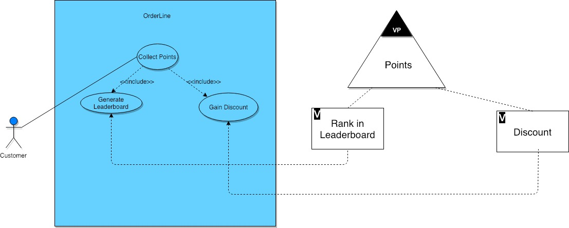
Collect Points Use Case Model

Slide 13
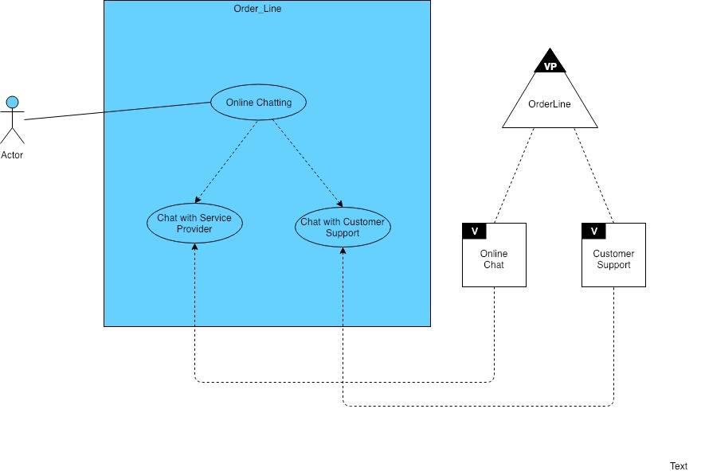
Online Chatting Use Case Model

Slide 14
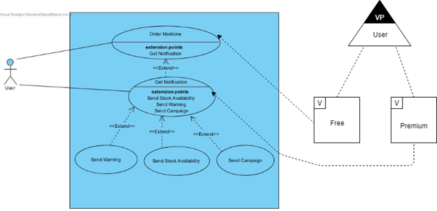
Get Notification Use Case Model

Slide 15
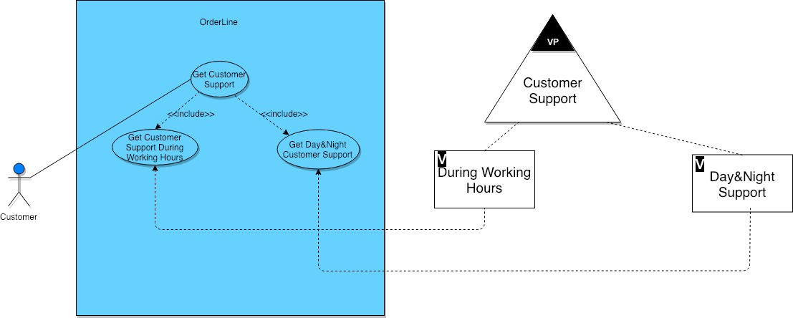
Customer Support Use Case Model

Slide 16
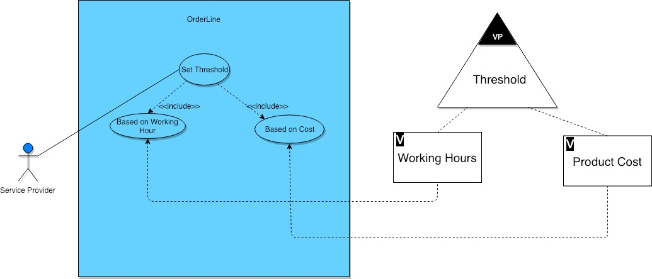
Set Threshold Use Case Model

Slide 17
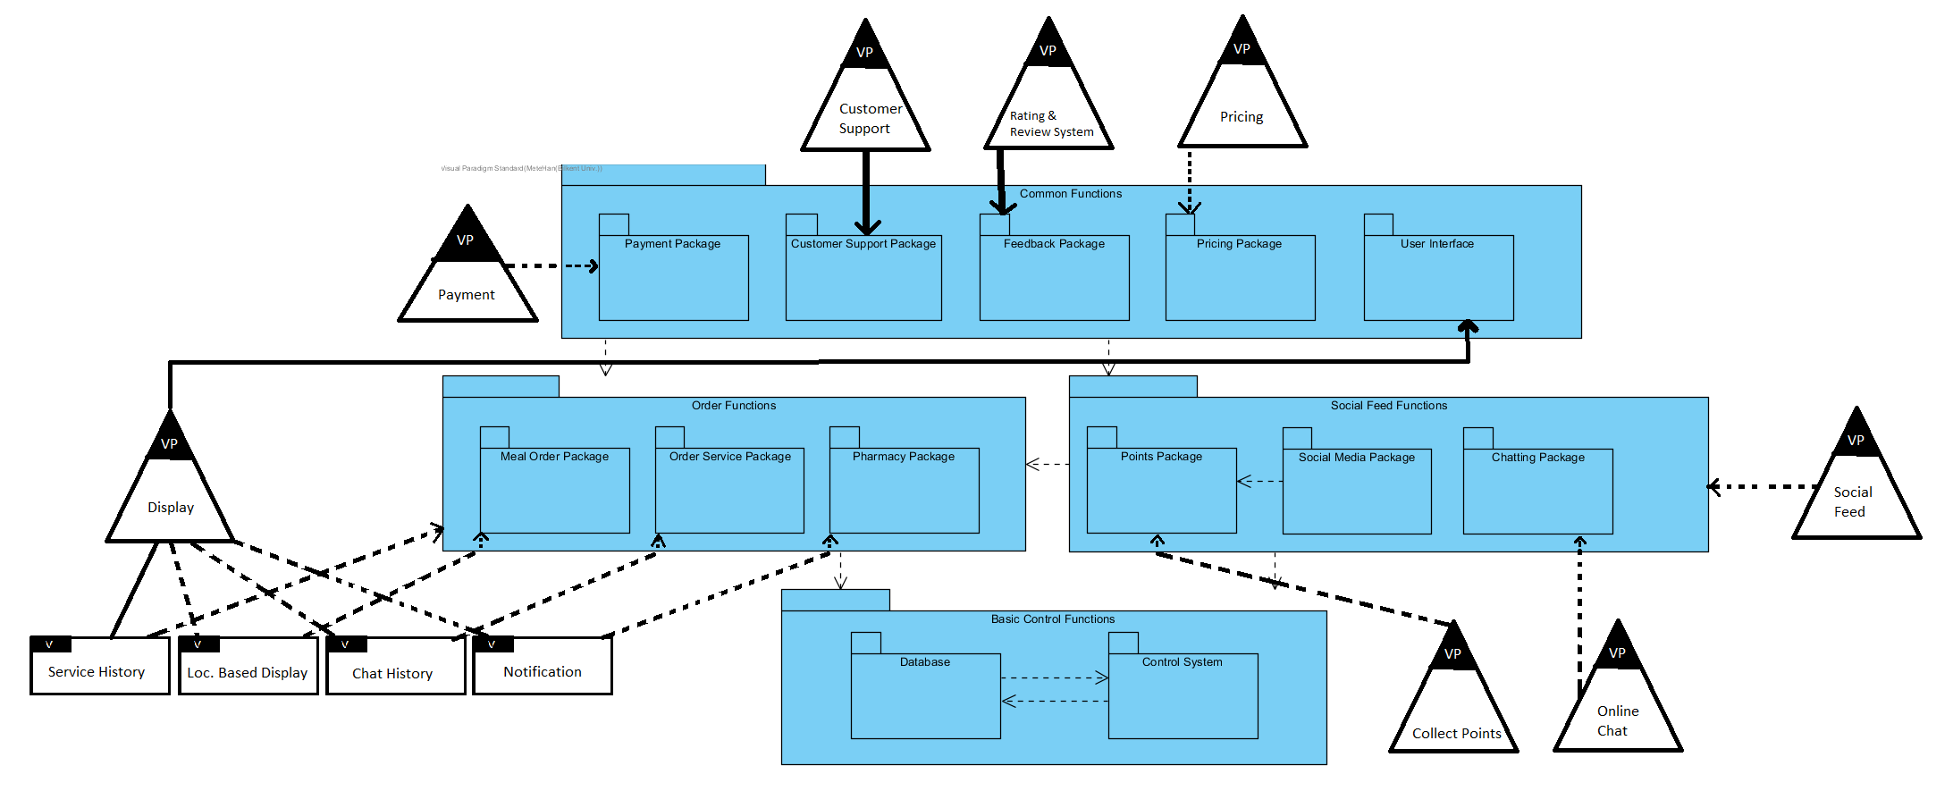
Package Diagram

Slide 18
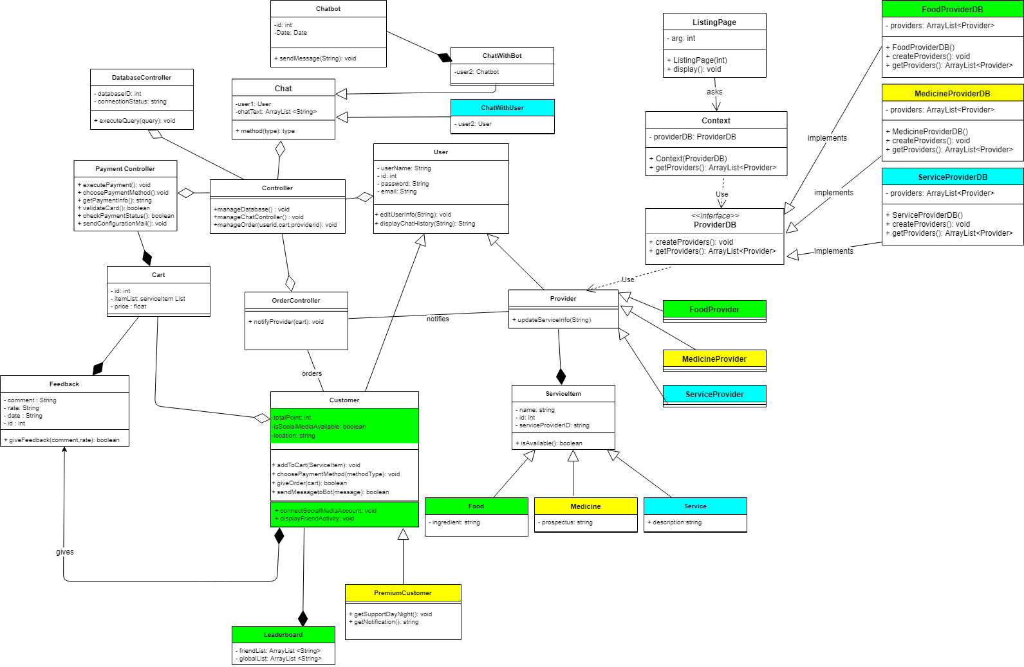
Class Diagram

Slide 19
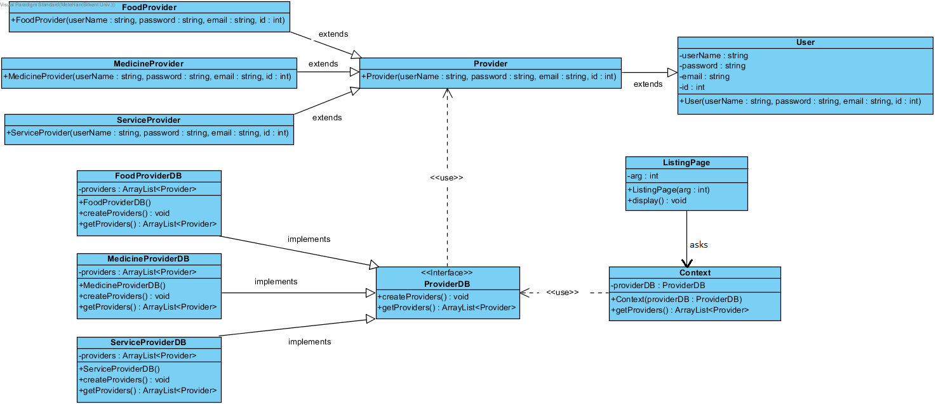
Strategy Design Pattern

Slide 20
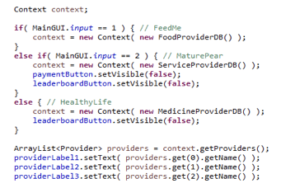
Software Reuse in Prototype
Packages are CodeBase, GUI,FeedMe,MaturePear and HealthyLife
CodeBase and GUI common
Strategy Design Pattern is applied.

Slide 21

Discussion
Requirements : A broad set of requirements to
evaluate on the Kano Methodology
Feature Model:
Different than the assignment
Finding common and variable features as well as product specific features and creating the feature model of the system
Kano Methodology : Some requirements decided in advance and no customer answering
Orthogonal Model:
First tried to organize systems related to each other using a single use case diagram
Could not find a tool to create orthogonal model
Prototype : Reused UI components which are classified as common for every plan

Slide 22
ANY QUESTIONS?
THANK YOU FOR LISTENING

