Slide 1

THE EFFECT OF MOVIE SCRIPT SIMILARITY ON MOVIE RECOMMENDATION
Eliz TEKCAN
Ezgi ÇAKIR
Mehmet Enes KELEŞ
Metehan KAYA

Slide 2

OVERVIEW
Datasets Used
How to Predict User Ratings
Algorithms Used
Validation Method
Results & Discussion
Conclusion
References

Slide 3



DATASETS USED
MovieLens 20M Dataset
Over 20 million movie ratings and taggings
imsdb movie scripts
1,093 movie scripts
OMDb API
Web service to obtain movie information

Slide 4
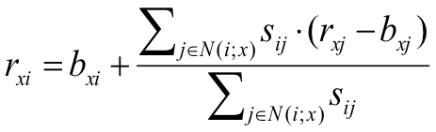
2. HOW TO PREDICT USER RATINGS
COLLABORATIVE FILTERING
s_{ij} = similarity measure of movies i and j
N(i; x) = all movies that were rated by x
b_{ij} = baseline estimate for s_{ij}
r_{xi} = rate given by user x to movie i

Slide 5
2.1 HOW TO DEFINE s_{ij}
A : K-shingling, Minhashing, and LSH
B : Cosine Similarity based on TF-IDF
C : Jaccard Similarity Based on Genres
D : Word2Vec
s_{ij} = 0.1 * A + 0.3 * B + 0.4 * C + 0.2 * D

Slide 6
3.1 TF-IDF
3. ALGORITHMS USED
TF-IDF is a numerical statistic that is intended to reflect how important a word is to a document.
TF: Term frequency means frequency of each word in the document.
IDF : Inverse document frequency shows how important this term for the document.
Low TF-IDF : however, therefore, etc.
High TF-IDF : some terminologies, character names
OUTPUT
A TF-IDF score vector for each movie script which are composed of the score of each word that is detected in any movie scripts.
Then, cosine similarity between each pairs of movie script is computed.

Slide 7
TF-IDF Results
Cosine similarities of movie pairs from different movies series
Expected situation: CosSim( Austin Powers , Avengers ) is LOW
Cosine similarities of movie pairs from same movie series
Expected situation: CosSim( Star Wars - Return of the Jedi , Star Wars - The Empire Strikes Back ) is HIGH
Unexpected situation: CosSim( Star Wars - Return of the Jedi , Star Wars - Revenge of the Sith ) is LOW

Slide 8
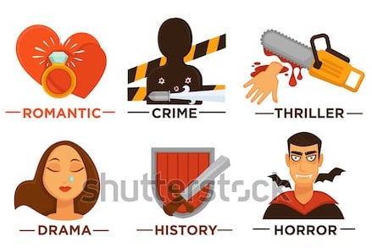
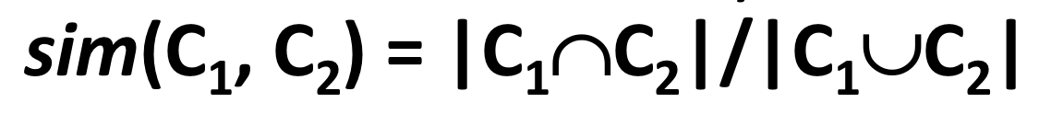
3.2 JACCARD-SIM BASED ON GENRES
Each movie has a list of its genres.
OUTPUT
Jaccard similarity based on genres for each movie pair.

Slide 9
3.3 K-SHINGLING, MINHASHING, LSH
Vocabulary containing 3 word shingles of each script
Computed min-hash signatures
Applied LSH to determine candidate pairs
Tested results
It turns out the algorithm works only for near duplicates.
OUTPUT
1 if movie script pair falls into the same bucket
0 otherwise

Slide 10
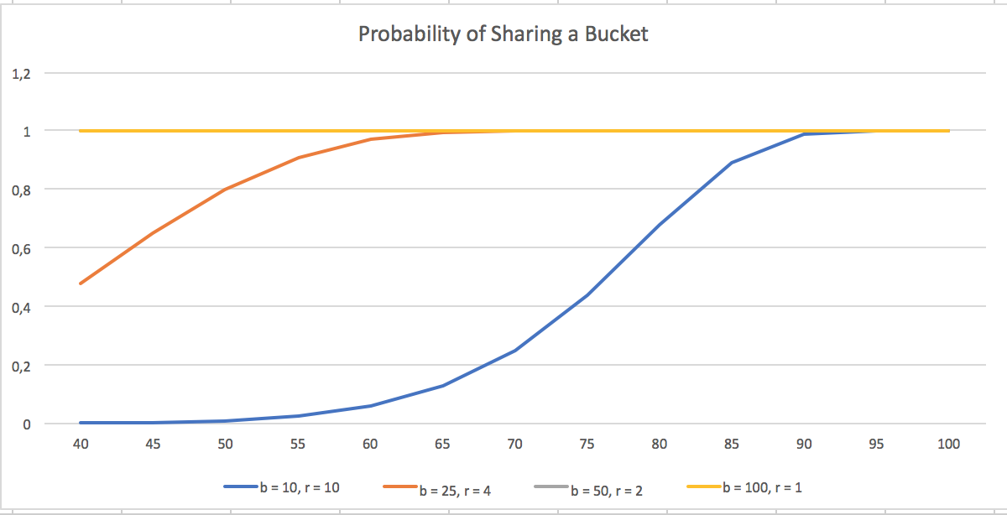

Slide 11


Similarity | b = 10, r = 10 | b = 25, r = 4 | b = 50, r = 2 | b = 100, r = 1
100 | 1 | 1 | 1 | 1
95 | 0,9999 | 1 | 1 | 1
90 | 0,9863 | 1 | 1 | 1
85 | 0,8884 | 1 | 1 | 1
80 | 0,6789 | 1 | 1 | 1
75 | 0,4399 | 0,9999 | 1 | 1
70 | 0,2491 | 0,9990 | 1 | 1
65 | 0,1268 | 0,9927 | 1 | 1
60 | 0,0588 | 0,9689 | 1 | 1
55 | 0,0250 | 0,9092 | 1 | 1
50 | 0,0097 | 0,8008 | 1 | 1
45 | 0,0034 | 0,6489 | 1 | 1
40 | 0,0010 | 0,4771 | 0,9998 | 1
same bucket for first test
same bucket in both first and second tests

Slide 12
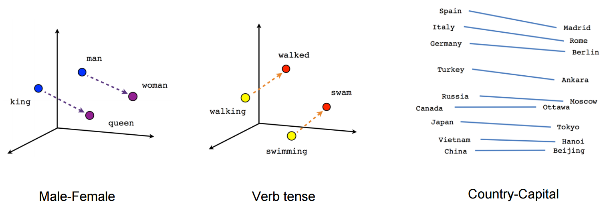
3.4 WORD2VEC
Word2vec is a two-layer neural net that processes text. Its input is a text corpus and its output is a set of vectors: feature vectors for words in that corpus.
pretrained vectors on wikipedia data
word2vec averages of each script
calculated cosine distance of each pair
normalized the distance
OUTPUT
Cosine similarity of Word2Vec averages of movie script pairs.

Slide 13
3.5 K-MEANS CLUSTERING
K-means clustering aims to partition n observations into K clusters in which each observation belongs to the cluster with the nearest mean.
Word2vec vectors of each word in a script
Clustered these words into 10 clusters
Centers of these clusters as a vector represent the movie
Clustered the movies into 3 clusters
Problem:
Different orderings of centers in vectors results in different outputs.
OUTPUT
Similar movies fall into the same cluster.
https://plot.ly/~eliztekcan/20/#/

Slide 14
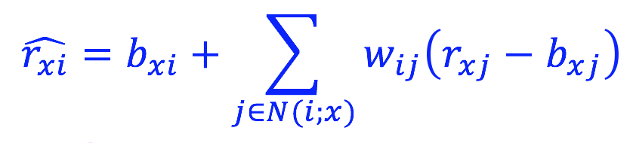
4. VALIDATION METHOD
COLLABORATIVE FILTERING WITH INTERPOLATION WEIGHTS

Slide 15
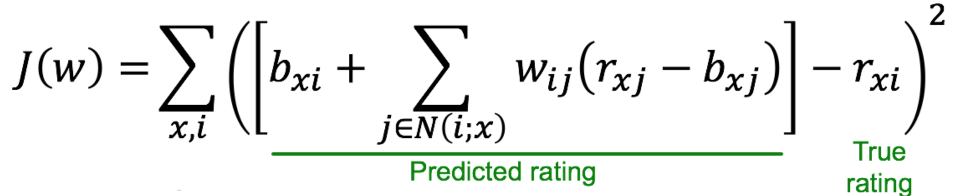
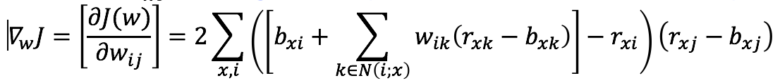
GRADIENT DESCENT

Slide 16
5. RESULTS & DISCUSSION
Cosine Similarity based on TF-IDF
For movies from the same movie series, proper names dominate TF-IDF result. Thus, they are seen as similar. On the contrary, for movies similar but from different movie series, various words dominate the result. So, they are not seen as similar.
Jaccard Similarity based on Genres
Similar movies are most likely to have many common genres. Since in dataset has some error, such as movies are from the same series do not have jaccard similarity which is 1. It leads to wrong results.
K-shingling, Min-hashing, LSH
This method is used to detect near duplicates. However, movies are never that much similar. Thus, the probability that movie pairs fall into the same bucket is too low.

Slide 17
5. RESULTS & DISCUSSION
Word2Vec
We did not observe negative effect of this algorithm.
K-means Clustering
Different orderings of centers in vectors result in different outputs. Cluster centers emerged as stop-words, such as however, so, etc.
SSE (Sum of Square Error) [ # of users , # of films ] = [ 10000 , 808 ]
Collaborative Filtering: SSE is about 281770
Collaborative Filtering with Interpolation Weights: SSE = 769.0788 when [ Rate , Epoch ] = [ 10^-5 , 200 ]
Mixture of both: SSE = 769.3347

Slide 18
WHAT TO DO NEXT?
Adjust different coefficients for used algorithms
Apply “ j in N(i; x) “ part at Collaborative Filterings
Randomized hyperplanes on TF-IDF

Slide 19
6. CONCLUSION
CF with interpolation weights performs well
Same applies for SVD with SGD
No correlation between semantic features of scripts and genres
k-shingling and minhashing is useful near duplicate
Semantic and syntactic similarity of scripts serves no purpose in recommendation systems

Slide 20
7. REFERENCES
[1] Jure Leskovec, Anand Rajaraman, Jeffrey D. Ullman, Mining of Massive Datasets. Cambridge University Press New York: 2011
[2] https://www.kaggle.com/grouplens/movielens-20m-dataset/version/1
[3] https://figshare.com/projects/imsdb_movie_scripts/18907
[4] http://www.omdbapi.com/

