Slide 1


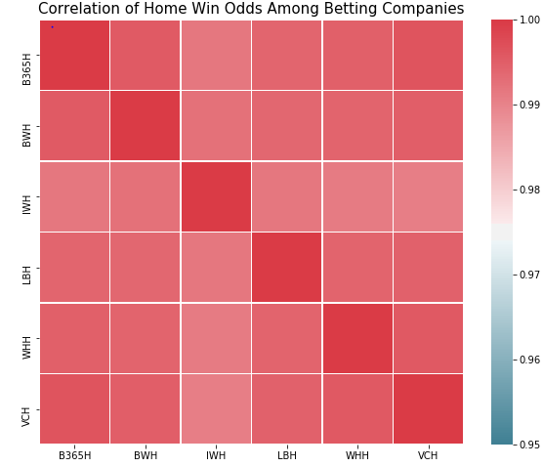
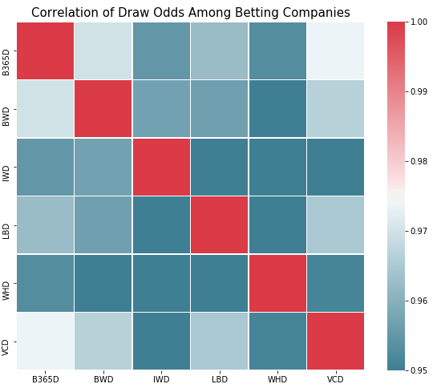
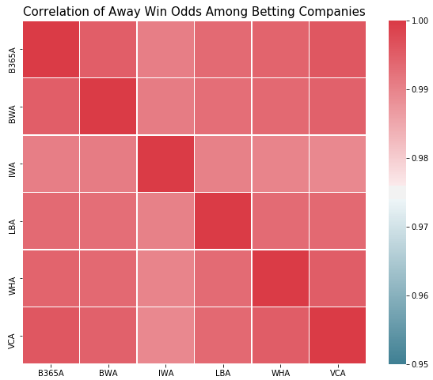
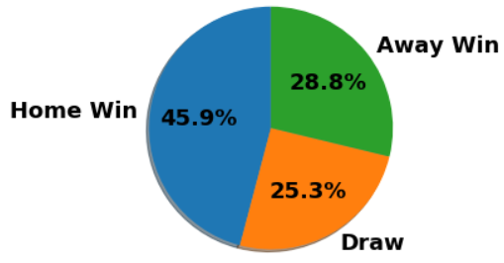
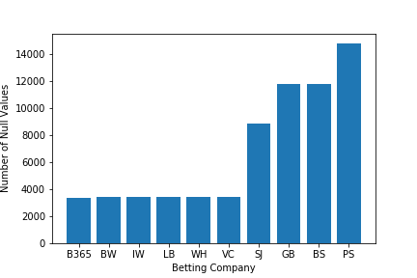
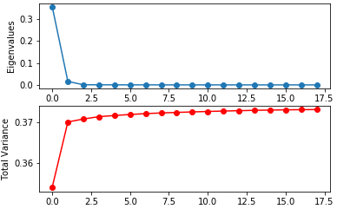

Uncovering the Great Betting Conspiracy
Mete Morris, Jiwon Lee, Jonghae Lee
Johns Hopkins University | Whiting School of Engineering | Baltimore, MD
Introduction
Results
Our objective is to analyze the accuracy of soccer betting companies based on empirical data from the European Soccer Database. We look at the betting odds of each company and compare real-life
results. Furthermore, we then implement classification methods to create our own predictions about soccer match outcomes and
compared them against the betting companies. In total, we looked at 6 companies and their betting odds for wins, losses, and draws for home and away teams for 22432 matches.
Figure 1— Correlation Matrix of Betting Odds Among Different Betting Companies
Betting odds are highly correlated!
Data Pre-Processing
Figure 4 _ Title
Text
Eliminate 4 betting companies with too many null values – threshold was 3500 (15%)
Removed any matches with any null values from any of the remaining 6 companies
25979 Original Matches 10 Betting Companies
22435 Processed Matches 6 Betting Companies
Figure 2—Title
Text
Figure 5 – Title
Text
Figure 3—Title
Text
Conclusion
Text
From decimal odds, we calculated the percentage chance that the betting companies associated using formula (left).

