Slide 1
Airway Management, Respiration, and Artificial Ventilation
Chapters 9-10

Slide 2
Upper Airway vs Lower Airway
Upper airway
  Begins at the mouth and nose
  The pharynx lies posterior and inferior to the mouth and nose
    Oropharynx is the upper portion
    Nasopharynx is the middle portion
    Laryngopharynx is the lower portion
  The larynx is the boundary between the upper and lower airways
Lower airway
  The trachea lies below the larynx
  Mainstem bronchi branch from the trachea and progressively become smaller
  Alveoli lie at the end of the bronchi
    Pulmonary capillaries surround the alveoli
    Oxygen and carbon dioxide are exchanged at the capillary

Slide 3
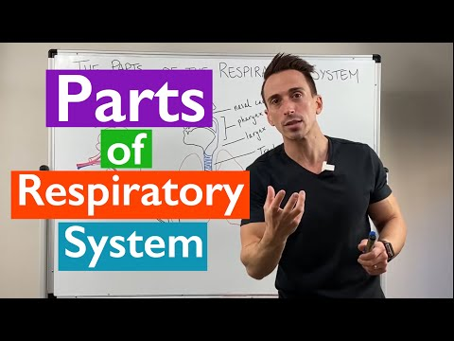
Anatomy of the Respiratory System

Slide 4
How is the pediatric airway different? Think the same anatomy, in a smaller space, that is proportionately larger
Airway structures of infants and children are shorter, narrower, and less rigid than in adults
  Mouth and nose are smaller and easily obstructed
  Tongue is proportionately larger
  Newborns and infants are nose breathers
  The trachea is softer, more flexible, and narrower and easily obstructed by swelling and foreign objects
  The chest wall is softer
  Breathing is more dependent on the diaphragm

Slide 5
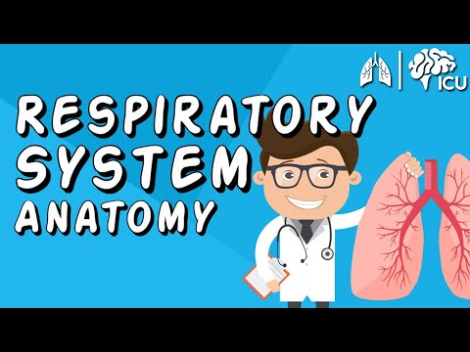
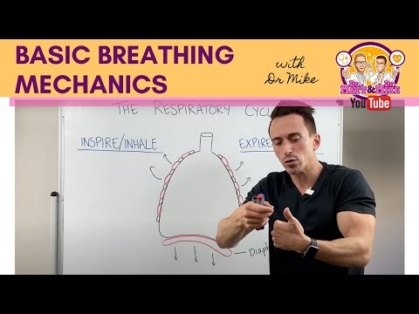
Breathing mechanics

Slide 6
Breathing Mechanics
Ventilation is the process of moving air into (inhalation) and out of (exhalation) the chest
Inhalation is an active process
  Chest muscles expand and the diaphragm contracts
  The size of the chest increases
  Negative pressure pulls air into lungs
  Exhalation is a passive process
Exhalation is a passive process
  Chest muscles and the diaphragm relax
  The size of the chest decreases
  Positive pressure pushes air out of the lungs
Tidal volume is the mount of air moved in one breath
Minute volume is the amount of air moved into and out of the lungs per minute
Ventilation is designed to move air to and from the alveoli for gas exchange
  Not all of the air breathed reaches the alveoli
  Some air occupies dead space
Alveolar ventilation refers to the amount of air that actually reaches the alveoli
  It can be altered by changes in rate or volume
  It depends heavily on tidal volume, but is affected by very fast or very slow rates

Slide 7
Breathing Physiology
Alveoli form the ends of the bronchial tubes
  Bunches of sacs are inflated and ventilated as air moves in and out
  Each alveolus is a bubble-like structure
Pulmonary capillaries bring blood close to the sacs
Thin alveoli and capillary walls allow for gas exchange
  Oxygen in the alveoli moves into the blood
  Carbon dioxide in the blood moves into the alveoli
Diffusion is movement of gases from an area of high concentration to an area of low concentration
Pulmonary respiration is diffusion of oxygen and carbon dioxide between the alveoli and the circulating blood
Cellular respiration is diffusion of oxygen and carbon dioxide between the cells and the circulating blood
In order for pulmonary and cellular respiration to occur, the respiratory and circulatory systems work in conjunction
  This is sometimes called the cardiopulmonary system
  It may also be called a ventilation-perfusion (V/Q) match
When either the respiratory or circulatory system fails, the process of respiration is defeated

Slide 8
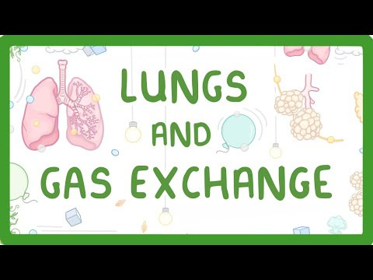
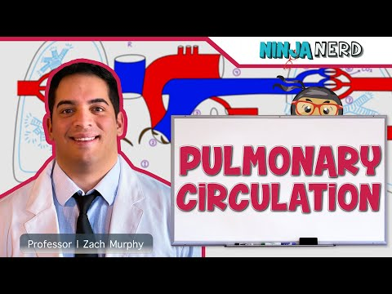
Gas exchange and the Cardiopulmonary system

Slide 9
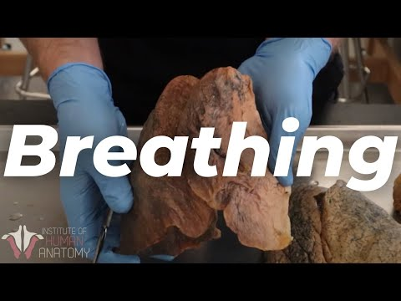
Breathing and Gas Exchange
“Ok, quick recap: Gas exchange between blood and alveoli, as well as between blood and tissue cells, take place by simple diffusion.
At the respiratory membrane, where the alveolar and capillary walls meet, gases move across the membranes, with oxygen entering the bloodstream and carbon dioxide exiting.
Besides the surface area of the alveolo-capillary membrane, the partial pressure gradients of the gasses and the matching of perfusion and ventilation are vital for the exchange to happen.”
Gas exchange in the lungs, blood and tissues | Osmosis

Slide 10
When things go wrong
When the cardiopulmonary system fails, the body compensates for hypoxia or hypercapnia
  Chemoreceptors stimulate the respiratory system to breathe more rapidly
  Respiratory rate and heart rate increase and blood vessels constrict
  Hypoxia is a low level of oxygen function
  Hypercapnia is a high level of carbon dioxide
Respiratory distress
  Compensation is working
  The patient has normal mental status, skin color, and oximetry readings
Respiratory failure (inadequate breathing)
  Compensation is not working
  Metabolic needs of the body are not met
Respiratory failure is a precursor to respiratory arrest (where you stop breathing all together…if not corrected it leads to cardiac arrest).

Slide 11

Lung Sounds
Four sounds can be indicative of limited air movement
  Stridor—High-pitched whistling sound; indicative of a severely narrowed air passage
  Hoarseness—Raspy change in voice; indicative of swelling around the vocal cords
  Snoring—Similar to a snore during sleep; indicative of diminished muscle tone
  Gurgling—Bubbling sound; indicative of vomit, blood, or secretions in the airway

Slide 12
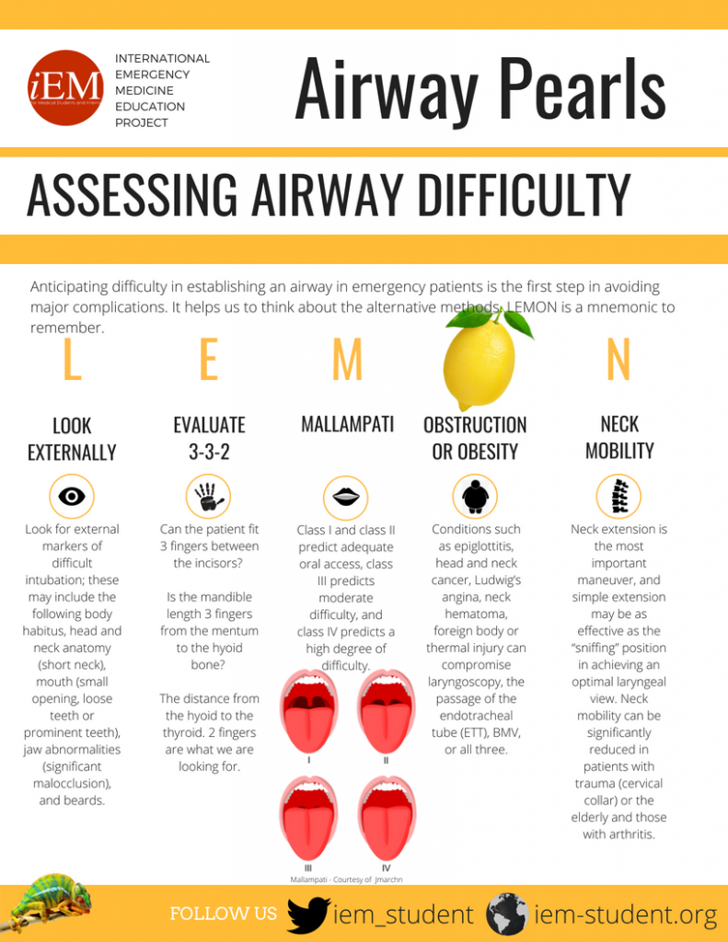
Airway Assessment leads to Airway Management
Airway assessment is not just a moment in time, but a constant consideration
  This is especially true in critical care patients
  You may need to consider how to keep an airway open immediately after establishing it
When the airway is partially obstructed, you must consider how long until it will be completely obstructed
The ability to maintain an airway can change over time
  Mental status affects the ability to maintain an airway
  There is no guarantee an airway will remain open
REMEMBER: ABC problems are what kill your patient first! ABC’s are not just a one and done. They need constant treatment, re-evaluation, and in some patients, you never make it past the ABC’s

Slide 13
How to manage an airway
Medications for an EMT:
Duoneb
Albuterol
Oxygen
  NRB
  NC
  NEB
  In some states and agencies…CPAP
  i-Gell (if they are unresponsive to pain)
Medications for a Paramedic:
Racemic Epinephrine
Epinephrine
Dexamethasone
Magnesium (in really bad asthmatic attacks)
Note(s):
Suction is your friend, but will not prove to be effective if there are solid objects obstructing the airway…sometimes chest/abdominal trusts, compressions, finger sweep, etc may be better options
Keep a bottle of saline nearby when using a french catheter to help clear the line if it gets clogged
If your medic is getting ready for an intubation, have an I-Gell ready as a backup airway
On a cardiac arrest, you may need two suction units to keep the airway clear
How can we manage the airway?
Repositioning:
Head tilt chin lift
  Use when no C-Spine precautions are not required
Jaw thrust
  Use when C-Spine precautions are required
Pillow or blanket under the shoulder blades
  This works great for children, no c-spine
Raising the head of the gurney
  Works great if you have a patient who is intoxicated and snoring
BLS Airway management tools:
OPA
  Measure corner of mouth to ear lobe
  Use when there is no gag reflex/no pain response
NPA
  Measure from nose to the ear lobe
  Use when there is no facial/head trauma and they have a gag reflex/pain response
    Note: NPAs are still painful
I-Gel

Slide 14
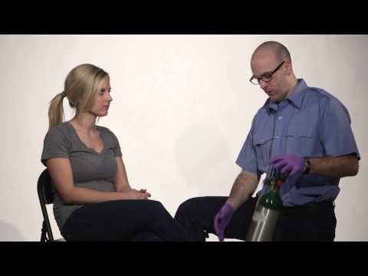
How to place on a NRB
If you have a really sick patient, and they are really struggling to breath, and you can not CPAP or bag, you have the option of blasting them with 25 LPM of O2 through a NRB (that is not the NREMT way, but the in field way)
You can take off the mask of the NRB and put it on an nebulizer acorn to have a mask version of the nebulizer if they can not hold the nebulizer in their mouth

Slide 15
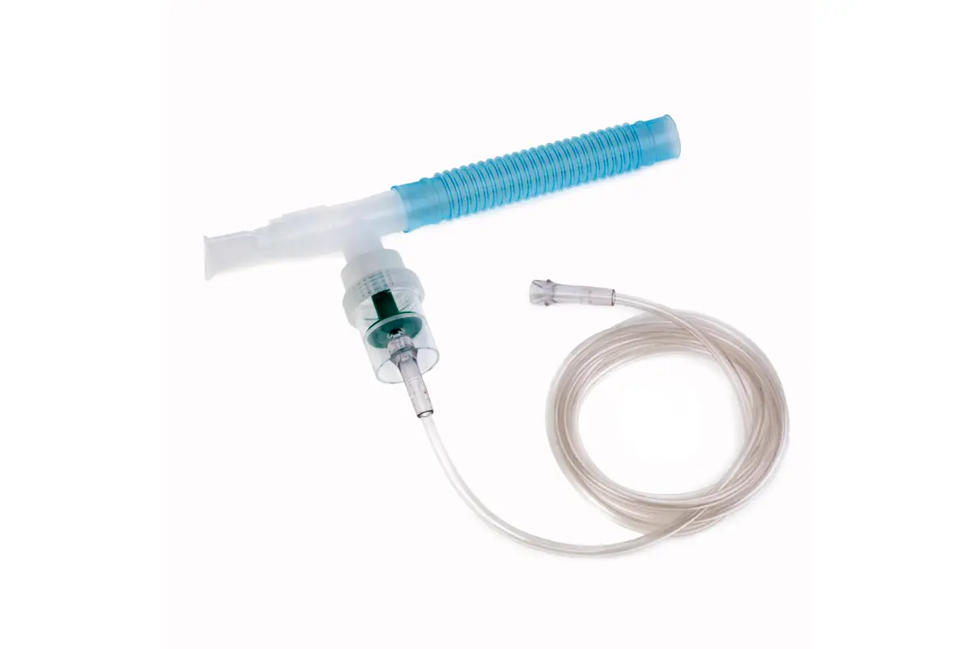
Small volume Nebulizer
Elephant trunk aka “the bendy piece)
You can take off the mask of the NRB and put it on an nebulizer acorn to have a mask version of the nebulizer if they can not hold the nebulizer in their mouth
Normally, 6-8 lpm of O2 is being applied to a nebulizer. Any more than 8 lpm can make the medication not atomize appropriately depending on your nebulizer
Mouth piece
O2 tubing
Acorn aka the place for your medication

Slide 16
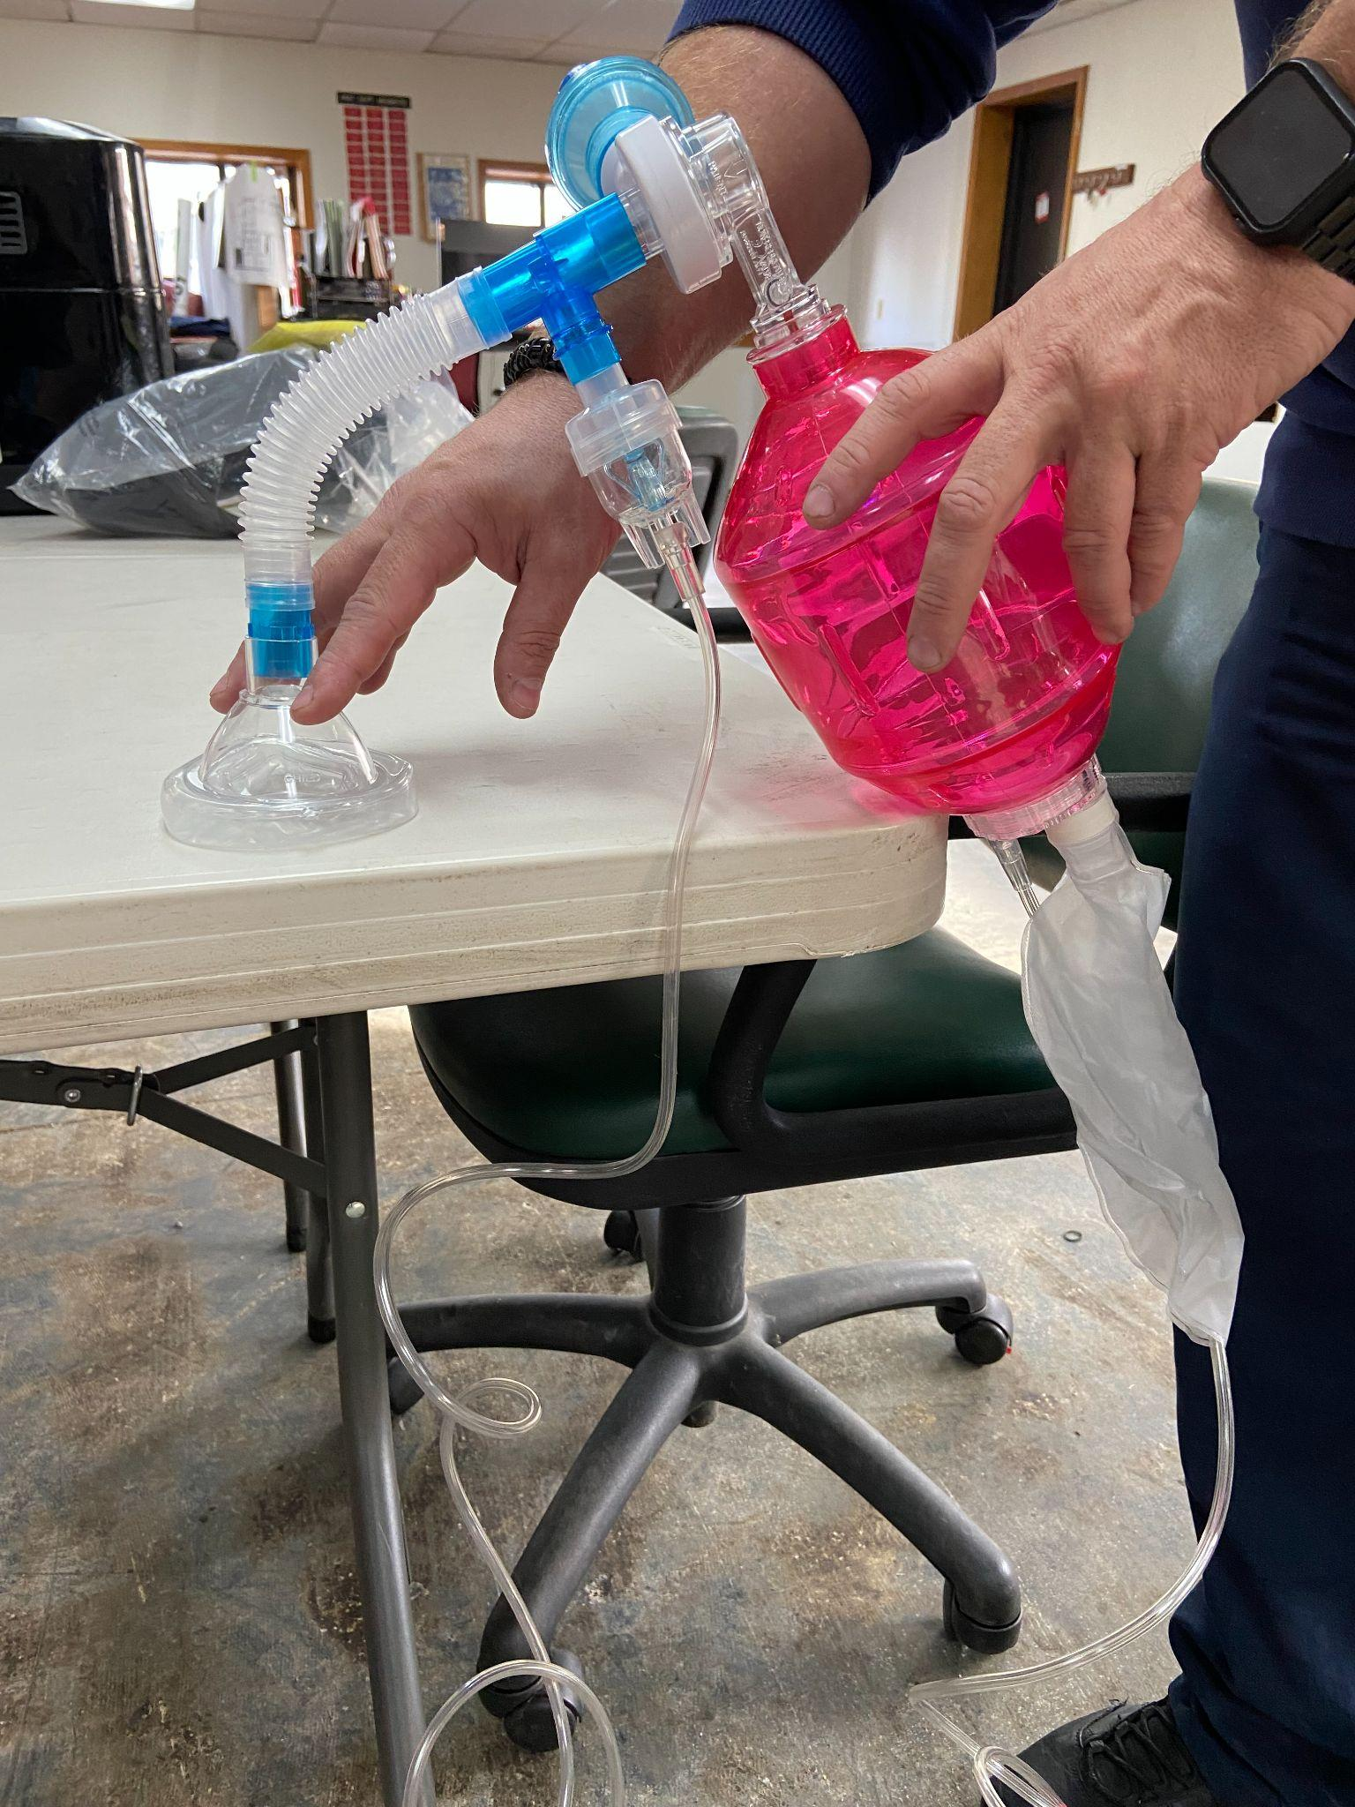
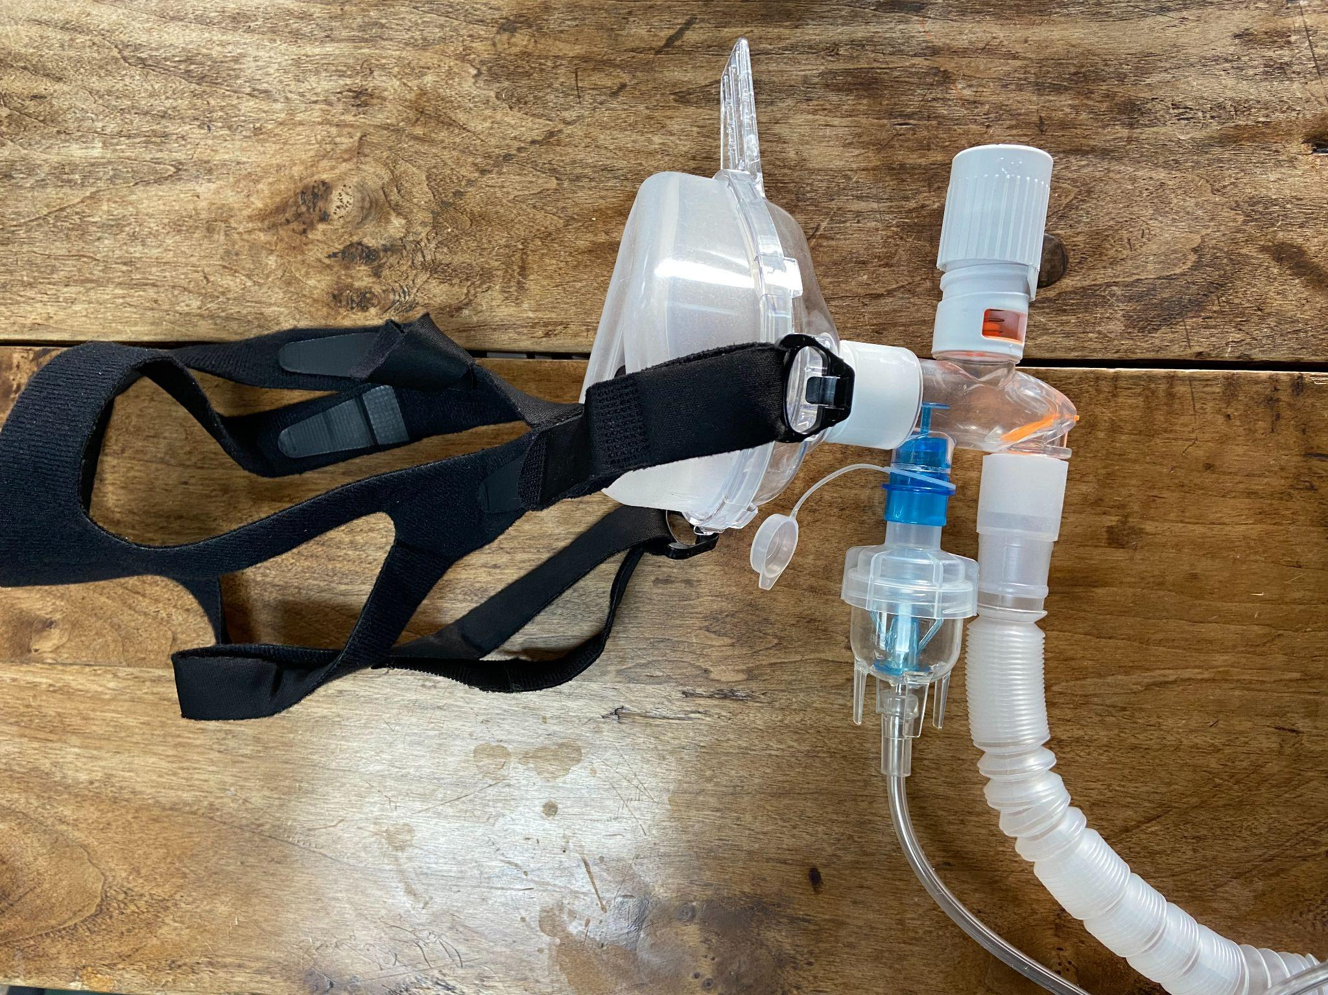
DuoNeb on CPAP and BVM
You will need two O2 sources (one for the neb and one for the CPAP or the BVM)
Positive pressure ventilation gets the medication down farther that if the pt were to just breathe it in
***This is not something that i learned in EMT school and I teach this to all of my EMT partners because I use it so often and it works so well!!!
Notes:
This is something i was never taught in school, and i wish i had, because the amount of times i have my partners set this up for me is crazy. So, as we know, duonebs are nebulized albuterol. If a pt is really constricted or having a hard time breathing, they are only going to get that medication so deep into their lungs on their own. So, so make this more effective, you can put a duo nub on a BVM or a CPAP. To do this you are going to need two O2 sources. With the CPAP it just clips onto the bottom. A BVM, that takes a little more mcgivering. You take you T and your multi adaptor and connect the duoneb to the bvm, then you will take that plastic tube from your neb packet, and attach the multi adaptor to the mask. This way you can keep the BVM upright enough for the medication to vaporize properly.

Slide 17
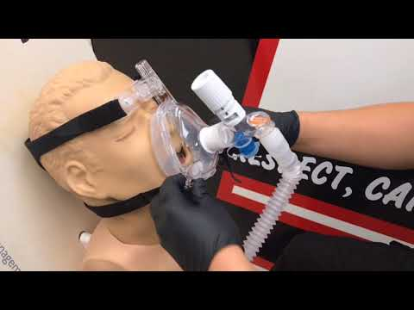
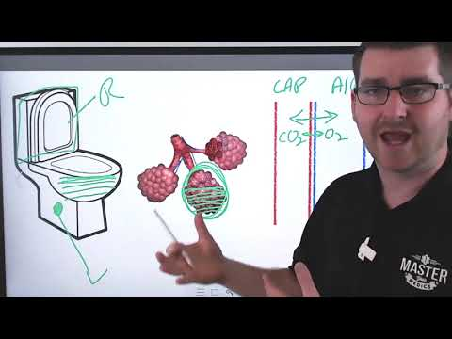
All things CPAP
The best way i have found to help prep a pt for how CPAP is going to feel is by saying to them “imagine you are diving down the freeway. You roll down the window and stick your head out. That is how CPAP is going to feel, you are going to have to breath against the air when you breathe out.”

Slide 18
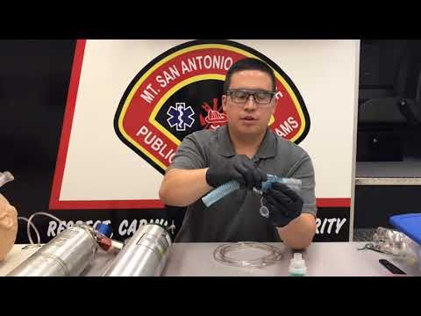
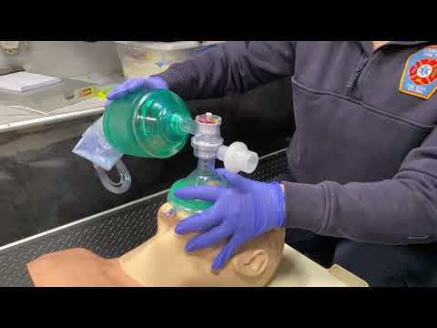
All things BVM
Neb on a BVM
BVM on an i-Gell

Slide 19
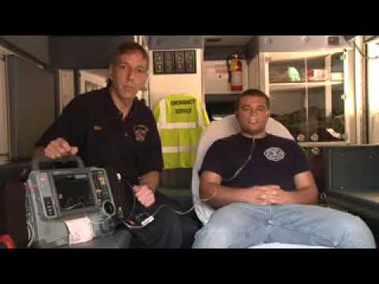
Waveform Capnography
If you are my partner…I want ETCO2 on everyone who has CPAP, BVM, or breathing too fast/slow/not deep enough
Normal ETCO2 is 35-45
Pro Tip: place one of these on all your overdose patients so you can monitor their respiratory rate easier
5 ETCO2, capnography, respiratory distress tips (ems1.com)

Slide 20
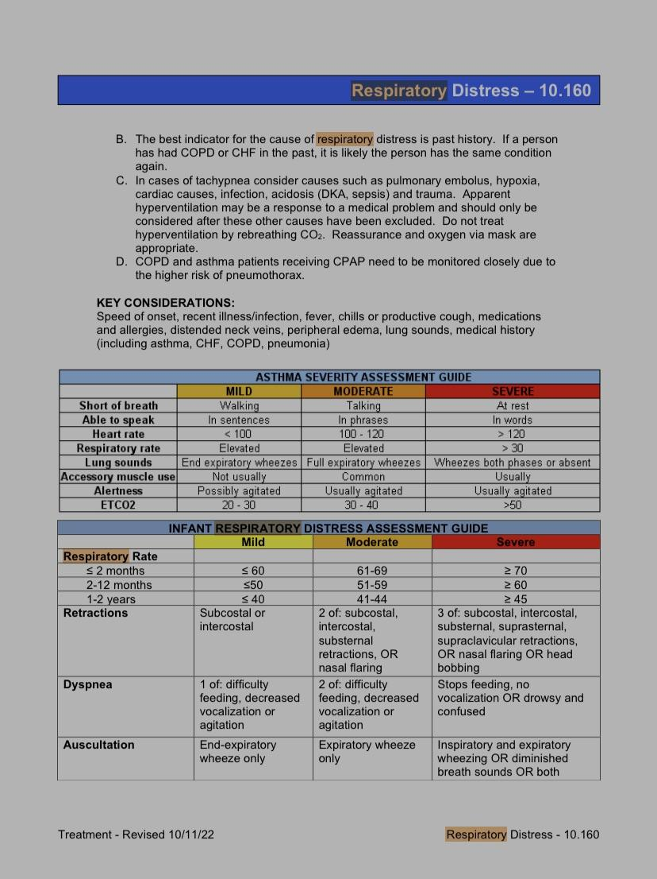
So how bad is it?
This is just an example of how to help gauge just how bad a person’s respiratory difficulty is.
Also keep in mind that very obese people can not lay flat due to the pressure on their chest prevents them from breathing well. Sometimes, just sitting them up helps a ton

Slide 21
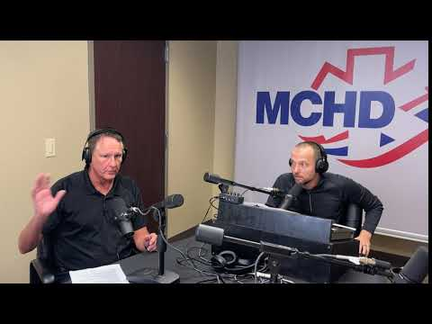
Airway protection vs patentency

Slide 22
Quizlet Resource
Airway Management, Respiration, and Artificial Ventilation Flashcards | Quizlet
Any questions?

