Slide 1
Cloud: parcel? Model?
By Chenxi Qiu & Edward Groot

Slide 2
Content
The content

Slide 3
Mixing
Model: dynamic equations – sources/sinks
Mixing
W
Cloud content
Buoyancy*
Mixing
Evaporation
θ
Melting
Condensation
Freezing (&ice deposition)
Mass

Slide 4
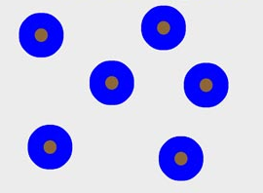


Model: moisture & cloud processes
VAPOR
E
<100% RH
C
100% RH
Parameterization based on Rotstayn et al. (2000), between 0 and -38°C
Slow
WL > WL.thres
Leaves parcel
M
0°C
D
F
-38 °C
Fast
WI > WI.thres
First step
Second step
Third step

Slide 5
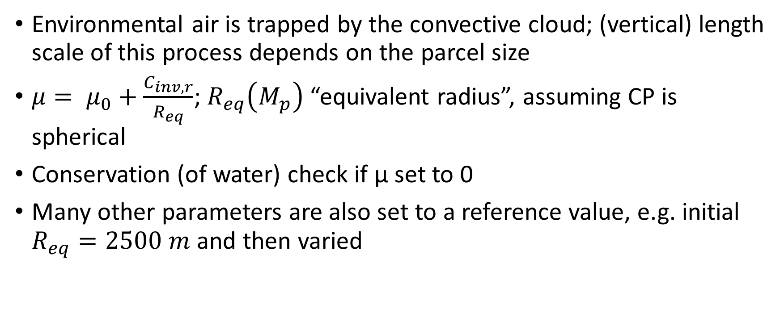
Dynamic entrainment
Environmental air is trapped by the convective cloud; (vertical) length scale of this process depends on the parcel size
$μ= μ_{0}+\frac{C_{inv,r}}{R_{eq}}$; $R_{eq}\left(M_{p}\right)$ “equivalent radius”, assuming CP is spherical
Conservation (of water) check if μ set to 0
Many other parameters are also set to a reference value, e.g. initial $R_{eq}=2500 m$ and then varied

Slide 6
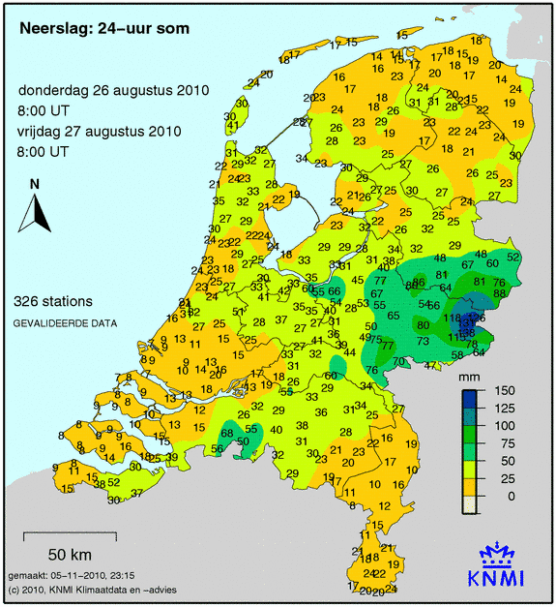
Environmental profile + assumptions
Observations of August 26th 2010 12 UTC/GMT in Essen, Germany
Slightly modified, assuming enriched moisture at ±3 km
Classical “surface based” convection
Linear interpolations between nearest levels
Initial small disturbance T & water vapor
Convective rain event in Gelderland & Overijssel

Slide 7
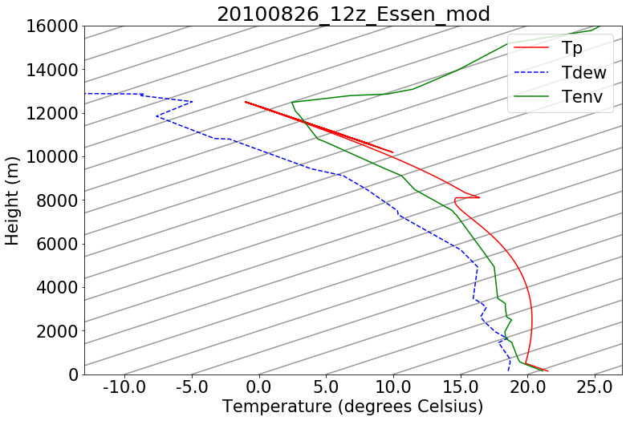
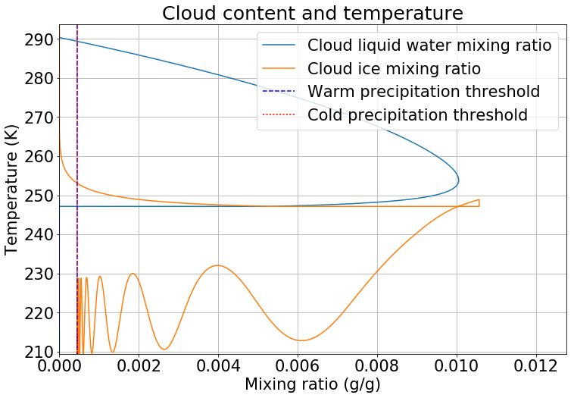
No entrainment
time
isotherms
Z (m)
time
0 °C
Mean precipitation over the final area of the parcel: 4.40 mm

Slide 8
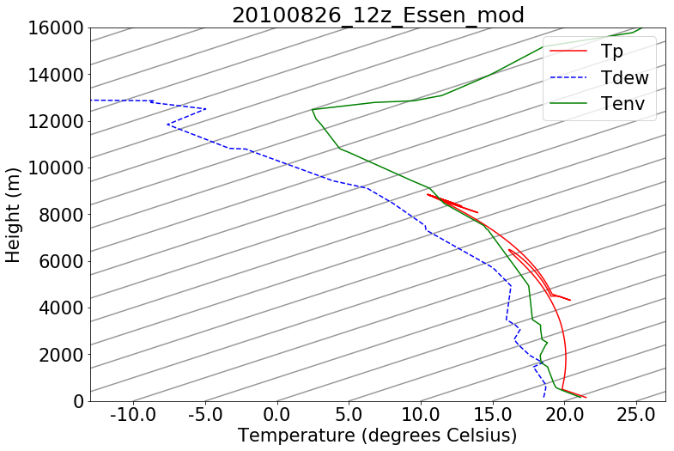
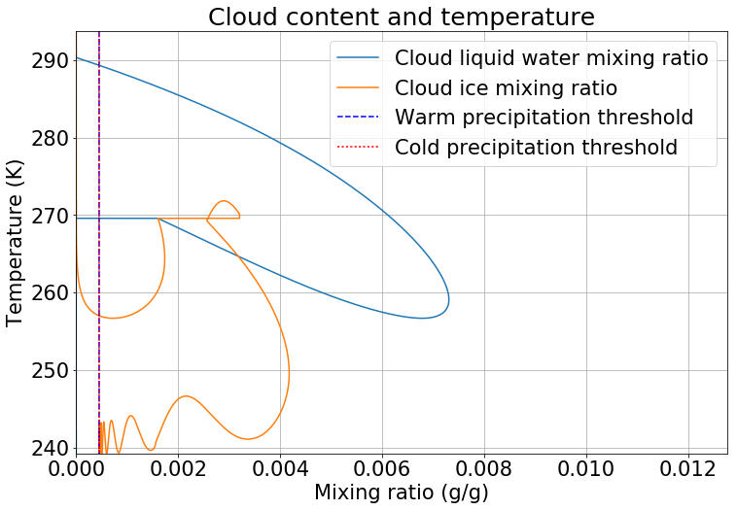

Constant entrainment $μ_{0}=5×{10}^{−5}$
time
isotherms
Z (m)
time
0 °C
Cinvr = 0.00, Mean precipitation over the final area of the parcel: 3.97 mm

Slide 9
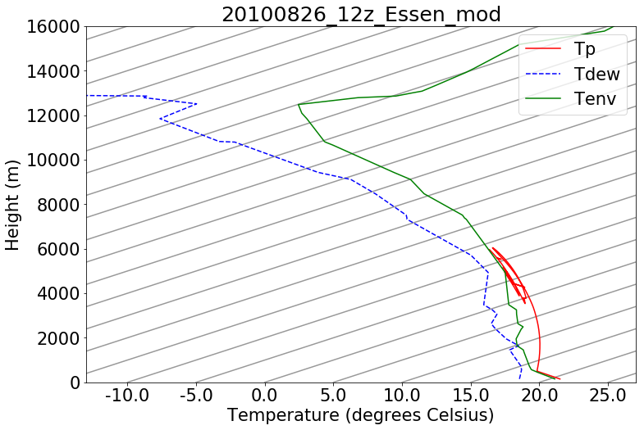
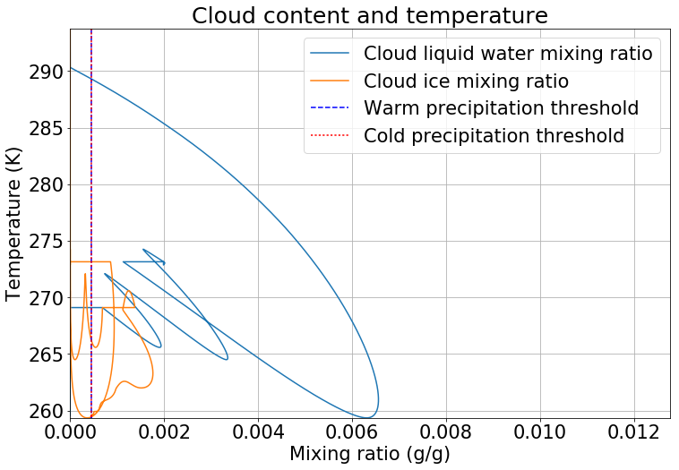


Full entrainment $μ= μ_{0}+\frac{C_{inv,r}}{R_{eq}}$
time
isotherms
Z (m)
time
0 °C
Reference run - $μ_{0}$ = 5e-5 & $C_{inv,r}$ = 0.16: 4.99 mm areal mean precipitation

Slide 10
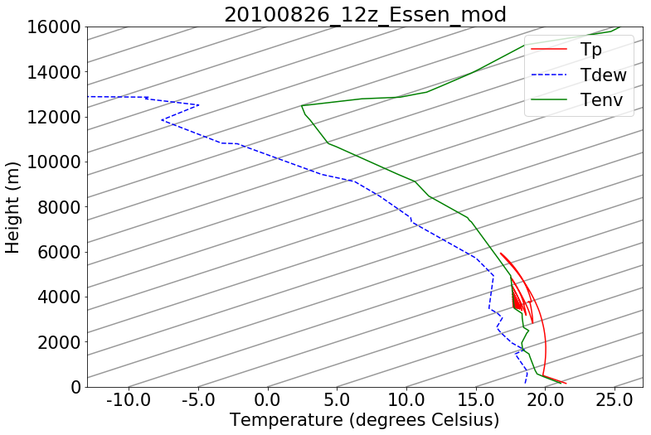
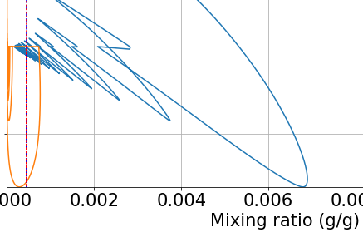
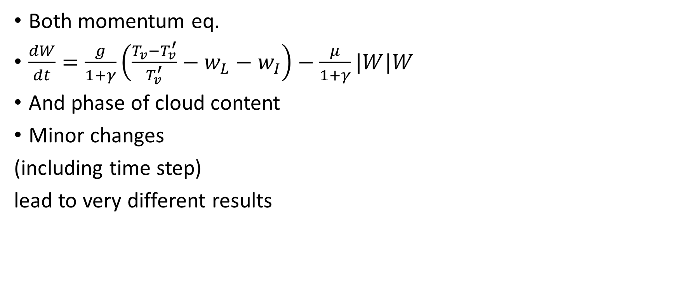
Very sensitive
Both momentum eq.
$\frac{dW}{dt}=\frac{g}{1+γ}\left(\frac{T_{v}−T_{v}^{′}}{T_{v}^{′}}−w_{L}−w_{I}\right)−\frac{μ}{1+γ}|W|W$
And phase of cloud content
Minor changes
(including time step)
lead to very different results
Tmelt

Slide 11
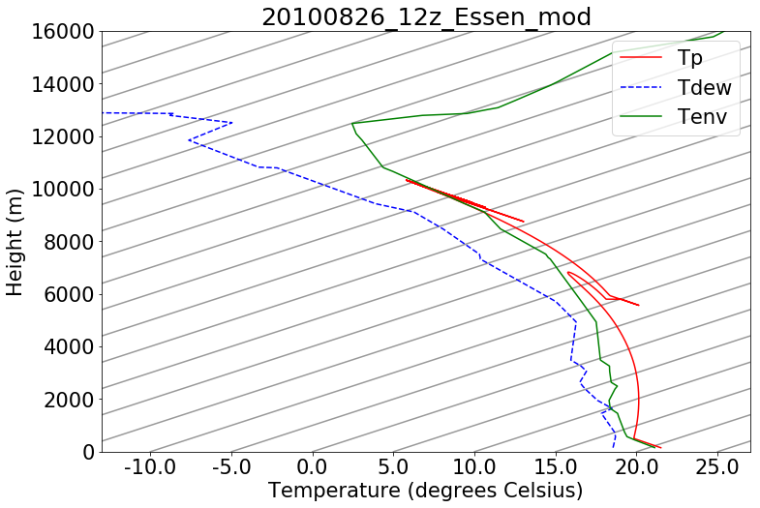
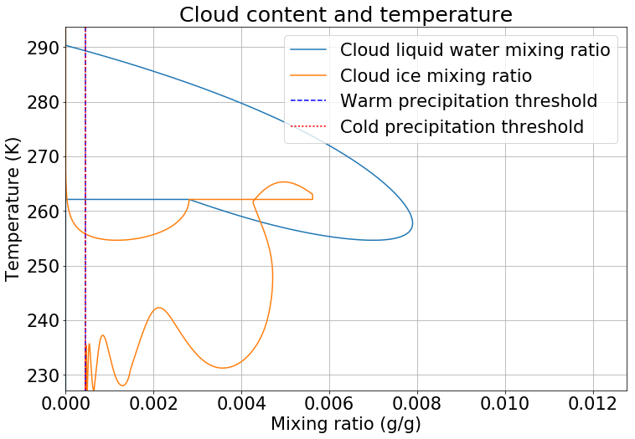
Change of μ0 to 0
Mean areal precipitation of 4.40 mm

Slide 12


Change of μ0 to 2e-5
Mean areal precipitation of 4.29 mm
We did more experiments

Slide 13
Change initial Req
Reference value: 2500 m; reasonable values 300-5000 m
No cloud at 10 m and negligible at 100 m
At 500 m: cloud with negligble ice content, very little precipitation (<0.1 mm)
But cloud has relevance for environmental moisture at z = 2.5-3 km
With 2500 m: result already shown as “full entrainment”

Slide 14

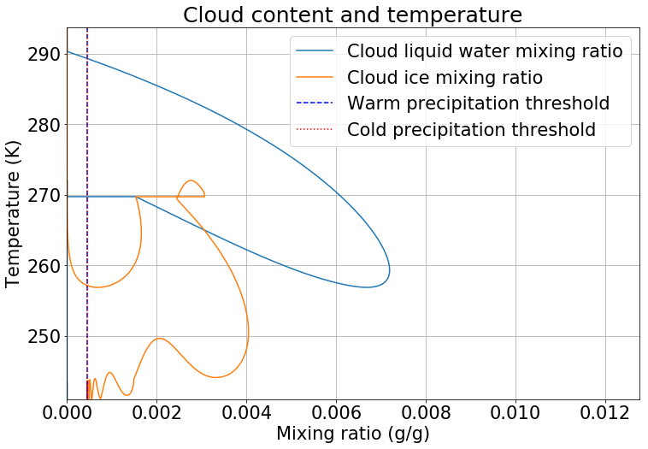
Change initial Req: 5000 m
Mean areal precipitation is 9.22 mm.

Slide 15
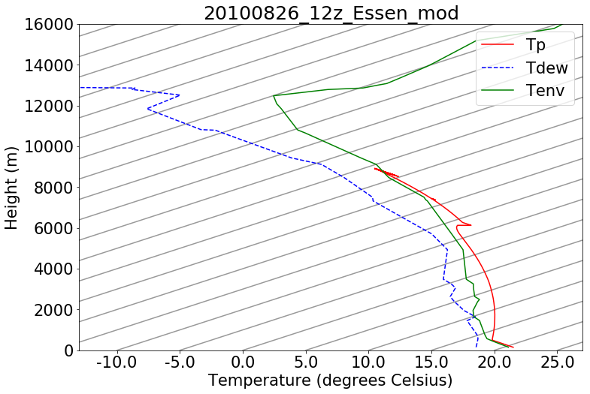
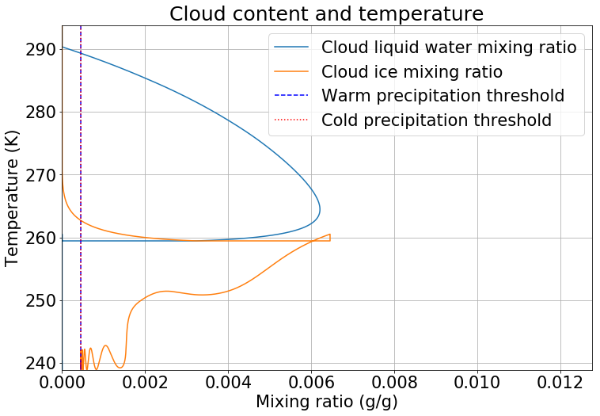

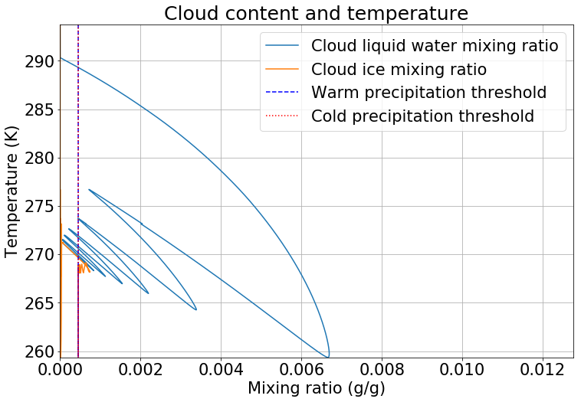
Sensitivity cloud water to ice conversion
If we set the ice initiation lower, little ice is initiated and less (mostly “warm”) precipitation can be produced
At superfast rate (mean precipitation 3.7 mm): 100% ice at 260 K
Heat of fusion may be important buoyancy push, although small (< 2K)
Cconv=50 Cconv=1

Slide 16
Sensitivity upper air moisture
Reduction of moisture above 2 km
Reduction | Precipitation
5% | 2.34
25% | 0.34
50% | 0.18
99% | 0.11

Slide 17
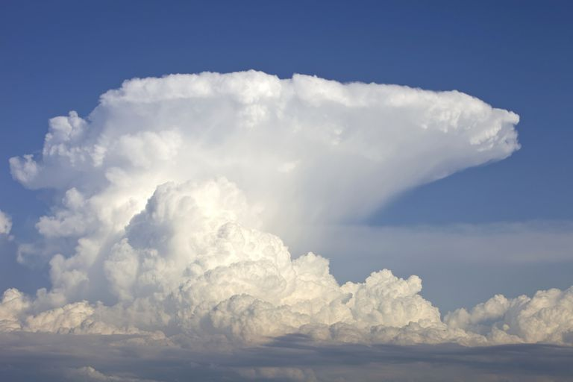
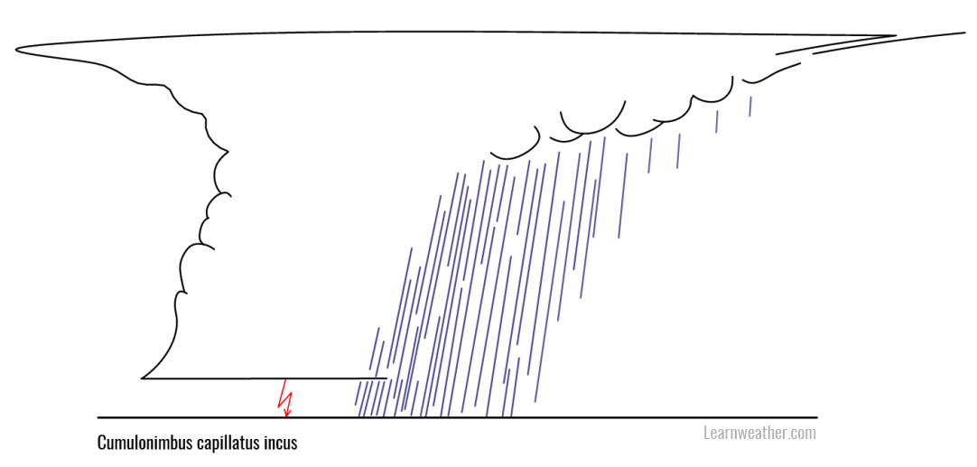
Discussion
Horizontal dynamics excluded in parcel model, but essential as “sorting mechanism”

Slide 18


Discussion
No oscillatory behavior in reality, but either dissipation or persistance due to role of horizontal dynamics
In this model, condensed water or ice is either inside or outside the parcel but does not go somewhere
Interaction parcel & cloud content
Limitation of parcel model
Over-sensitivity of mixed clouds for 260-273 K temperature?
But in general the parameterizations (foremost conversion to ice) are hugely simplified
No sublimation/riming (via liquid water)

Slide 19
Conclusion

Slide 20
Thank you for your attention

