Slide 1
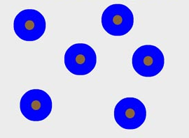


VAPOR
E
<100% RH
C
100% RH
Parameterization based on Rotstayn et al. (2000), between 0 and -38°C
Slow
WL > WL.thres
M
0°C
D
F
-38 °C
Fast
WI > WI.thres
First step
Second step
Third step

Slide 2
Mixing
Mixing
Evaporation
θ
Melting
Mass
Condensation
Freezing (&ice deposition)
W
Cloud content
Buoyancy
Mixing

