Slide 1
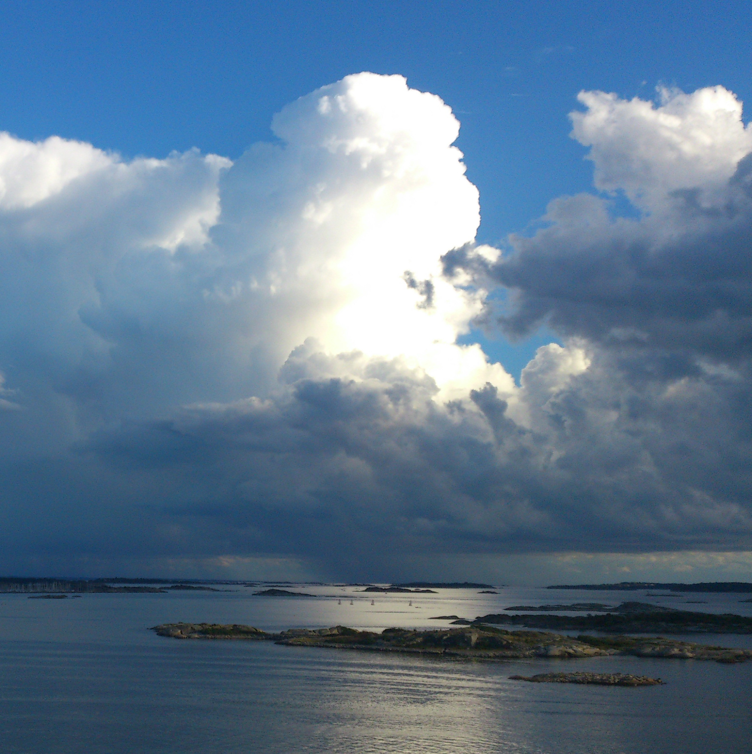
Cloud: parcel? Model?
By Chenxi Qiu & Edward Groot
November 1st, 2018

Slide 2
Aim of the model
Relevance of some processes for convective cloud:
Environment
Phase of cloud (liquid/ice/mixed)
Entrainment

Slide 3
Model: dynamic equations
Sources
Sinks
Condensation
Evaporation
θ
Freezing (&ice deposition)
Melting
Mixing
Mixing
Cloud content
w
Buoyancy
Mixing
Buoyancy
parcel mass
Mixing

Slide 4
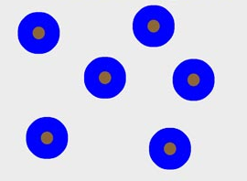
Model: moisture & cloud processes
VAPOR
E
<100% RH
C
100% RH
First step
Second step
Third step

Slide 5
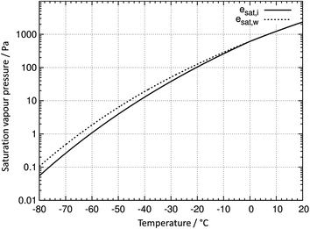

Model: moisture & cloud processes
VAPOR
Parameterization based on Rotstayn et al. (2000), between 0 and -38°C
E
<100% RH
C
100% RH
D
M
0 °C
F
-38 °C
First step
Second step
Third step

Slide 6

Model: moisture & cloud processes
VAPOR
E
<100% RH
C
100% RH
Slow
WL > WL.thres
Fast
WI > WI.thres
D
M
0 °C
F
-38 °C
leaving parcel
First step
Second step
Third step

Slide 7
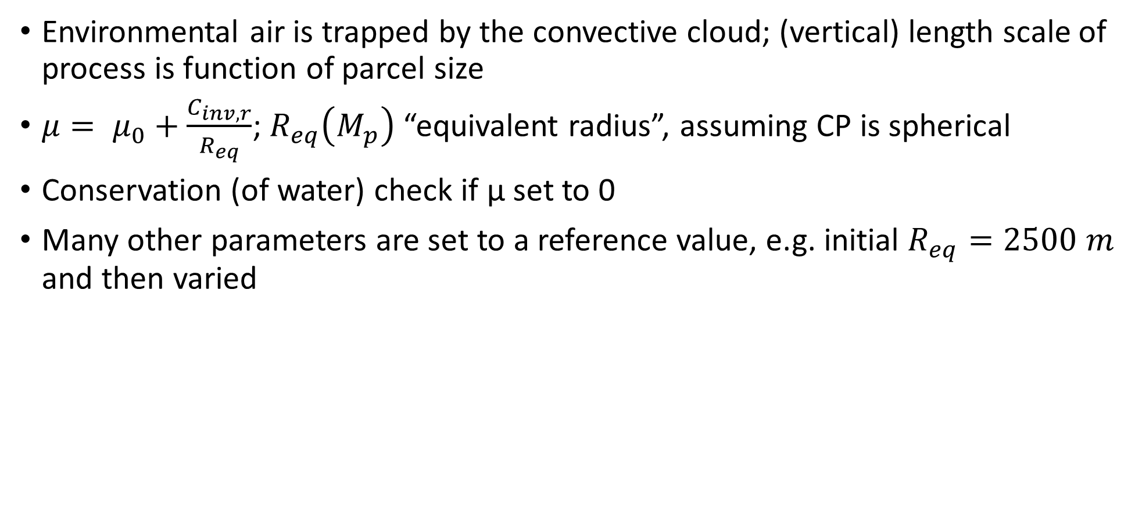
Dynamic entrainment
Environmental air is trapped by the convective cloud; (vertical) length scale of process is function of parcel size
$μ= μ_{0}+\frac{C_{inv,r}}{R_{eq}}$; $R_{eq}\left(M_{p}\right)$ “equivalent radius”, assuming CP is spherical
Conservation (of water) check if μ set to 0
Many other parameters are set to a reference value, e.g. initial $R_{eq}=2500 m$ and then varied

Slide 8
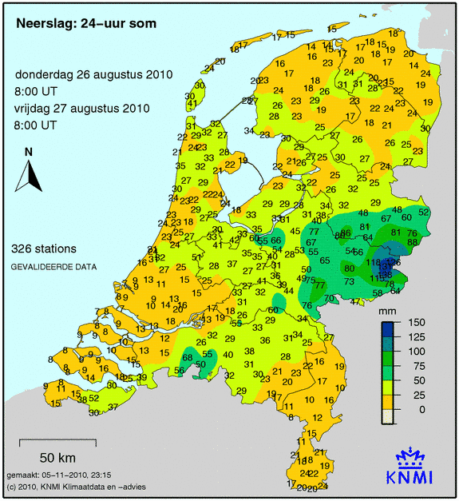
Environmental profile
Convective rain event in Gelderland & Overijssel
Observations of August 26th 2010 12 UTC/GMT in Essen, Germany
Slightly modified, assuming enriched moisture at ±3 km
Classical “surface based” convection
Initial small disturbance T & water vapor
Linear interpolations between nearest levels
Essen

Slide 9
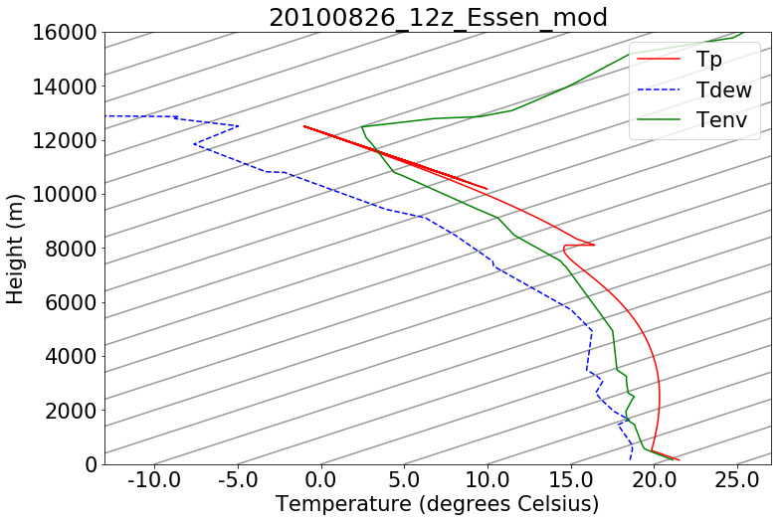
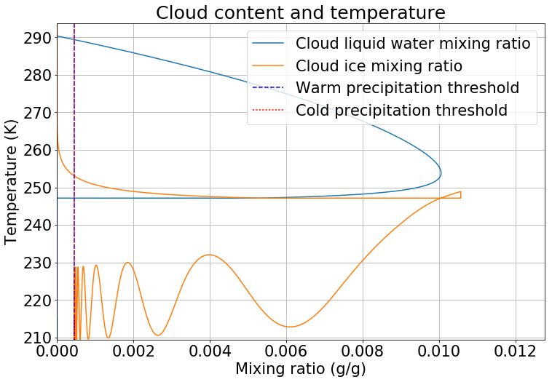
No entrainment
time
Heat of fusion
isotherms
Z (m)
time
0 °C
Mean precipitation over the final area of the parcel: 4.40 mm

Slide 10
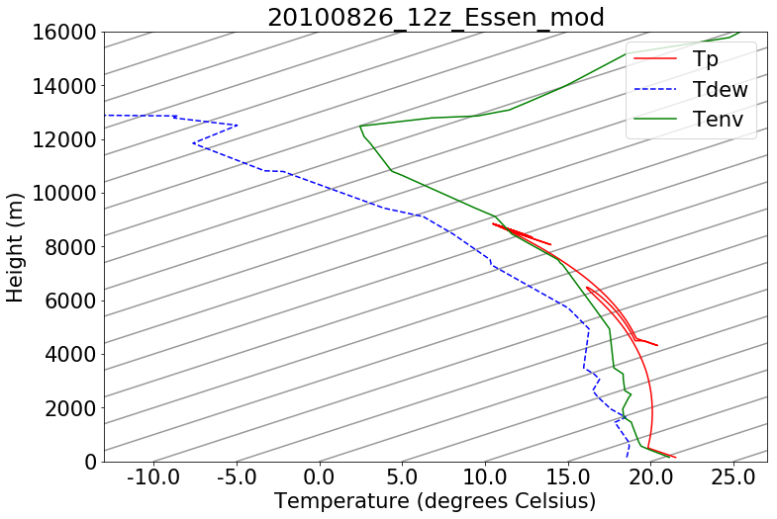
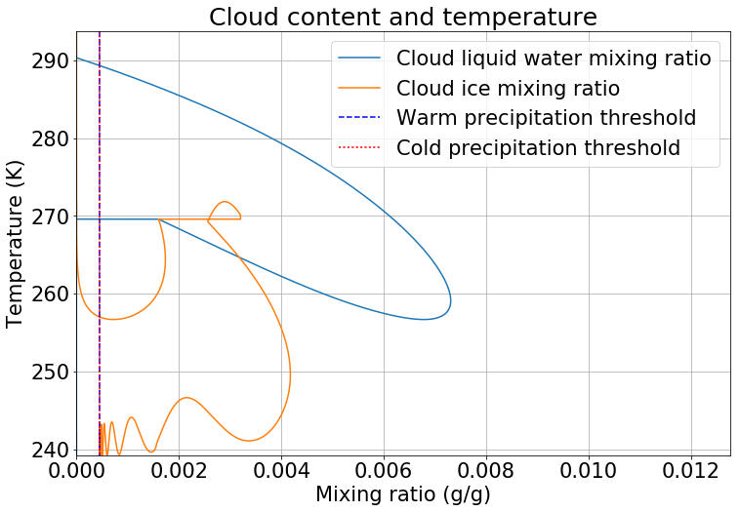
Constant entrainment $μ_{0}=5×{10}^{−5}$
time
isotherms
isotherms
Z (m)
Z (m)
time
time
0 °C
0 °C
Mean precipitation over the final area of the parcel: 3.97 mm

Slide 11
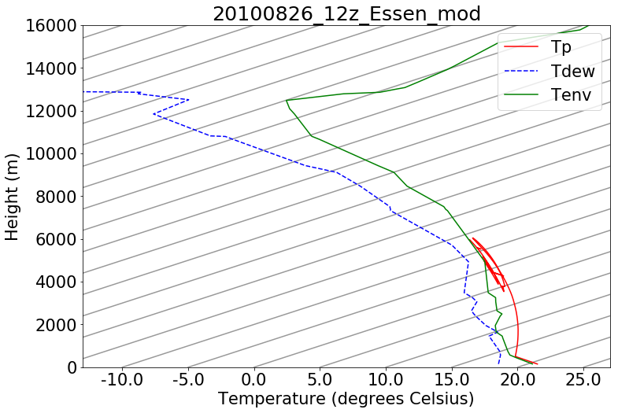
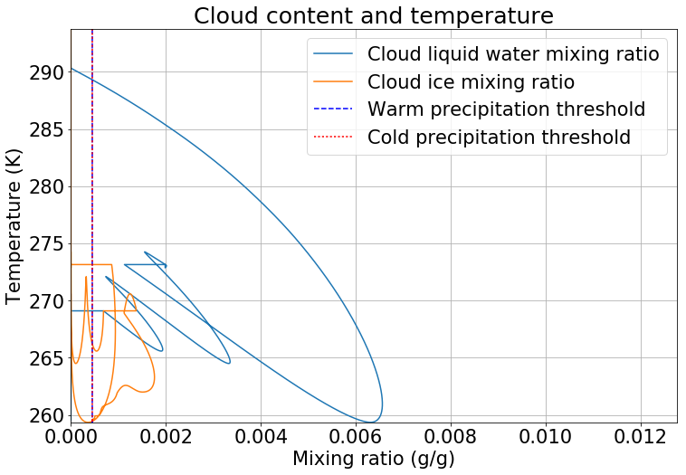

Full entrainment $μ= μ_{0}+\frac{C_{inv,r}}{R_{eq}}$
isotherms
Z (m)
time
0 °C
Reference run - $μ_{0}$ = 5e-5 & $C_{inv,r}$ = 0.16
4.99 mm areal mean precipitation

Slide 12
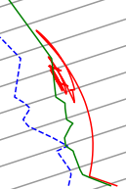
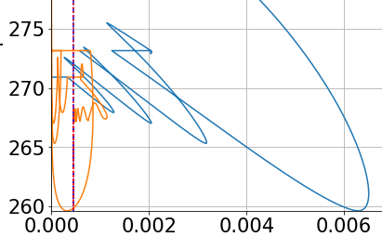

Sensitive!
Both momentum eq. and phase of the cloud content
$\frac{dW}{dt}=\frac{g}{1+γ}\left(\frac{T_{v}−T_{v}^{′}}{T_{v}^{′}}−w_{L}−w_{I}\right)−\frac{μ}{1+γ}|W|W$
Tmelt

Slide 13
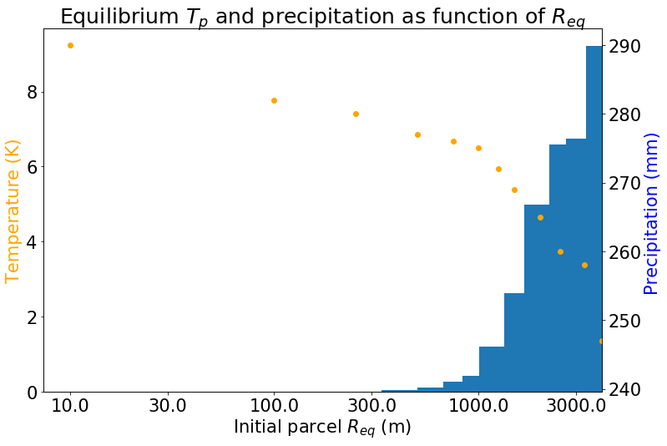
Change initial Req
Reference value: reasonable values 300-5000 m
Smaller clouds have relevance for environmental moisture at z = 2.5-3 km

Slide 14
Sensitivity upper air moisture
Reduction of moisture above z = 2 km
Reduction | Mean precipitation (mm) | Cloud equilibrium temperature (K)
0% | 4.99 | 260
2% | 4.02 | 264
4% | 2.50 | 267
25% | 0.34 | 277

Slide 15
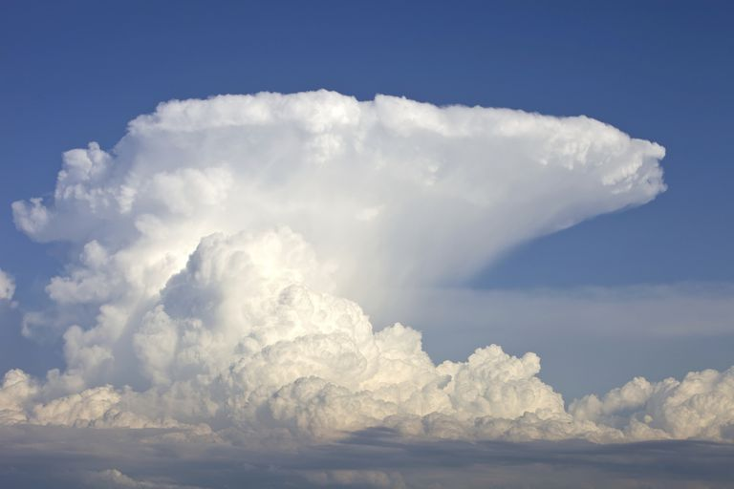
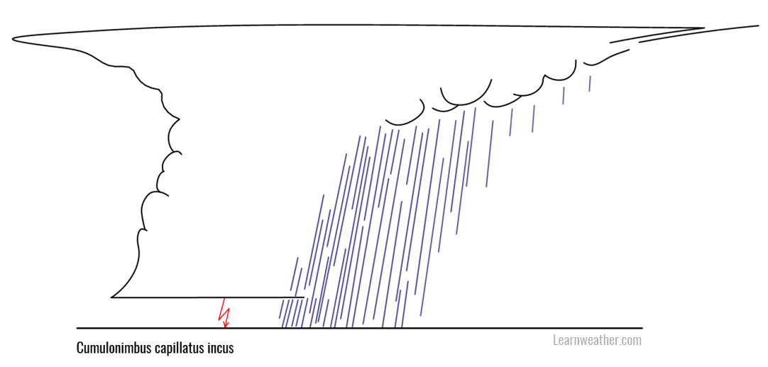
Discussion
Horizontal dynamics excluded in parcel model, but essential as “sorting mechanism”

Slide 16
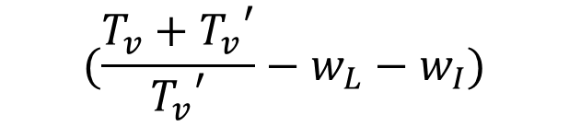
Discussion
$$(\frac{T_{v}+{T_{v}}^{′}}{{T_{v}}^{′}}−w_{L}−w_{I})$$
No oscillatory behavior in reality (either dissipation or persistance)
In this model, condensed water or ice gets either inside or outside parcel
Interaction parcel & cloud content
Limitation of parcel model
In general the parameterizations (foremost conversion to ice) are hugely simplified
No sublimation/riming (all via liquid water)

Slide 17
Conclusions
The parcel model allows to illustrate some senstivity for entrainment & phases
Relevance feedbacks: e.g. release of heat of fusion
However, the most important limitations:
no horizontal wind field
In reality, convective clouds may co-exist and interact

Slide 18
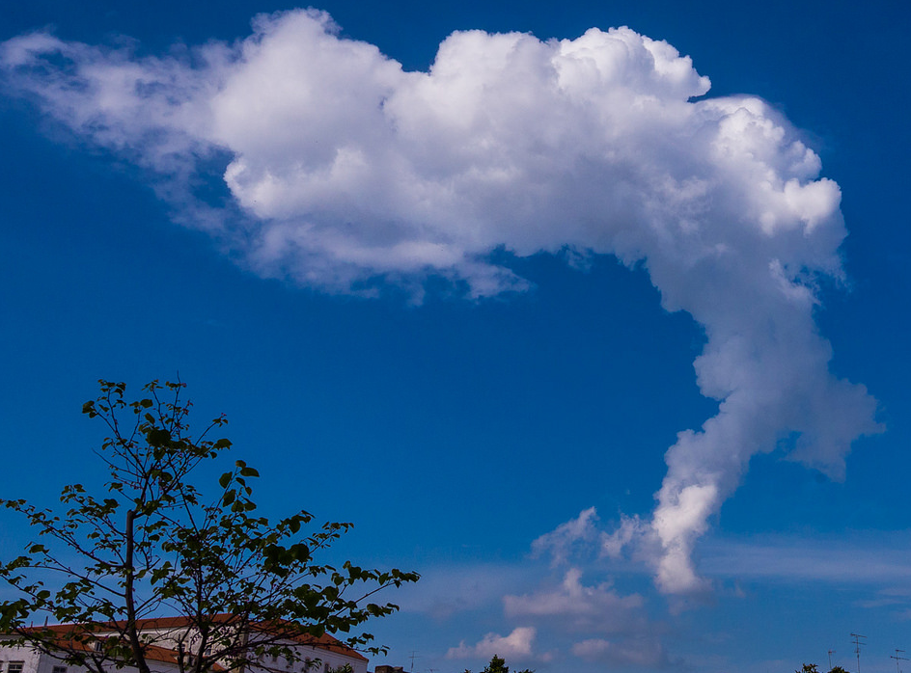

Thank You for your attention! Any Question?

