Slide 1
Greenland: Ice deceleration?
Edward Groot and Inge van Tongeren

Slide 2
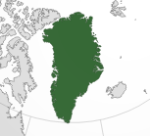
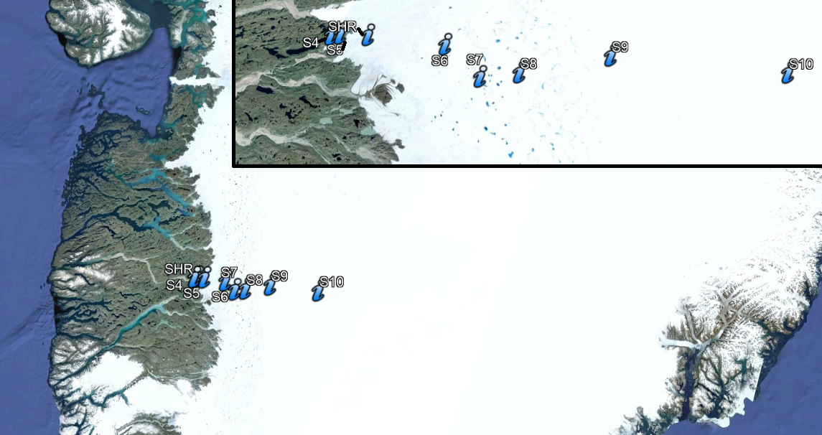

Introduction
$GPS sensors$

Slide 3
Seasonal cycle
Start melting season: melting of ice
Water
Pressure
Friction of bed
Flow
velocity
Drainage efficiency
Autumn:
melt stops
Smaller tunnels

Slide 4
Multi-annual timescale
Drainage
system
Sustained melting of ice
Water
Pressure
Friction of bed
Flow
velocity
Tunnels close less fast

Slide 5
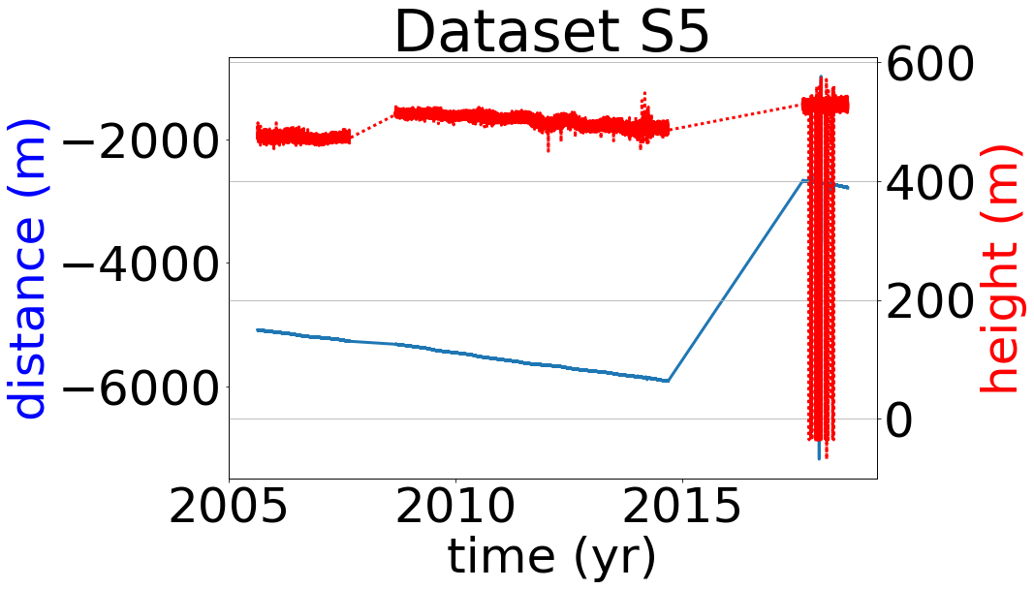
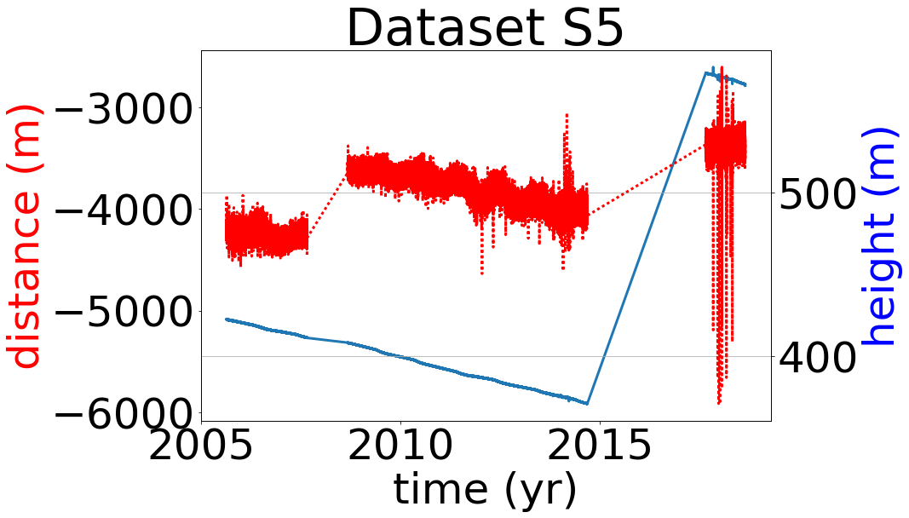
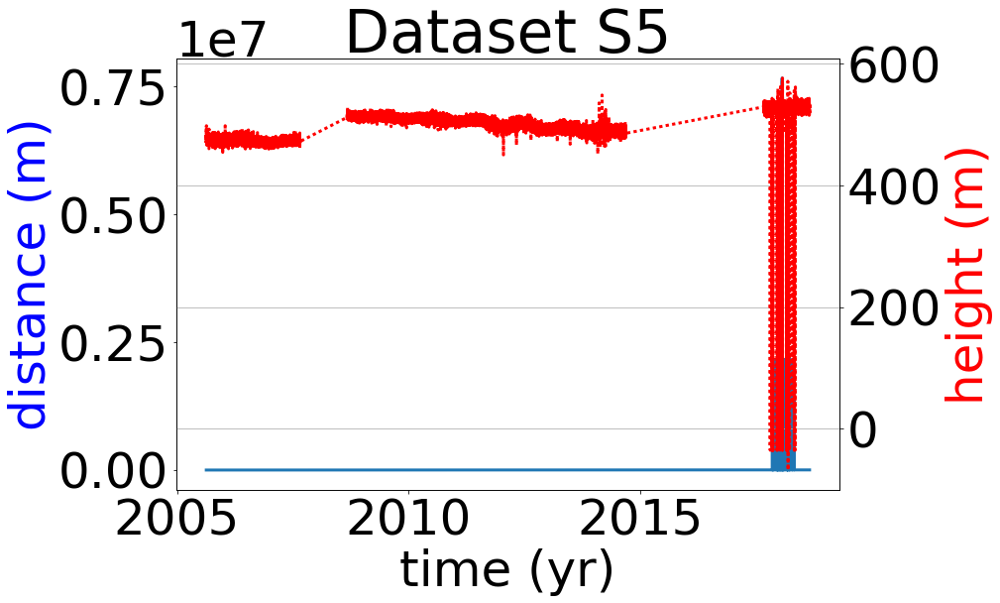
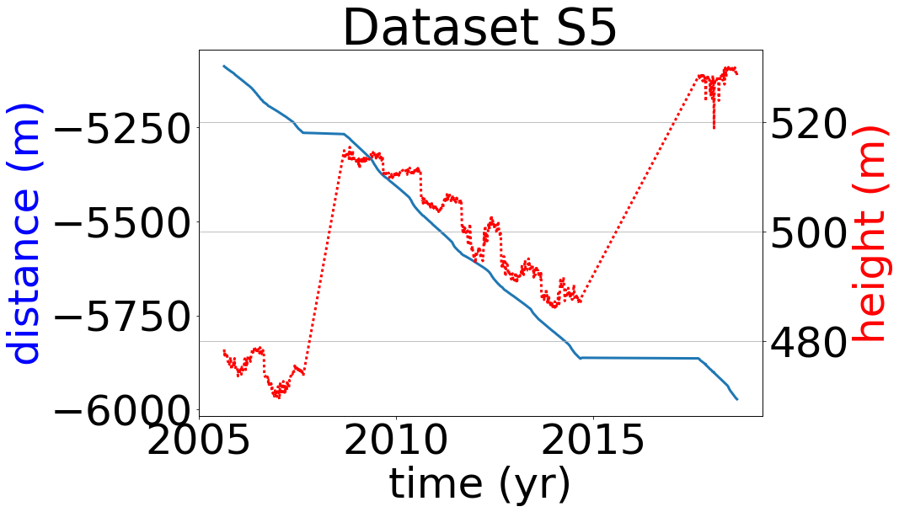
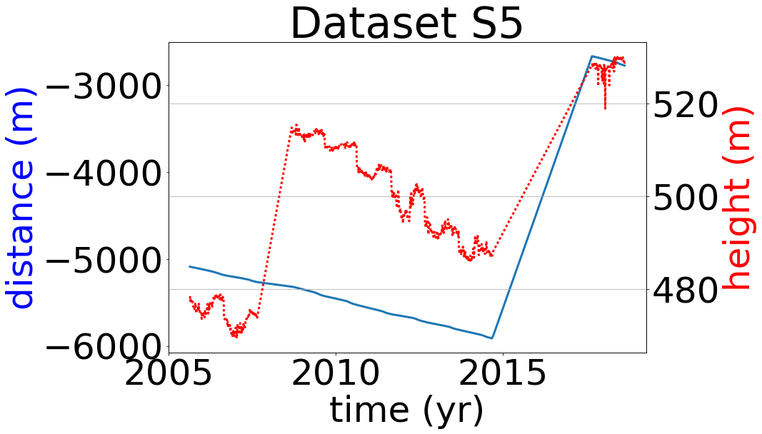
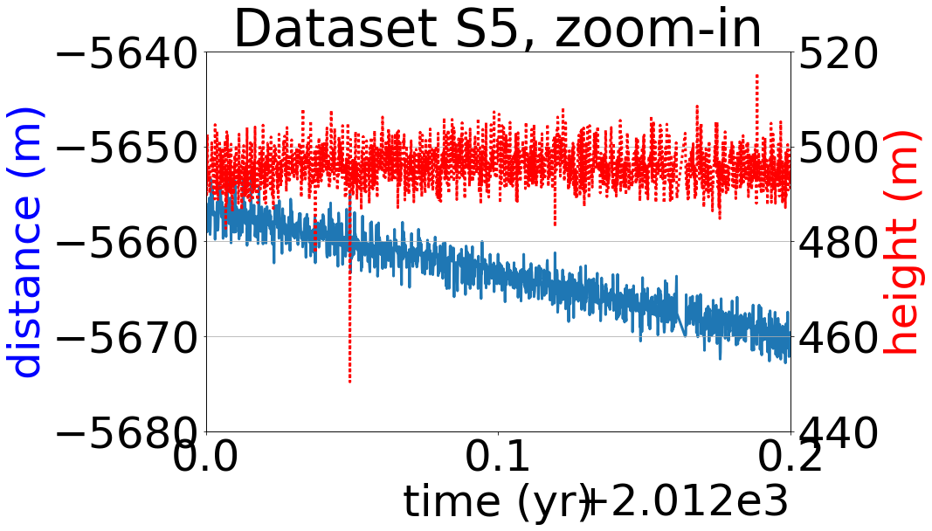
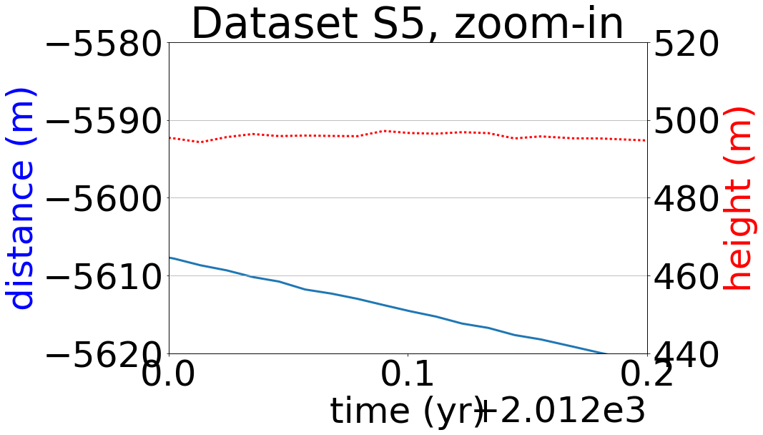
Raw dataset, cropped
Remove 0’s
Remove outliers height
Remove instrument re-siting
Averaging
Averaging + remove re-siting

Slide 6
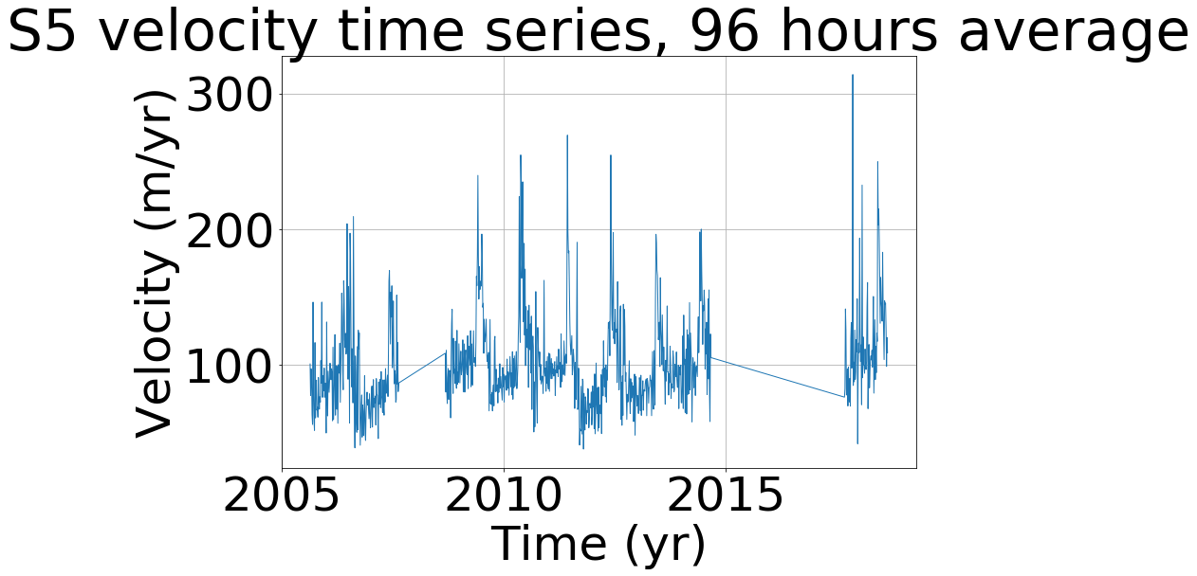

Data processing
Outliers: outside $μ ± 10σ$(iterative)
After processing the data (previous slide), velocities can be derived

Slide 7
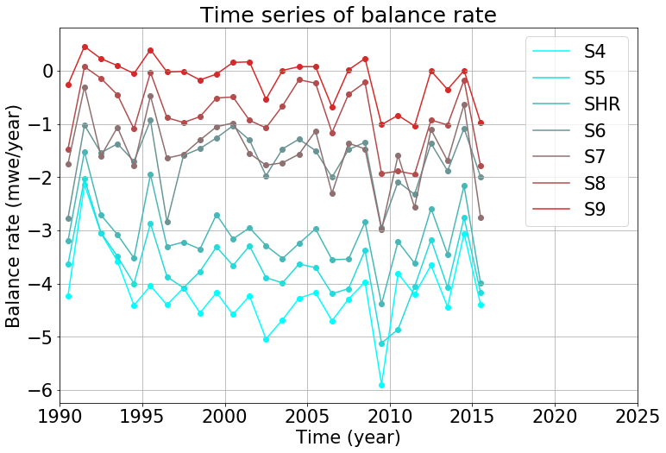
Mass balance rate time series
Significant at P < 0.01:
Significant at 0.05 > P > 0.01:

Slide 8
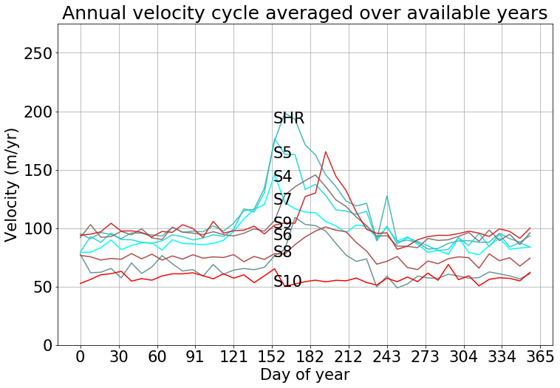
Seasonal cylce

Slide 9
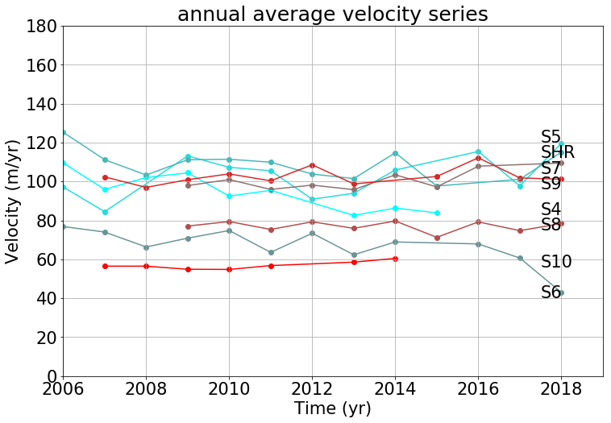
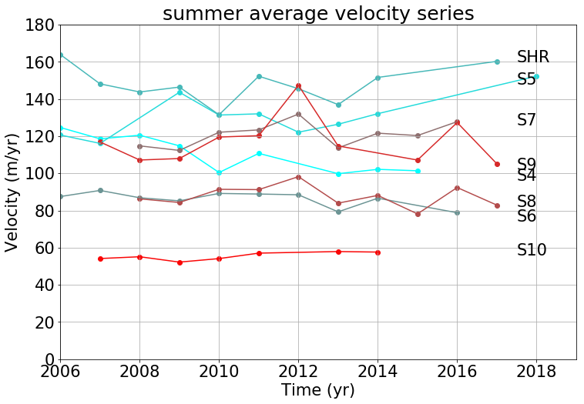
Velocity time series
Significant at P < 0.01:
Significant at 0.05 > P > 0.01:

Slide 10
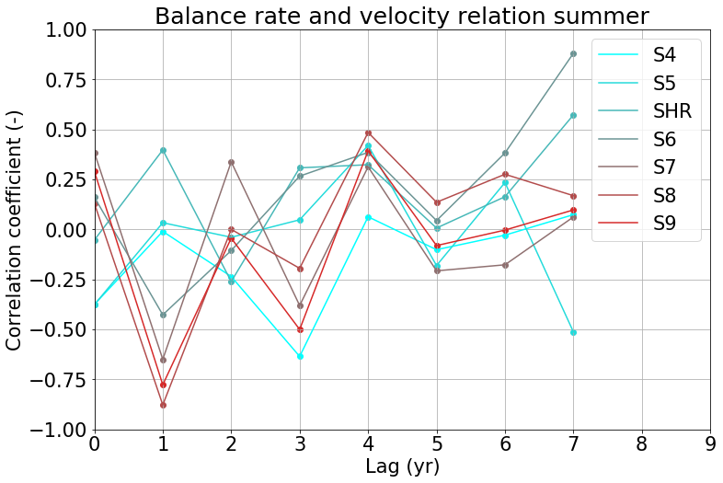
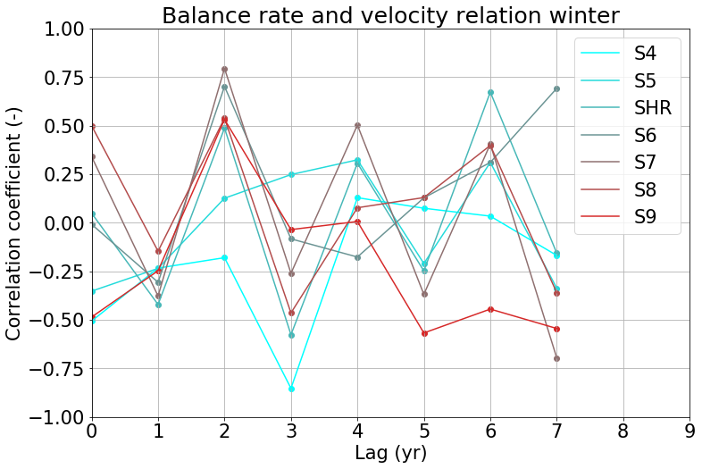
Mass balance vs velocity

Slide 11
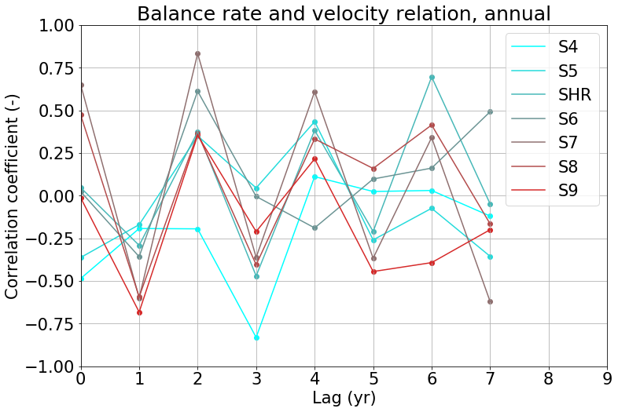
Mass balance vs velocity

Slide 12
Conclusion
Seasonal cycle
Annual velocity trends: only locally significant (outlet); thickness effect?
Summer velocity upper ablation zone seems to accelarate at previous year’s melt (balance rate)
Winter velocity (slighly lower in ablation zone) seems to decelerate subsequently

Slide 13
Questions?

Slide 14
Discussion
Seasonal cycle comparable to literature, except minimum
Variable sign and significance of velocity trends (report vs literature)
Self-regulatory mechanism also found in literature
Accumulative balance rates

