Slide 1
Greenland: Ice deceleration?
Edward Groot and Inge van Tongeren

Slide 2
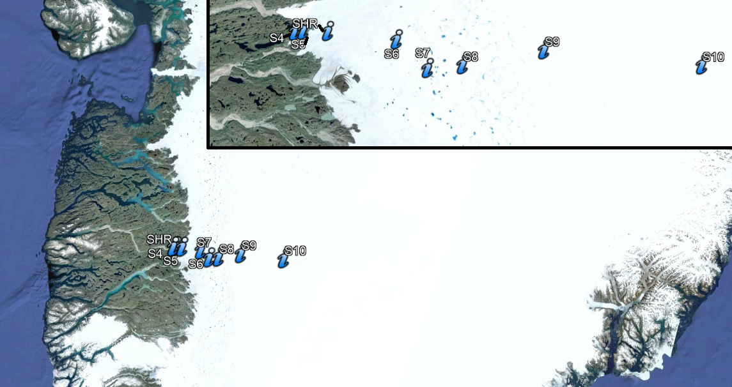
Introduction

Slide 3
Seasonal cycle
Start melting season: melting of ice
Water
Pressure
Friction of bed
Flow
velocity
Drainage
efficiency
Autumn:
melt stops
Smaller tunnels

Slide 4
Multi-annual timescale
Drainage
system
Sustained melting of ice
Water
Pressure
Friction of bed
Flow
velocity
Tunnels close less fast

Slide 5
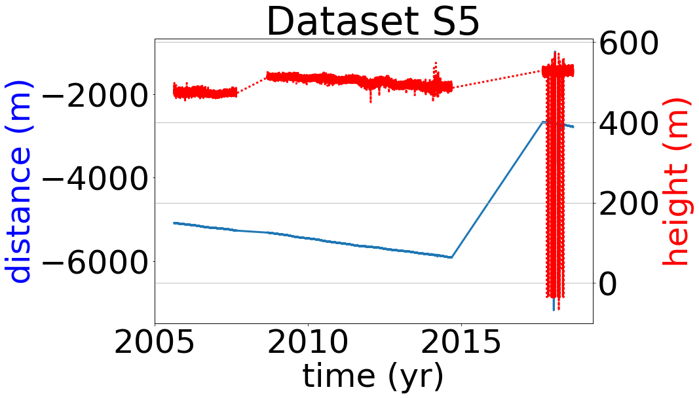
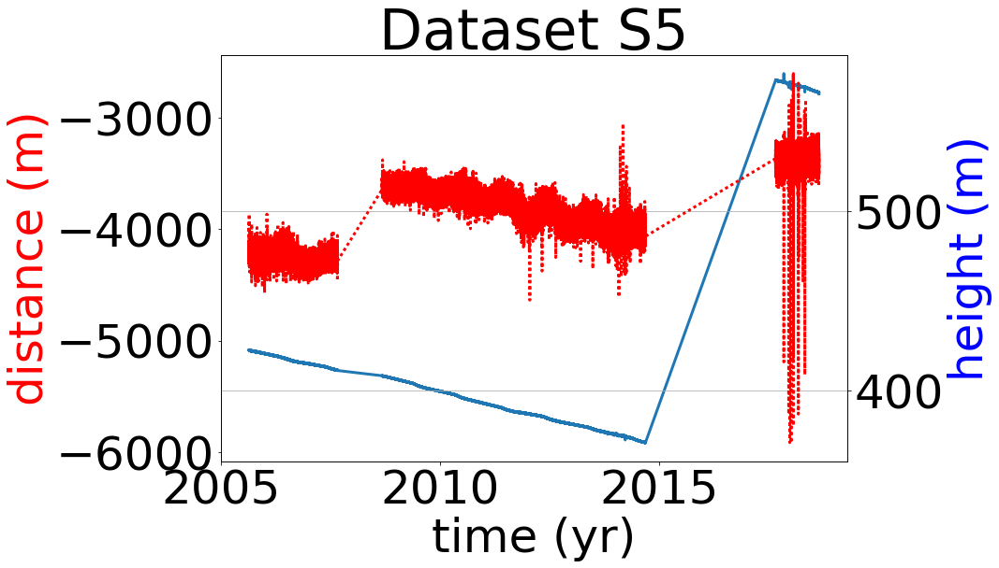
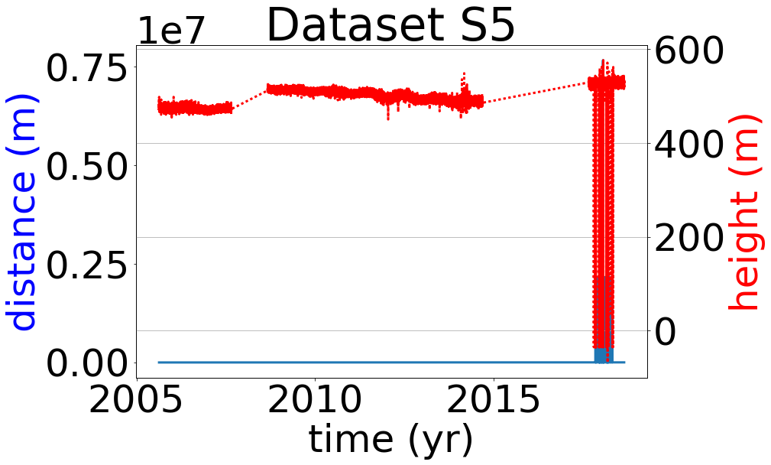
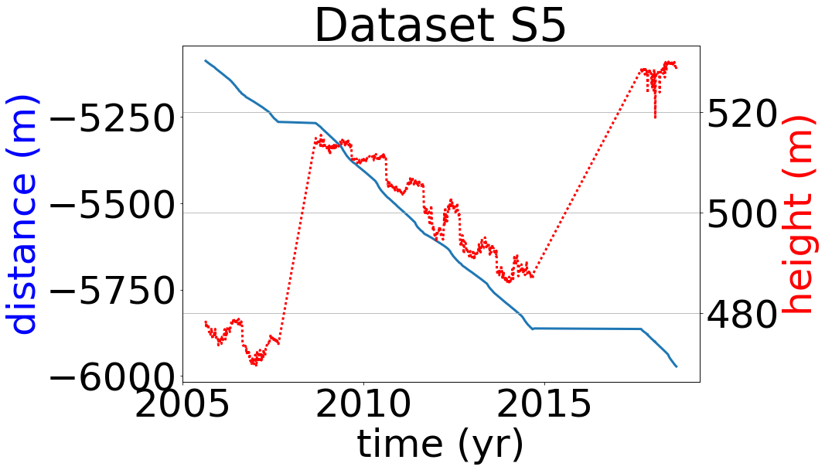
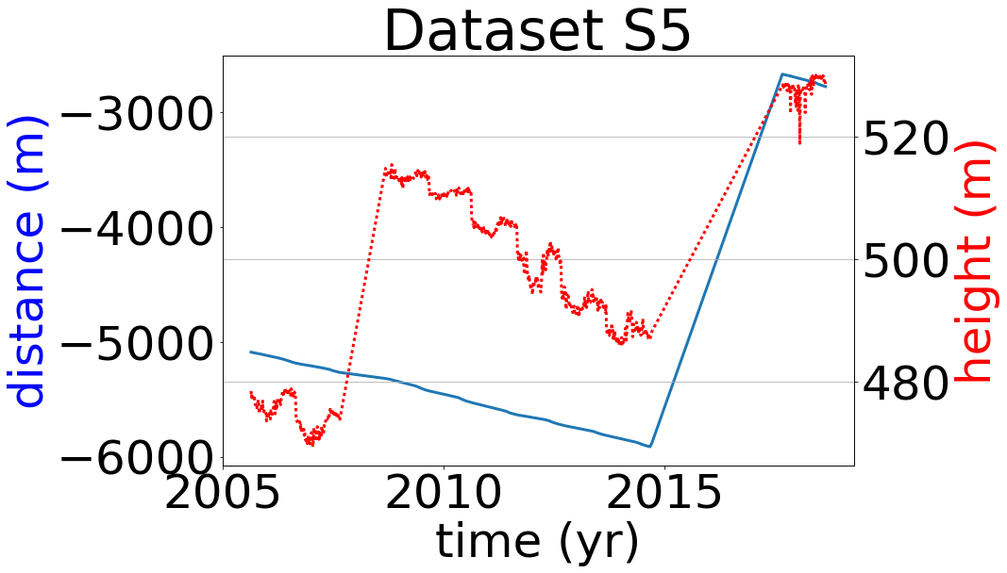
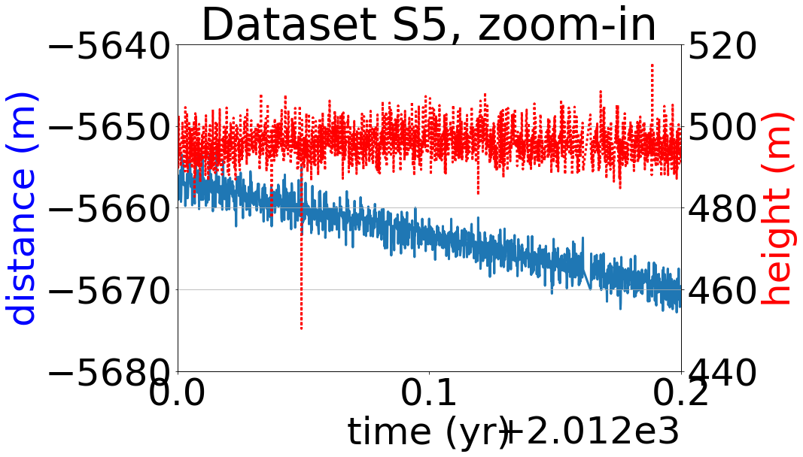
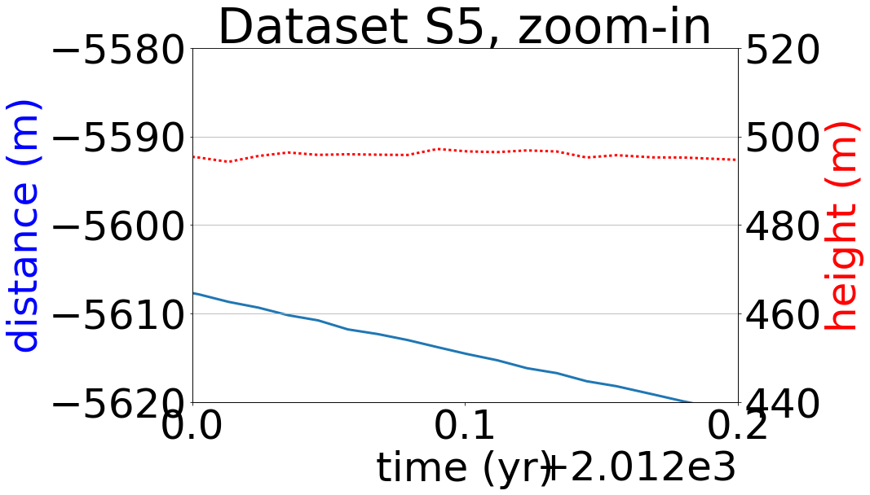
Raw dataset, cropped
Remove 0’s
Remove outliers height
Remove instrument re-siting
Averaging
Averaging + remove re-siting

Slide 6
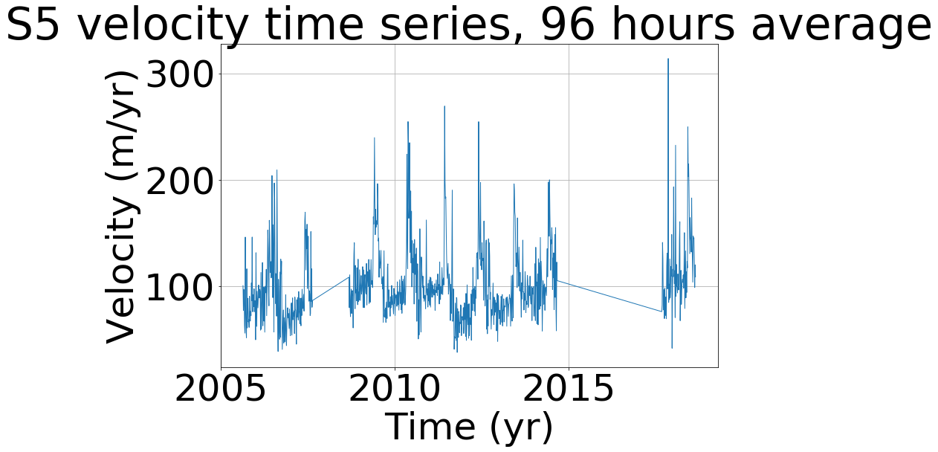

Data processing
Outliers: outside $μ ± 10σ$(iterative)
After processing the data (previous slide), velocities can be derived

Slide 7
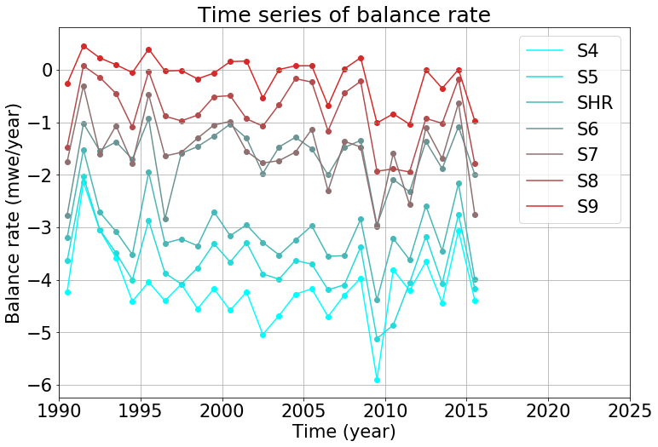
Mass balance rate time series
Significant at P < 0.01:
Significant at 0.05 > P > 0.01:

Slide 8
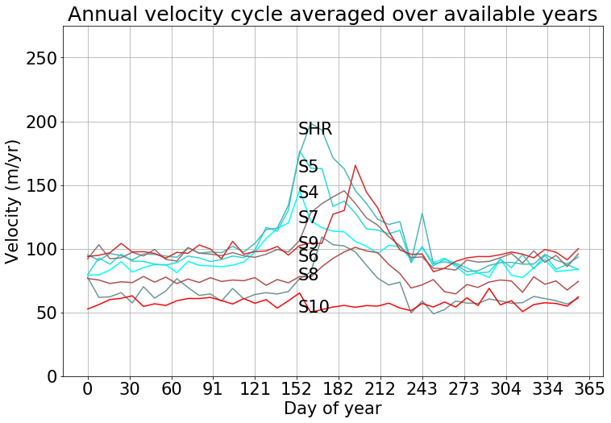
Seasonal cylce

Slide 9
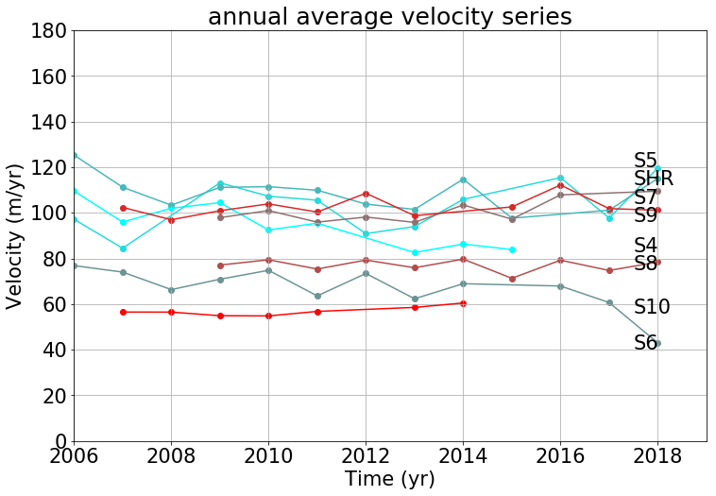
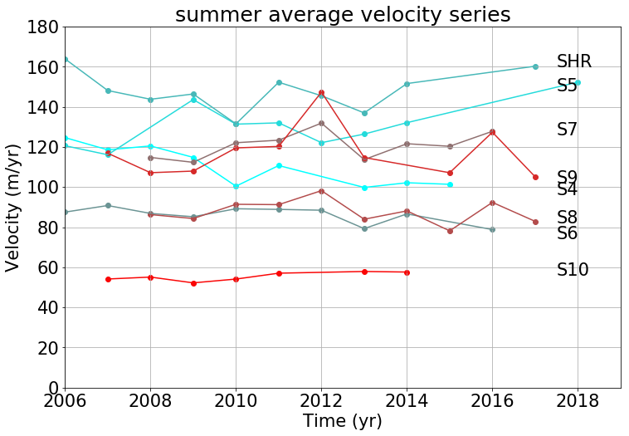
Velocity time series
Significant at P < 0.01:
Significant at 0.05 > P > 0.01:

Slide 10
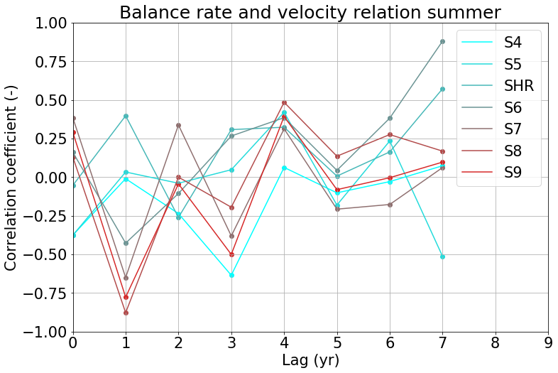
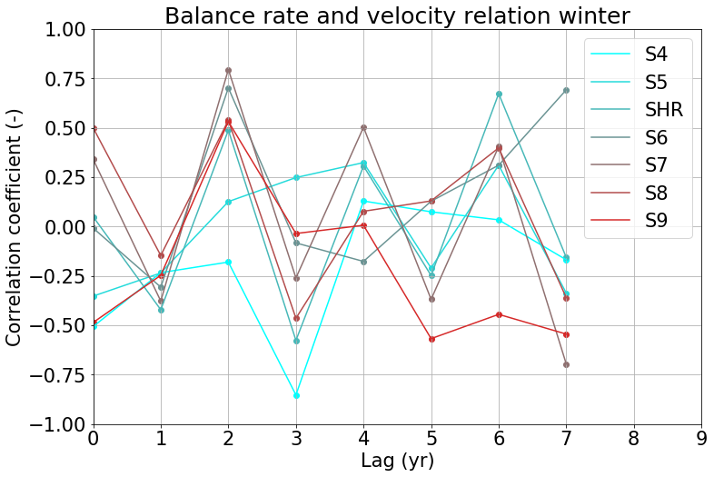
Mass balance vs velocity

Slide 11
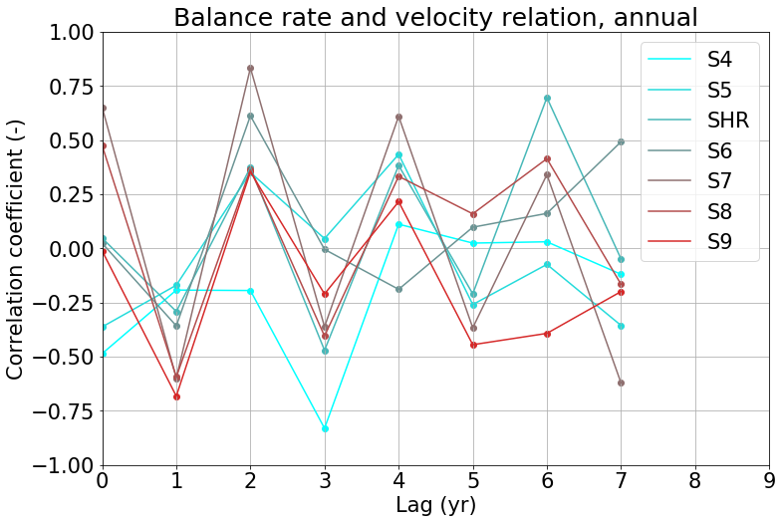
Mass balance vs velocity

Slide 12
Discussion slide?
Comparing with literature?

Slide 13
Conclusion
Annual velocity trends: only locally significant (outlet); thickness effect?
Seasonal cycle
Summer velocity upper ablation zone seems to accelarate at previous year’s melt (balance rate)
Winter velocity (somewhat lower) seems to decelerate subsequently

Slide 14
Questions?

