Slide 1
Greenland: Ice deceleration?
Edward and Inge van Tongeren

Slide 2
Program

Slide 3
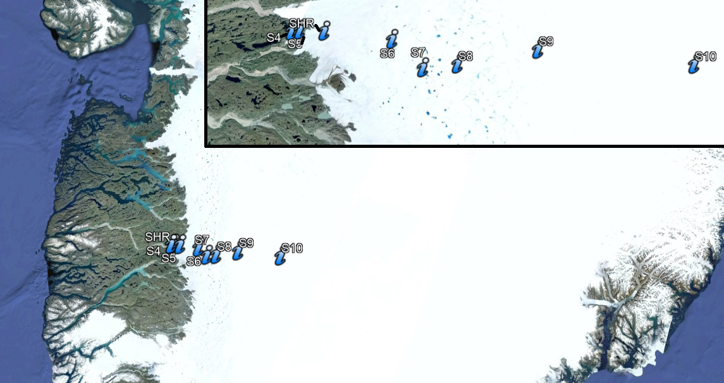
Introduction

Slide 4
Seasonal cycle
Melting of ice
Start melt season
Start melt season

Slide 5
Interannual and decadal timescales

Slide 6
Raw data

Slide 7
Data processing

Slide 8
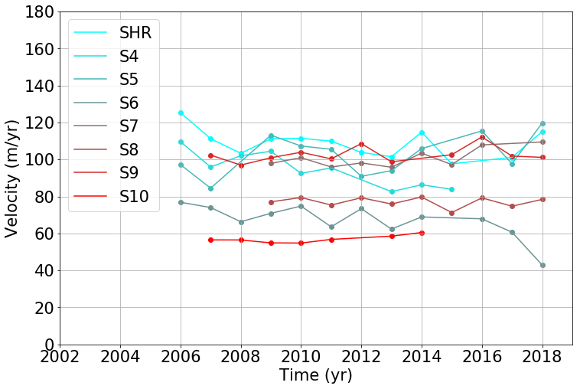
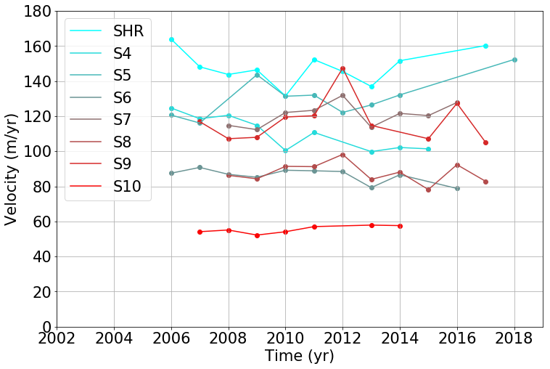
Results

Slide 9
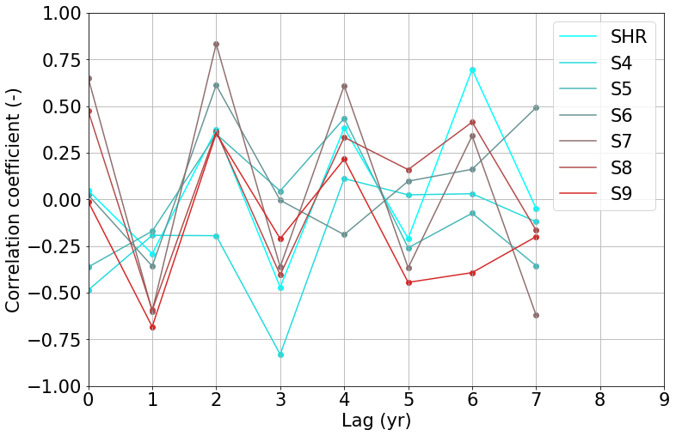
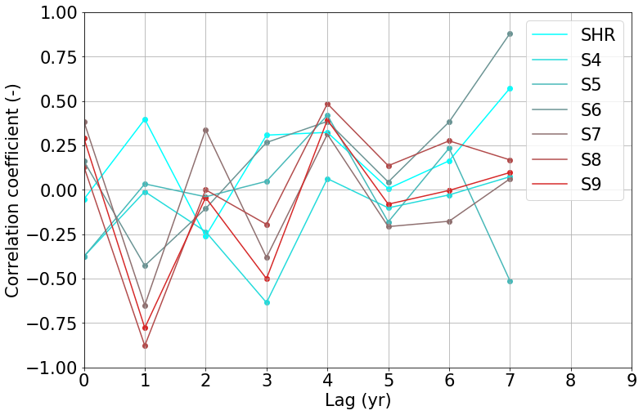
Results

Slide 10
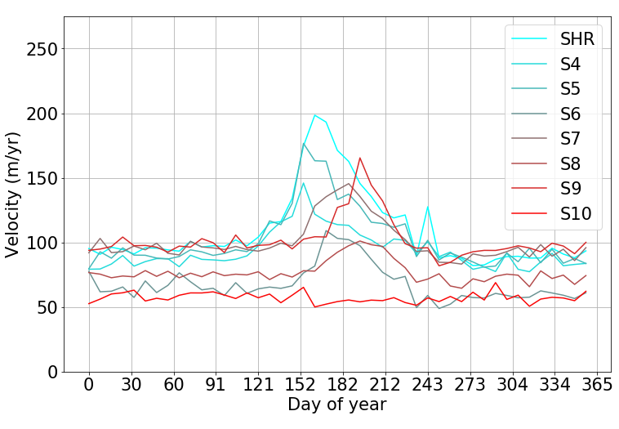
Seasonal cylce

Slide 11
Conclusion

Slide 12
Questions?

