Slide 1
Final cross validations
Set of 90, 40 and 15 predictors
40 predictors: set of 15 physical predictors, plus some of the best additional predictors
Still processing the 40 set (ran yesterday, still processing figures, only final cross validation ready)
Also: working on last small 4 predictor experiment

Slide 2
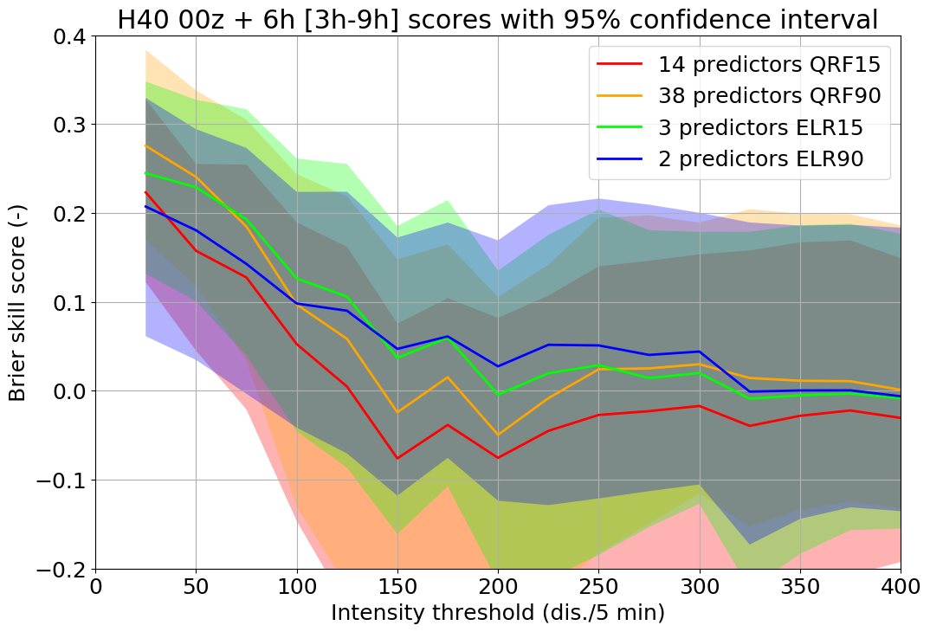
Threshold forecasts, 00z +3 to +9 h
Best: ELR15 & QRF90
Skill lost at 95% confidence between 75 and 100 dis./5 min

Slide 3
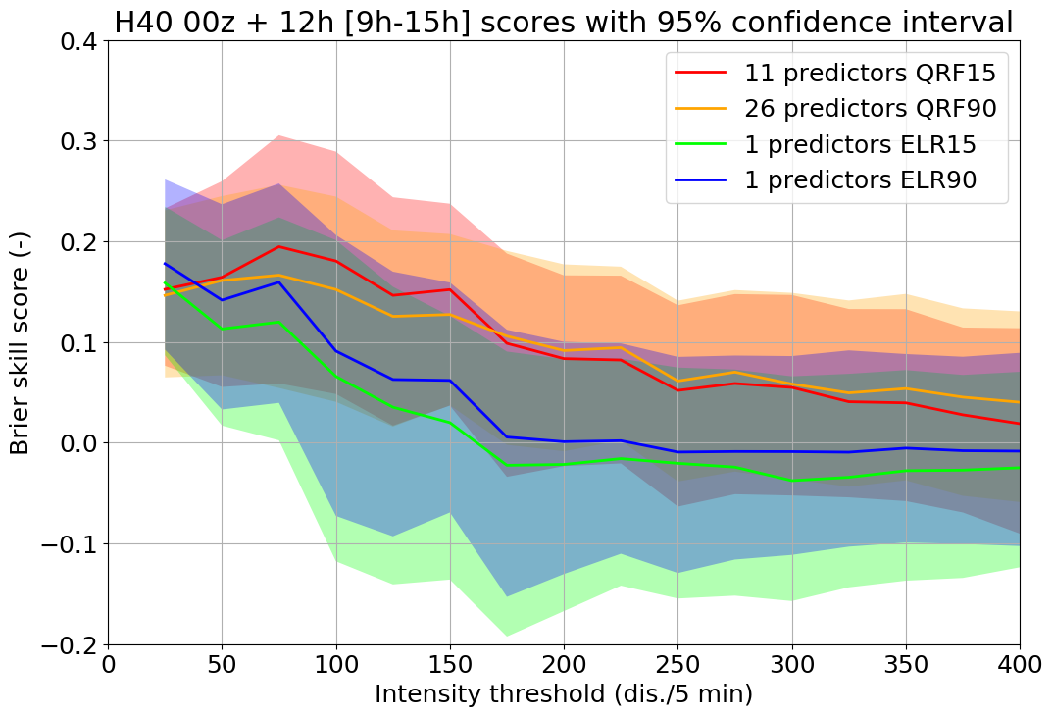
Threshold forecasts, 00z +9 to +15 h
Best: QRF15
Skill lost at 95% confidence 175 dis./5 min

Slide 4
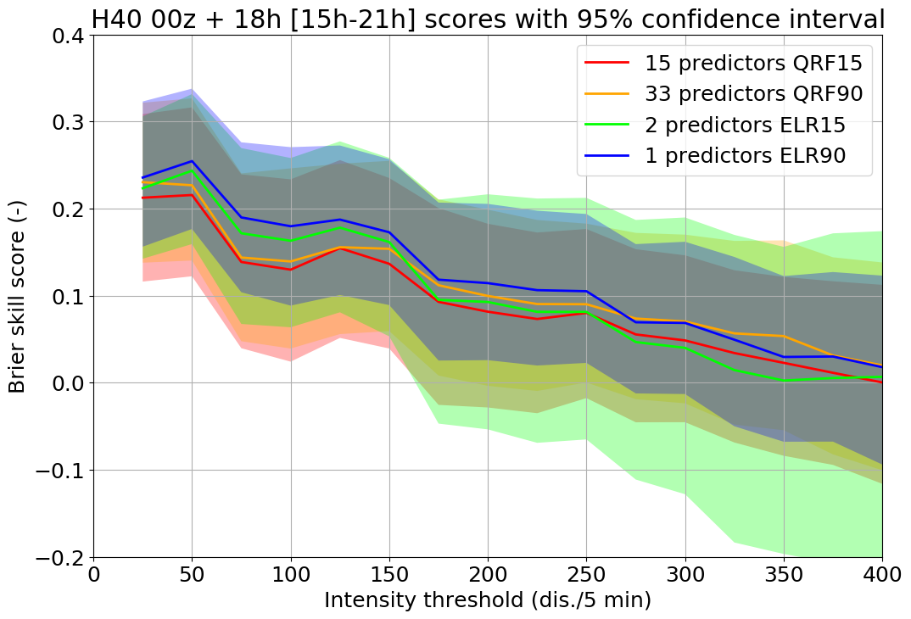
Threshold forecasts, 00z +15 to +21 h
Best: ELR90
Skill lost at 95% confidence 275 dis./5 min

Slide 5
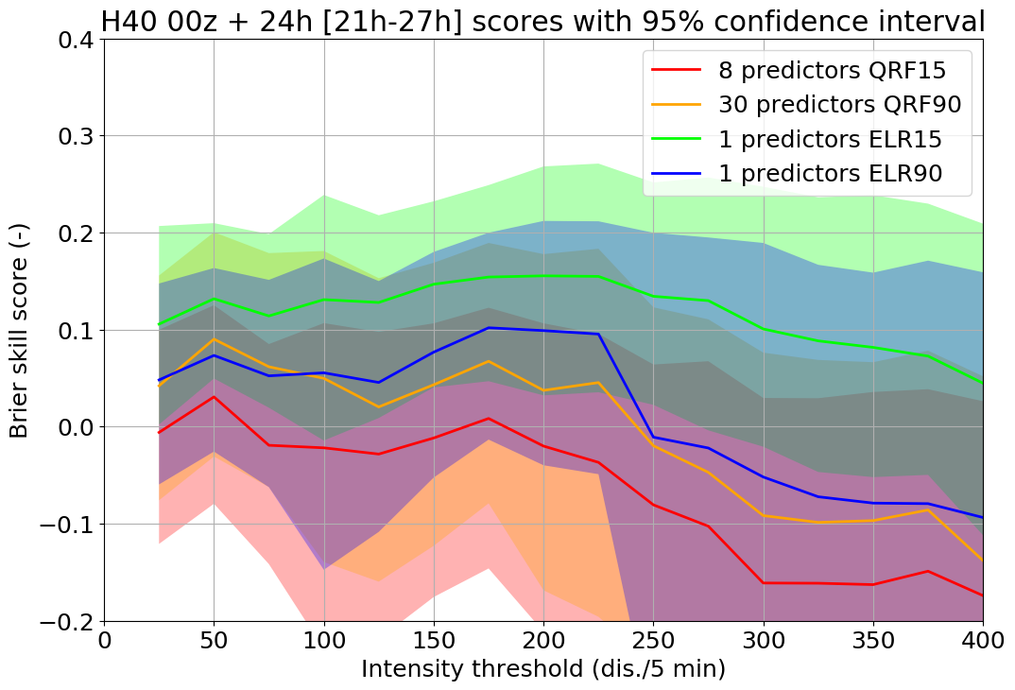
Threshold forecasts, 00z +21 to +27 h
Best: ELR15
Results don’t look very stable, but potentially skill up to 275 dis./5 min

Slide 6
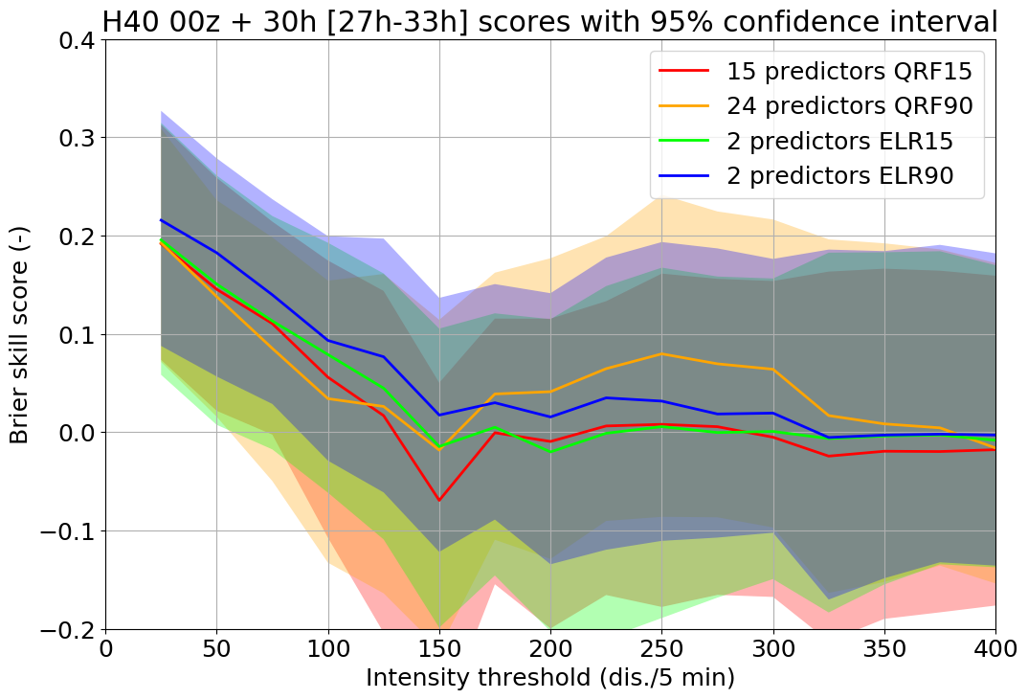
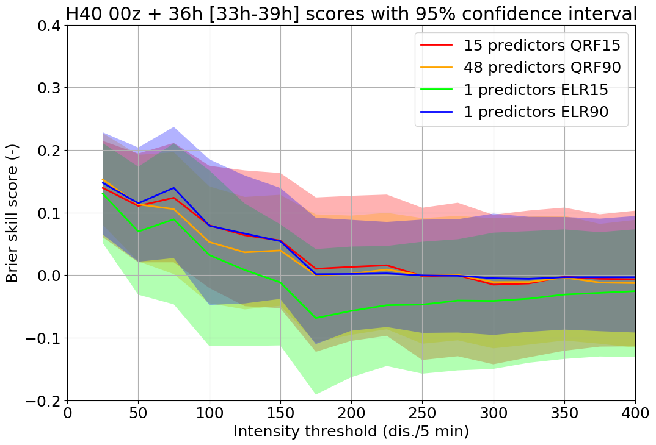
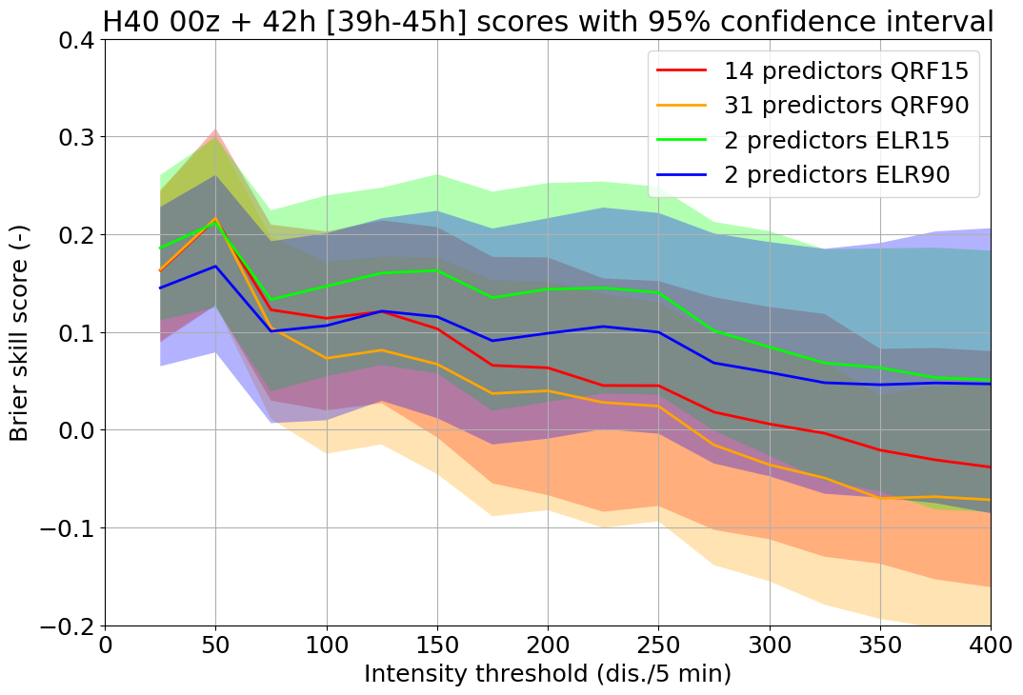
Threshold forecasts

Slide 7
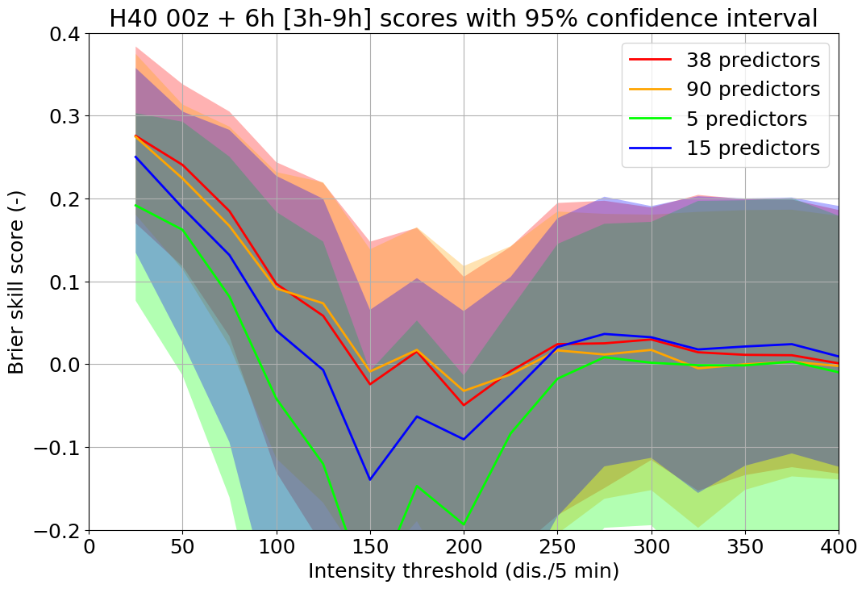
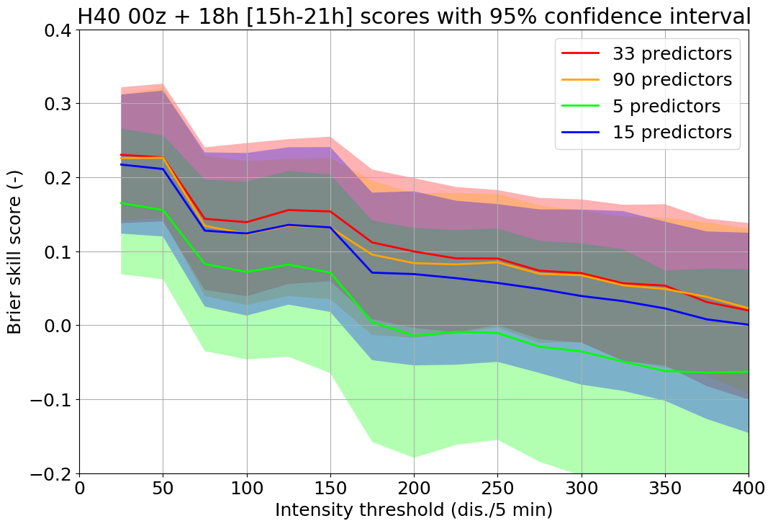
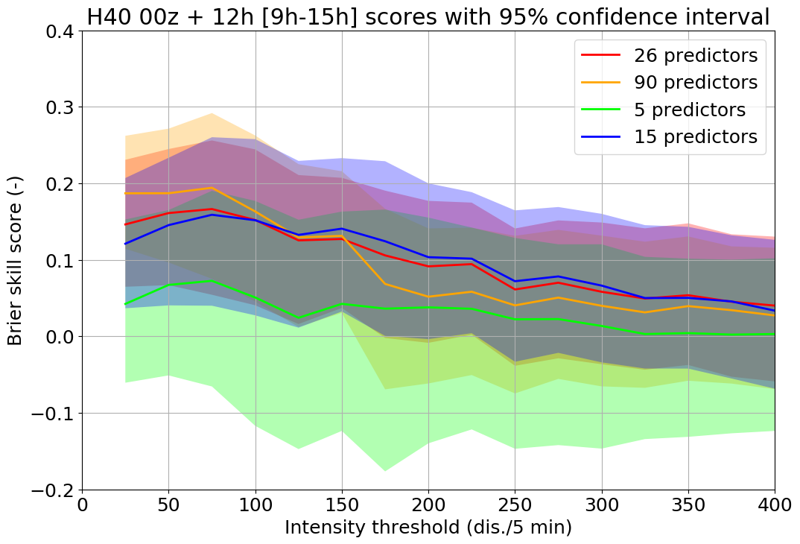
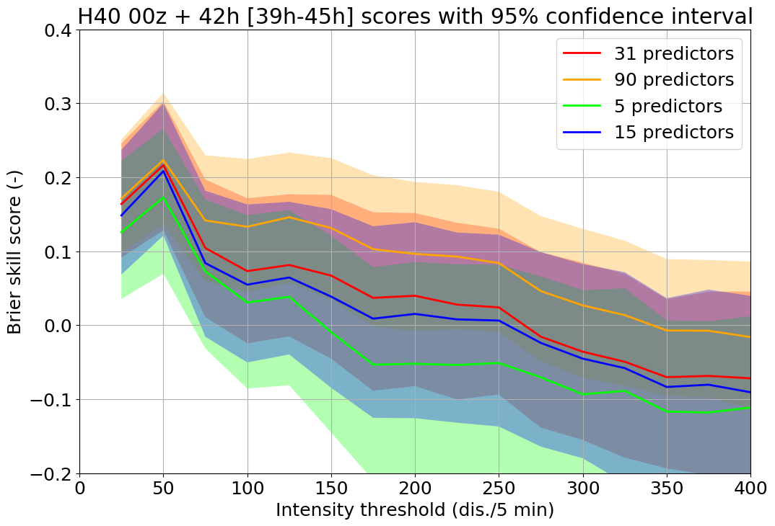
Red:
chosen
in initial
cross
val.

Slide 8
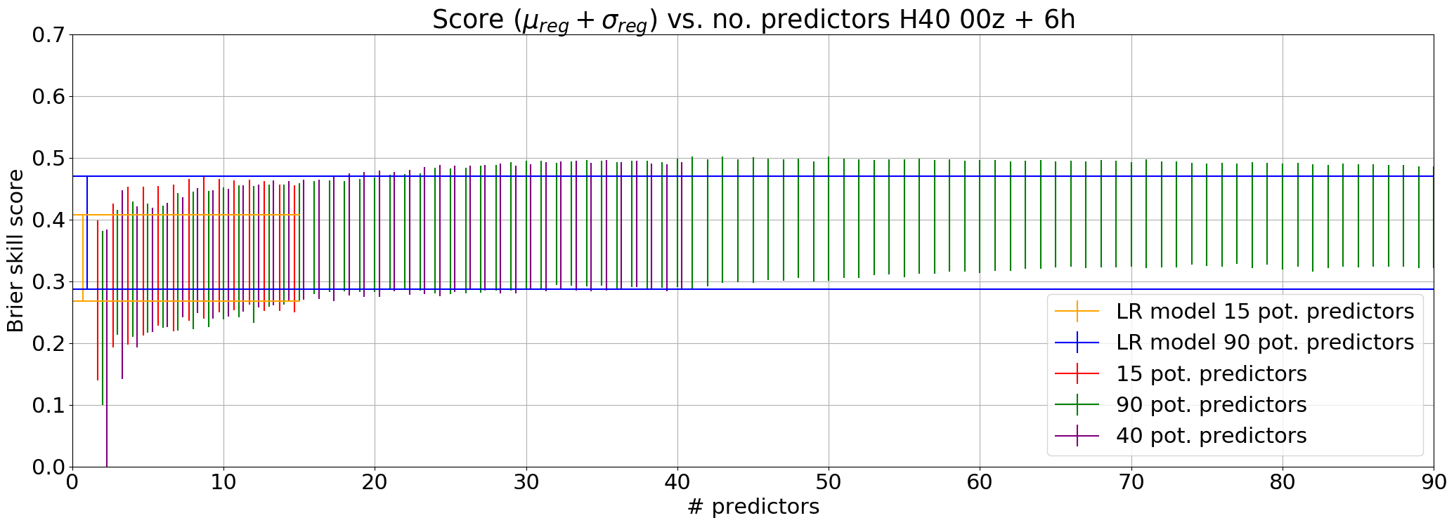
Yes/no, 00z +3 to +9h
No. predictors: LR15 → 3, LR90 → 4

Slide 9
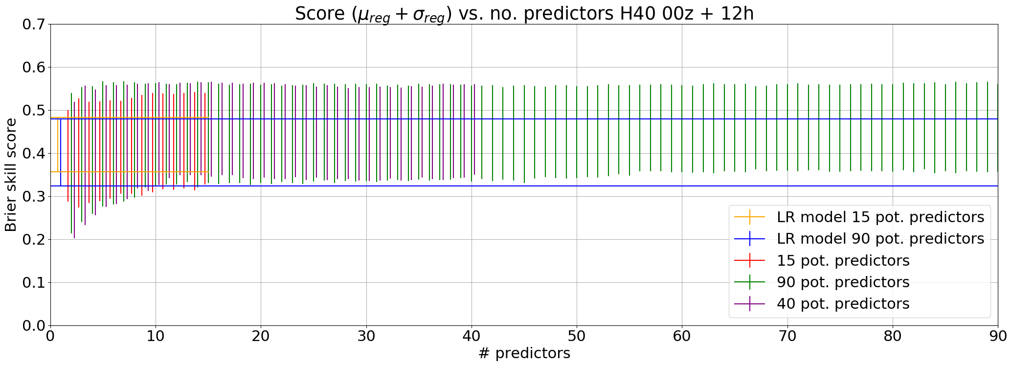
Yes/no, 00z +9 to +15h
No. predictors: LR15 → 2, LR90 → 1

Slide 10
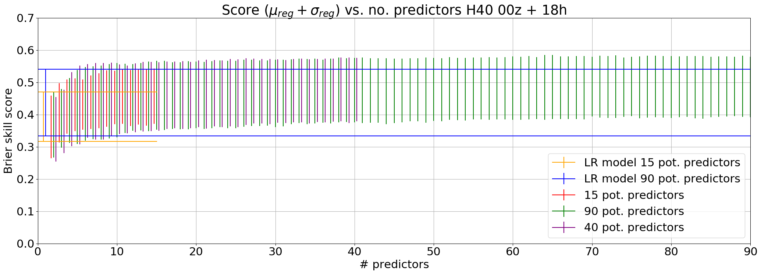
Yes/no, 00z +15 to +21h
No. predictors: LR15 → 2, LR90 → 2

Slide 11
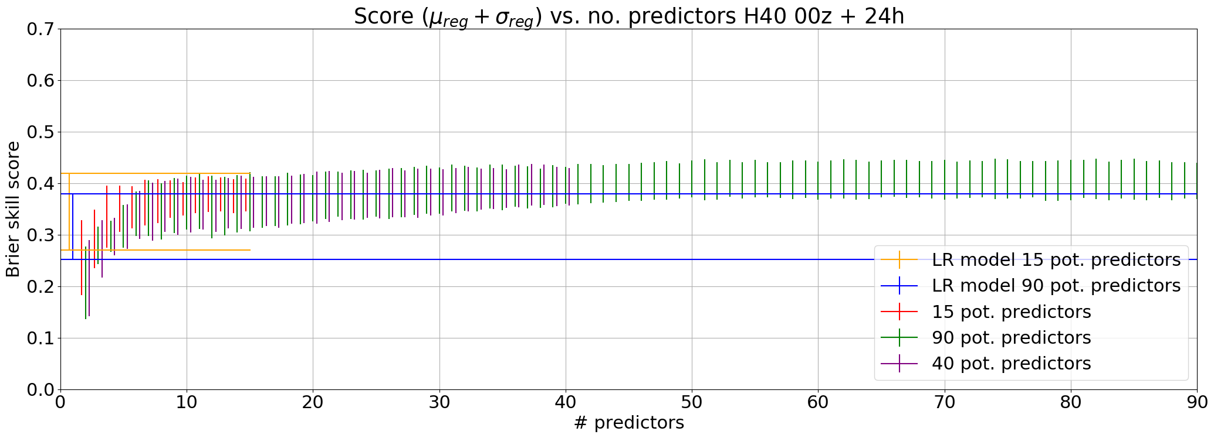
Yes/no, 00z +21 to +27h
No. predictors: LR15 → 3, LR90 → 2

Slide 12
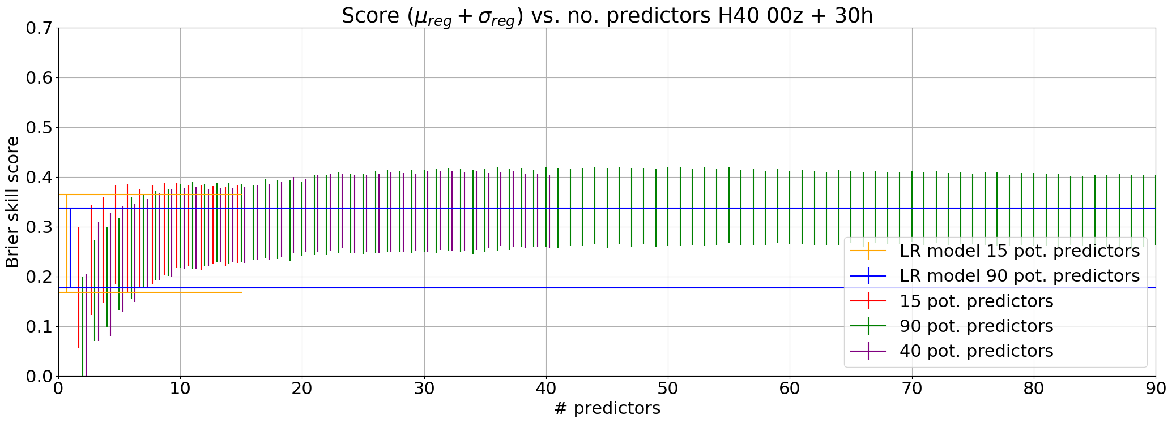
Yes/no, 00z +27 to +33h
No. predictors: LR15 → 2, LR90 → 1

Slide 13
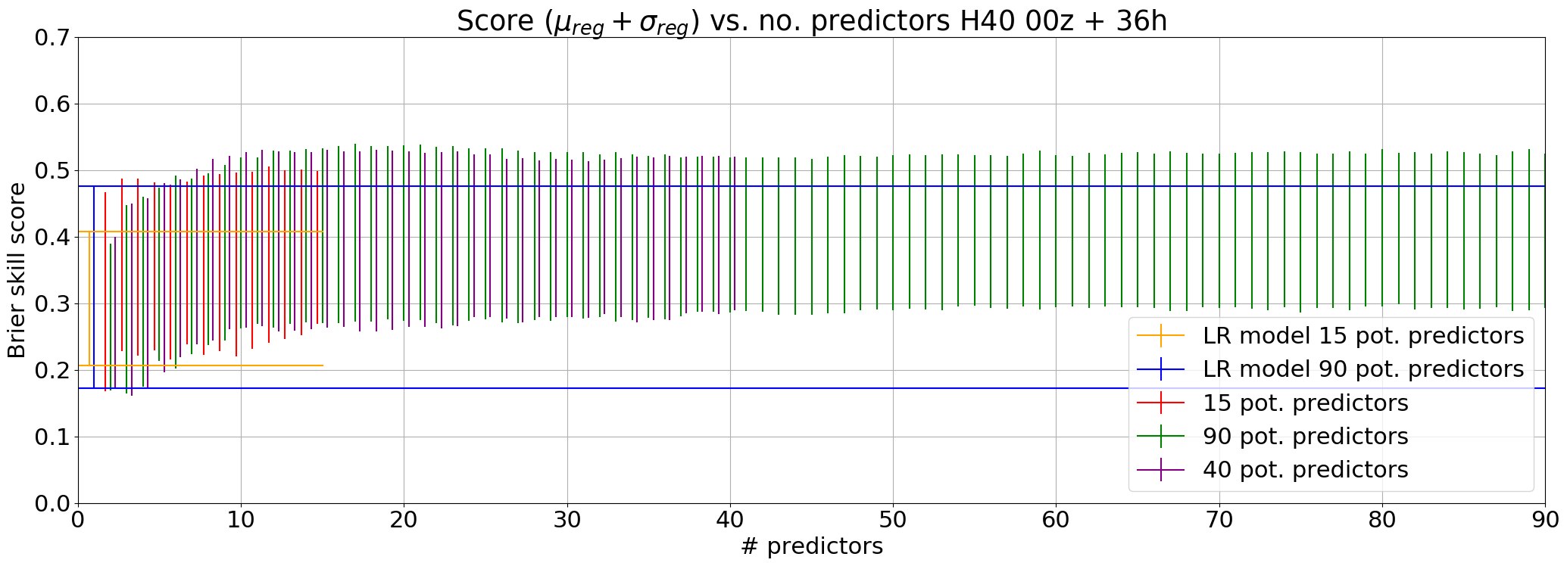
Yes/no, 00z +33 to +39h
No. predictors: LR15 → 1, LR90 → 1

Slide 14
Yes/no, 00z +39 to +45h
No. predictors: LR15 → 4, LR90 → 4

Slide 15
Small things
I have assumed same hyperparameter settings as with 15 and 90 predictors for 40 case for now
Next things:
Completing experiments with 40 set
Writing about predictors and physical predictor set
And write more of the thesis
(Organizing scripts)
Make results for 06z for some of the experiments??

