Slide 1
Last week….
Exclude LNB > 12.5 km (or very similar value)

Slide 2
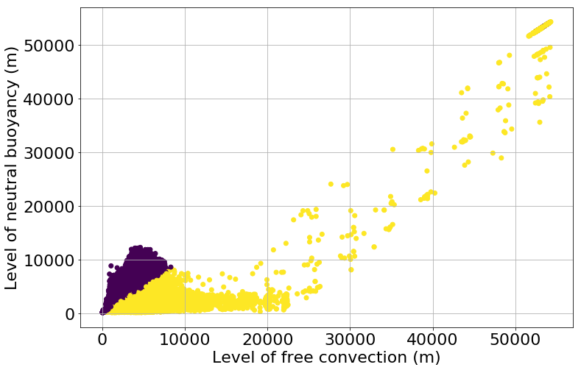
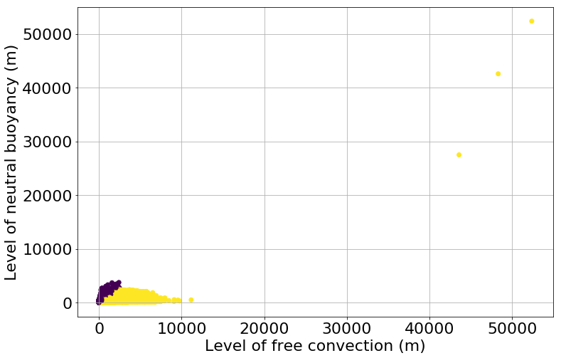

LFC and LNB > 12.5 km
Maximum Minimum
color: which of the 2 is bigger (purple = correct)

Slide 3
Test with binary predictors
Binary predictor appears to be used (six times for QRF threshold):
high PW values & instability which is 1 for 2% of the records and otherwise 0
in 5 most important predictors of most important models (H00 + 24/30)

Slide 4
Progress
Reliability plots (next slide)
Other valid times & lead times
Selection occurences & frequencies QRF
Documentation of the code
Writing

Slide 5
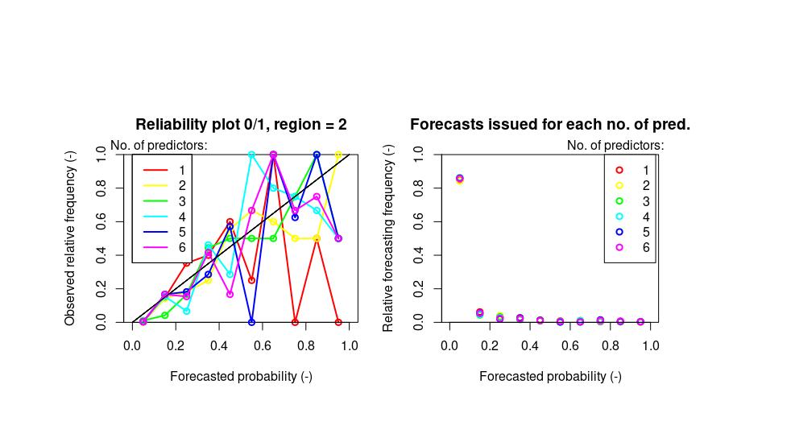
Reliability plots

Slide 6
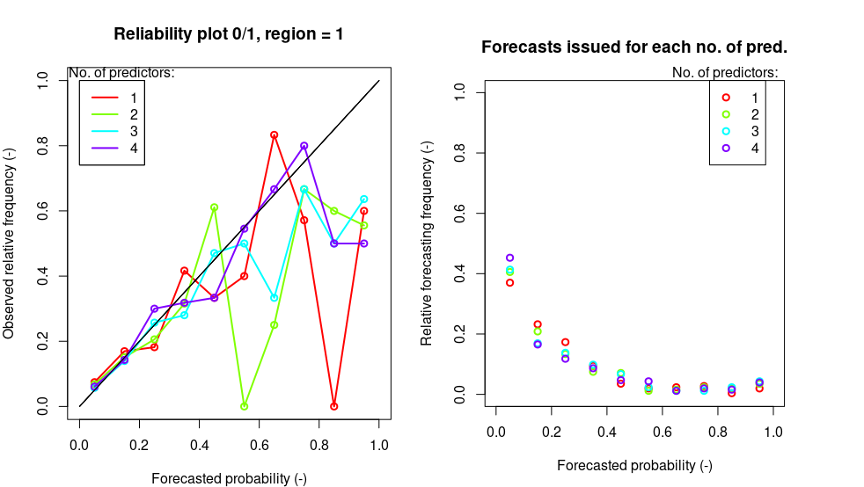
Reliability plots thresholds

Slide 7
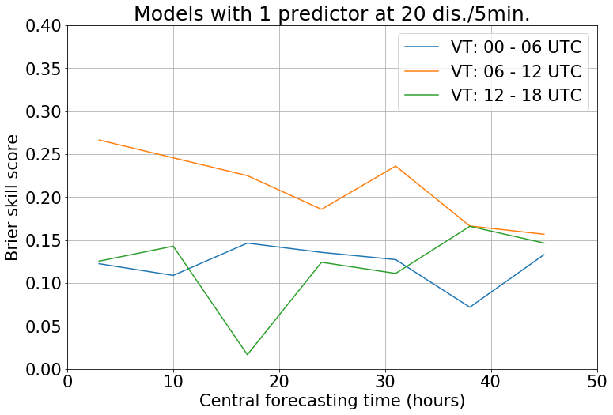
VT&LT comparison
Threshold (20 for validation): 1 predictor is always the best, except for model with highest score

Slide 8
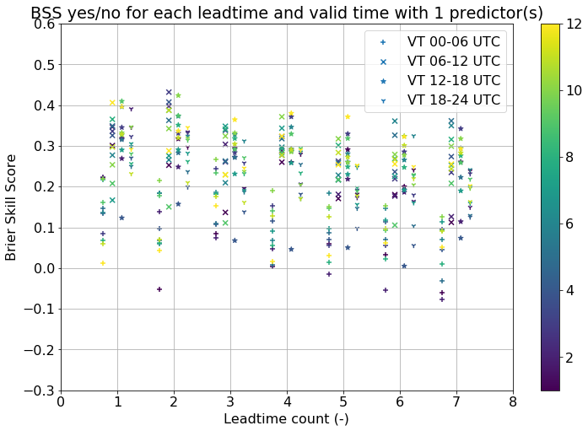
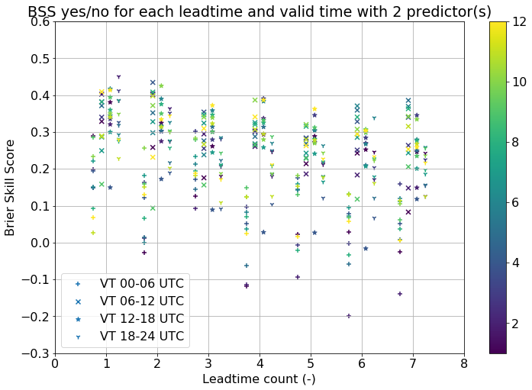
VT&LT comparison: 0/1
Color = region index;
Final cross-validation results

Slide 9
Ensemble CRPSS
At this point, Ensmble CRPS is calculated (but can easily change to CRPSS)
If trained on higher percentiles with transformation, influenced (relatively) more by errors in lower percentiles and for QRF (no transformation) (relatively) more by errors on higher percentiles; isn’t this a problem?

Slide 10
Selection occurences: QRF thres, H00z+12/18
 | Variable name | Freq
1 | Theta_w850_max_pow0.2 | 0.142255892255892
2 | theataW_850mb_6hrlymax | 0.126262626262626
3 | theataW_925mb_6hrlymax | 0.122053872053872
4 | Bradbury_0mabovegnd_6hrlymin | 0.053030303030303
5 | Theta_w850_min_pow0.2 | 0.044051627384961
6 | Bradbury_PW1 | 0.04320987654321
7 | theataW_850mb_6hrlymin | 0.042648709315376
8 | Edward_PW1 | 0.038159371492705
9 | theataW_925mb_6hrlymin | 0.037037037037037
10 | DPT_850mb_6hrlymax | 0.0331088664422

Slide 11
Next steps…
Continue writing
More detailed predictors study of seemingly important predictors (instability indicators usually)
Now: send the codes?
For next week: finish some part of writing (methods)?

