Slide 1
VT&LT comparison 0/1 using 9-fold

Slide 2
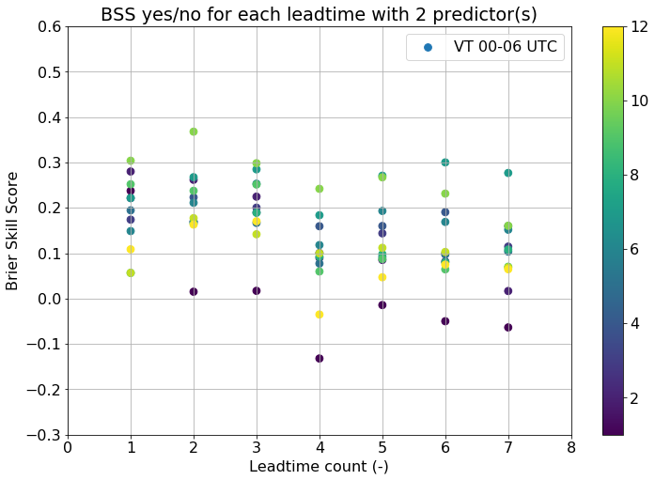
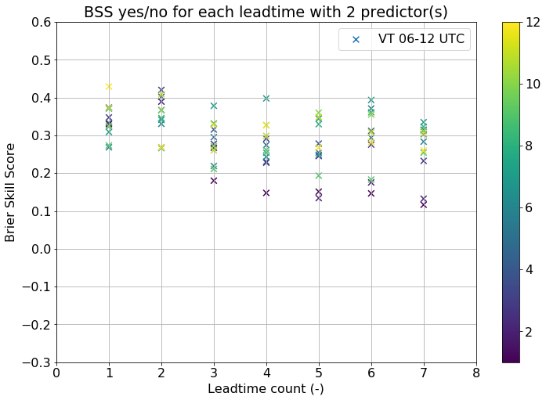


VT&LT comparison 0/1

Slide 3
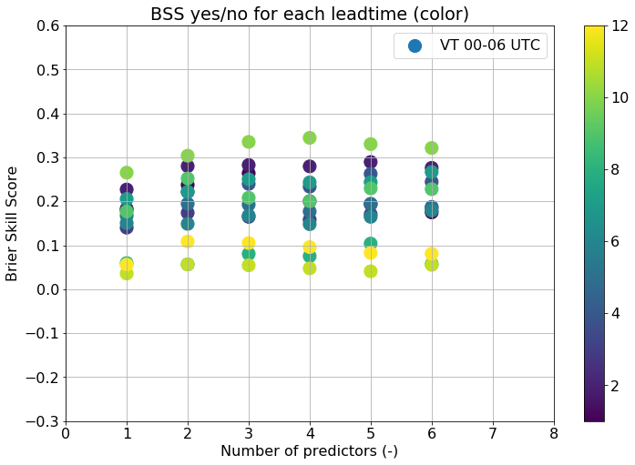
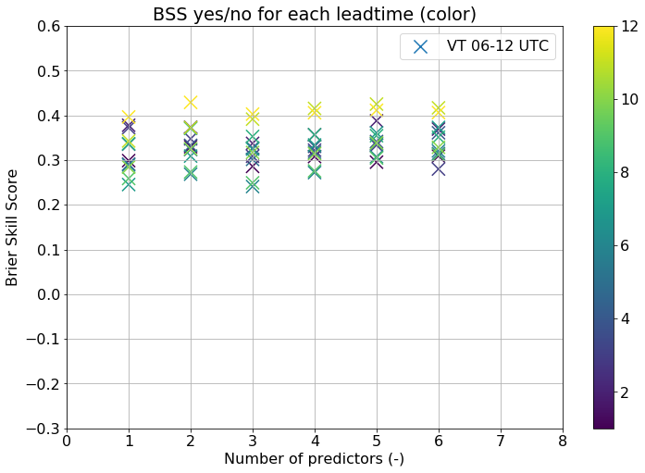
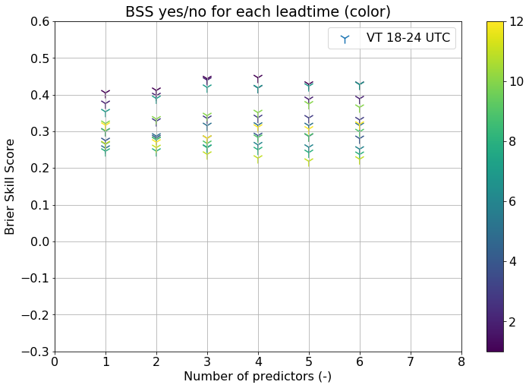
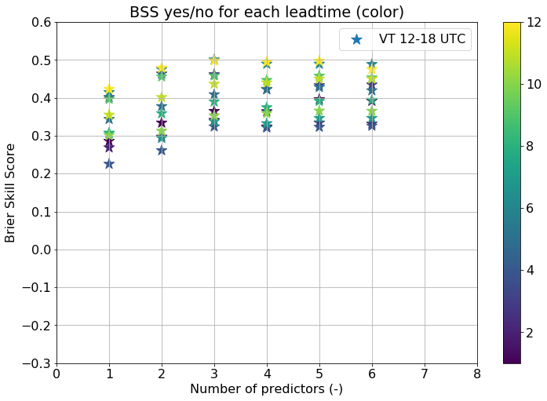
LT 1 comparison: 0/1

Slide 4
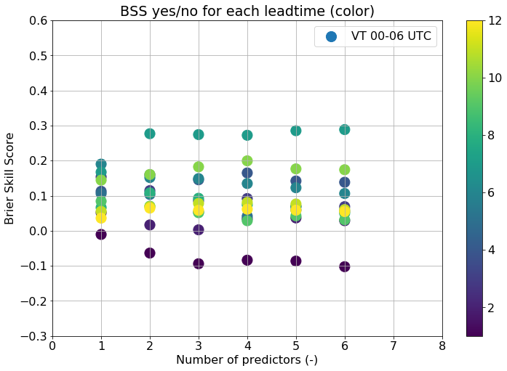
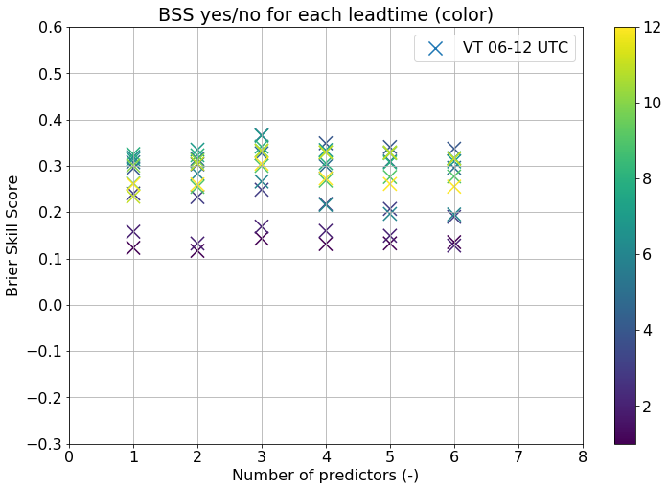
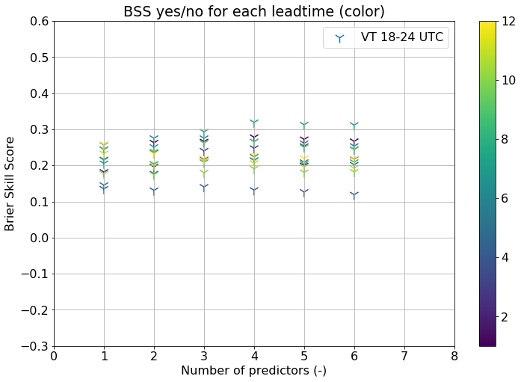
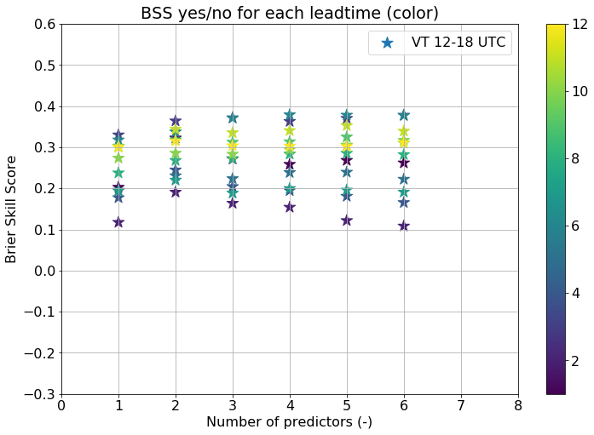
LT 7 comparison: 0/1

Slide 5
Recent progress
Working with shell script
New transformations
Documenting code
Improved visualisation
Use of continuous ranked probability skill score

Slide 6
Recent progress
Studying in detail relation between skill score and threshold, with old dataset
With the new dataset ready to derive training strategy for ELR

Slide 7
This week
Small script for predictor selection analysis (E)LR: frequency tables
The shell script has run through all methods, LT’s & VT’s circumventing errors (by changing x in set.seed(x) if necessary)
Start with 00z Harmonie-40 reforecasts & 2015-2017 lightning dataset (next slides)

Slide 8
Climatology 2015-2017
Following results are based on the full year, so including winter statistics

Slide 9
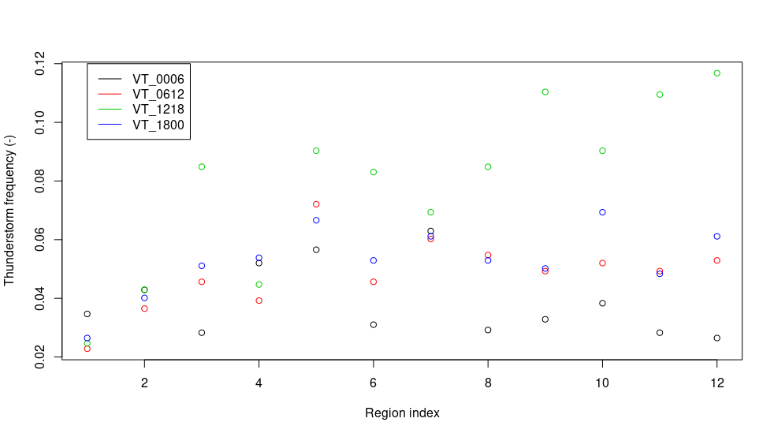
2 points

Slide 10
Climatology 2015-2017
Occurrence at least 2 dis. irrespective of region:
3.8% at night, 7.9% during afternoon (all year!)
About 10% more with only 1 dis.

Slide 11
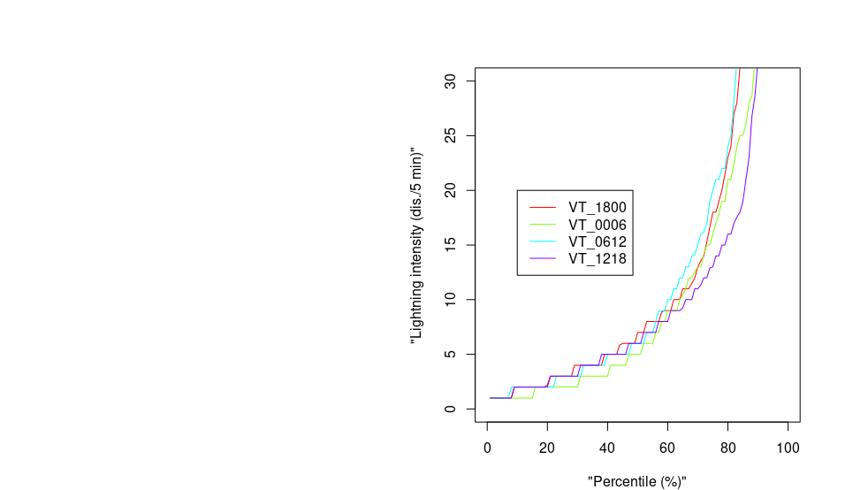
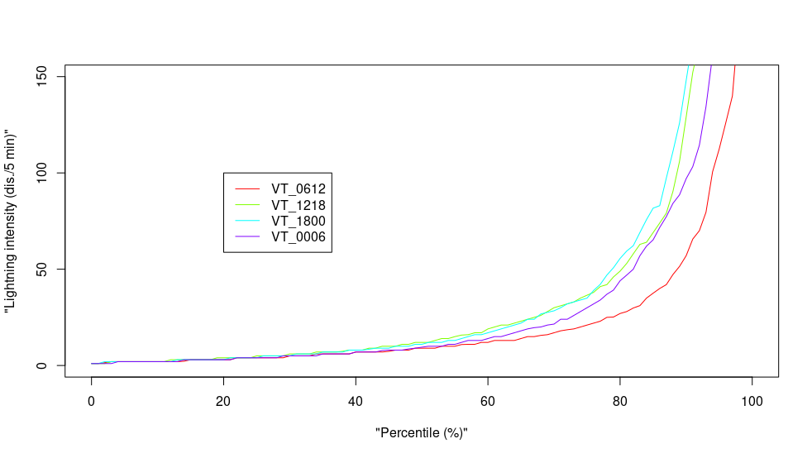
Note: line colors incompatible

Slide 12
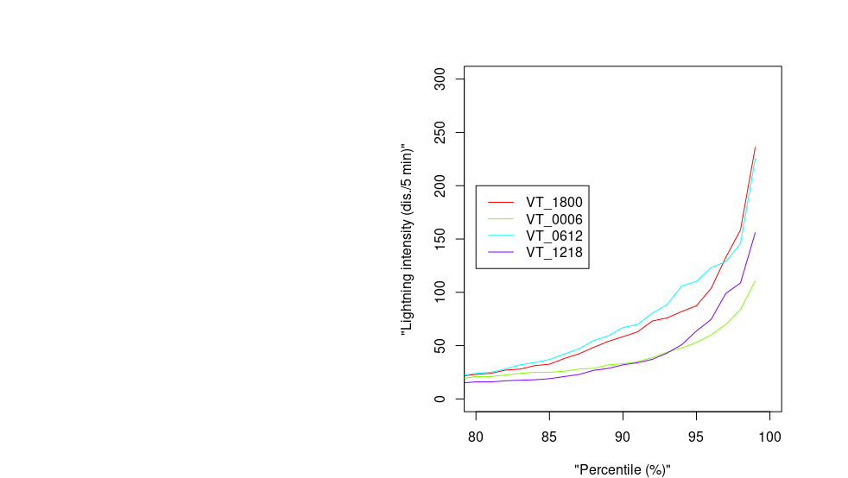
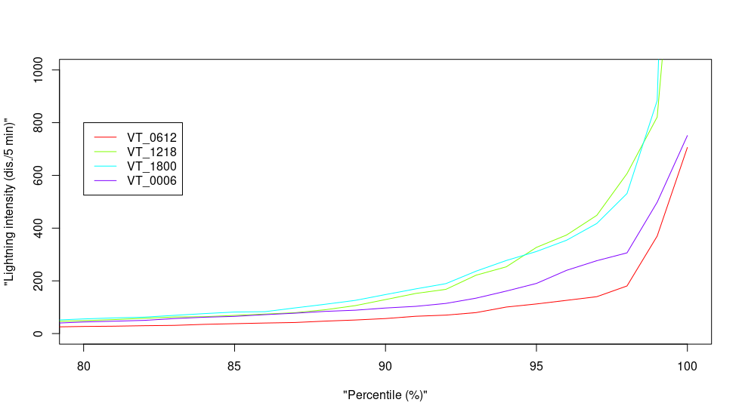
Note: line colors incompatible

Slide 13
Climatology 2015-2017 vs. 2010-2013
Total no. of discharges all year
2015 → 202.548*
2016 → 712.593
2017 → 455.085
2013 → 80.391
2011 → 96.606
2010 → 52.165

Slide 14
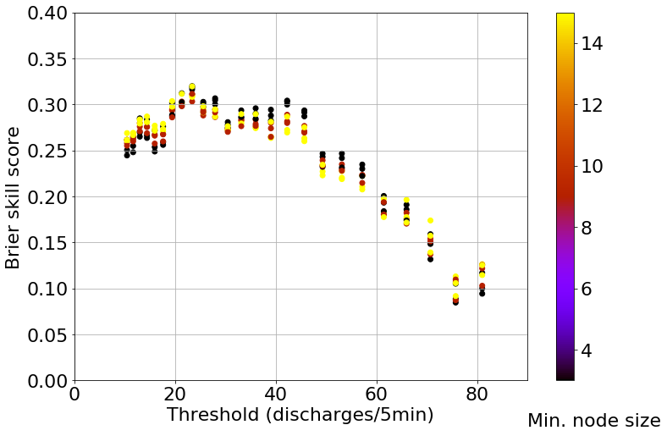
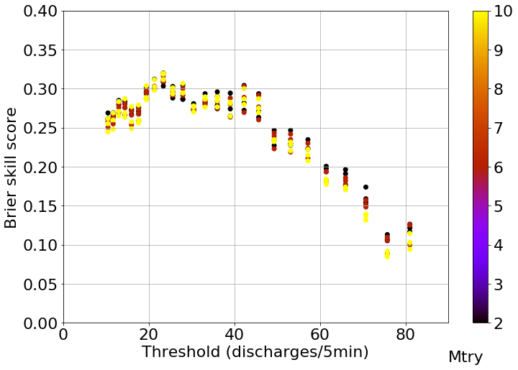
Inconsistent hyperparameters?
Threshold dependence hyperparam.
Example: 70 out of 111 pred., LT = 1, VT = 18-0

Slide 15
Next steps…
What is on the list?
First: get the new Harmonie-40 dataset ready
Derive additional predictors Harmonie
Do training and define settings (threshold quantiles for training!)
Run all 9-fold cross validations
Define model selection strategy & select
Feedback on writing (and possibly the code)

