Slide 1
Results from detection system comparison
(De Vos, 2015)
“Even though misclassification may occur in both systems, the number
of flashes in FLITS far exceeds KLDN. This diminishes the number of times
KLDN would reach the weather alarm criterion of 500 TL strokes within 50 *
50 km2 within 5 minutes. Upon examination however, the situations in which
FLITS reaches the weather alert criterion are not found by KLDN by just
diminishing the number of discharges in the weather alarm criterion. The
number of strokes detected by KLDN during FLITS severe weather peaks
vary between several hundreds to values below 10, therefore making it im-
possible to distinguish these severe weather peaks from non-severe weather”

Slide 2
Results from detection system comparison
(De Vos, 2015)
“Upon examination however, the situations in which
FLITS reaches the weather alert criterion are not found by KLDN by just
diminishing the number of discharges in the weather alarm criterion. The
number of strokes detected by KLDN during FLITS severe weather peaks
vary between several hundreds to values below 10, therefore making it im-
possible to distinguish these severe weather peaks from non-severe weather”
This leads to the expectation of lower scores, cause at higher lightning intensities, they are not always detected! Therefore potentially lower skill scores??
Do we still have data to find out about this?

Slide 3
VT&LT comparison 0/1 using 9-fold

Slide 4
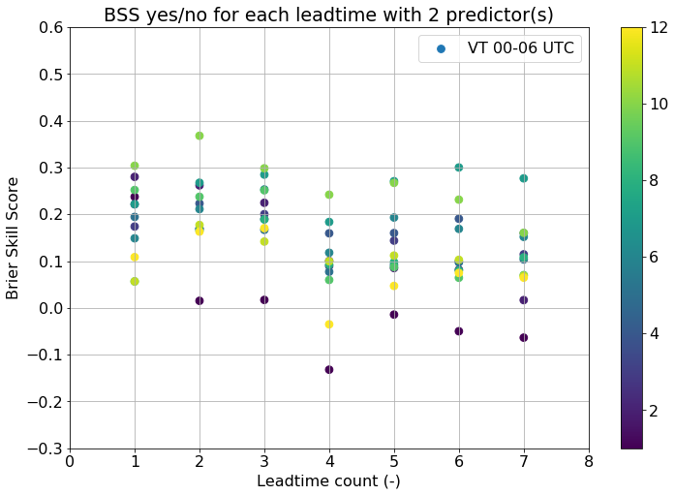
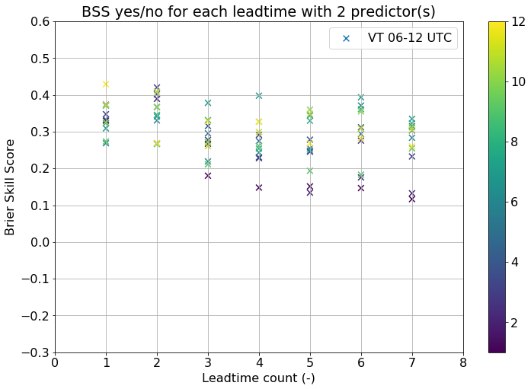


VT&LT comparison 0/1

Slide 5
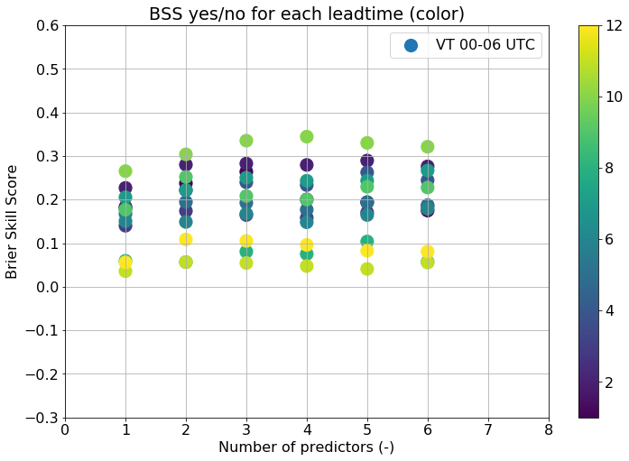
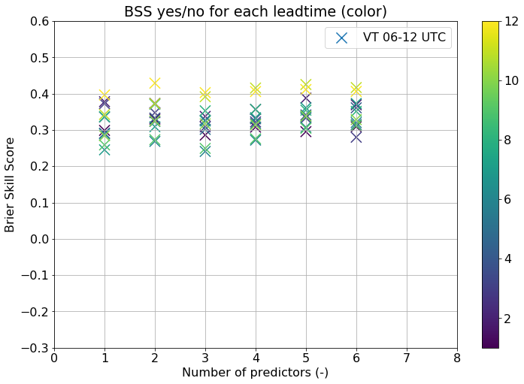
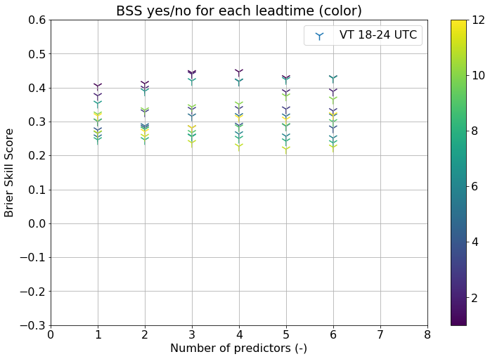
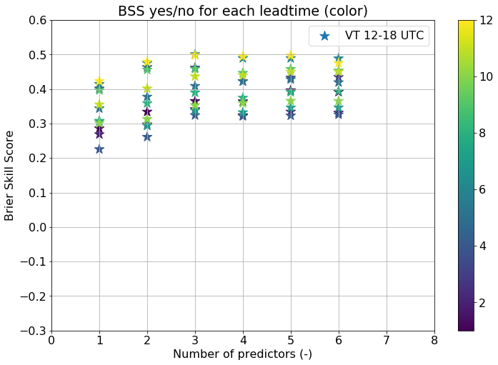
LT 1 comparison: 0/1

Slide 6
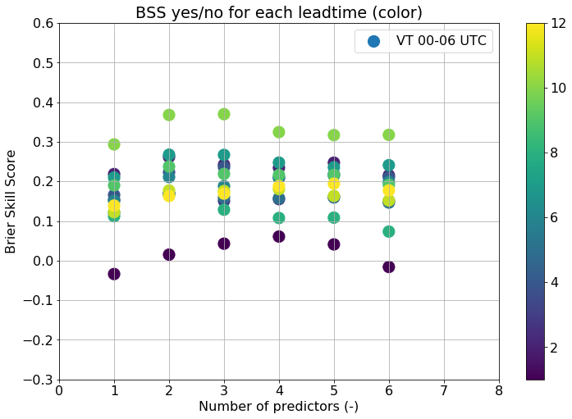
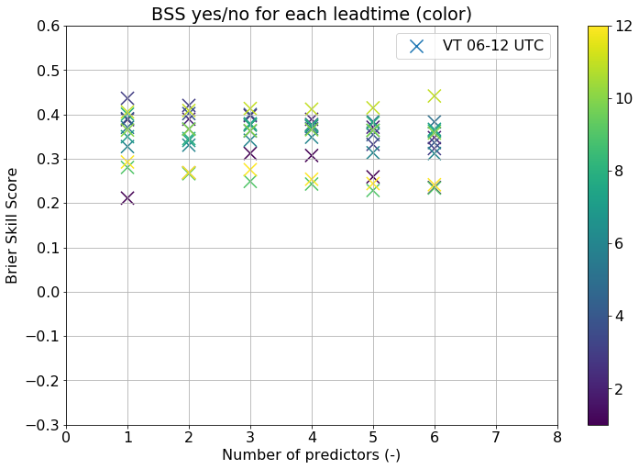

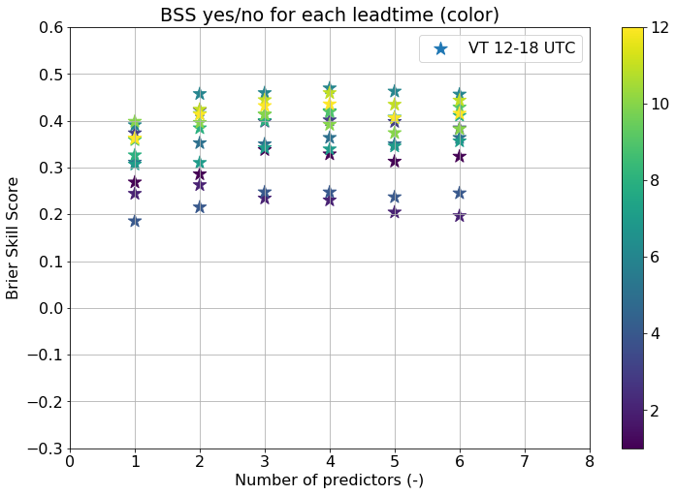
LT 2 comparison: 0/1

Slide 7
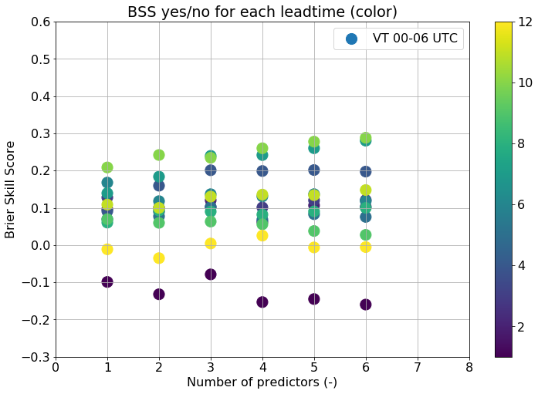
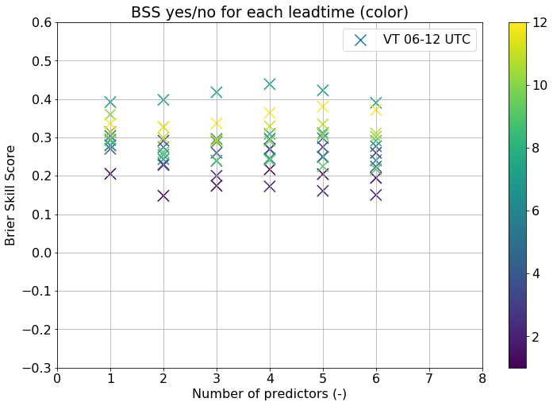
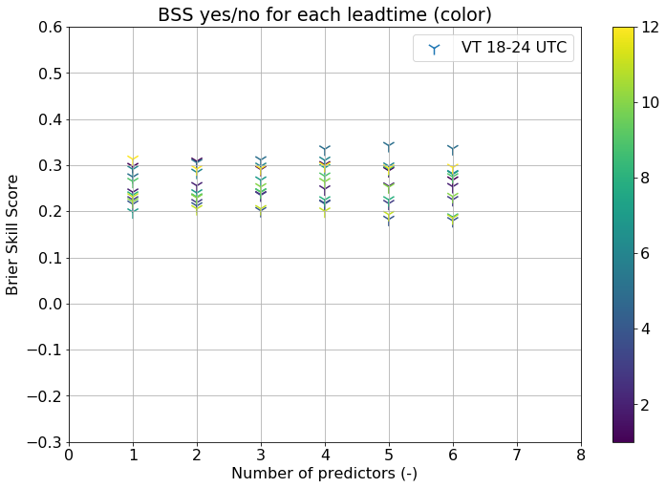
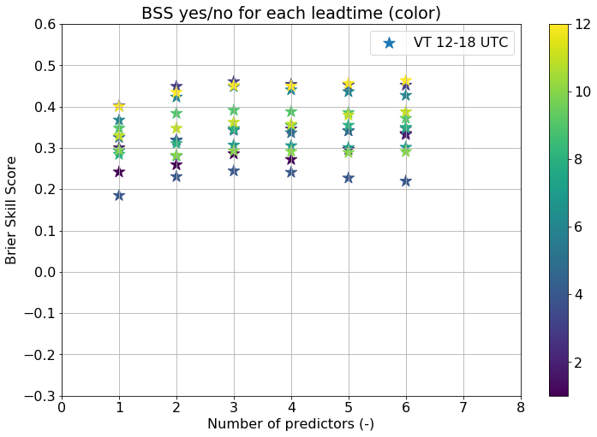
LT 4 comparison: 0/1

Slide 8
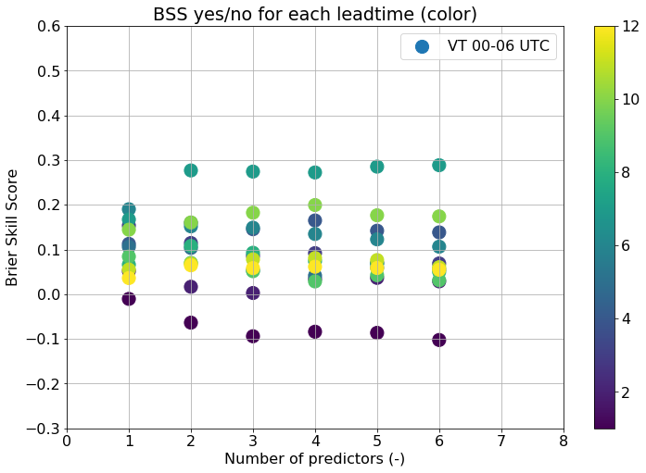
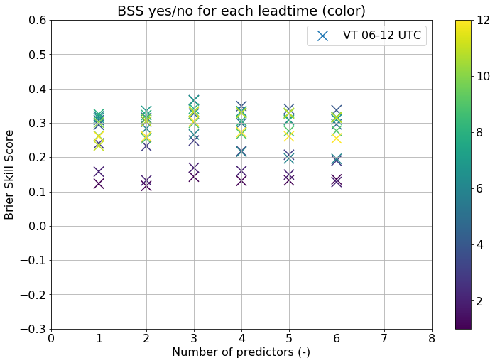

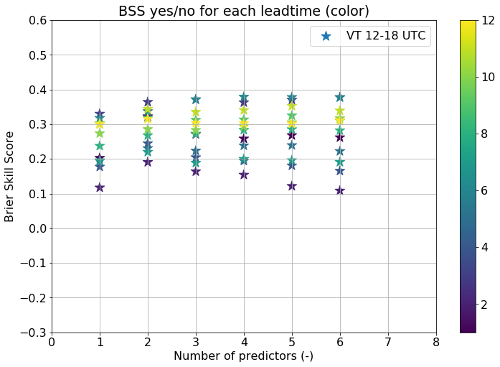
LT 7 comparison: 0/1

Slide 9
Optimalization
After the previous ~10 variables that wouldn’t work in ELR, another one: minimum CIN. When transforming it, this one works though.

Slide 10
Today
Starting a shell script; list of steps to be done before execution (some of the next steps)

Slide 11
Graphs with threshold percentiles to train on
No clear and systematic behavior; starting at 75-80 percentile usually very unstable and at 20 the forecast is not optimal
Many example graphs

Slide 12
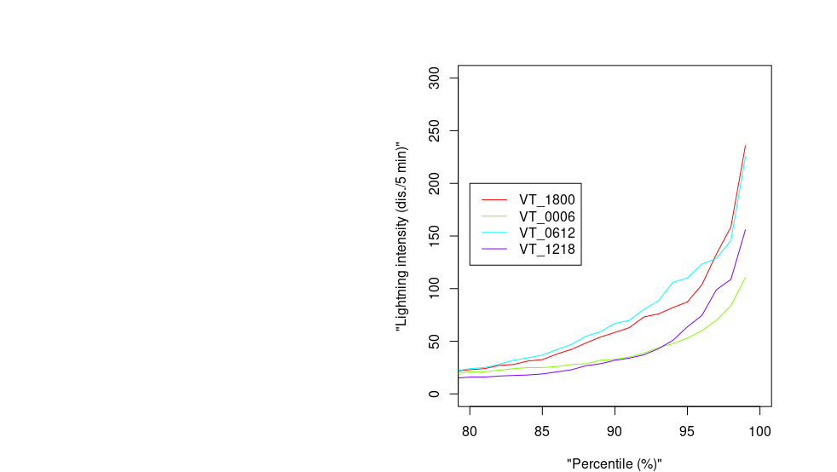
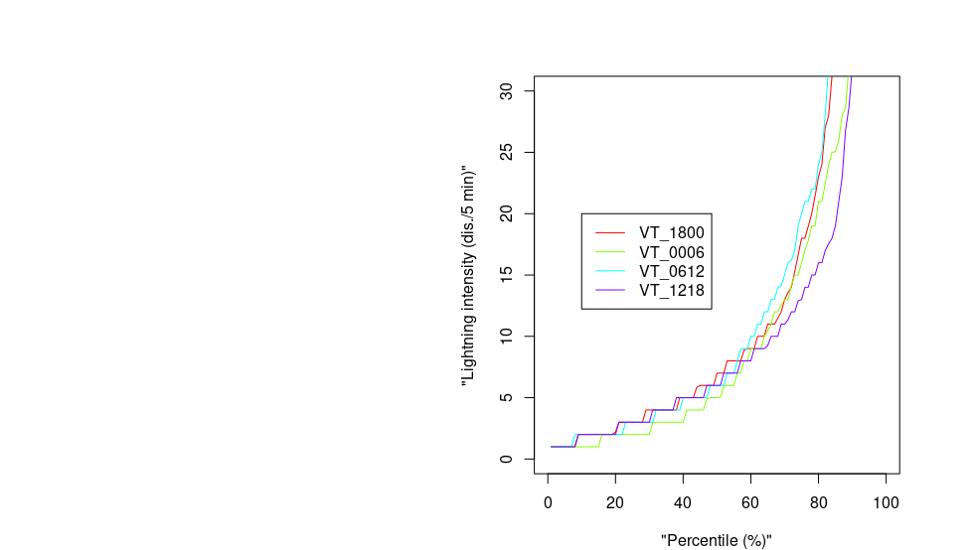
Ensemble CRPSS

Slide 13
Climatology 2015-2017
Following results are based on the full year, so including winter statistics

Slide 14
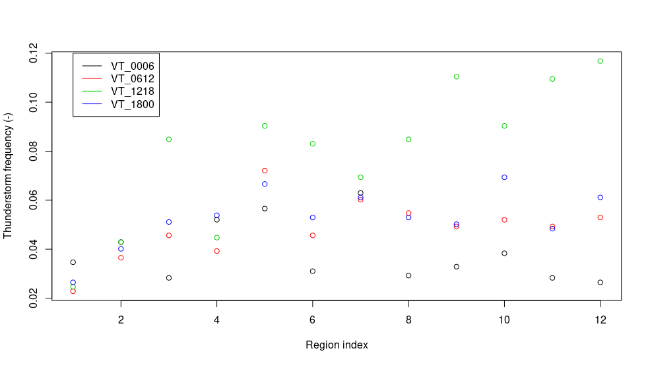
2 points

Slide 15
Climatology 2015-2017
Occurrence at least 2 dis. irrespective of region:
3.8% at night, 7.9% during afternoon (all year!)
5.4% over all VT combined
About 10% more with 1 dis.
About 9% less if > 2 dis.
About 15% less if > 3 dis.

Slide 16
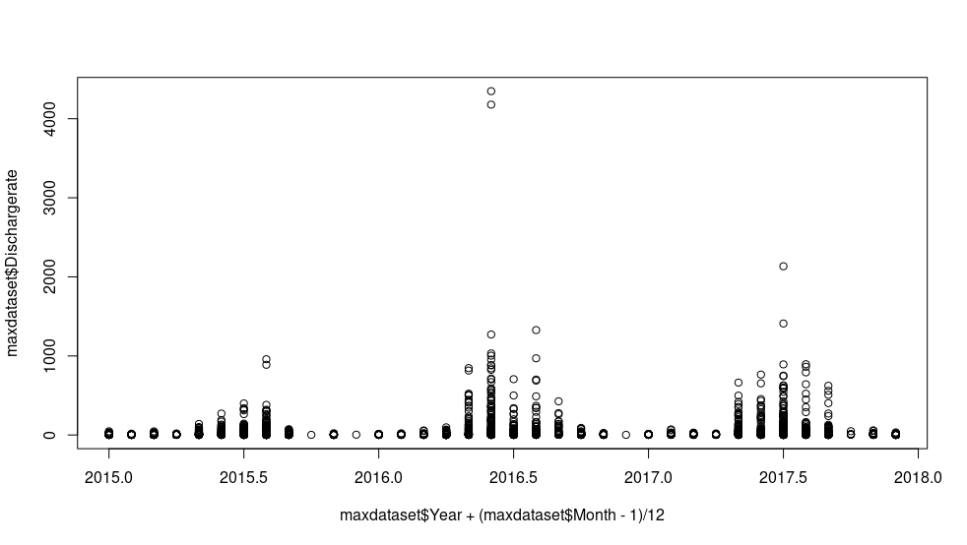
Q0.98:
2015 → 29
2016 → 91
2017 → 86
Dis./region/6hours
At least 2 dis.
2015 → 4.5%
2016 → 5.9%
2017 → 5.6%

Slide 17
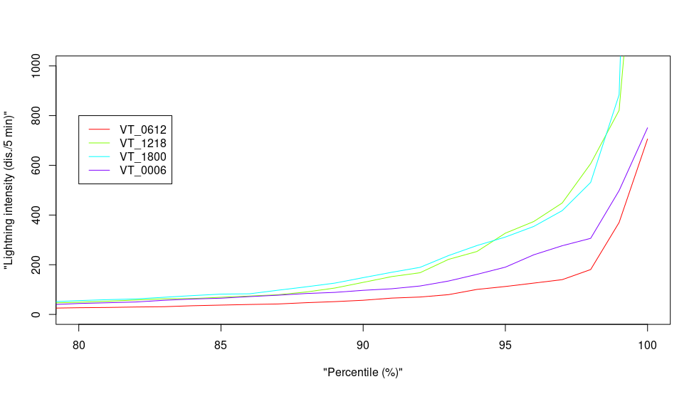
Note: line colors incompatible

Slide 18
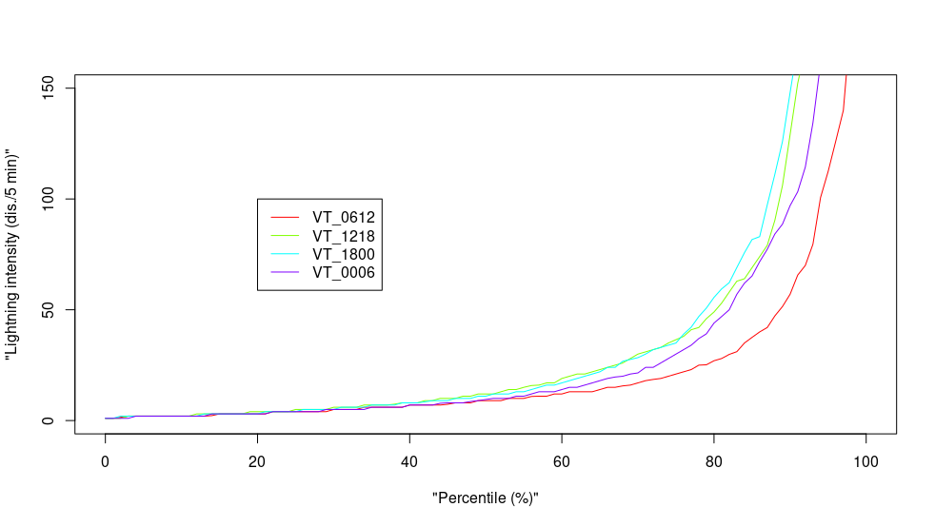
Note: line colors incompatible

Slide 19
Climatology 2015-2017 vs. 2010-2013
Total no. of discharges all year
2015 → 202.548*
2016 → 712.593
2017 → 455.085
2013 → 80.391
2011 → 96.606
2010 → 52.165
* some missing values on december 1st: 48x “99999”

Slide 20
Runs weekend
All VT, LT 0-24 hours worked
Got stuck doing 24-30 hours (error in transformation)
Yes or no LR: first variable (transformed) MUCAPE or (transformed) modified Jefferson max.
Thresholds ELR: first variable Boyden/Bradbury/K-ind/Showalter/BoydenPW/BradburyPW

Slide 21
Runs weekend
QRF results are overwhelming(ly many scores)
But also in general: need to define focus & tasks

Slide 22
Number of predictors
ELR: usually 1 or 2, sometimes 3 (mainly evening, short LT)

Slide 23
ELR: binaries
At LT 5, ELR unable to fit one binary
(According to google search results matrix uninvertible and therefore) most likely be because linear combination of other columns
The variable is chosen once as third predictor for training one year, one LT and one VT in ELR, for a model which would have 3 predictors

Slide 24
ELR: binaries
The fit for which it fails does not decrease AIC and in general the predictor does barely if the three additional variables that were in this case are used to apply to the whole dataset (all VT & LT)

Slide 25
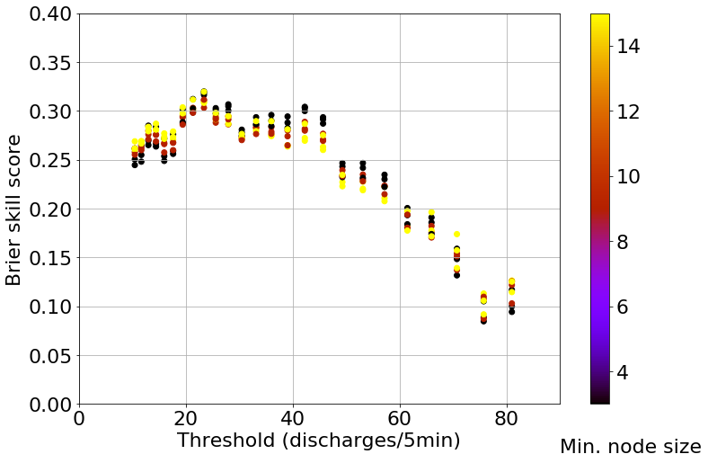
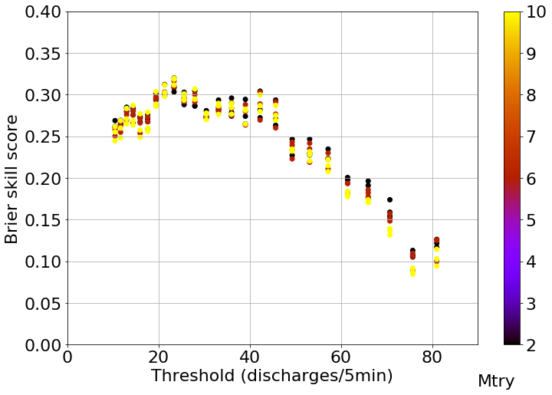
Inconsistent hyperparameters?
Threshold dependence hyperparam.
Example: 70 out of 111 pred., LT = 1, VT = 18-0

Slide 26
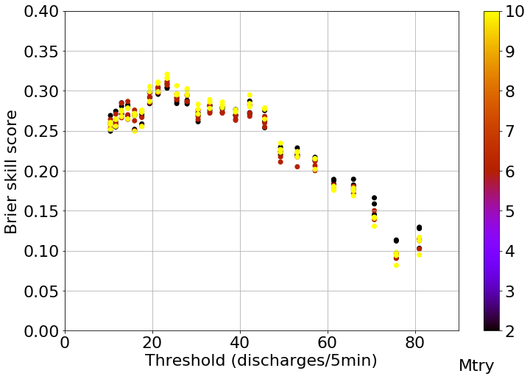
Inconsistent hyperparameters?
Threshold dependence hyperparam.
Example: 60 vs. 70 pred., LT = 1, VT = 18-0

Slide 27
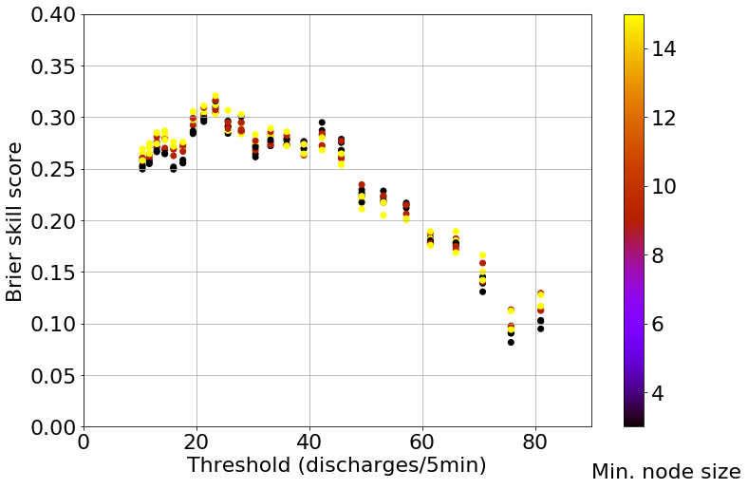
Inconsistent hyperparameters?
Threshold dependence hyperparam.
Example: 60 vs. 70 pred., LT = 1, VT = 18-0

Slide 28
Hyperparameter settings: 0/1
Best seems mtry = 2
When skill scores are not too high (0.1-0.2), node size = 15 best usually (compared to 9 and 3) or reaches maximum with fewer predictors
Higher skill scores: usually overlap

Slide 29
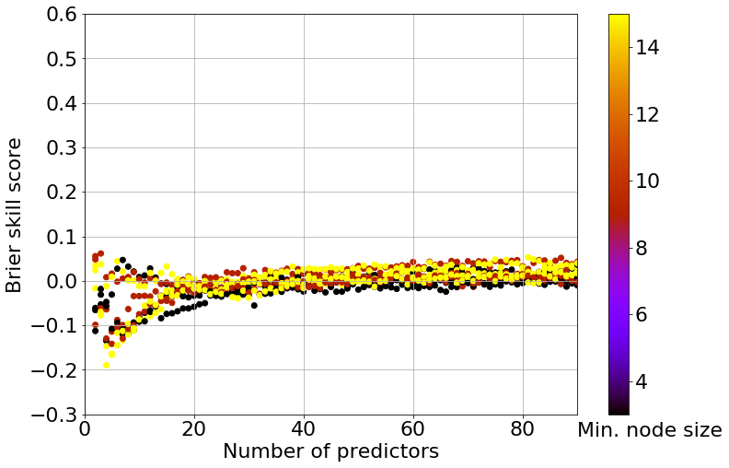
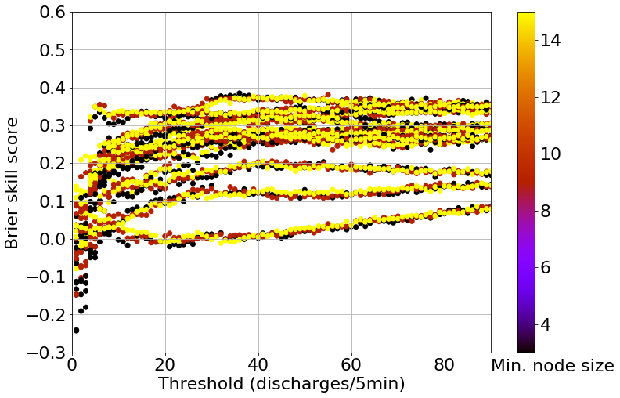
Hyperparameter settings
Number of predictors
Example thresholds
Example yes/no

Slide 30
Hyperparameter settings: thresholds
Mtry: 2 is better, or all are comparable
Node size: when very important (clearly different scores), 3 is best here
Sometimes reversed, but smaller difference

Slide 31
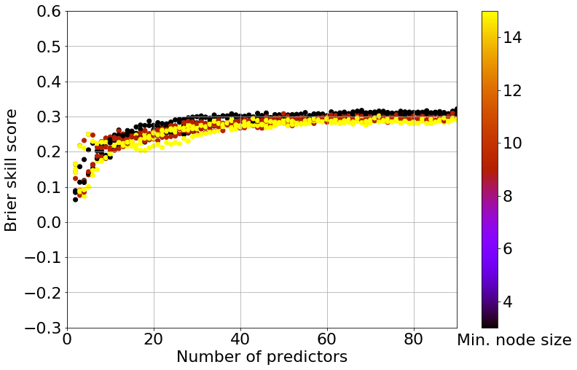
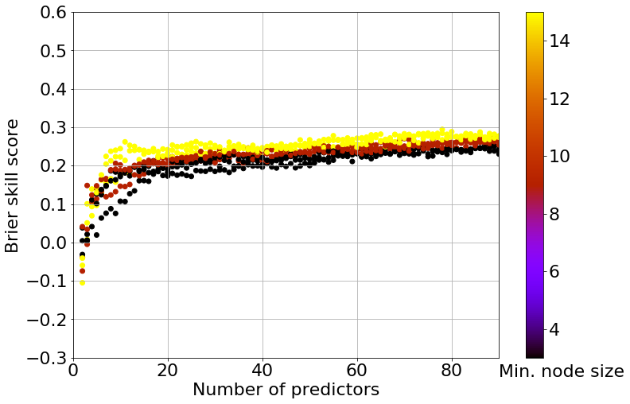

Slide 32
ELR
At LT 7, for one VT max Fateev was not optimizable
Changing set.seed helped, but is not allowed!

Slide 33
Next steps… (slide last week)
Decide about thresholds and percentiles ELR training and verification
Writing
→ Have written a document of 5500 words
Send the codes?
Finish some first writing section?

