Slide 1
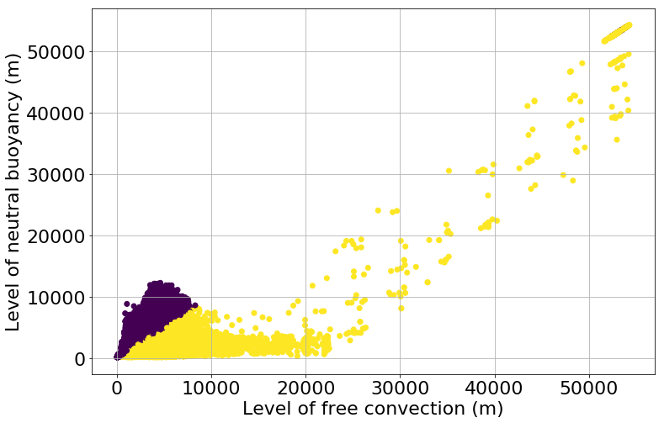
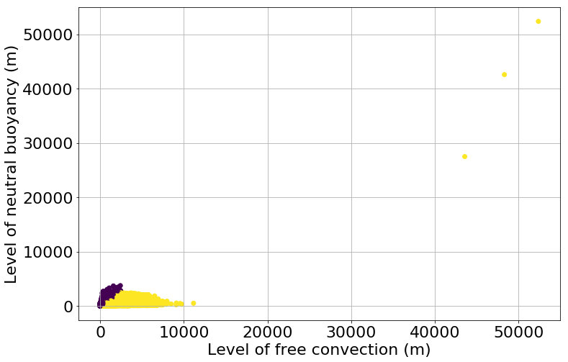

LFC and LNB > 12.5 km
Maximum Minimum
color: which of the 2 is bigger (purple = correct)

Slide 2
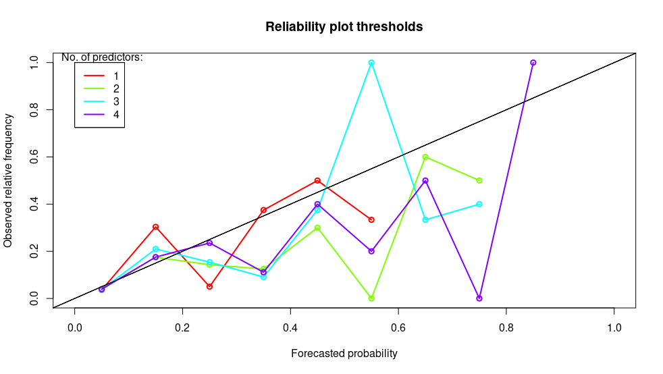
Reliability plot
Thresholds ELR, at threshold 40

Slide 3
Test with binary predictors
Never selected for any method (and irrelevant in QRF)
binary1 = (Boyden,max > 93) x (PW,max > 10) x (LidStrength,min < 3)
binary1 returns 0 if thunderstorm impossible, only 20% probability for 0
binary2 = binary1 x (ModJefferson,max > 20) x (TotalsTotals2e,max > 20)

Slide 4
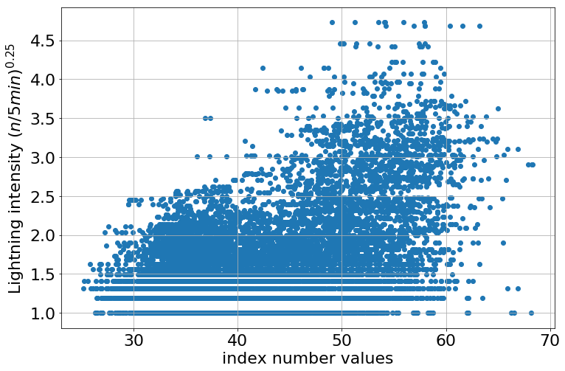
Other predictors
(Boyden,max – 85) x log(PW,max)
frequently in QRF with thresholds (approx 3%)

Slide 5
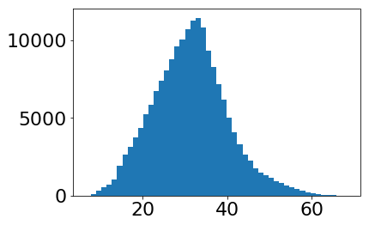
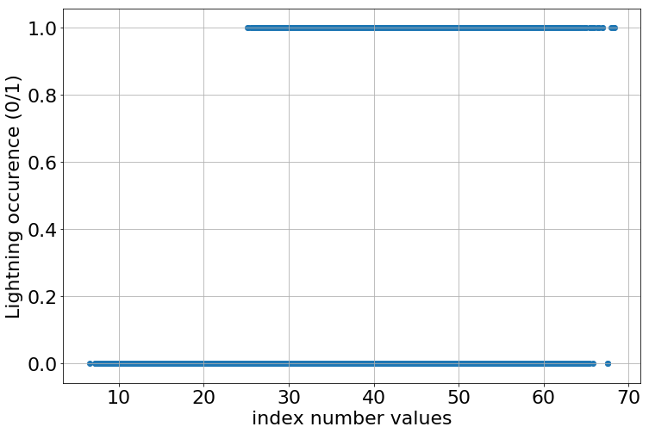
Other predictors
(Boyden,max – 85) x log(PW,max)
frequently in QRF with thresholds

Slide 6
Yes/no case, composed predictors, approx 5% combined

Slide 7
All composed predictors
Boyden_PW1 = (new_Obs$Boyden_0mabovegnd_6hrlymax-85)*PW1,
Boyden_PW2 = (new_Obs$Boyden_0mabovegnd_6hrlymax-85)*PW2,
Bradbury_PW1 = (new_Obs$Bradbury_0mabovegnd_6hrlymin-14)*PW1,
Bradbury_PW2 = (new_Obs$Bradbury_0mabovegnd_6hrlymin-14)*PW2,
Edward_PW1 = (new_Obs$theataW_925mb_6hrlymax-new_Obs$theataW_500mb_6hrlymin)*PW1,
Edward_PW2 = (new_Obs$theataW_925mb_6hrlymax-new_Obs$theataW_500mb_6hrlymin)*PW2,
LidS_PW = log(0.01+new_Obs$LidStrength_0mabovegnd_6hrlymin*PW2),
Lifted_PW1 = PW1/(new_Obs$Lifted_0mabovegnd_6hrlymin+6),
Lifted_PW2 = PW2/(new_Obs$Lifted_0mabovegnd_6hrlymin+6),
binary_1 = as.numeric((new_Obs$Boyden_0mabovegnd_6hrlymax > 93) *(new_Obs$PrecipitableWater_0mabovegnd_6hrlymax > 10) *(new_Obs$LidStrength_0mabovegnd_6hrlymin < 3) ),
binary_2 = as.numeric((new_Obs$Boyden_0mabovegnd_6hrlymax > 93) *(new_Obs$PrecipitableWater_0mabovegnd_6hrlymax > 10) *(new_Obs$LidStrength_0mabovegnd_6hrlymin < 3)*(new_Obs$modJefferson_0mabovegnd_6hrlymax > 20)*(new_Obs$TotalTotals_2e_0mabovegnd_6hrlymax > 20) ),

Slide 8
All composed predictors
cos_WDIR_500_max = cos(new_Obs$WDIR_500mb_6hrlymax),
sin_WDIR_500_max = sin(new_Obs$WDIR_500mb_6hrlymax),
cos_WDIR_850_max = cos(new_Obs$WDIR_850mb_6hrlymax),
sin_WDIR_850_max = sin(new_Obs$WDIR_850mb_6hrlymax),
cos_WDIR_500_min = cos(new_Obs$WDIR_500mb_6hrlymin),
sin_WDIR_500_min = sin(new_Obs$WDIR_500mb_6hrlymin),
cos_WDIR_850_min = cos(new_Obs$WDIR_850mb_6hrlymin),
sin_WDIR_850_min = sin(new_Obs$WDIR_850mb_6hrlymin)

Slide 9
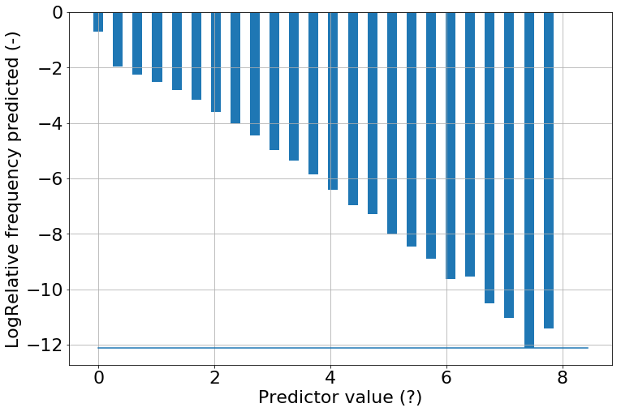
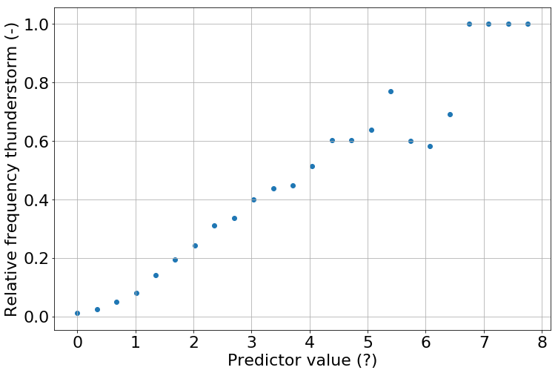
Better plots for exploring yes/no
Harmonie-precip, max (square root)

Slide 10
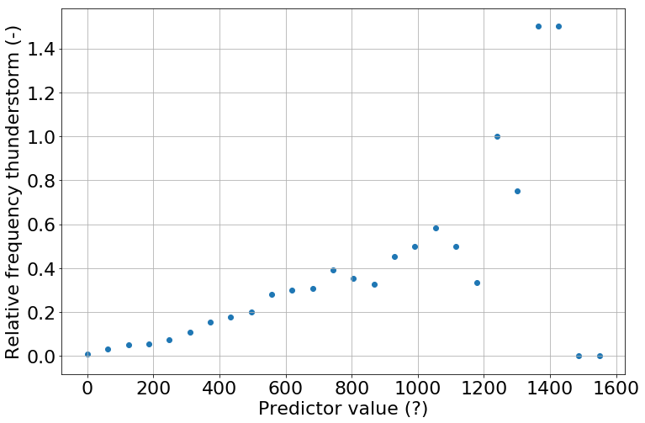
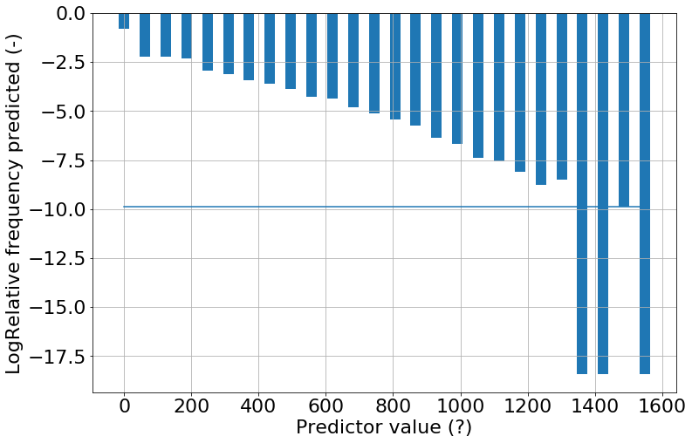
EC-6hr precip

Slide 11
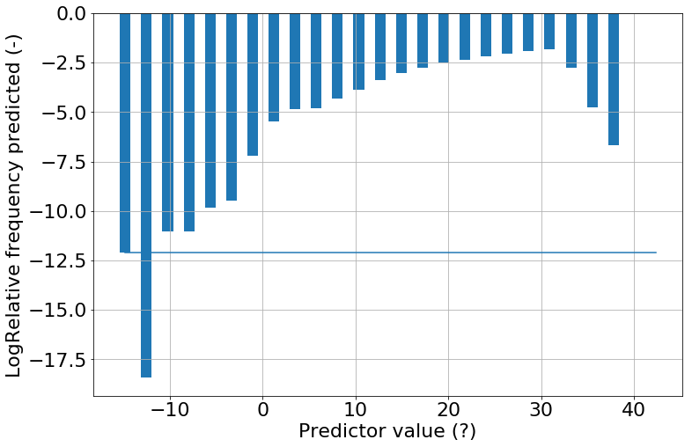
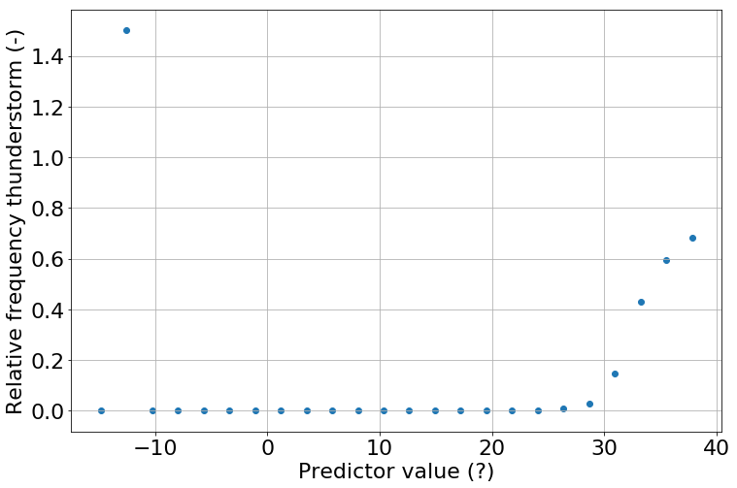
Modified Jefferson, max
1 value
No values

Slide 12
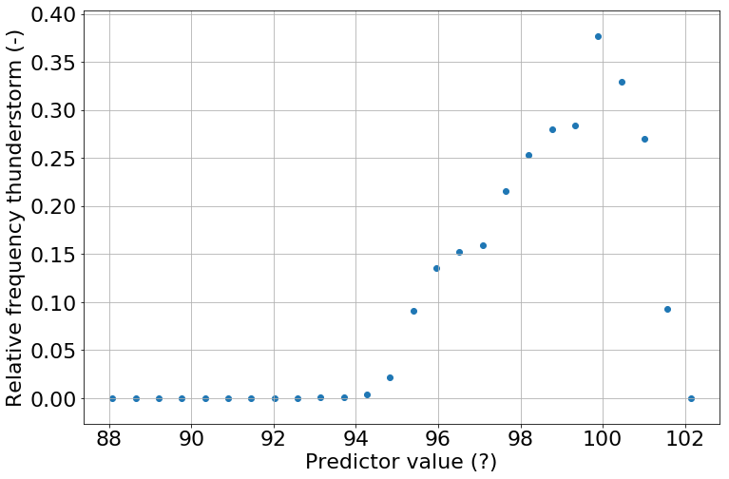
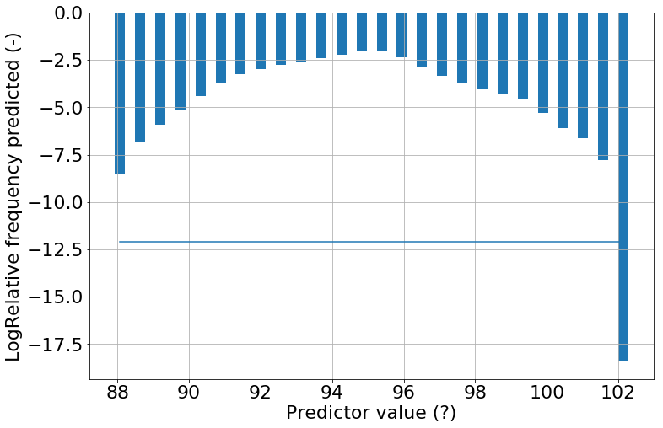
Boyden, max

Slide 13
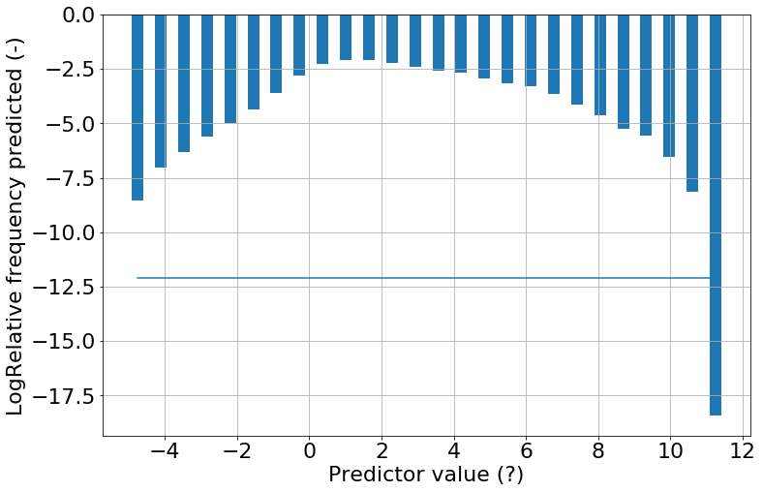
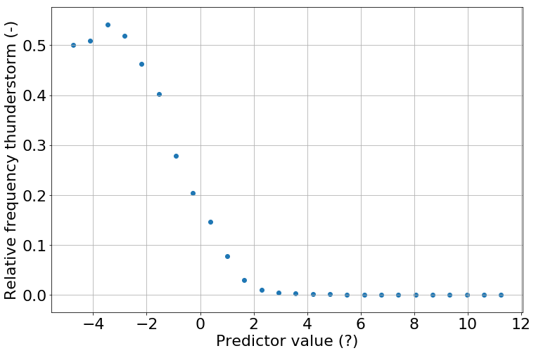
Bradbury, min

Slide 14
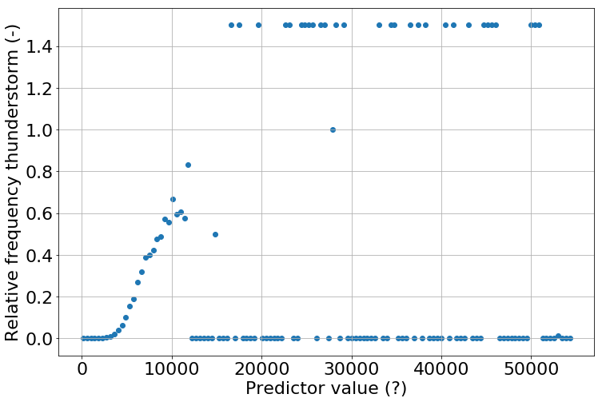
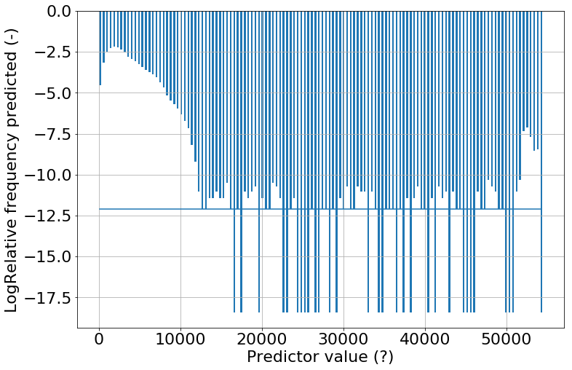
LNB,max

Slide 15
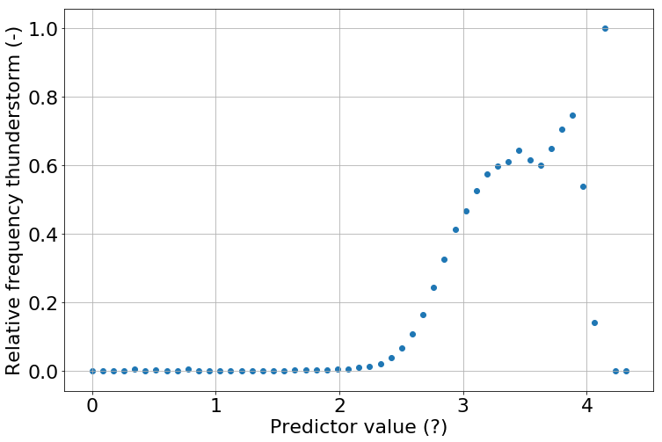
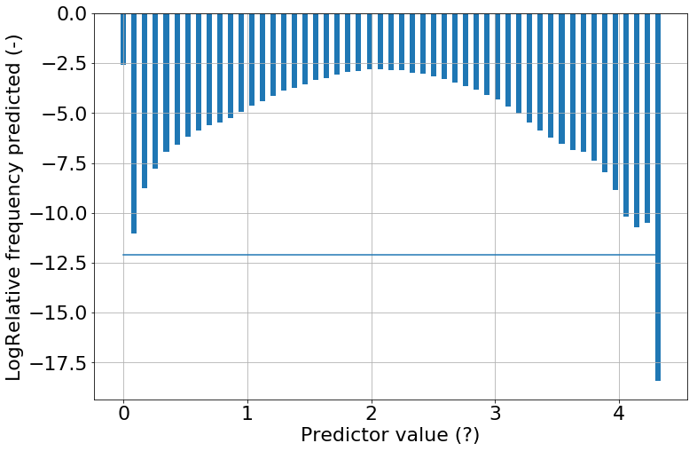
CAPE,max^0.2

Slide 16
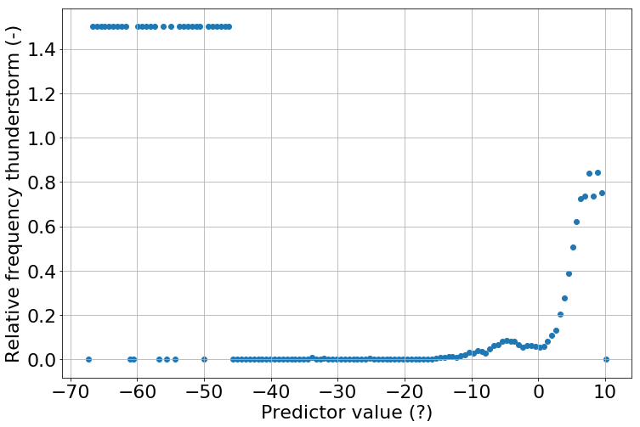
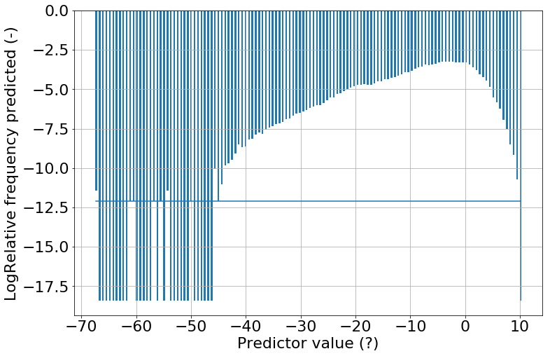
600 hPa Td, max

Slide 17
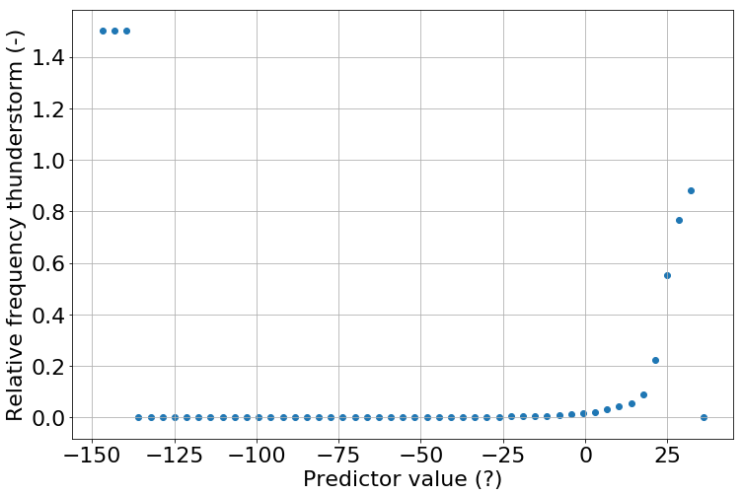
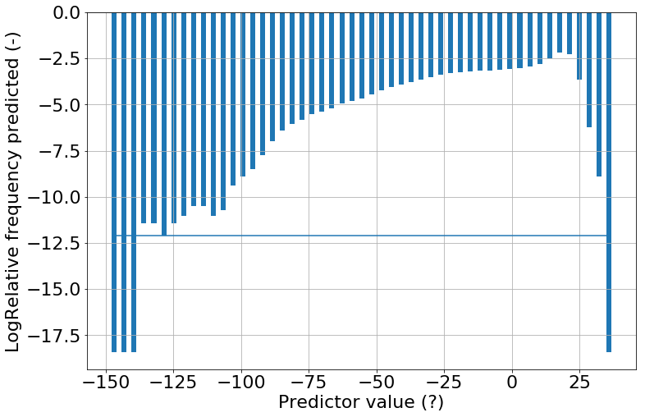
Fateev,max

