Slide 1
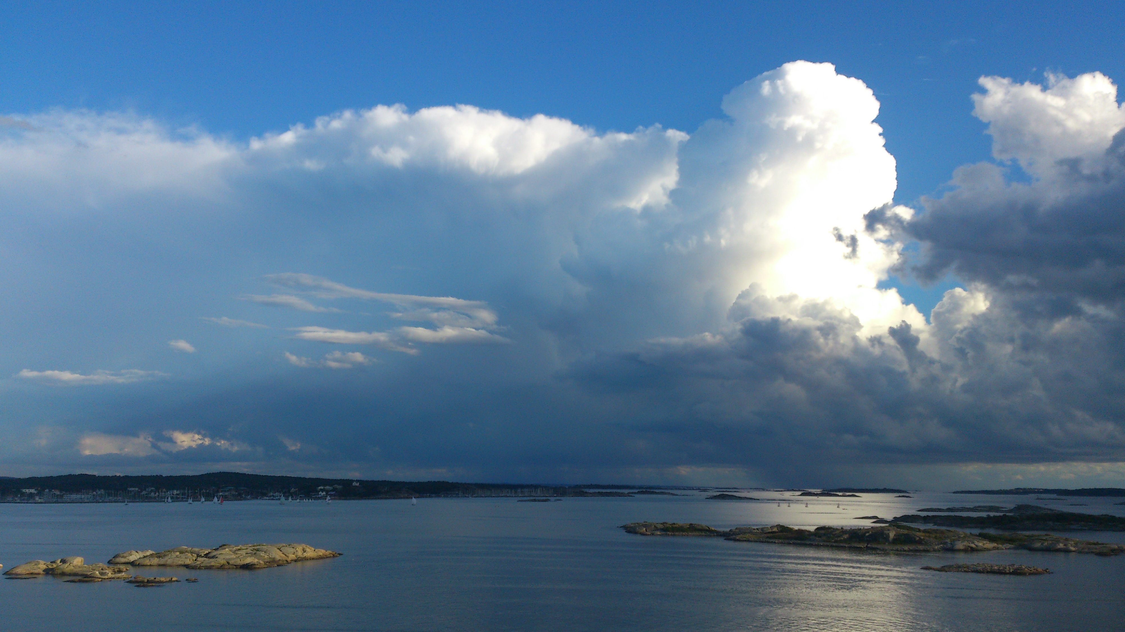
Probabilistic thunderstorm forecasts using Harmonie predictors with logistic regression and machine learning technique(s)
Date: February 2019
By Edward Groot
Supervisors: Maurice Schmeits (KNMI), Kirien Whan (KNMI), Willem Jan van de Berg (IMAU)

Slide 2
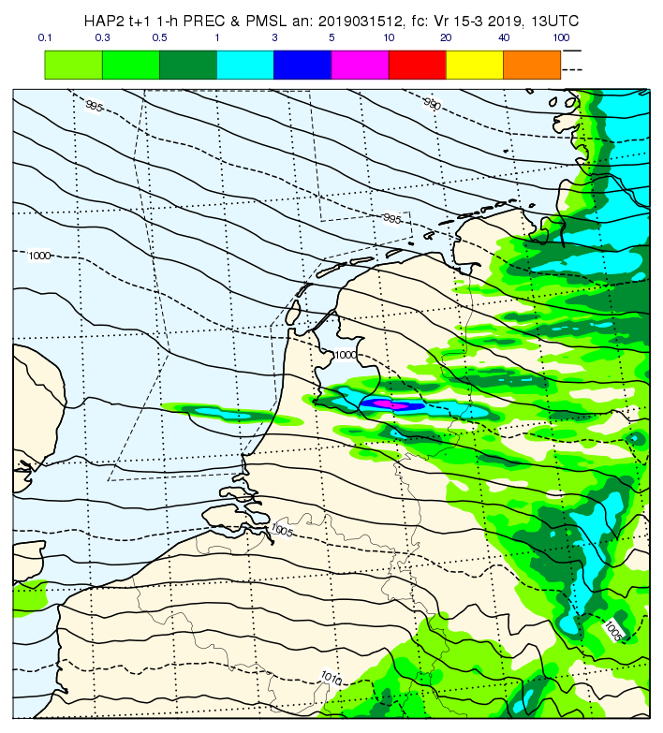
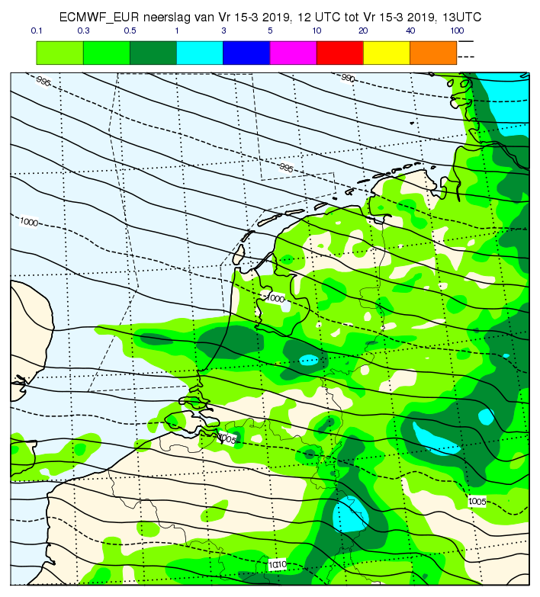
Numerical weather models
Harmonie: short term; 0-48 hours at 2.5x2.5 km & 65 layers (currently)
Solves deep convection (showers with local hail/thunder)
Exactly same valid time, physically different models and initialization time:

Slide 3
Aim
Increase physical understanding and forecasting of thunderstorms in NL (and interrelation between the two)
Compare statistical post-processing methods for thunderstorms/severe convection
Make an operational post-processing model for weather forecasting: thunderstorm occurrence and thunderstorm intensity

Slide 4
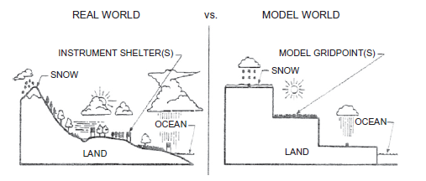
Why post-processing?
Direct model output (DMO) from a numerical weather prediction (NWP) model is biased, because
Model has gridboxes which represent gridbox average conditions
Also: missing physics & chaos in the system
We can correct systematic errors!

Slide 5
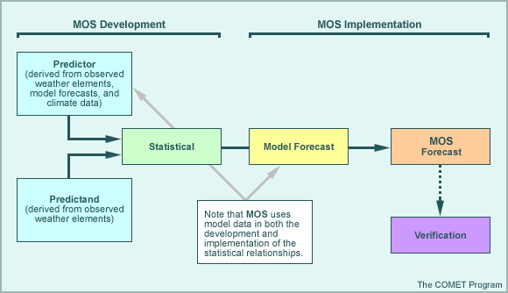
Model Output Statistics (MOS)

Slide 6
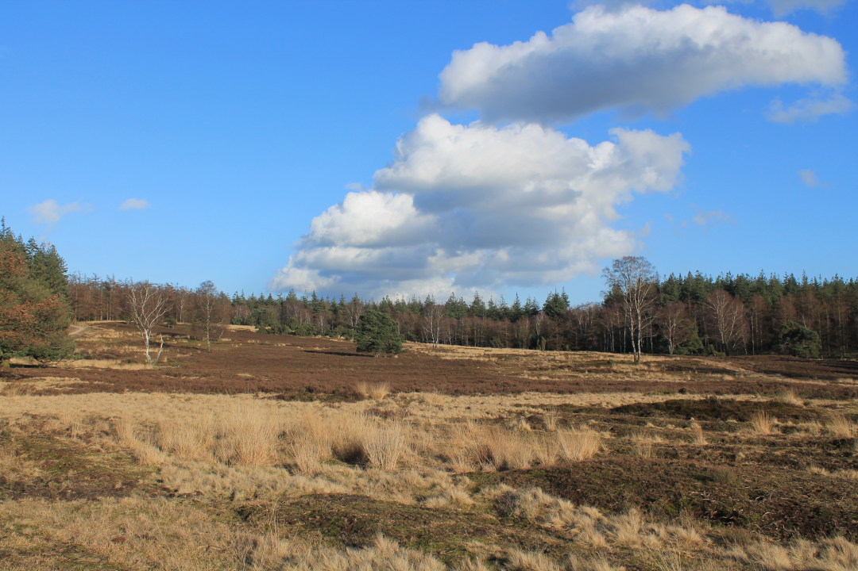
Convection
Shallow vs. deep
10x10 km models have all convection parametrized
Newer Harmonie-model (2.5x2.5 km) solves deep convection

Slide 7
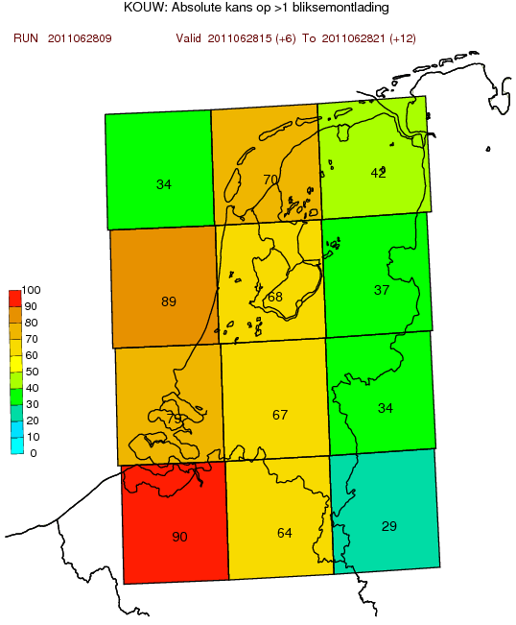
Previously constructed model...
Based on logistic regression and extended logistic regression, shortly (E)LR
10x10 km models have convection parametrized
Newer Harmonie-model (2.5x2.5 km) solves deep convection

Slide 8
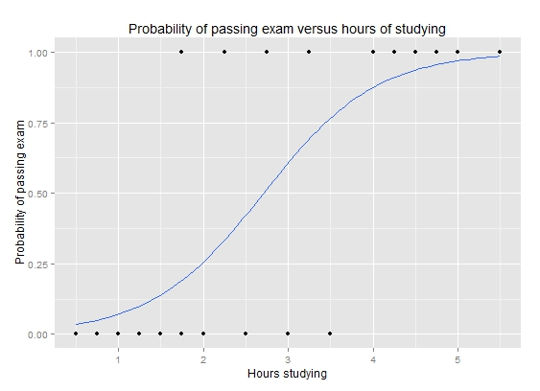
Logistic regression
Logistic transformation of (multivariate) linear regression model
P: probability of event observation
Example: wikipedia

Slide 9

Quantile regression forest
Simplified example tree
Forest of trees
Trees of nodes
Nodes: split observations in two subsets based on predictor variables
Trees “vote” like in a parliament (but could have multiple votes)
Rain > 2 mm
Y: 10%
Temperature > 25 deg. C
N: 2%
Cloud cover > 70 %
Y: 25%
Rain > 5 mm
N: 6% >
Wind > 5 m/s

Slide 10

Predictor selection
Dozens of variables
Best are selected
Stepwise selection and/or
elimination
clipart.com

Slide 11
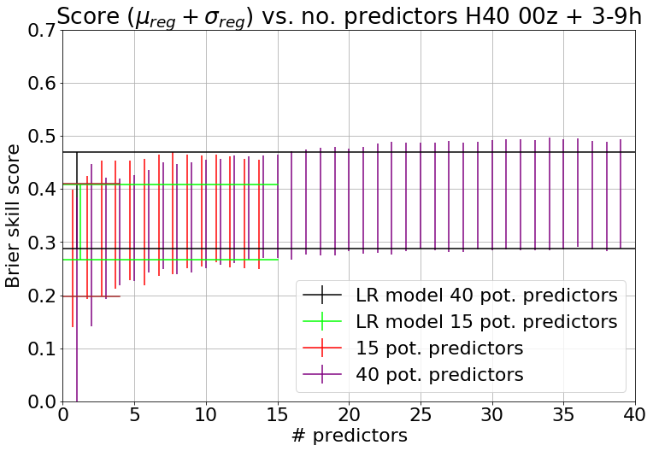
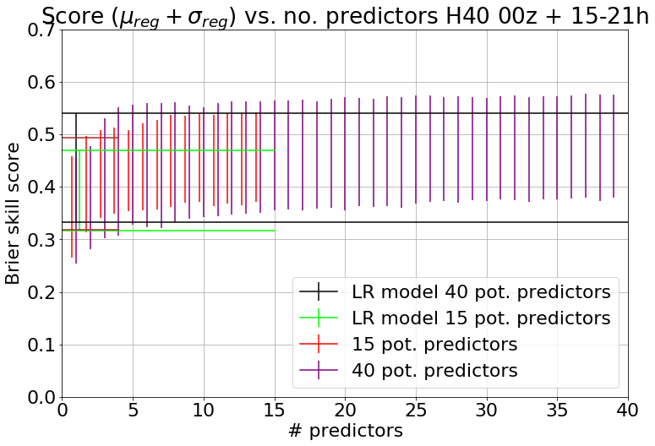
Results
Thunderstorm example yes/no
Score: 0 = every day same probability of climatology
1 = every day 100% (if thunderstorm) or 0% (if no thunderstorm)

Slide 12
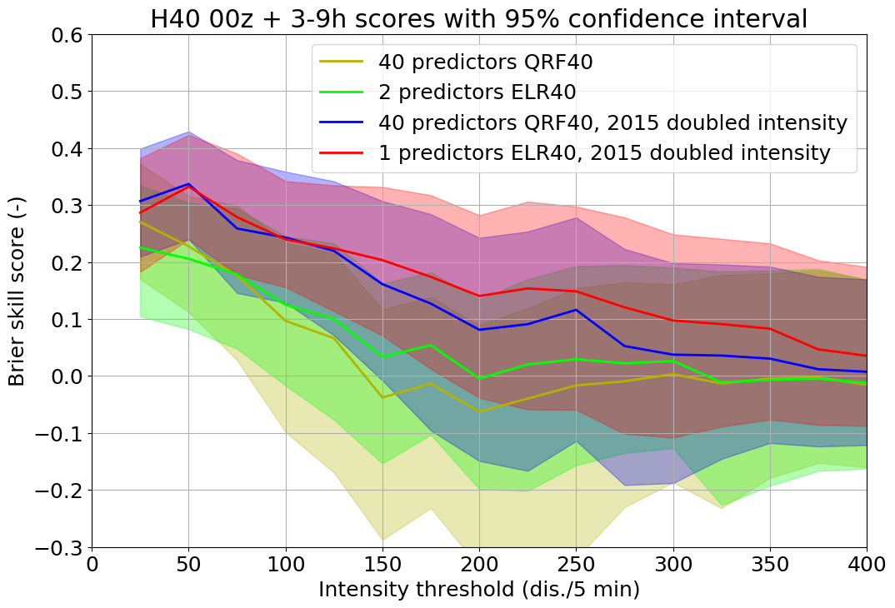
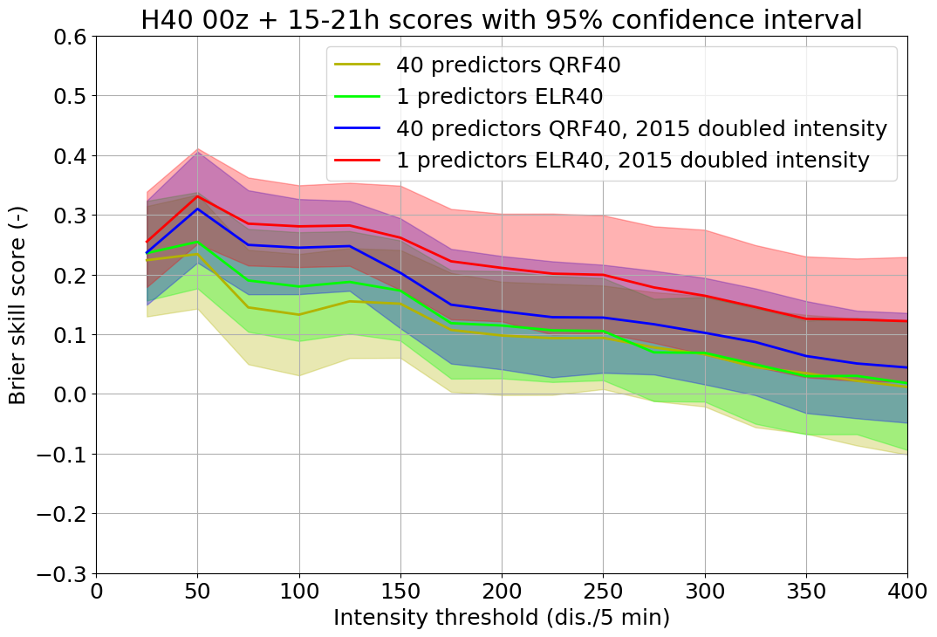
Extra slides
Model verification for some thresholds
Modified lightning detections over 2015 & original set

Slide 13
Questions?

