Slide 1


Probabilistic thunderstorm forecasts using Harmonie and ECMWF predictors with logistic regression and machine learning technique(s)
Date: March 2019
By Edward Groot
Supervisors: Maurice Schmeits (KNMI), Kirien Whan (KNMI), Willem Jan van de Berg (IMAU)

Slide 2

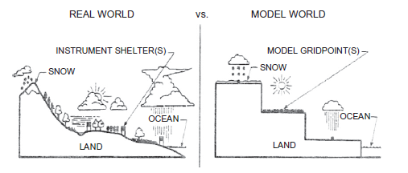
Why statistical post-processing?
Direct model output (DMO) from a numerical weather prediction (NWP) model is biased, because
Model has gridboxes which represent gridbox average conditions
Also: missing physics & chaos in the system
Allows to quantify uncertainty from deterministic output
We can correct systematic errors!

Slide 3
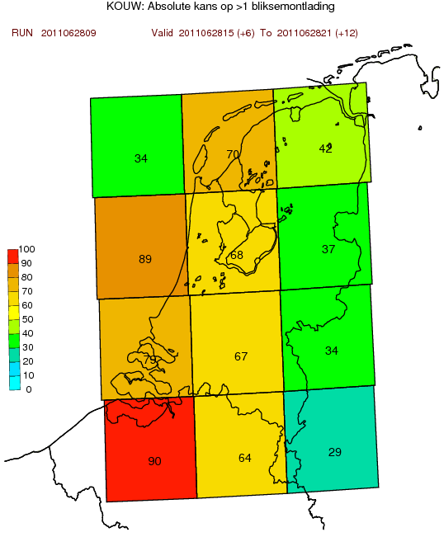
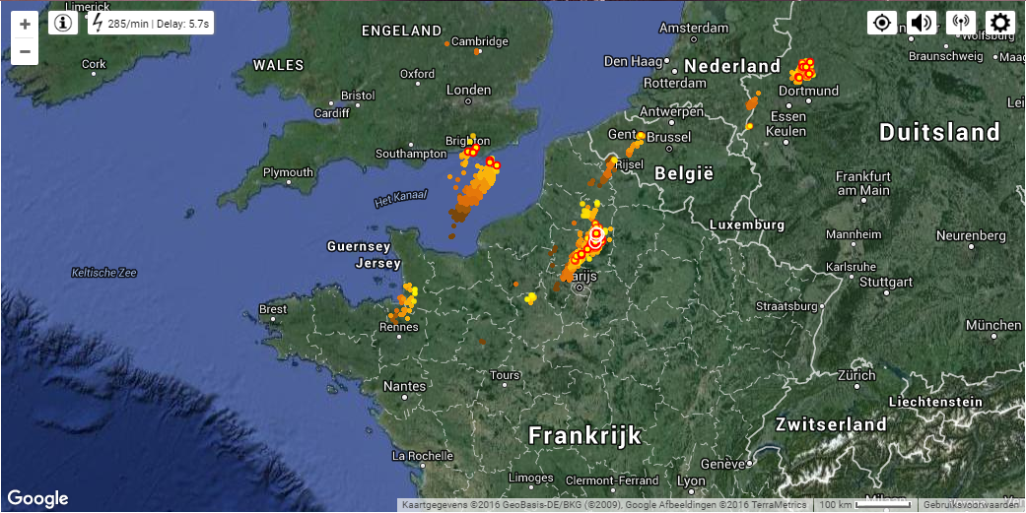
Predictand
1. Occurrence of 2 or more lightning discharges within a region, “thunderstorm event”
2. Maximum intensity within region, number of discharges / 5 min
Based on “KLDN detections” (as “truth”)
Any lightning detection dataset is not 100% accurate
Netherlands distributed in 12 regions; 6 hour time bins

Slide 4
Methodology
Use and compare (extended) logistic regression & quantile regression forests (all multivariate)
Derive conditional thunderstorm probabilities; conditional on predictor from NWP model output
Precursor: heavily leaning on instability indices and convective precipitation from hydrostatic HIRLAM + ECMWF
This system based on non-hydrostatic Harmonie: e.g. vertical velocity, cloud ice & graupel content
Algorithms for predictor selection/elimination from potential predictor set

Slide 5
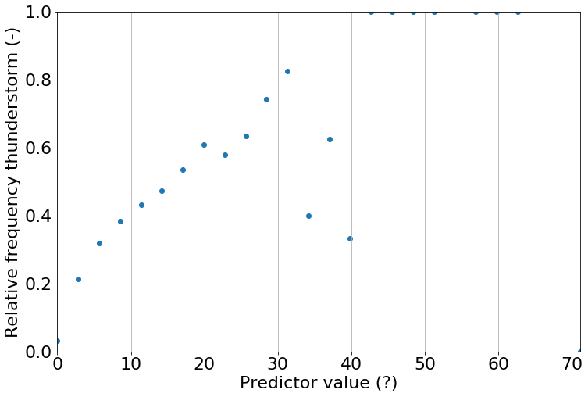
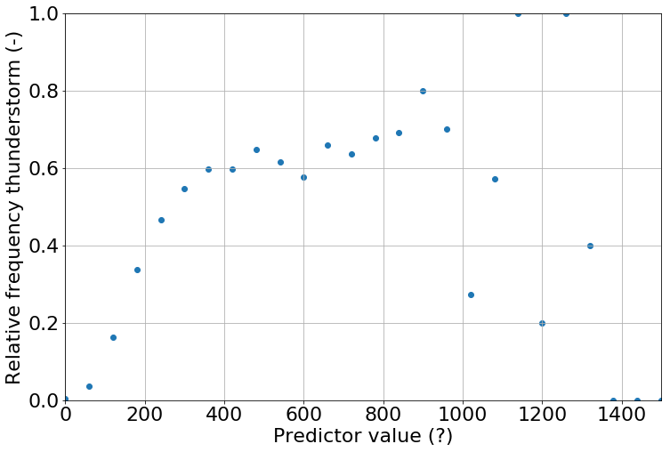
Methodology
Build models with conditional thunderstorm probability/intensity
Conditional on model CAPE/precipitation (single predictor empirical example)
Unstable (statistically)
Unstable (statistically)
Harmonie max. hourly conv. Precip. (mm)
Most Unstable CAPE max (entrainment corr.)

Slide 6
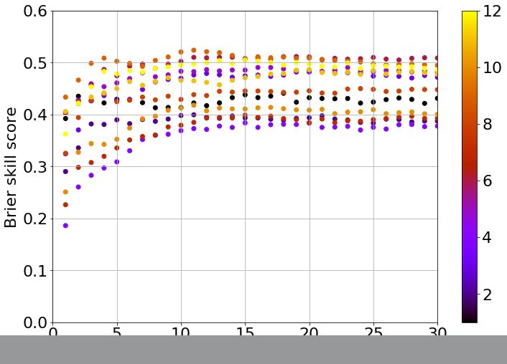
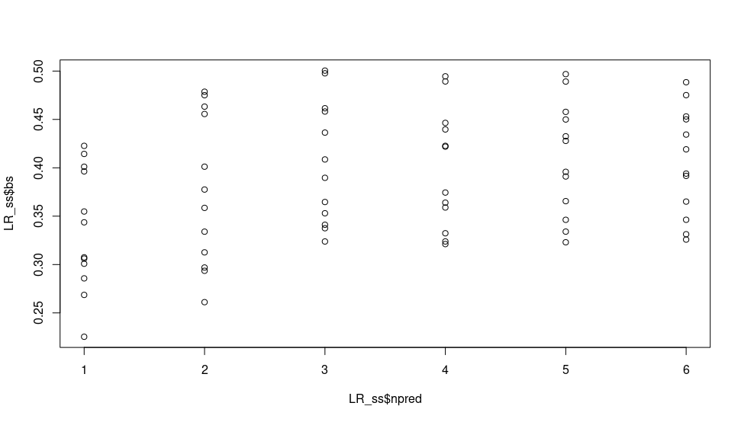
Preliminary result (example)
Brier skill score as function number of predictors
QRF: initial cross-validation Region no.
Logistic regression: initial cross-validation
Brier Skill Score
Same 12 regions
No. predictors →
No. predictors →

