Slide 1
Thesis structure in minds to start with...
1. Introduction post-processing deep convection/previous KOUW etc
2.1 Theory post-processing (important parts done)
2.2 Some thunderstorm/deep convection theory; detections & previous results on thunder occurrence in showers
?? Datasets chapter
3.1 Individual predictors & what we can learn (figures & vertical velocity not better than graupel+MUCAPE)
3.2 Thunderstorm climatology
4. Comparing the methods
5. Combining predictors physically with examples & discussion, correlations and additional value of multiple predictors
6. Some interpretive discussion, recommendations for further analysis, etc.
7. If time allows: case study (and maybe some other figure to illustrate verification)
8. Conclusions

Slide 2
Next things
I have assumed same hyperparameter settings as with 15 and 90 predictors for 40 case for now
Next things:
Completing experiments with 40 set
Writing about predictors and physical predictor set
And write more of the thesis
(Organizing scripts)
Make results for 06z for some of the experiments??

Slide 3
Discussion with Lotte
Maybe we could answer the following:
Can we see that either CG or CC detections in the files relate to the inhomogenity in 2015?
If one correction factor would be used, what is the consequences? Interpretations, maybe with region discussion showing indications for discrepancy in detection efficiency.
A separate study (small version of what she did) on original dataset is appropriate but impossible
But I made some plots

Slide 4
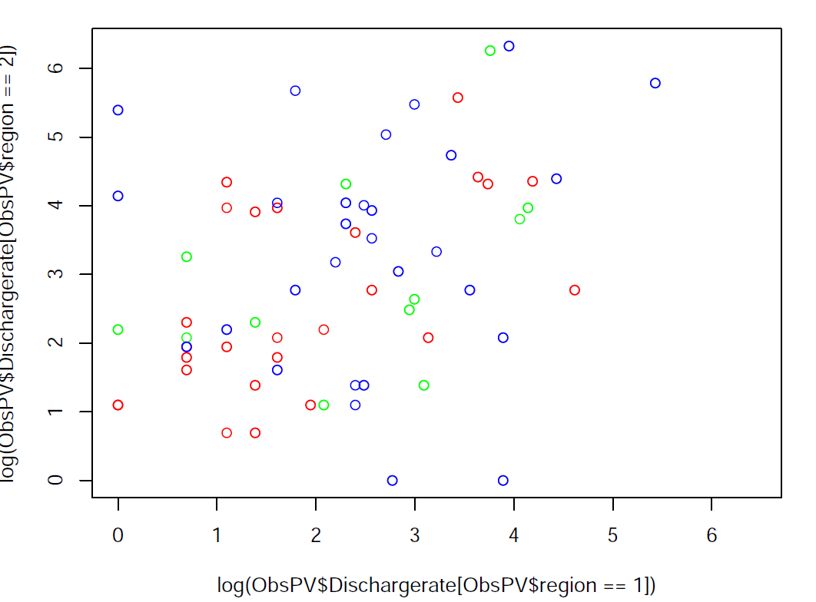
Region 1 intensity vs. region 2
Red = 2015
Plots made for all neighbouring regions
Usually no conclusion, sometimes you could argue about something (but not conclude)

Slide 5
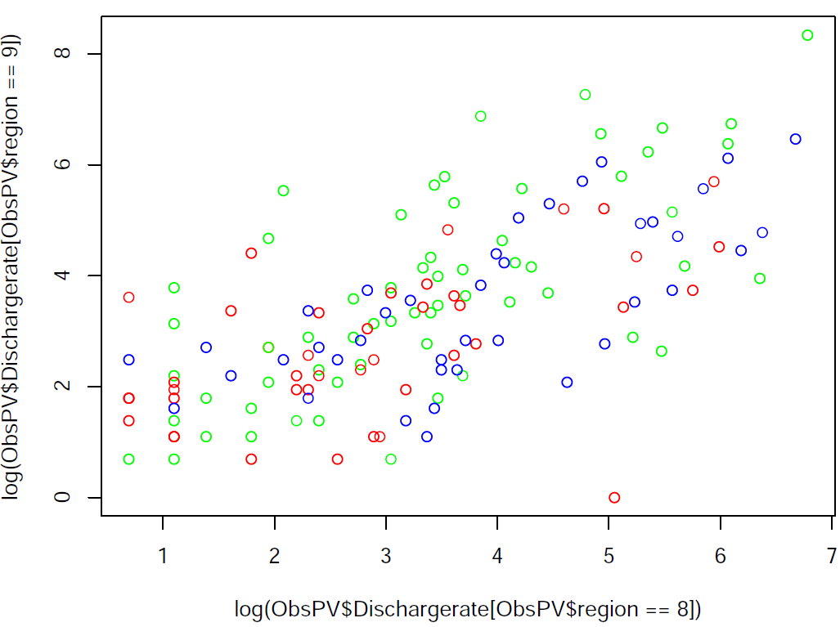
Red = 2015
Plots made for all neighbouring regions
Underdetection in 9 or just low intensity year?

Slide 6
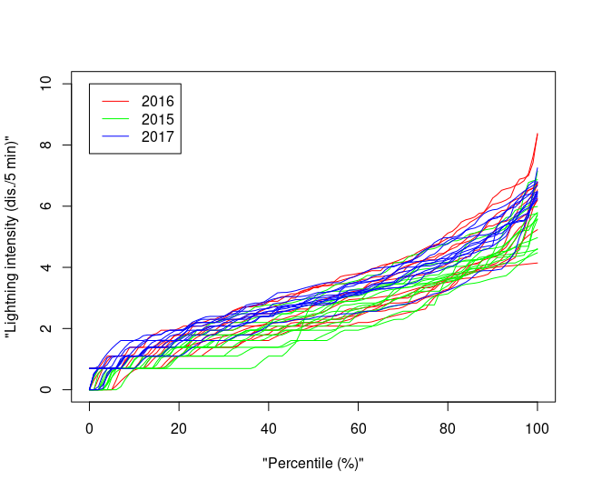
Back to bigger picture
Regionwise (12 lines) quantiles of intensities colored by year
Multiply by 2 for 2015?

Slide 7
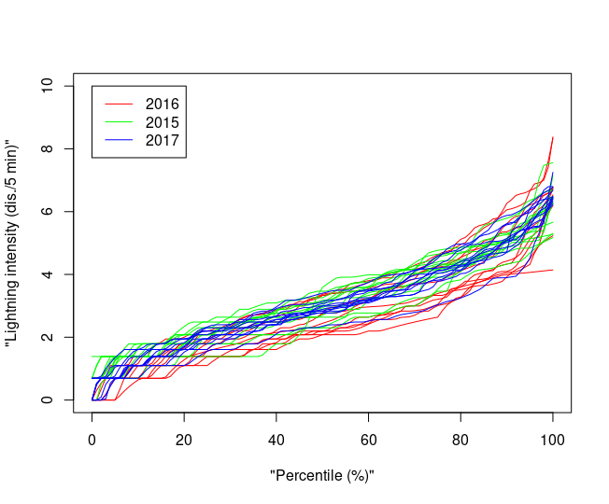
Back to bigger picture
Multiply by 2?
Looks better, but now 2016 is strange, maybe a few regions had bad efficiency in that year too?
Or just no severe storms?

Slide 8
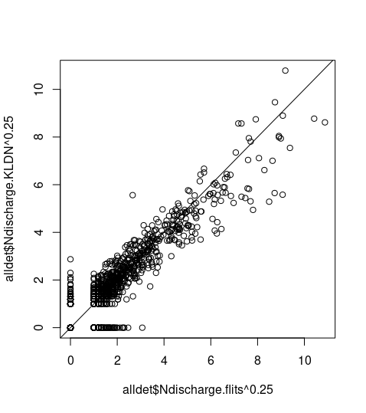
Comparison KLDN & flits
After transformation: 2015
2016 was not in set (?)
Total: roughly 258.000 in flits vs. 190.000 in KLDN (when both present)

Slide 9
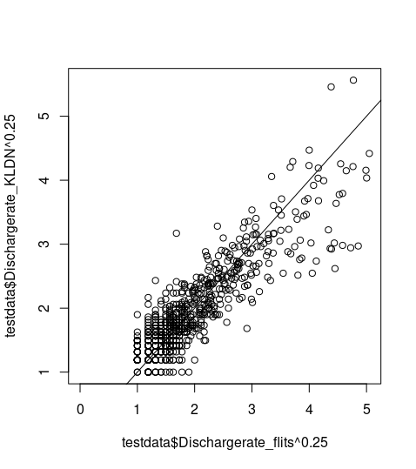
Comparison KLDN & flits
After transformation: 2015
2016 was not in set (?)
Total: roughly 258.000 in flits vs. 190.000 in KLDN (when both present)

Slide 10
Now
Some figures to explain and and guide reader through statistical methods

Slide 11
Grib-files
Harmonie40 output
Read 6 hours
of a single run (00z)
Derive regional statistics,
time tendencies,
additional predictors
Apply each method &
potential predictor set (4)
Complete dataset &
read by lead time (7 sets)
Lightning
detection
Applying each method & potential predictor set
Full data for lead
time & pot. pred. set
2015
Train
Models
Validated with test
set predictions
Settings for
final cross
Test
2016
Train
2017
2015 train
Final models
If predicting lightning frequency:
apply bootstrapping (uncertainty)
Full data for lead
time & pot. pred. set
Settings known
2016 train
2017 test

Slide 12
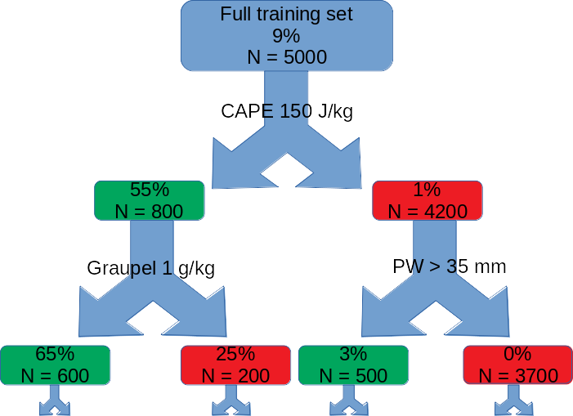

Slide 13
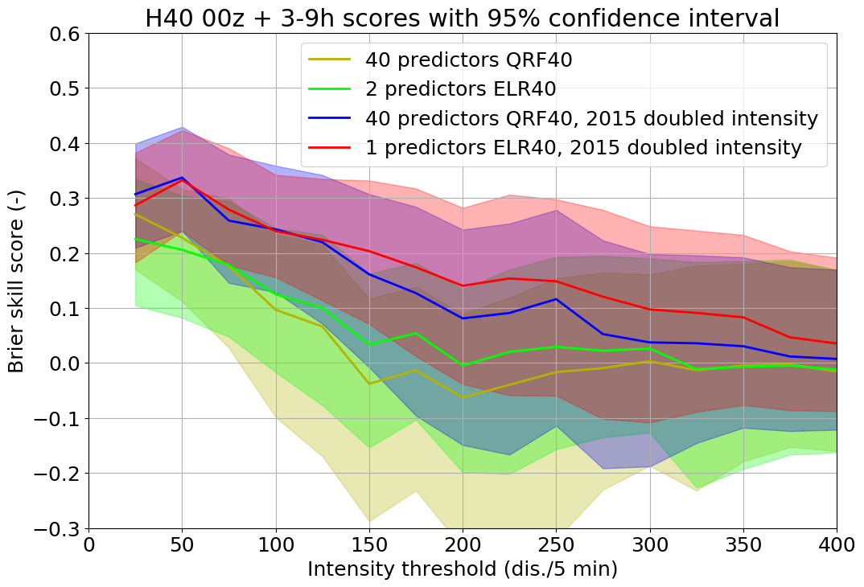
Multiply 2015 by 2
Later we could find a more correct factor but
Much better predictions at all lead times!!

Slide 14
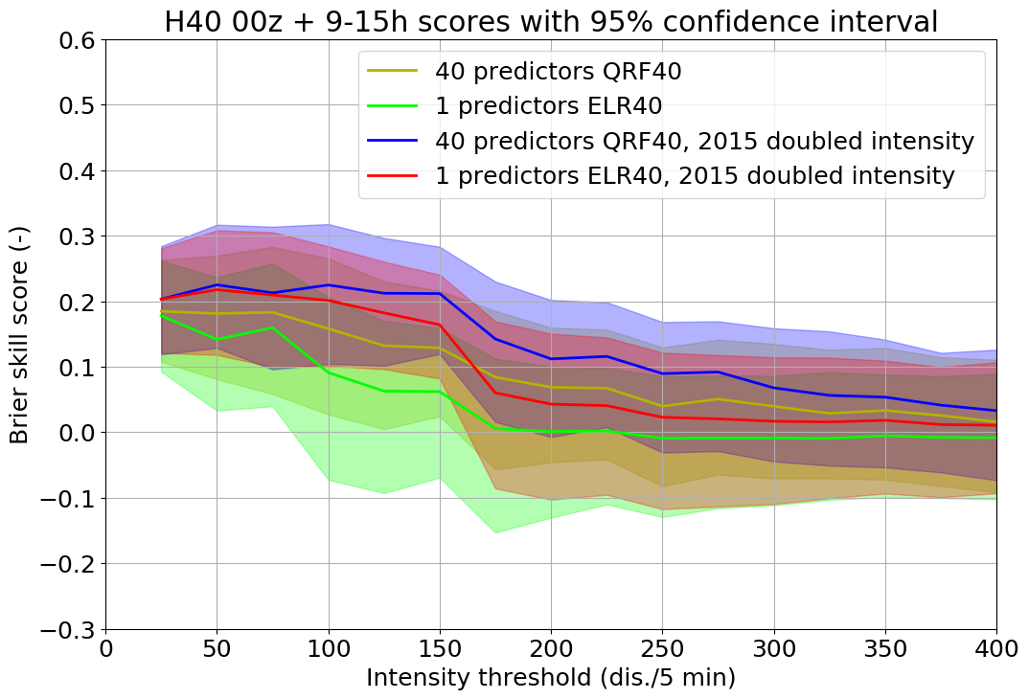
Multiply 2015 by 2
Later we could find a more correct factor but
Much better predictions at all lead times!!

Slide 15
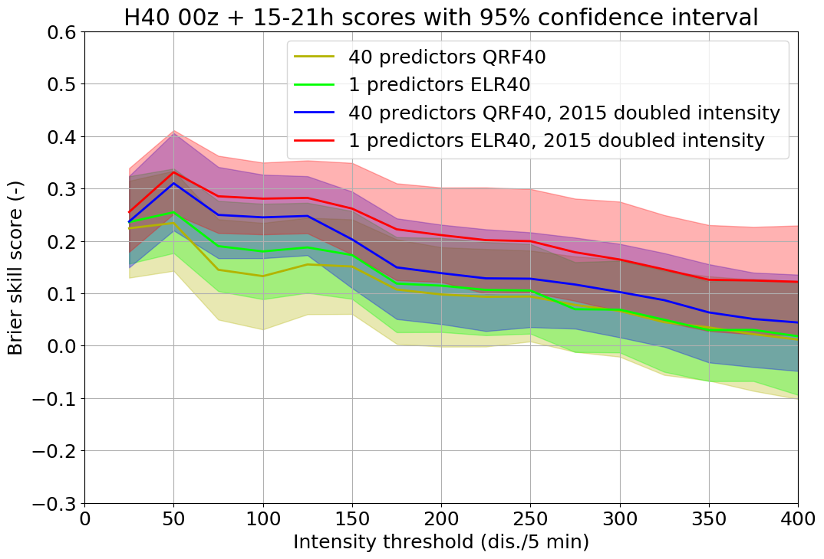
Multiply 2015 by 2
Later we could find a more correct factor but
Much better predictions at all lead times!!

Slide 16
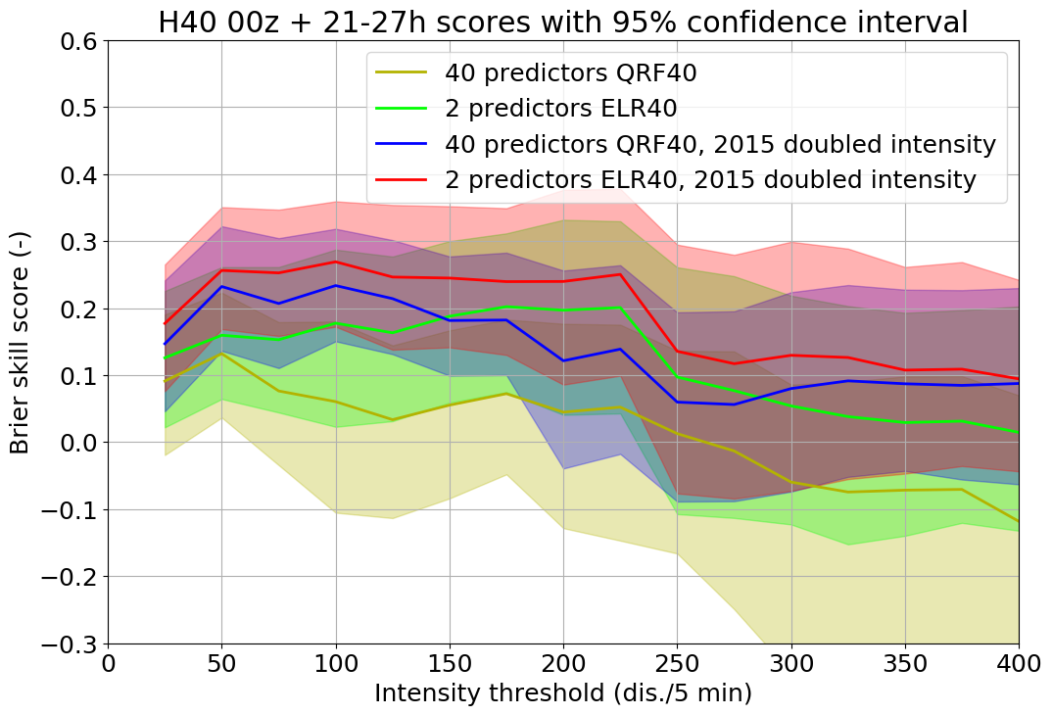
Multiply 2015 by 2
Later we could find a more correct factor but
Much better predictions at all lead times!!

Slide 17
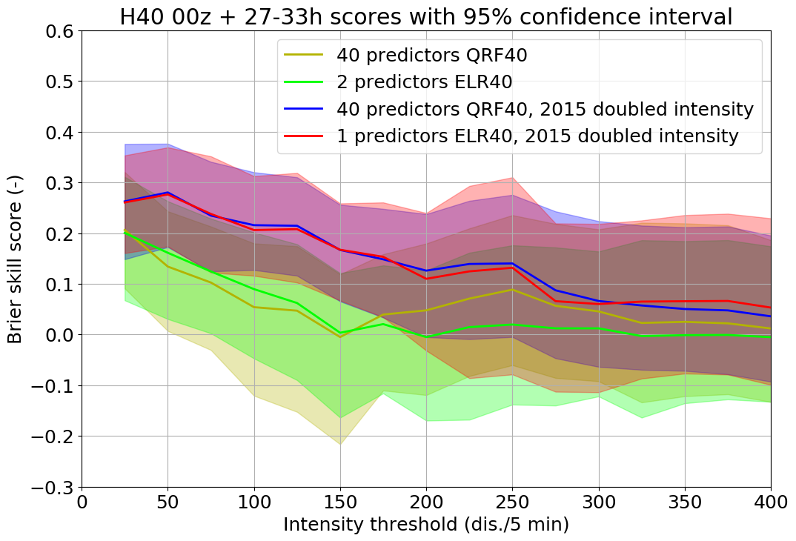
Multiply 2015 by 2
Later we could find a more correct factor but
Much better predictions at all lead times!!

Slide 18
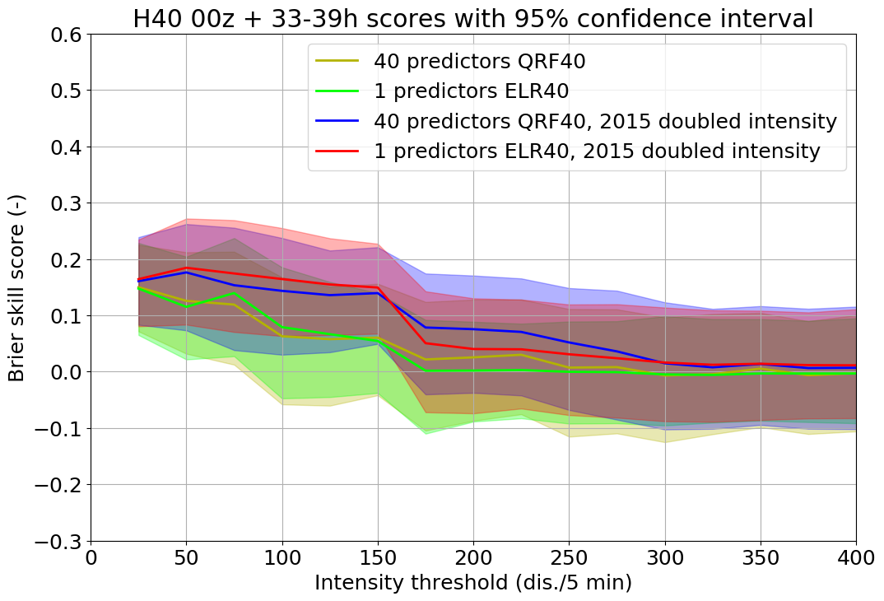
Multiply 2015 by 2
Later we could find a more correct factor but
Much better predictions at all lead times!!

Slide 19
Multiply 2015 by 2
Later we could find a more correct factor but
Much better predictions at all lead times!!

Slide 20
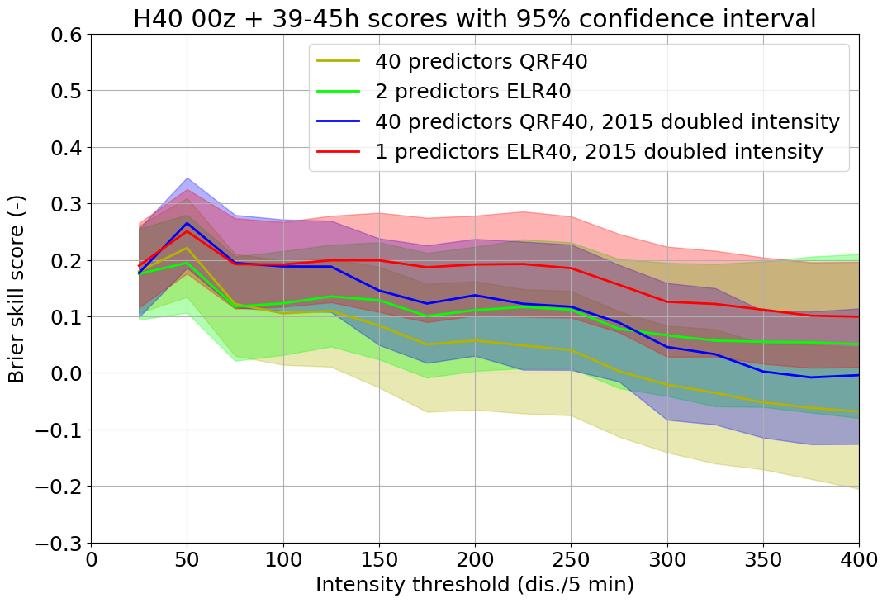
Multiply 2015 by 2
Later we could find a more correct factor but
Much better predictions at all lead times!!

