Slide 1
Probabilistic thunderstorm forecasts using Harmonie and ECMWF predictors with logistic regression and machine learning technique(s)
Date: February 2019
By Edward Groot
Supervisors: Maurice Schmeits, Kirien Whan, Willem Jan van de Berg

Slide 2
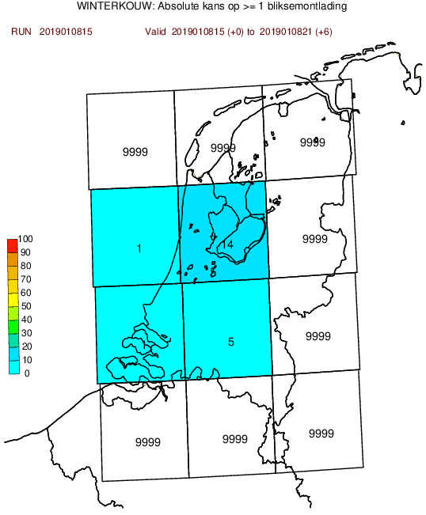
Previously constructed model...
Based on logistic regression and extended logistic regression, shortly (E)LR
Post-processing hirlam and ECMWF output: both have convection parametrized

Slide 3
Why post-processing?
Direct model output from a numerical weather prediction (NWP) model is biased, because
Model has gridboxes & just a representation of the real world
Also: missing physics & chaos in the system
We can correct for this!
Here: Wilkx figure of model grid

Slide 4
Predictand
Occurrence of 2 or more lightning discharges within a KOUW region, “thunderstorm event” (previous slide)
Maximum intensity within region, number of discharges / 5 min
Based on “KLDN detections” (as “truth”)
The lightning detection dataset is not 100% accurate

Slide 5
Predictor variables
Varies from humidity, temperature and wind speed to derived quantities
Some best-known derivates
level of neutral buoyancy (LNB)
level of free convection (LFC)
(figure)

Slide 6
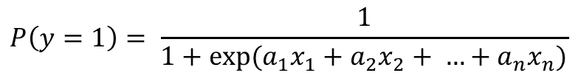
Logistic regression
Model:
Where P(y = 1) denotes the probability that a lightning event occurs
Selection and elemination
$$P\left(y=1\right)= \frac{1}{1+exp(a_{1}x_{1}+a_{2}x_{2}+ …+a_{n}x_{n})}$$

Slide 7
Extended logistic regression

Slide 8
Quantile regression forest

Slide 9
Quantile regression forest

Slide 10
Predictor selection

Slide 11
Model evaluation & selection

Slide 12
Aim

Slide 13
Physical context

Slide 14
Application context

