Slide 1
Probabilistic thunderstorm forecasts using Harmonie and ECMWF predictors with logistic regression and machine learning technique(s)
Date: February 2019
By Edward Groot
Supervisors: Maurice Schmeits (KNMI), Kirien Whan (KNMI), Willem Jan van de Berg (IMAU)

Slide 2
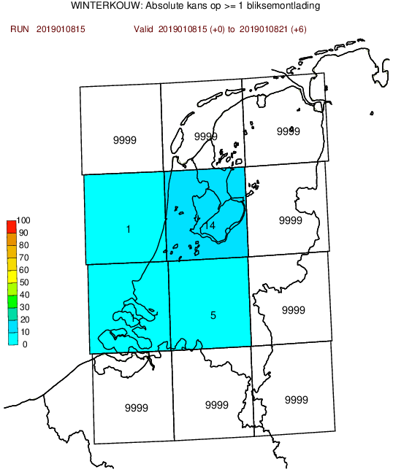
Previously constructed model...
Based on logistic regression and extended logistic regression, shortly (E)LR
Post-processing hirlam (11x11 km) and ECMWF output: both have convection parametrized
Newer Harmonie-model (2.5x2.5 km) solves (deep) convection

Slide 3
Why post-processing?
Direct model output from a numerical weather prediction (NWP) model is biased, because
Model has gridboxes & just a representation of the real world
Also: missing physics & chaos in the system
We can correct for this!
Here: Wilks figure of model grid

Slide 4
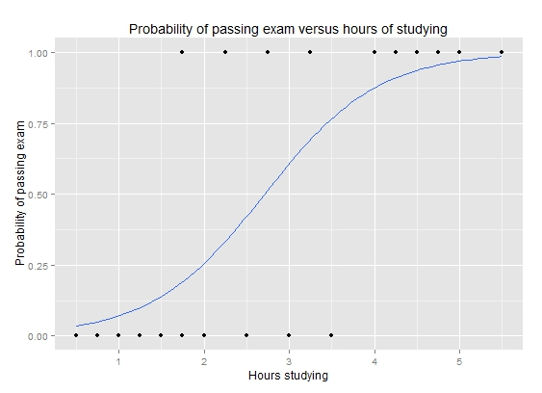
Logistic regression
Logistic transformation of (multivariate) linear regression model
P: probability of event observation
Example: wikipedia

Slide 5
Extended logistic regression
Extension with threshold θ
Results in conditional probability density function
Shift line as function of θ

Slide 6

Quantile regression forest
Simple example tree
Forest of trees
Trees of nodes
Nodes: split observations in two based on predictor
Minimize sum of variance of each of the two sets
X1 > 10
Y:
X2 > 5
N:
X3 > 2
Y:
X1 > 3
Y:
X4 > 8

Slide 7

Quantile regression forest
Random selection of dataset for each tree
Random selection of potential predictors for each node
=> many different trees (250) that group similar records
=> probability density function based on “near neighbours” in important predictors

Slide 8
Hyperparameters
For each model type, number of predictors is a so-called hyperparameter
Many for QRF: number of trees, number of observations in final split

Slide 9
Model evaluation & selection
Cross-validating: training on 3 years with 3 random subsets
12 KOUW regions
Train again with best hyperparameter combination based on scores in cross-validation

Slide 10
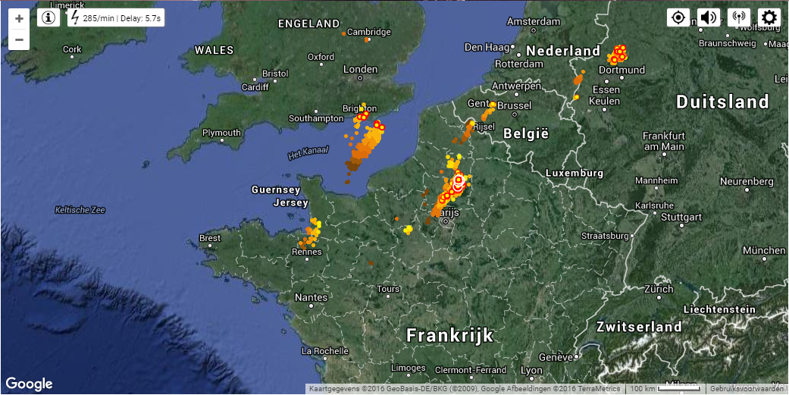
Predictand
1. Occurrence of 2 or more lightning discharges within a KOUW region, “thunderstorm event” (previous slide)
2. Maximum intensity within region, number of discharges / 5 min
Based on “KLDN detections” (as “truth”)
The lightning detection dataset is not 100% accurate
Example of lightning detection system

Slide 11
Predictor variables
Varies from humidity, temperature and wind speed to derived quantities
Some best-known derivates
level of neutral buoyancy (LNB)
level of free convection (LFC)
(figure CAPE)

Slide 12
Predictor selection
Dozens of variables
Best are selected
Stepwise selection and/or elimination

Slide 13
Aim
Compare statistical post-processing methods for convection
Make an operational post-processing model for weather forecasting
Increase physical understanding of thunderstorms and their forecasting

Slide 14
Physical context
Differences in between predictor selection land and sea (temperature contrasts, dynamical triggers) and over lead time and valid time
Differences in skill between statistical optima and physical consistency?
Which instability indices and which dynamical quantities?

Slide 15
Application context

