Slide 1
Probabilistic thunderstorm forecasts using Harmonie and ECMWF predictors with logistic regression and machine learning technique(s)
Date: February 2019
By Edward Groot
Supervisors: Maurice Schmeits, Kirien Whan, Willem Jan van de Berg

Slide 2
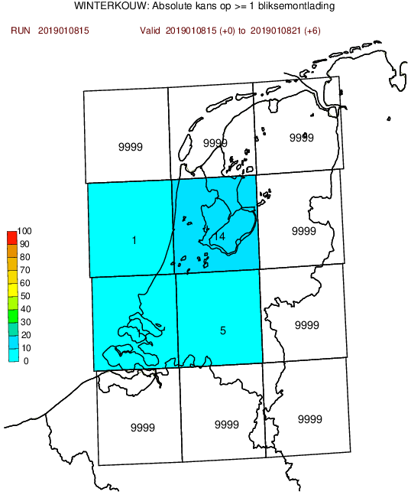
Previously constructed model...
Based on logistic regression and extended logistic regression, shortly (E)LR
Post-processing hirlam and ECMWF output: both have convection parametrized

Slide 3
Why post-processing?
Direct model output from a numerical weather prediction (NWP) model is biased, because
Model has gridboxes & just a representation of the real world
Also: missing physics & chaos in the system
We can correct for this!
Here: Wilkx figure of model grid

Slide 4
Predictor variables
Varies from humidity, temperature and wind speed to derived quantities
Some best-known derivates
level of neutral buoyancy (LNB)
level of free convection (LFC)
(figure)

Slide 5
Logistic regression

Slide 6
Extended logistic regression

Slide 7
Quantile regression forest

Slide 8
Quantile regression forest

Slide 9
Predictor selection

Slide 10
Model evaluation & selection

Slide 11
Aim

Slide 12
Physical context

Slide 13
Application context

