Slide 1
Usage Analysis For Education Institute Facility
Presented by Team #5
Yifan Xu
Chen Xu
Silin Huang

Slide 2
Agenda
Datasets & Feature List
Requirements
Use Cases
Use Case Diagram

Slide 3
Datasets
Basic Library Information
Library Wi-Fi Usage
Public Elementary School
Public Hight School
Deprecated School

Slide 4
Feature List
Options of various education datasets
Display user selected datasets
Perform statistical operations on datasets (min/max, standard deviations, etc.)

Slide 5
Requirements
Choose a dataset from the datasets list
Display data in different ways (line, bar, pie, etc.)
Modify & Filter data by rows and columns

Slide 6
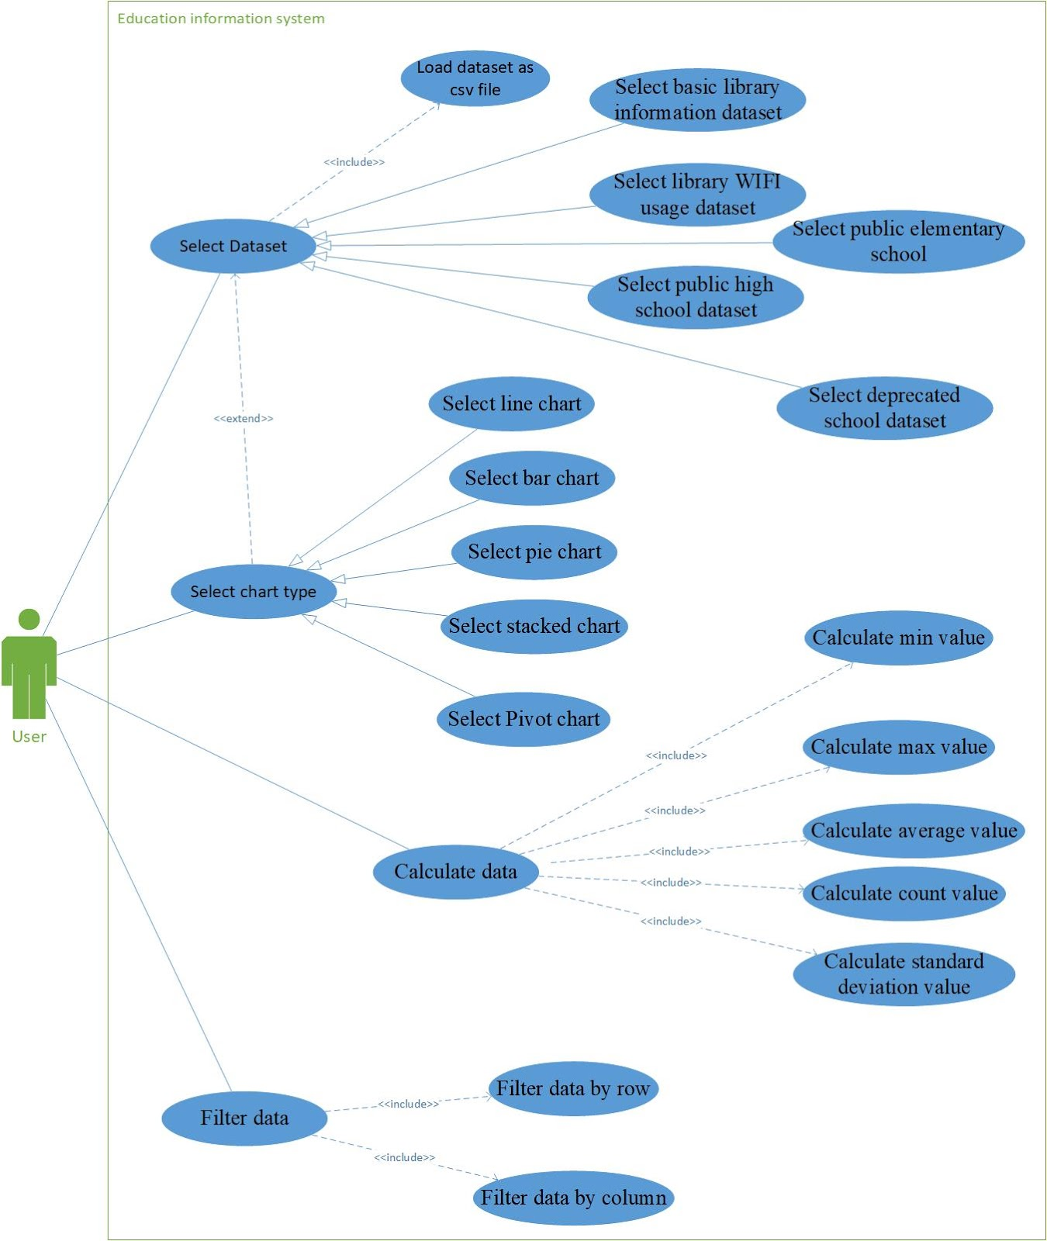
Use Cases & Diagram
Actor: User
Use Cases
Select dataset
Select chart type
Filter data
Calculate data

Slide 7
Questions?

