Slide 1
Object orient Analysis &Design
面向对象分析与设计师
OOAD_Lab_02_BlackJack.ppt
[Play 21 point (Card) game]
主讲: 姜宁康 博士
日期: 26/11/7

Slide 2
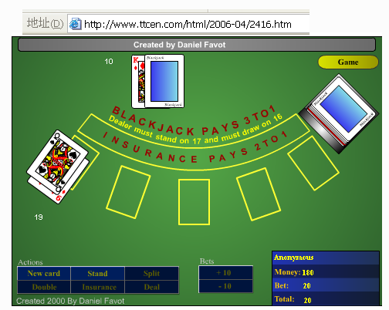
Sorry! Link is invalid now.
OOAD Lecture, Author: NK Jiang

Slide 3
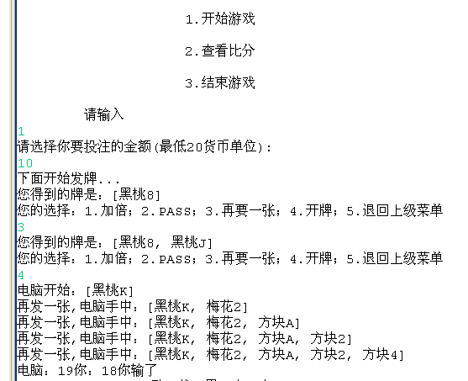
Reference UI: Example
OOAD Lecture, Author: NK Jiang

Slide 4
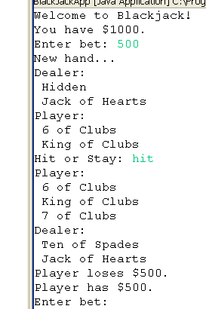
Reference UI
OOAD Lecture, Author: NK Jiang

Slide 5
实验要求
Read the requirement carefully, then analyze 理解系统需求,进行系统分析
  Design Usecase Model 给出用例模型
  Design Domain Model 给出领域模型
    Understand why an concept be defined as Class or Attribute of a class 就重要的概念类,理解为什么它是类而不是属性
  Design model 给出设计模型
    Class diagram 主要是设计类图
    Describe the functionality of key method in some classes 对主要的操作，要给出描述
    Select two scenarios and draw SD according to Class diagram用顺序图描述系统的主要用例实现
Implement, test, demonstrate your system 系统实现、测试、演示
Time schedule 时间：
  （10.11 ~ 10.25，课堂检查部分小组 系统运行）
  提交实验报告（电子版） （ 班10月27日提交）
    提交实验报告（电子版）
    提交项目工程包
提醒
  1/ 在完成基本要求的基础上可以美化UI （可选）
  2/ 网上有现成的源代码：只可参考，绝对不能照抄。
OOAD Lecture, Author: NK Jiang

Slide 6
Requirements Summary Statement
The intended purpose of this software application is to implement a game of blackjack. In the game of blackjack, one or more individuals play against the dealer (or house，庄家). Although there might be more than one player, each player plays only against the dealer, and not any of the other players.
From a player‘s perspective, the goal of the game is to draw cards(发牌) from the deck（一副牌） until the sum of the face value of all the cards equals 21 or as close to 21 as possible, without exceeding 21.
  If the sum of the face value of all the cards exceeds 21, the player loses.
  If the sum of the face value of the first two cards equals 21, the player is said to have blackjack. The dealer plays the game along with the players. The dealer must deal the cards, present a player with additional cards, show all or part of a hand, calculate the value of all or part of a hand, calculate the number of cards in a hand, determine the winner, and start a new hand.
A card must know what its face value is and be able to report this value. The suit of the card（牌的花色） is of no importance (but it might be for another game in the future). All cards must be members of a deck of cards. This deck must have the functionality to deal the next card, as well as report how many cards remain in the deck.
During the game, a player can request that a card be dealt to his hand. The player must be able to display the hand（此处指‘这手牌’）, calculate the face value of the hand, and determine the number of cards in the hand. When the dealer asks the player whether to deal another card or to start a new game, the player must respond.
Each card has its own face value (suit does not factor into the face value). Aces count as 1 or 11. Face cards (Jack, Queen, King) each count as 10. The rest of the cards represent their face values.
The rules of the game state that
  if the sum of the face value of the player's cards is closer to 21 than the sum of the face value of the dealer's cards, the player wins an amount equal to the bet that was made.
  If the player wins with a blackjack, the player wins 3:2 times the bet made (assuming that the dealer does not also have blackjack). If the sum of the face value of the player's cards exceeds 21, the bet is lost. Blackjack (an ace and a face card or a 10) beats other combinations of 21.
If the player and the dealer have identical scores and at least 17, it is considered a draw and the player retains the bet.
OOAD Lecture, Author: NK Jiang

Slide 7
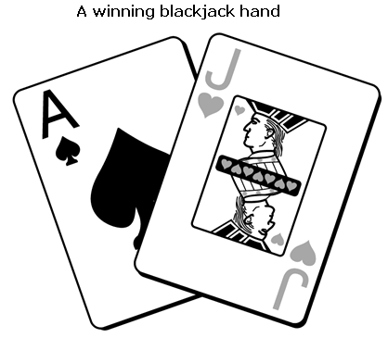
If the sum of the face value of first two cards is 21 point, you have a “ blackJack”
OOAD Lecture, Author: NK Jiang

Slide 8
Identifying the Blackjack Classes
Nouns
  in general, classes correspond to nouns, which are objects
    people,
    places,
    and things
  Although it is true that nouns generally indicate classes, nouns are not the only places where classes are found.
From
  requirements summary statement
Result
  highlight all the nouns, you have a good list from which you can start collecting your objects
OOAD Lecture, Author: NK Jiang

Slide 9
Let's identify some nouns from our blackjack example:
  If the player and the dealer have identical scores and at least 17, it is considered a draw and the player retains the bet
Now let's make a list of the possible objects (classes):
  Game Blackjack Dealer House Players
  Player Cards Card Deck Hand
  Face value Suit Winner Ace
  Face card King Queen Jack
  Bet
OOAD Lecture, Author: NK Jiang

Slide 10
Do it with the skill we have studied!
OOAD Lecture, Author: NK Jiang

