Slide 2


Changes in the trade-wind atmospheric boundary layer due to
mesoscale SST variability
in a coupled simulation
Presenter: Alessandro Storer
Supervision: prof. Claudia Pasquero
prof. Dino Zardi (Univ. Trento)
Meteo X Change conference, 10 – 11 April 2025

Slide 3
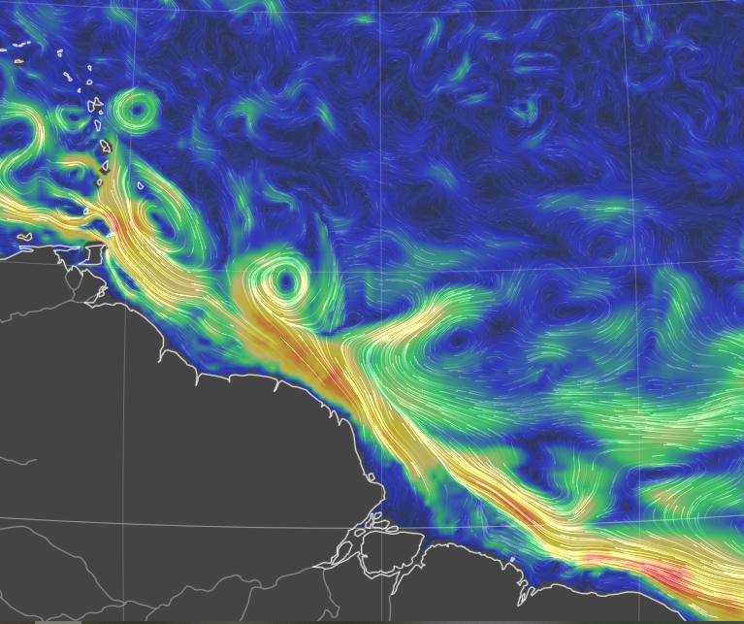
The Sub - / Mesoscale – an introduction
Important in the global energy budget!
(Renault et al. 2023, Seo et al. 2023,
Bishop et al. 2020)
Thermal feedback TFB
Modulates local temperature, stability and circulation through modified thermodynamic fluxes
10N
NUMERICAL DATASETS
- Conceptual bulk model for PBL
High-resolution coupled simulation:
WRF 2km atmosphere
CROCO 1km ocean
Daily averages in February 2020
EUREC4A region Stevens et al. 2021
EQ
60W
50W
40W
Sea sfc currents on 6 th April 2025
earth.null.school
Notes:
Check minobe’s and chelton’s, fabien’s articles for summarizing image

Slide 4
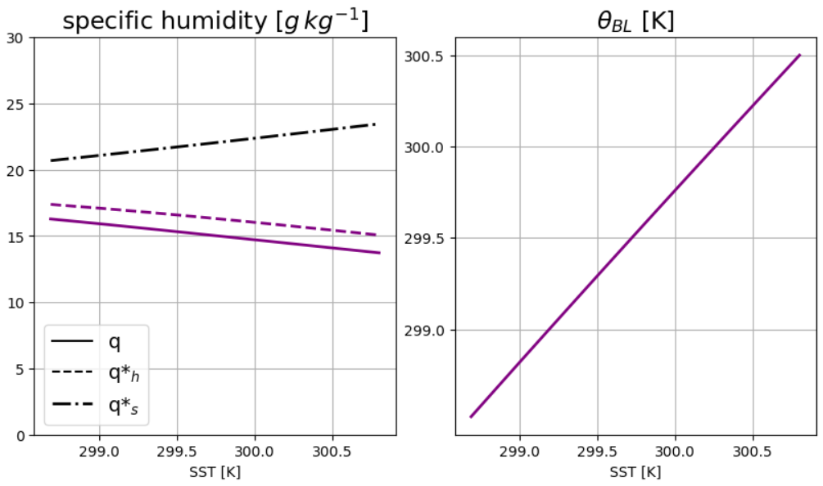
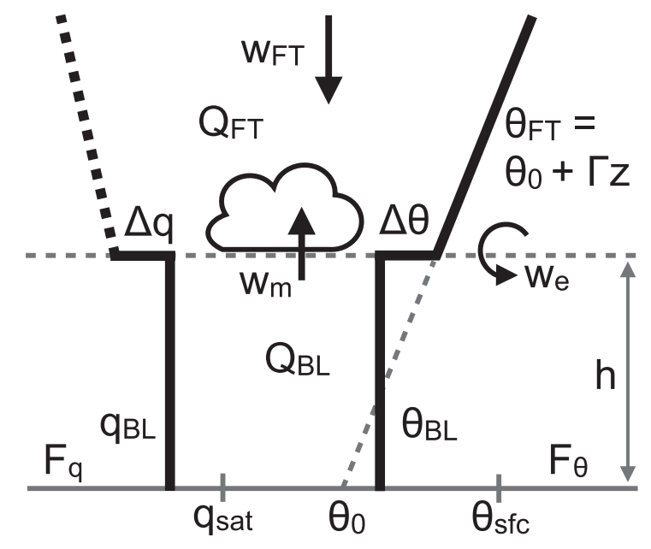
From lower complexity ….
Conceptual Bulk model
starring:
Stevens et al. 2002
Neggers et al. 2006
Naumann et al. 2019
Moisture decreases!
Temperature follows SST
!?

Slide 5
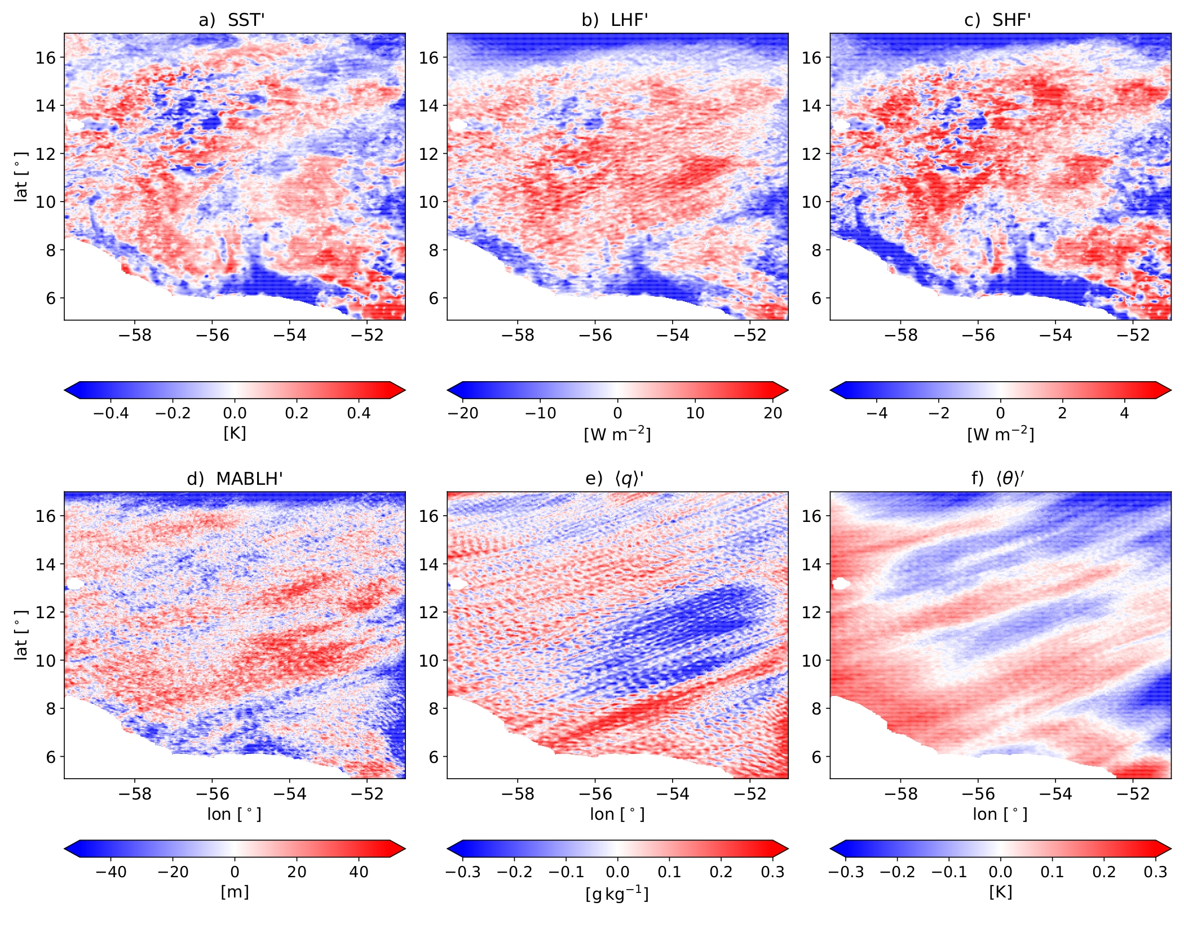
… to higher complexity – Realistic simulation
High-pass filtered fields (200 km) – 11th Feb. 2020

Slide 6

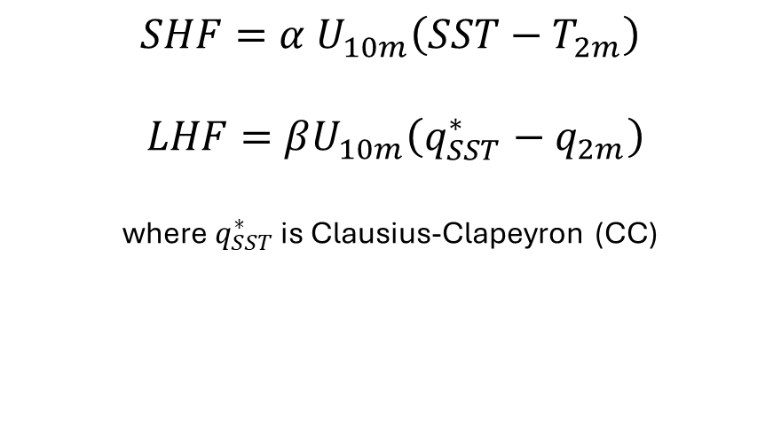
Sensitivity of surface fluxes to SST
MABL
$$SHF=α U_{10m}\left(SST−T_{2m}\right)$$
$$LHF=βU_{10m}\left(q_{SST}^{∗}−q_{2m}\right)$$
where $q_{SST}^{∗}$ is Clausius-Clapeyron (CC)
SHF’ ?
LHF’ ?
SHF’ ?
LHF’ ?
$$sensitivities == \frac{∂HF′}{∂SST′}$$
SST’ < 0
SST’ > 0
Notes:
Check how WRF is computing surface fluxes in the coupled simulation

Slide 7
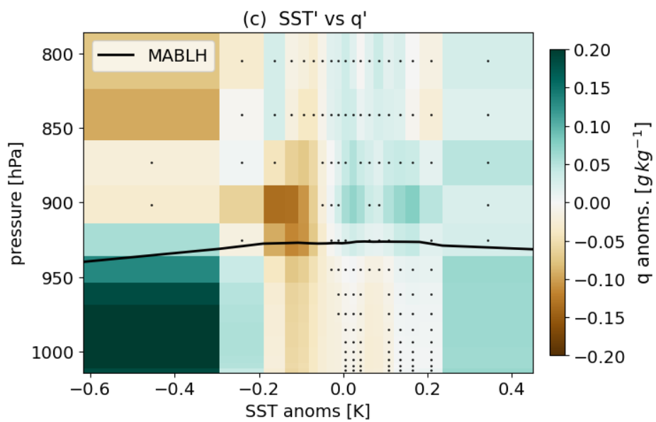
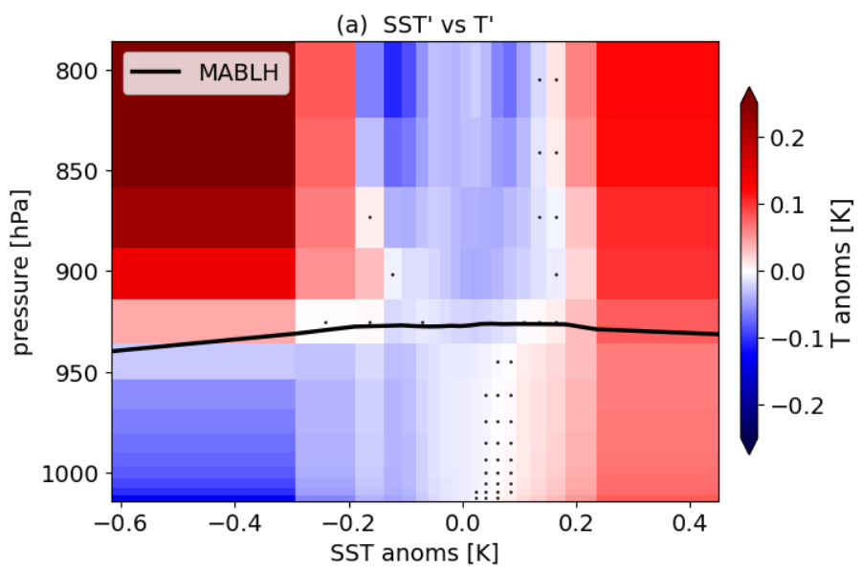
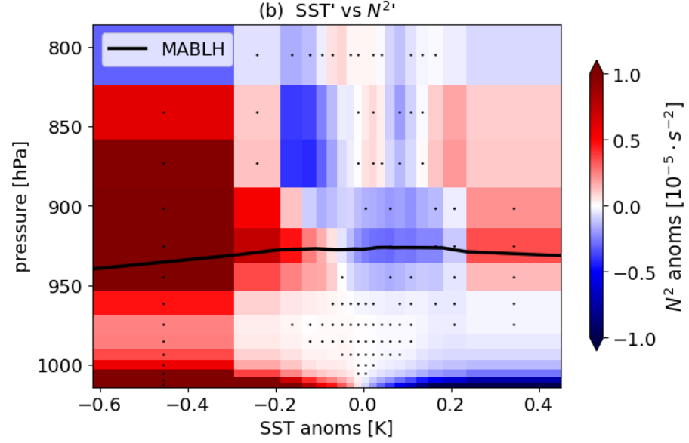
Air column response!
Specific humidity anomalies
Temperature anomalies
Stability anomalies
Compare with
Borgnino et al. 2025

Slide 8
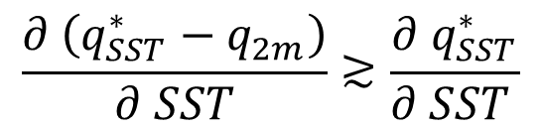
Conclusions
Lively thermo - / dynamics
at the mesoscale!
MABL’
MABL moisture set by
SURFACE EVAPORATION
ENTRAINED DOWNWELLING
Feedback on surface LHF
$$\frac{∂ \left(q_{SST}^{∗}−q_{2m}\right)}{∂ SST}≳\frac{∂{ q}_{SST}^{∗}}{∂ SST }$$
SST’ < 0
SST’ > 0

