Slide 1
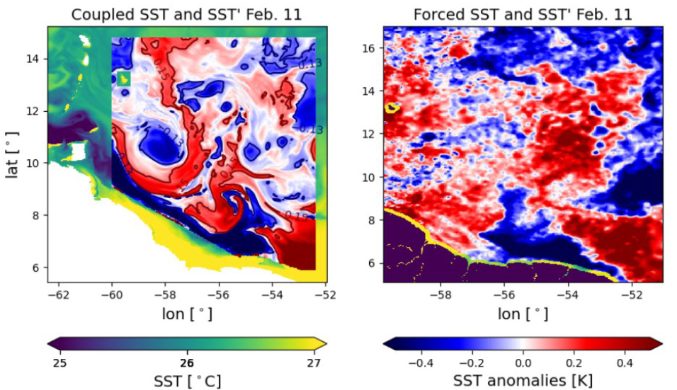
Comparing SST’ @ 200km , coupled vs forced

Slide 2
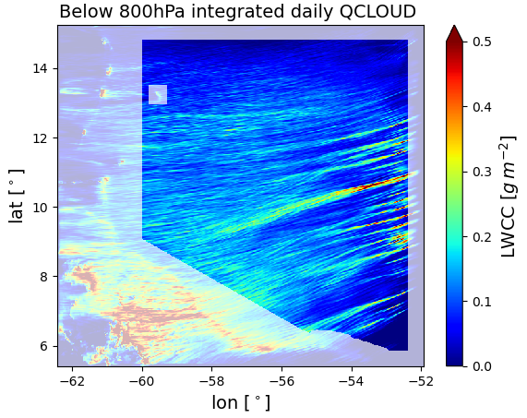
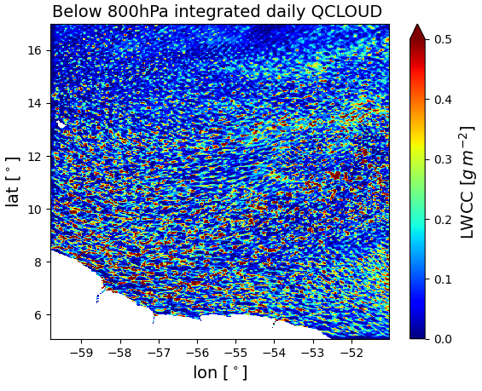
Below 800hPa integrated daily QCLOUD – 1st Feb
Coupled
Forced

Slide 3
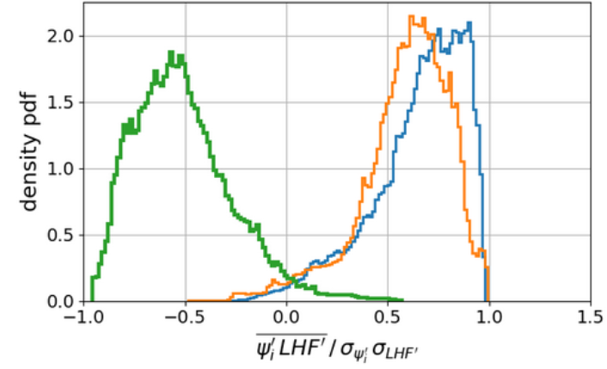
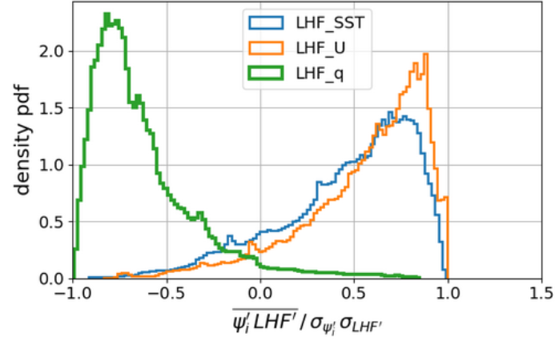

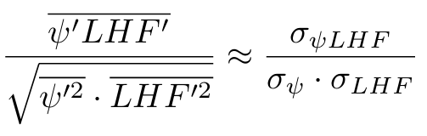
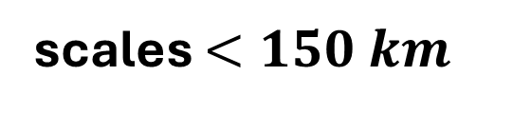

18
NORMALIZED COVARIANCES («LOCAL CORRELATIONS»)
scales $<150 km$
$$60km<scales <150km$$
local correlation
local correlation
SST variability dominates at small scales
U leads variability at larger scales
q inhibits LHF release

Slide 4
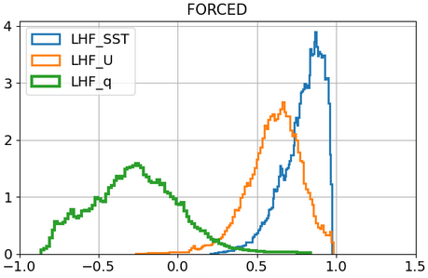
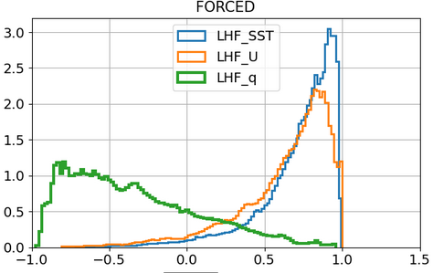
18
NORMALIZED COVARIANCES («LOCAL CORRELATIONS»)
scales $<150 km$
$$60km<scales <150km$$
local correlation
local correlation
SST variability dominates at small scales
U leads variability at larger scales
q inhibits LHF release

Slide 5
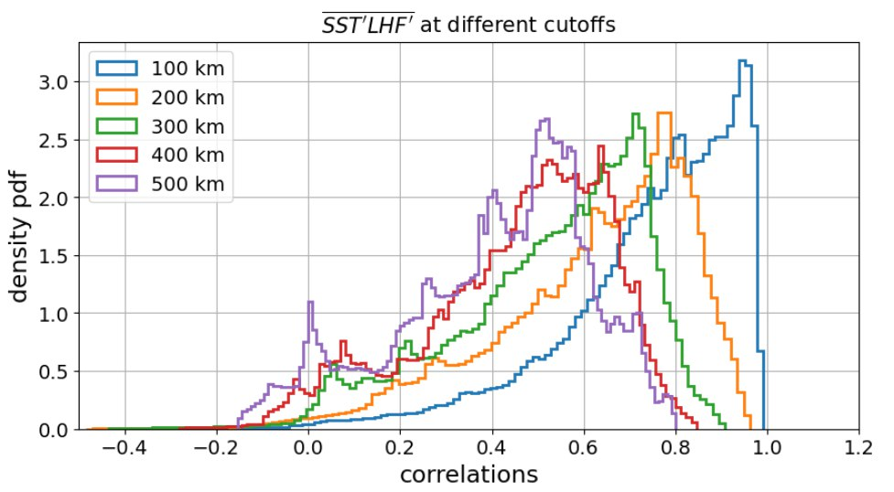
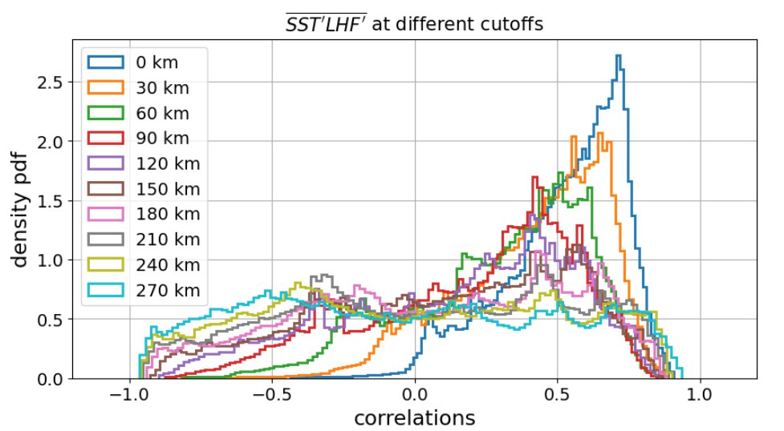
SCALE – DEPENDENT SST-LHF CORRELATIONS
High pass
Band pass

Slide 6
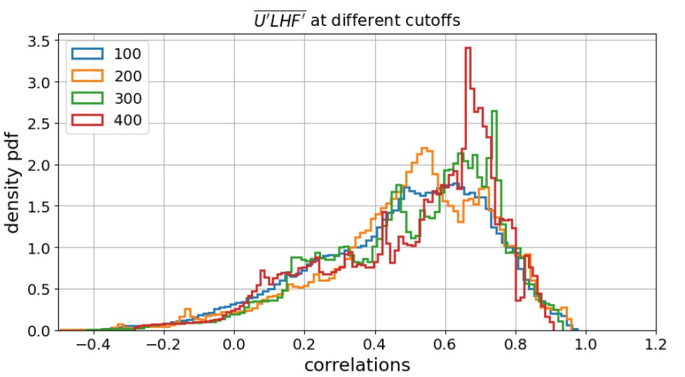
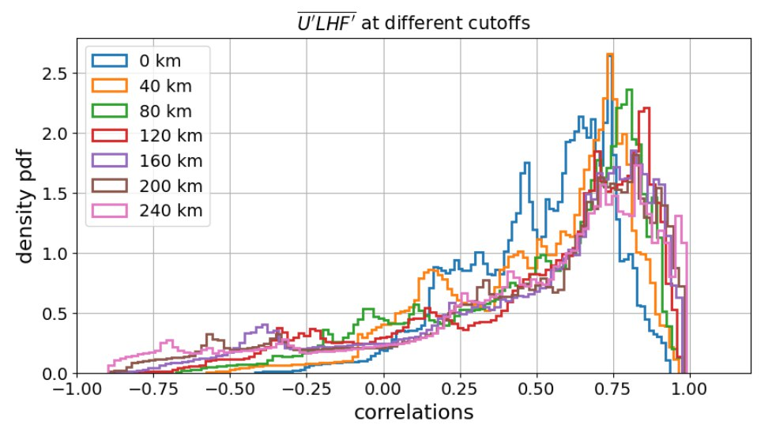
SCALE – DEPENDENT U-LHF CORRELATIONS
High pass
Band pass
} km

Slide 7
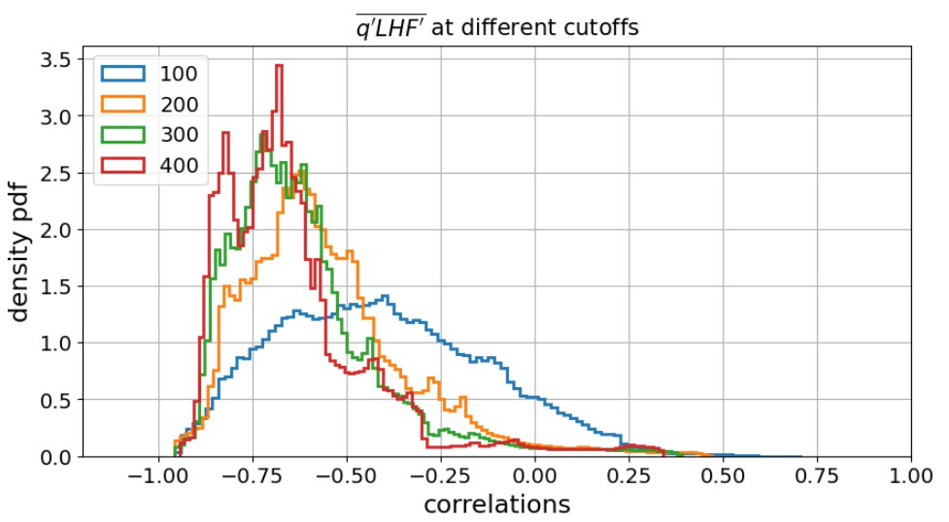
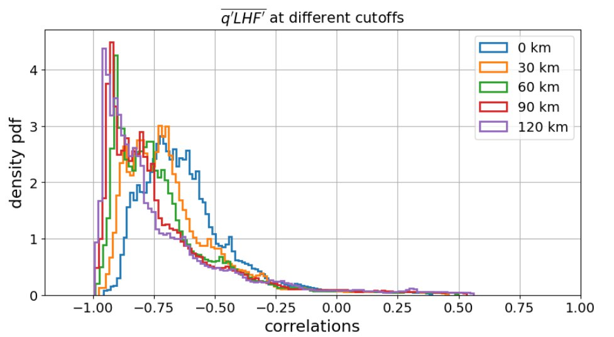
SCALE – DEPENDENT q-LHF CORRELATIONS
High pass
Band pass

Slide 8
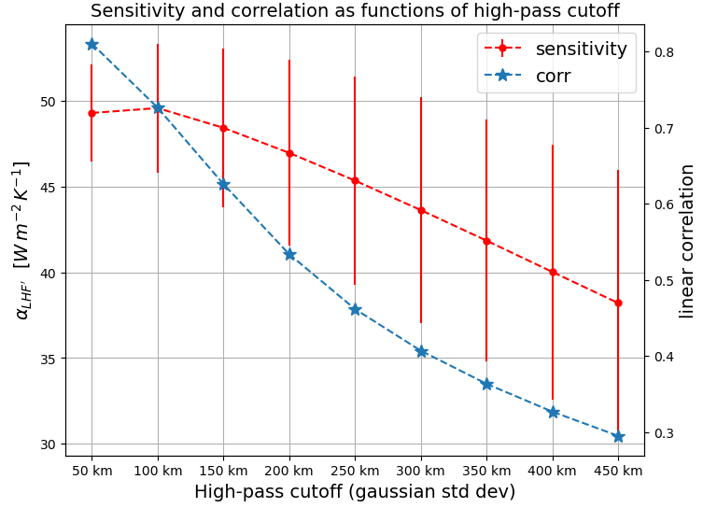
Role of SST anomalies through coupling coefficients (senstivity)

Slide 9


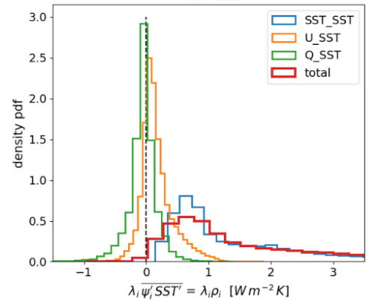
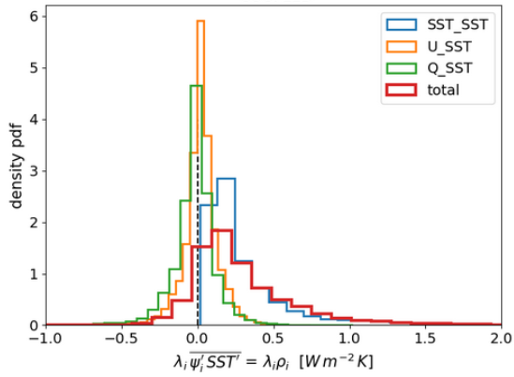
SST-LHF local covariances

Slide 10


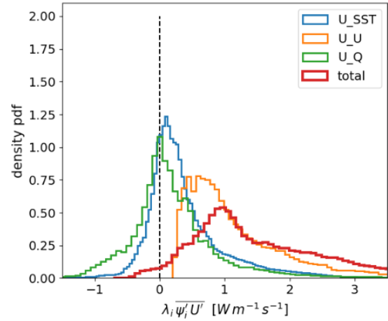
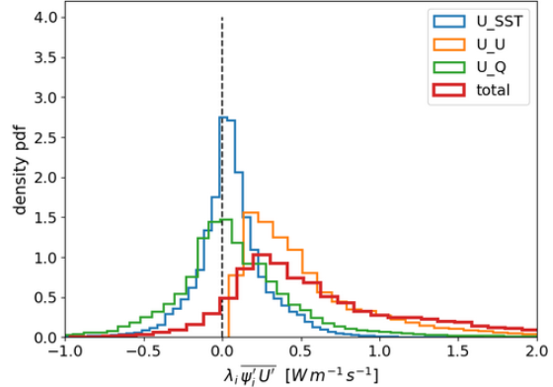
U-LHF local covariances

Slide 11


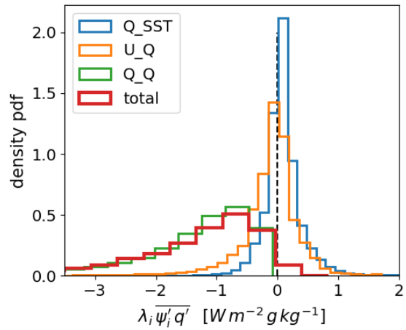
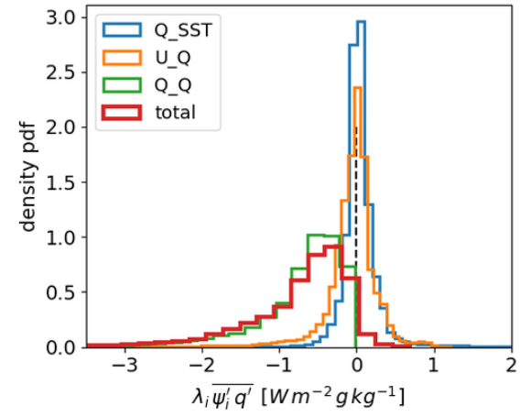
Q-LHF local covariances

Slide 12
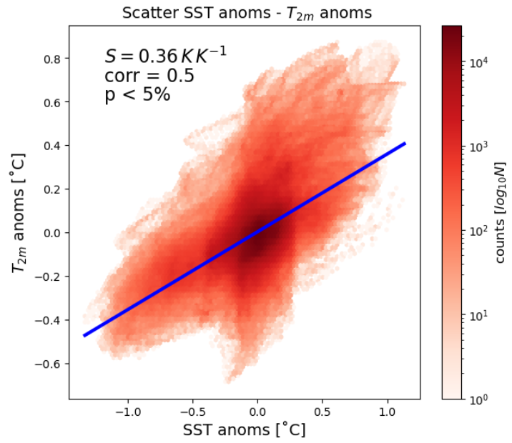
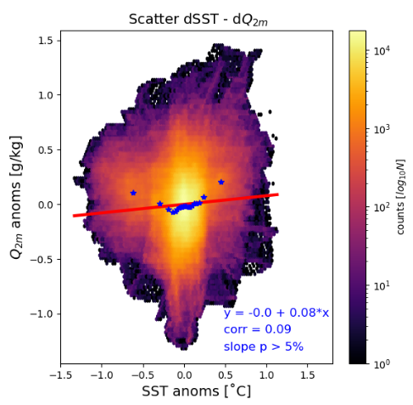

Slide 13



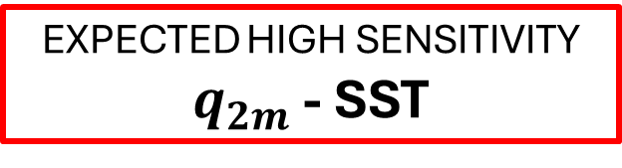
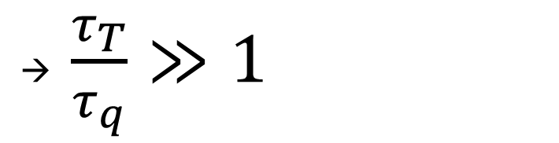
11
ARE SURFACE FLUXES THE END OF THE STORY?
DRY ENTRAINMENT
Ideal PBL:
Vertically homogeneous
NO horizontal advection
ONLY surface fluxes
Newtonian relaxation
PBL
LHF, SHF
→ $\frac{τ_{T}}{τ_{q}}≫1$
EXPECTED HIGH SENSITIVITY $q_{2m}$ - SST

