Slide 1
Finish barotropic waves

Slide 2
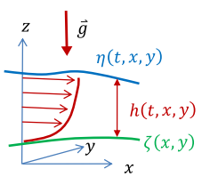

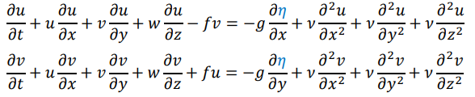
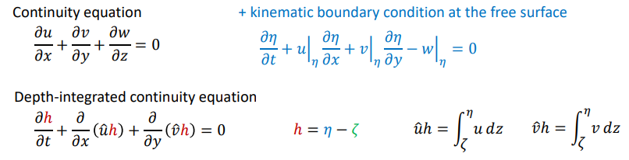
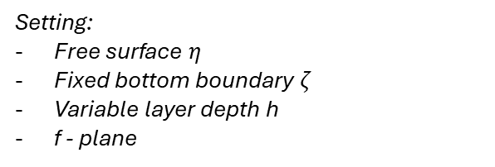
Assume hydrostatic balance +
Density variations are not strictly important (neglect)
Resulting momentum equations
Setting:
Free surface $η$
Fixed bottom boundary $ζ$
Variable layer depth h
f - plane

Slide 3
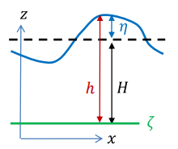
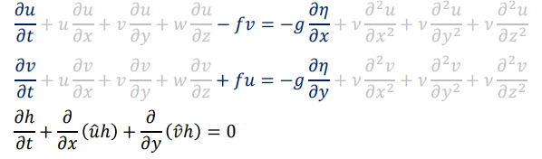
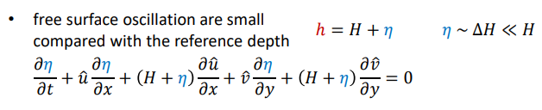
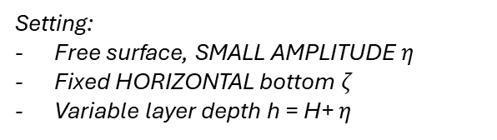
NO EKMAN
Assume hydrostatic balance +
Density variations are not strictly important (neglect)
Resulting momentum equations
Setting:
Free surface, SMALL AMPLITUDE $η$
Fixed HORIZONTAL bottom $ζ$
Variable layer depth h = H+ $η$
Small perturbations compared to mean depth – this simplifies equations further

Slide 4
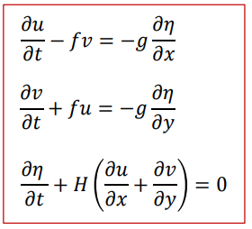
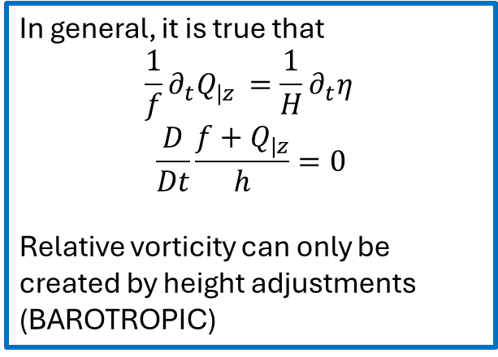
Basic set of equations to open
the world of Barotropic waves
In general, it is true that
$$\frac{1}{f}∂_{t}Q_{|z }=\frac{1}{H}∂_{t}η_{ }$$
$$\frac{D}{Dt}\frac{f+Q_{|z}}{h}=0$$
Relative vorticity can only be created by height adjustments (BAROTROPIC)
Setting:
Free surface, SMALL AMPLITUDE $η$
Fixed HORIZONTAL bottom $ζ$
Variable layer depth h = H+ $η$
1° particular solution: free surface plane wave – TRIVIALE
2° particular solution:
x
(u,v,h)
y

Slide 5
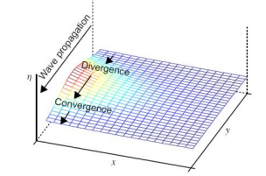
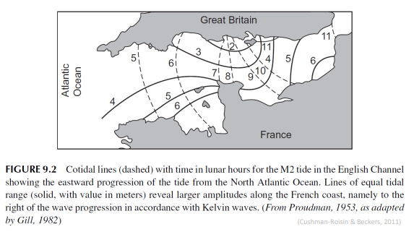


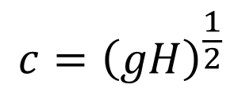
FRANCE
Rest of the world
U velocity = 0 → geostrophic balance on x axis
ROSSBY RADIUS OF DEFORMATION
understand where Gravity and Coriolis
are as important
$$c={\left(gH\right)}^{\frac{1}{2}}$$
Non-dispersive waves → are there even dispersive examples?

Slide 6
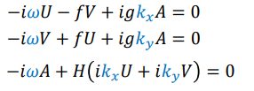
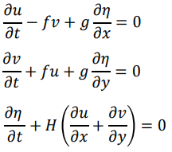
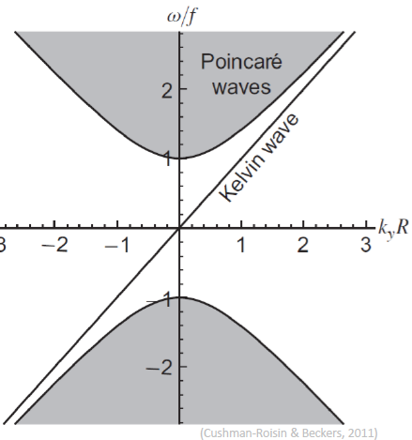
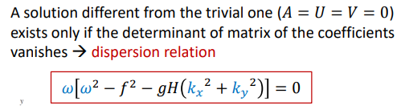


Fourier
space
Physical
space
POINCARE’ / SVERDRUP WAVES

Slide 7

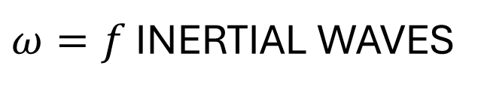
$ω=f$ INERTIAL WAVES
POINCARE’ / SVERDRUP WAVES
One can show, for stratified fluids
Notes:
In stratified fluids, reduced gravity would appear

Slide 8
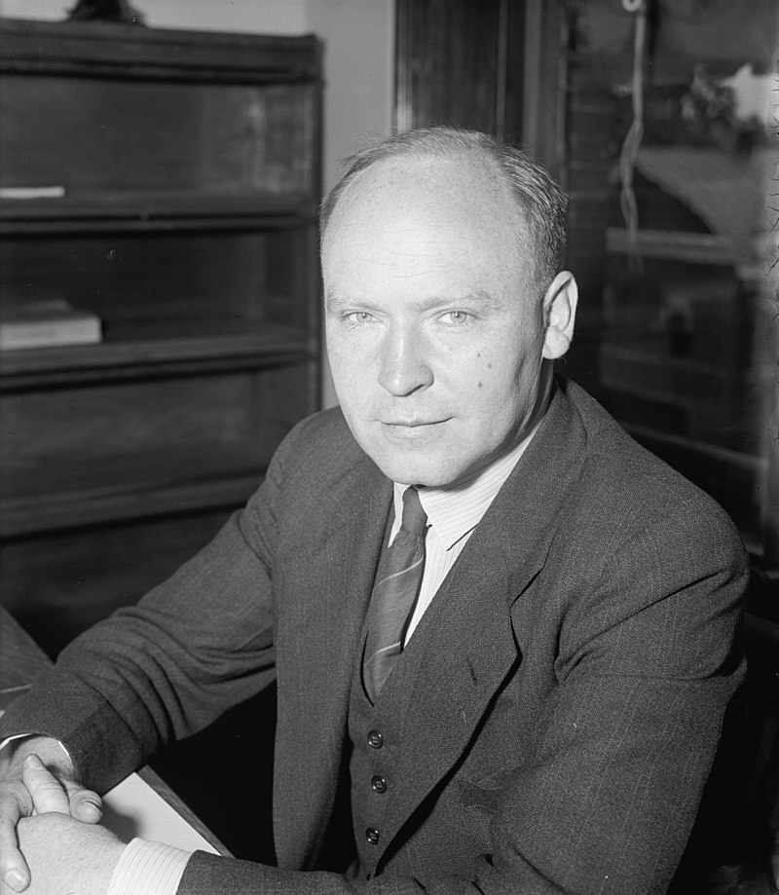
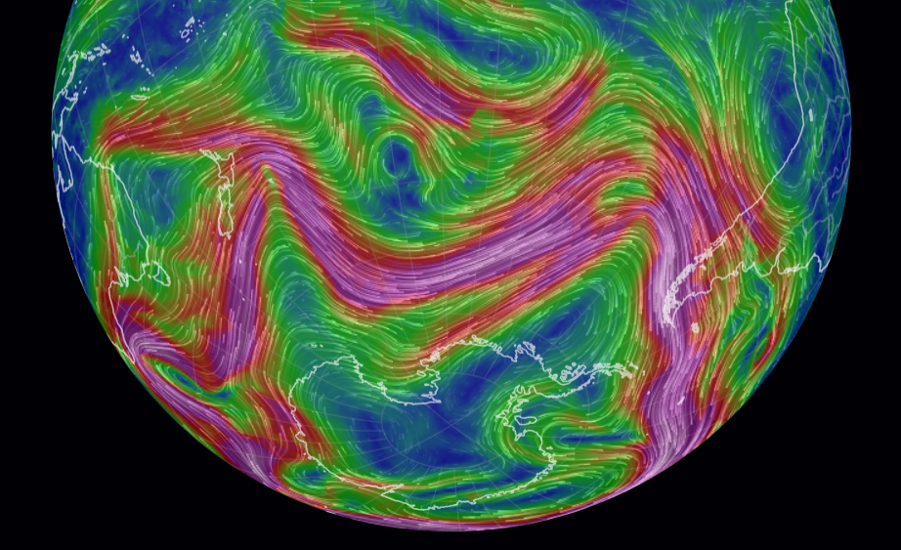

Rossby waves
Dramatically linked to
$β$-plane effects
Hey there, you wavy thing
(C.G.A. Rossby)

Slide 9
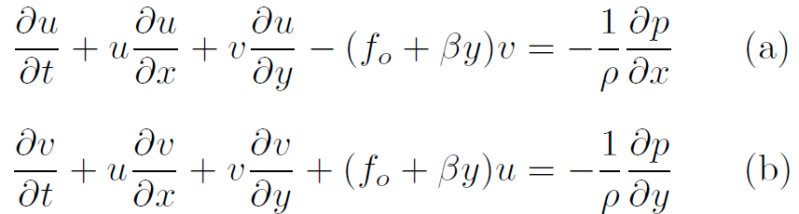
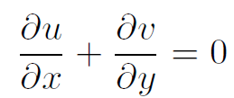
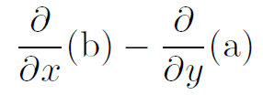
Barotropic inviscid formulation
Fix the upper free surface, for now
Key point in all these waves:
CONSERVATION OF VORTICITY
absolute: this example
Barotropic potential: next
obtain eq. for
vorticity
By doing

Slide 10
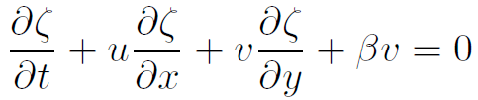
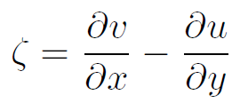















Slide 13
