Slide 1
The role of dynamic topography in the coupled climate system:
An open question awaiting answers in present-day and past climate
A PhD thesis proposal
Alessandro Storer – 04.06.2025

Slide 3
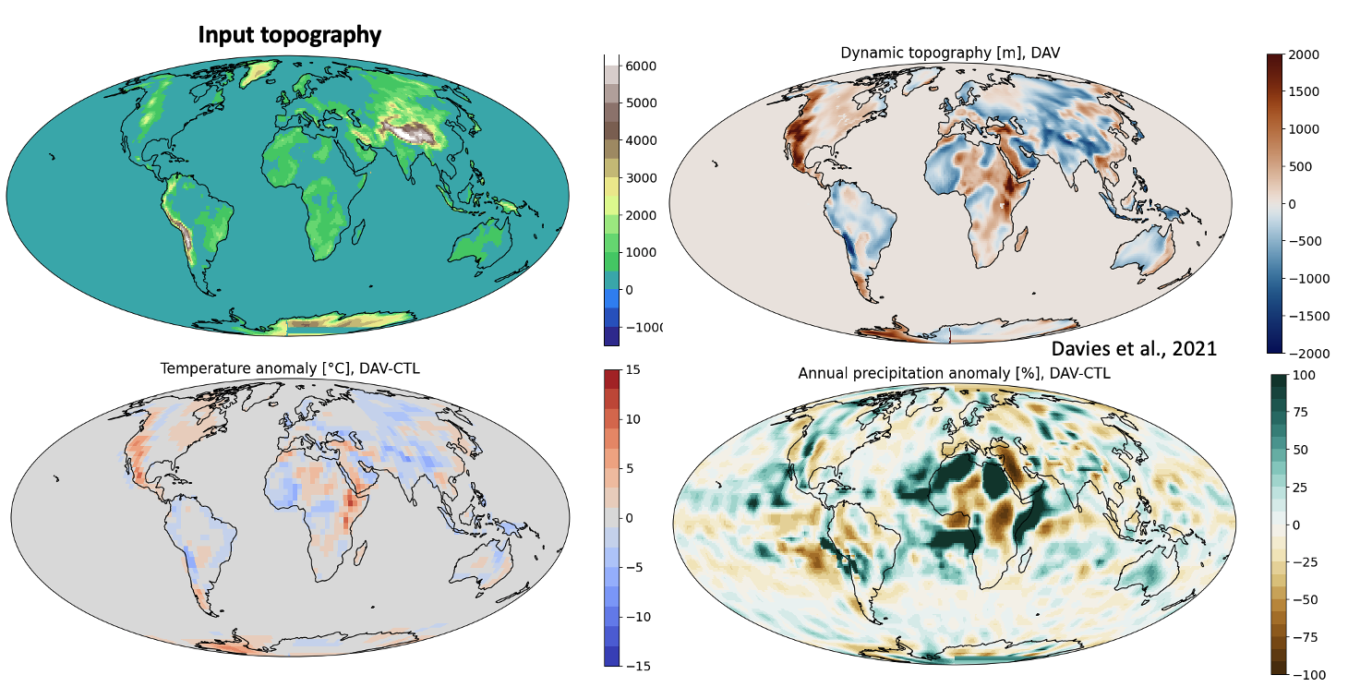
Sternai et al., 2025

Slide 4
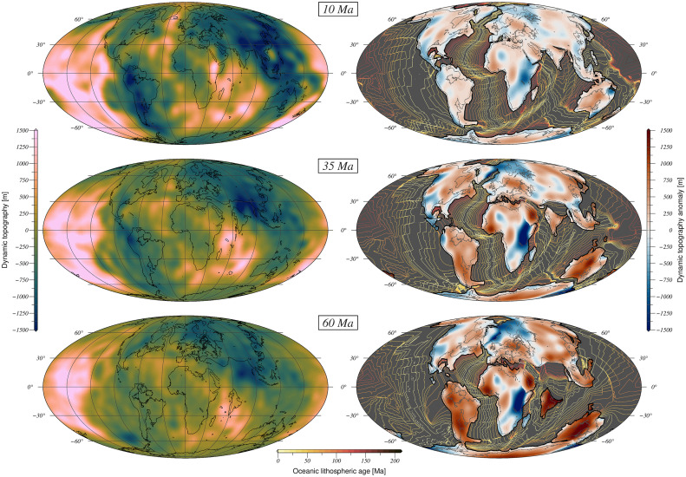
Straume et al., 2024

