Slide 1
Finish barotropic waves

Slide 2
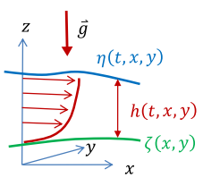

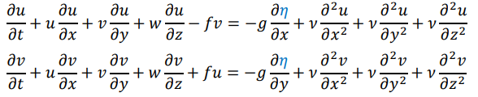
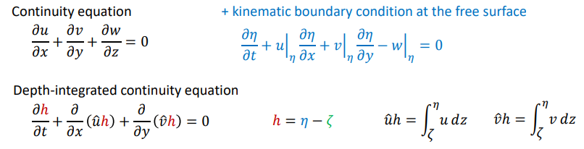
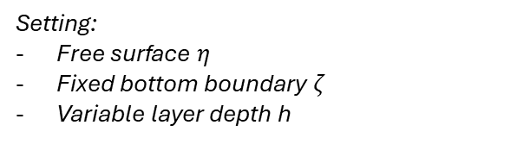
Assume hydrostatic balance +
Density variations are not strictly important (neglect)
Resulting momentum equations
Setting:
Free surface $η$
Fixed bottom boundary $ζ$
Variable layer depth h

Slide 3
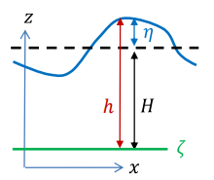
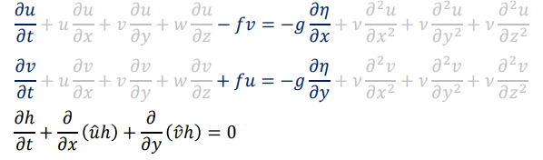
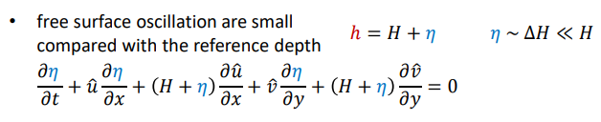
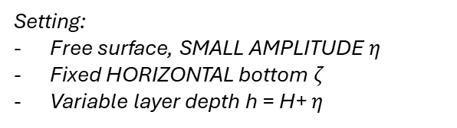
NO EKMAN
Assume hydrostatic balance +
Density variations are not strictly important (neglect)
Resulting momentum equations
Setting:
Free surface, SMALL AMPLITUDE $η$
Fixed HORIZONTAL bottom $ζ$
Variable layer depth h = H+ $η$
Small perturbations compared to mean depth – this simplifies equations further

Slide 4
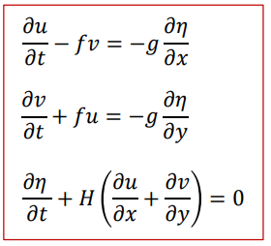
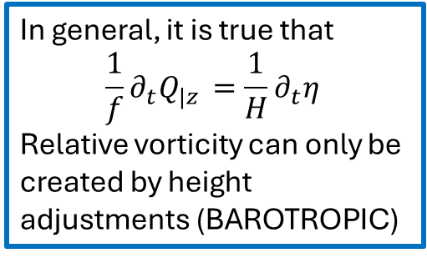
Basic set of equations to open
the world of Barotropic waves
In general, it is true that
$$\frac{1}{f}∂_{t}Q_{|z }=\frac{1}{H}∂_{t}η_{ }$$
Relative vorticity can only be created by height adjustments (BAROTROPIC)
Setting:
Free surface, SMALL AMPLITUDE $η$
Fixed HORIZONTAL bottom $ζ$
Variable layer depth h = H+ $η$
1° particular solution: free surface plane wave – TRIVIALE
2° particular solution:
x
(u,v,h)
y

Slide 5
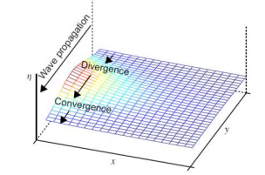
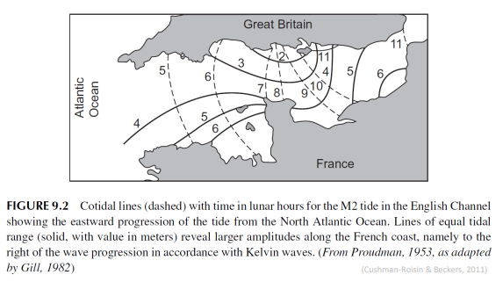
FRANCE
Rest of the world
U velocity = 0 → geostrophic balance on x axis

Slide 6
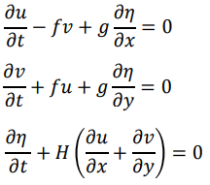
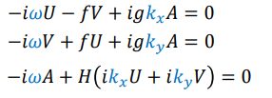
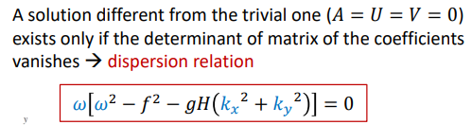
Fourier
space
Physical
space

Slide 7
Rossby

