Slide 1
Finish barotropic waves
By Ale

Slide 2
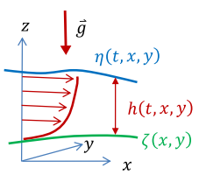

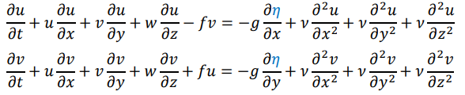
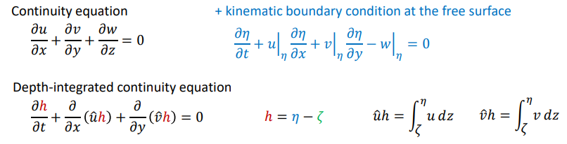
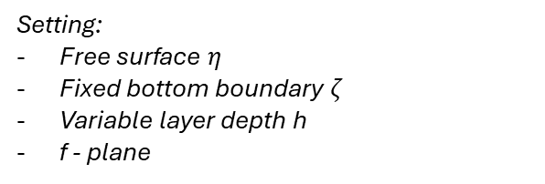
Assume hydrostatic balance +
Density variations are not strictly important (neglect)
Resulting momentum equations
Setting:
Free surface $η$
Fixed bottom boundary $ζ$
Variable layer depth h
f - plane

Slide 3
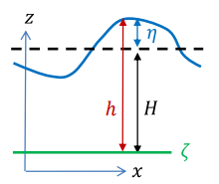
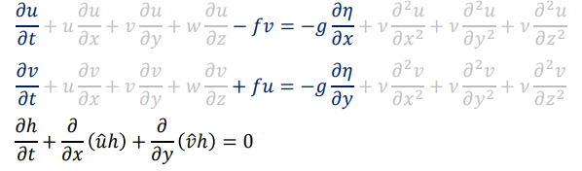
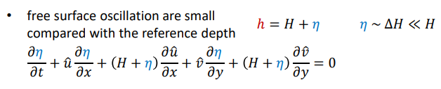
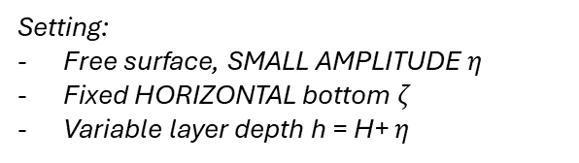
NO EKMAN
Assume hydrostatic balance +
Density variations are not strictly important (neglect)
Resulting momentum equations
Setting:
Free surface, SMALL AMPLITUDE $η$
Fixed HORIZONTAL bottom $ζ$
Variable layer depth h = H+ $η$
Small perturbations compared to mean depth – this simplifies equations further

Slide 4
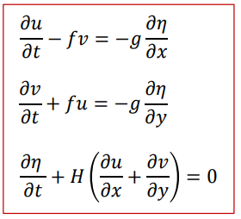
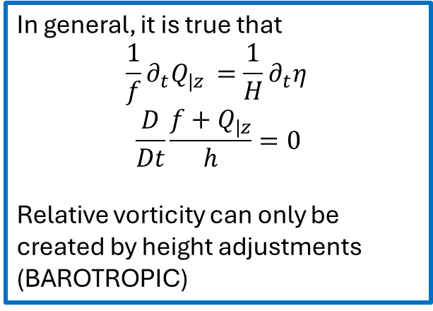
Basic set of equations to open
the world of Barotropic waves
In general, it is true that
$$\frac{1}{f}∂_{t}Q_{|z }=\frac{1}{H}∂_{t}η_{ }$$
$$\frac{D}{Dt}\frac{f+Q_{|z}}{h}=0$$
Relative vorticity can only be created by height adjustments (BAROTROPIC)
Setting:
Free surface, SMALL AMPLITUDE $η$
Fixed HORIZONTAL bottom $ζ$
Variable layer depth h = H+ $η$
1° particular solution: free surface plane wave – TRIVIALE
2° particular solution:
x
(u,v,h)
y

Slide 5
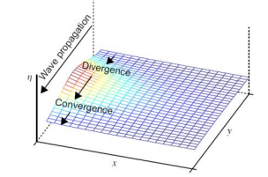
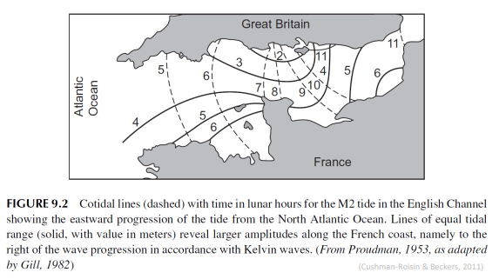


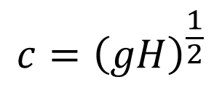
FRANCE
Rest of the world
U velocity = 0 → geostrophic balance on x axis
ROSSBY RADIUS OF DEFORMATION
understand where Gravity and Coriolis
are as important
$$c={\left(gH\right)}^{\frac{1}{2}}$$
Non-dispersive waves → are there even dispersive examples?

Slide 6
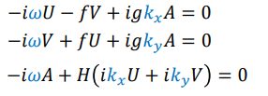
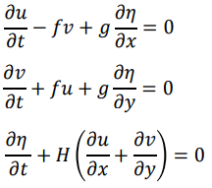
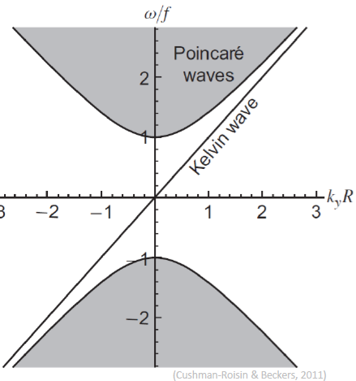
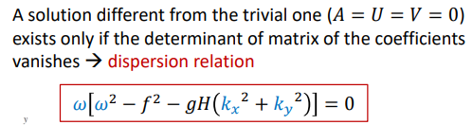


Fourier
space
Physical
space
POINCARE’ / SVERDRUP WAVES

Slide 7

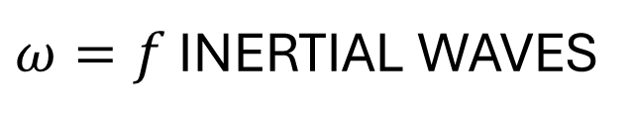
$ω=f$ INERTIAL WAVES
POINCARE’ / SVERDRUP WAVES
One can show, for stratified fluids
Notes:
In stratified fluids, reduced gravity would appear

Slide 8
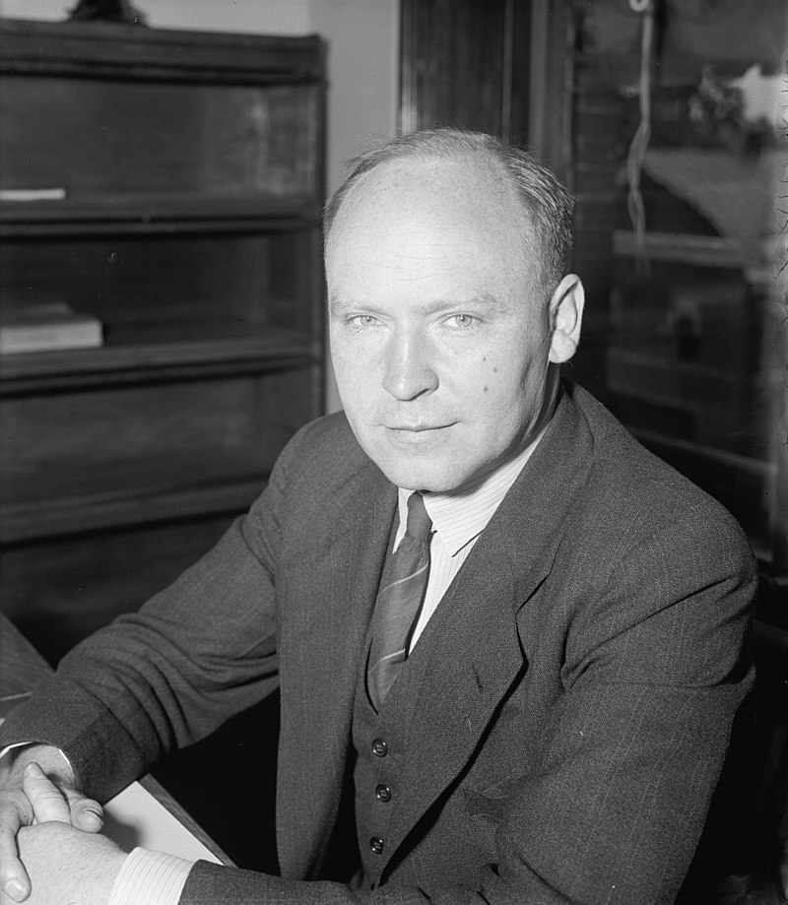
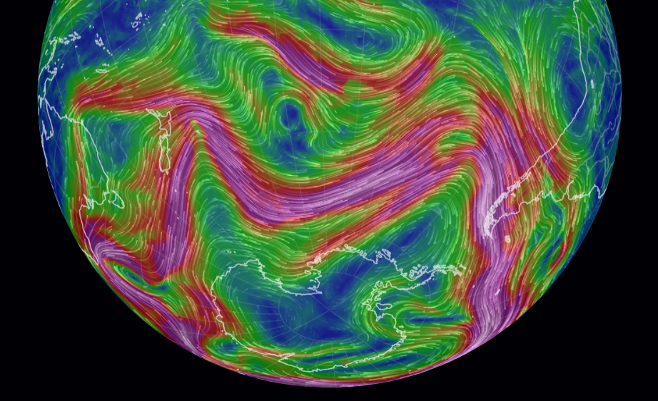

Rossby waves
Dramatically linked to
$β$-plane effects
Hey there, you wavy thing
(C.G.A. Rossby)

Slide 9
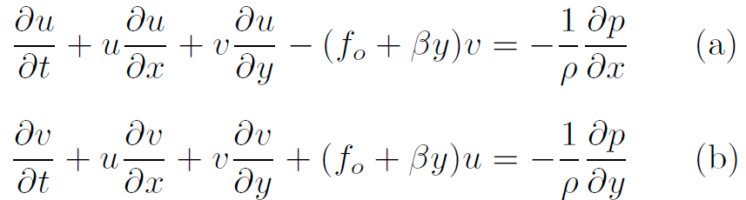
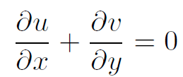
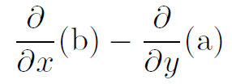
Barotropic inviscid formulation
Fix the upper free surface, for now
Key point in all these waves:
CONSERVATION OF VORTICITY
absolute: this example
Barotropic potential: next
obtain eq. for
vorticity
By doing

Slide 10
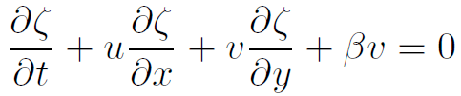
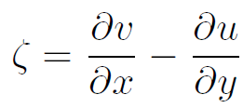
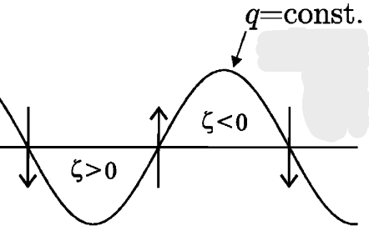
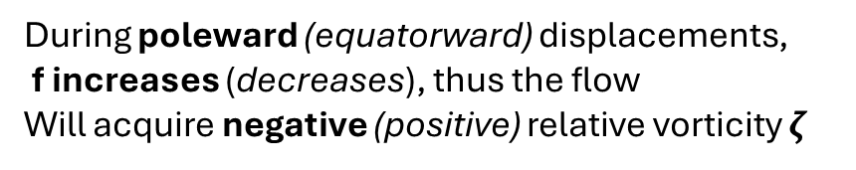
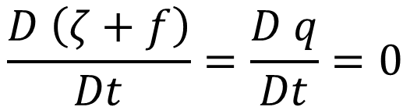
Momentum equations
$$\frac{D \left(ζ+f\right)}{Dt}=\frac{D q}{Dt}=0$$
POLE (f increases)
During poleward (equatorward) displacements,
f increases (decreases), thus the flow
Will acquire negative (positive) relative vorticity $ζ$
Technical note: if you add baroclinicity to such meandering, you get H-L pressure patterns

Slide 11
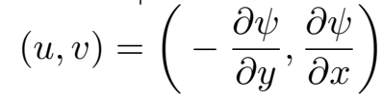
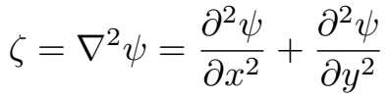

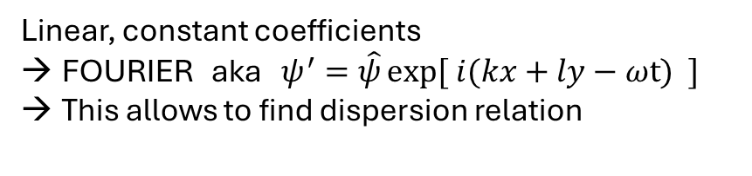
Horizontal non-divergence → STREAMFUNCTION
which implies
Now, let’s consider perturbations with respect to a uniform zonal-only background flow
Linear, constant coefficients
FOURIER aka $ψ^{′}=\hat{ψ}\exp{[ i(kx+ly−ωt) ]}$
This allows to find dispersion relation

Slide 12

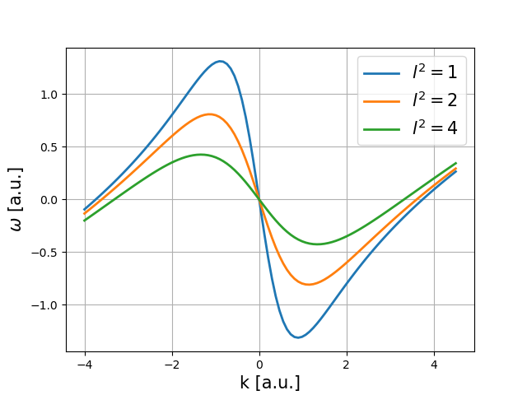

Doppler shift due to mean flow
So how does a Rossby wave propagate?

Slide 13
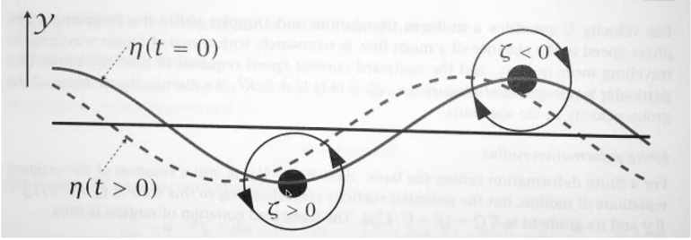
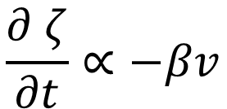
Momentum equations
$$\frac{D \left(ζ+f\right)}{Dt}=\frac{D q}{Dt}=0$$
POLE (f increases)
Having a restoring term of this kind
$$\frac{∂ ζ}{∂t}∝−βv$$
Makes the phase of the wave
Propagate westward

Slide 14
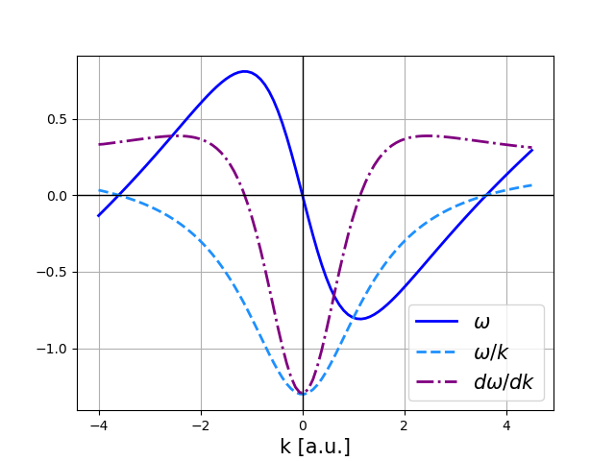
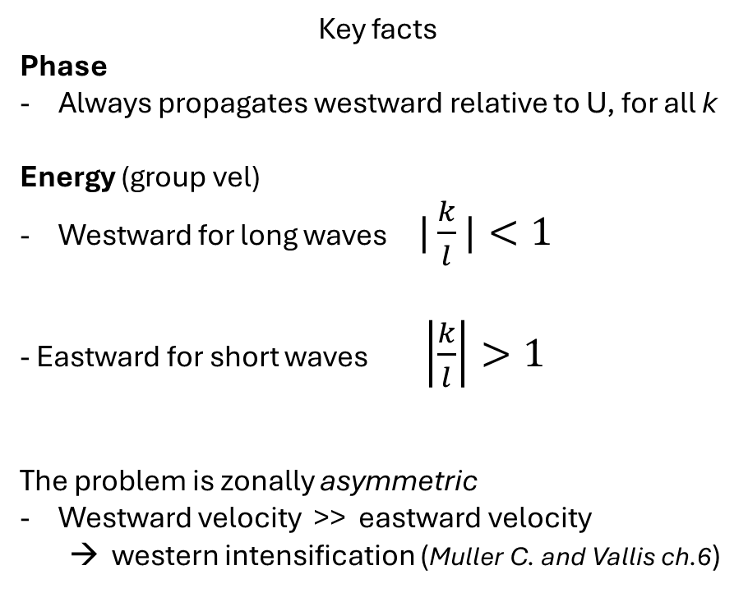
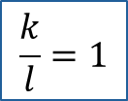
How does the wave propagate?
Zonal phase speed and group velocity
Key facts
Phase
Always propagates westward relative to U, for all k
Energy (group vel)
Westward for long waves $|\frac{k}{l}|<1$
- Eastward for short waves $\left|\frac{k}{l}\right|>1$
The problem is zonally asymmetric
Westward velocity >> eastward velocity
→ western intensification (Muller C. and Vallis ch.6)
$$\frac{k}{l}=1$$
short
waves
Long
waves
: A stationary wave will necessarily
propagate its energy eastward

Slide 15
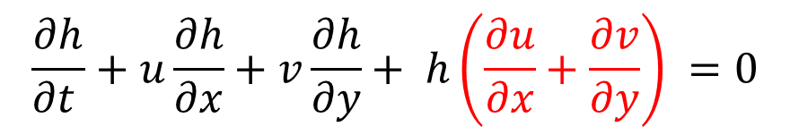
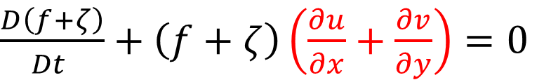
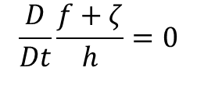

Case with variable depth
$$=−g ∇h$$
$$\frac{D}{Dt}\frac{f+ζ}{h}=0$$
$$\frac{∂h}{∂t }+u\frac{∂h}{∂x}+v\frac{∂h}{∂y}+ h\left(\frac{∂u}{∂x}+\frac{∂v}{∂y}\right) =0$$
Combine a) and b) in the usual way
$\frac{D\left(f+ζ\right)}{Dt }+\left(f+ζ\right)\left(\frac{∂u}{∂x}+\frac{∂v}{∂y}\right)=0$
«continuity equation» for absolute vorticity
Now the column can be squeezed!

Slide 16






















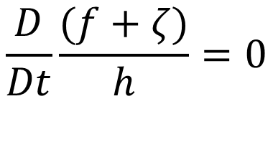









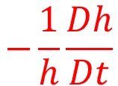














Case with variable depth
$\frac{D\left(f+ζ\right)}{Dt }+\left(f+ζ\right)\left(\frac{∂u}{∂x}+\frac{∂v}{∂y}\right)=0$
«continuity equation» for absolute vorticity
$$−\frac{1}{h}\frac{Dh}{Dt}$$
$$\frac{D}{Dt}\frac{(f+ζ)}{h}=0$$
(Lagrangian) conservation of
barotropic potential vorticity
From which it follows

Slide 17
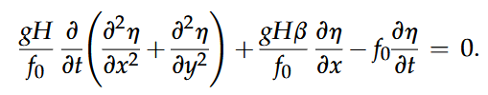
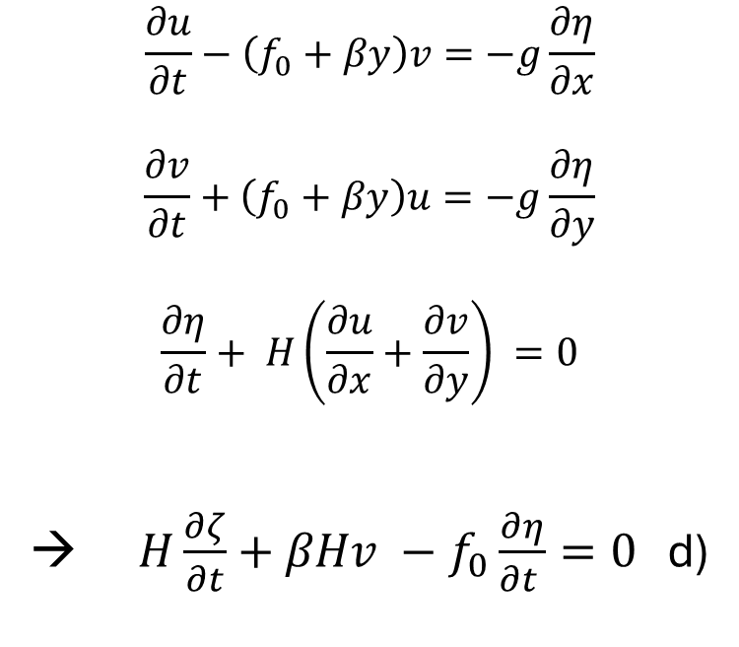
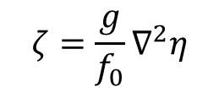
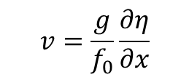
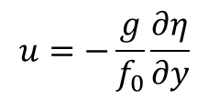
$$\frac{∂u}{∂t}−\left(f_{0}+βy\right)v=−g\frac{∂η}{∂x}$$
$$\frac{∂v}{∂t}+\left(f_{0}+βy\right)u=−g\frac{∂η}{∂y}$$
$$\frac{∂η}{∂t}+ H\left(\frac{∂u}{∂x}+\frac{∂v}{∂y}\right) =0$$
→ $H\frac{∂ζ}{∂t}+βHv −f_{0}\frac{∂η}{∂t }=0$ d)
Dispersion relation with finite deformation radius
Back to linearized, quasi-geostrophic barotropic equations
→ Let f vary with y
“ the departure from strict geostrophy determines the evolution
of the flow described by d). We can therefore use the geostrophic
relations for velocity everywhere except in the
horizontal divergence term in the vorticity equation. “ (Kundu)
NB: this is not valid close to the Equator,
where we are far from geostrophic equilibrium
$$u=−\frac{g}{f_{0}}\frac{∂η}{∂y}$$
POTENTIAL FLOW ANALYSIS
$$ζ=\frac{g}{f_{0}}∇^{2}η$$
$$v=\frac{g}{f_{0}}\frac{∂η}{∂x}$$
→
To which we can apply Fourier

Slide 18
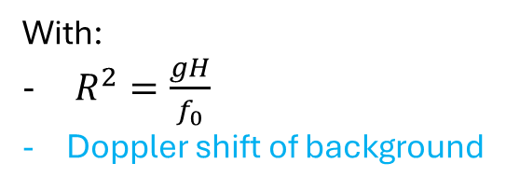
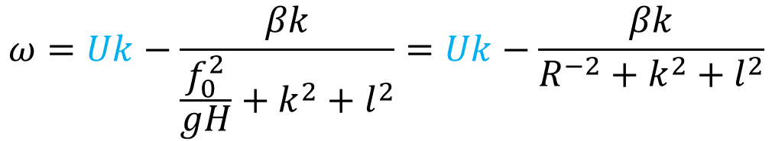
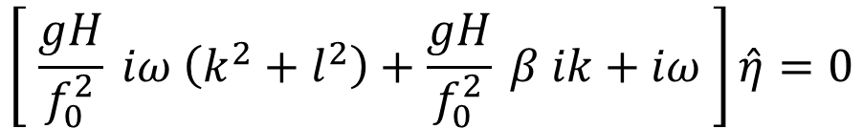
→
To which we can apply Fourier
$$\left[ \frac{gH}{f_{0}^{2}} iω \left(k^{2}+l^{2}\right)+\frac{gH}{f_{0}^{2}} β ik+iω \right]\hat{η}=0$$
From which it follows
With:
$R^{2}=\frac{gH}{f_{0}}$
Doppler shift of background
$$ω=Uk−\frac{βk}{\frac{f_{0}^{2}}{gH}+k^{2}+l^{2}}=Uk−\frac{βk}{R^{−2}+k^{2}+l^{2}}$$

Slide 19



Topographic Rossby waves
Keeping the usual linearized momentum budget,
We now allow the mean depth to vary with y
Basically any tank experiment works like this

Slide 20





Two different perspective
But same results

Slide 21

Previsione di come Andre
Difenderà la sua tesi di PhD
:) XD LOL VIVALABBRUZZO

Slide 22







But wait…
What’s going on in the meridional direction?
$$l= ±{\left[\frac{β}{U−c_{p,x}} −k^{2} \right]}^{1/2}$$
There is a sign ambiguity!
This must be settled to understand where energy propagates
$\frac{∂ζ^{′}}{∂t}+U\frac{∂ζ^{′}}{∂x}+βv^{′}=−r ζ^{′}$
→
Add a little amount of drag
Wavy solution for the flow potential
$$ψ=A e^{i\left(kx+ly−ω_{r}t\right)}$$
$$ω_{r}=Uk −\frac{βk}{k^{2}+l^{2}}−ir ≔ ω_{R}−ir$$
→

Slide 23

















GOAL: find conditions on c so as to obtain decaying solution

Slide 24









$$y=a(θ−θ_{0})$$
Beta-plane approx
NW to SE tilt
$$y=0$$
SW to NE tilt

Slide 25




A couple of comments
$$l= ±{\left[\frac{β}{U−c_{p,x}} −k^{2} \right]}^{1/2}$$
All roses and flowers until
$$U≤c_{p,x}$$
In that case, non linear wave breaking
Waves propagate up to the
critical latitude
NB: $β$ gets larger towards the Equator
SW to NE tilt in the Northern Hemisphere
NW to SE tilt in the southern hemisphere
That’s why those two orientations
are visibly more marked

Slide 26


Slide 27














