Slide 1

VERICARGO ONETRUTH
Governed Supply Chain Ontology and Exception Copilot
One shipment. Two destinations. One governed truth.
Challenge: Supply Chain Ontology and Governed Conversational Analytics
Team: VeriCargo | Team Lead: See Keng Lek | Team size: 1

Slide 2

01 | BUSINESS PROBLEM
Fragmented truth blocks timely action
ERP says delivered. The Shipping Instruction says Vietnam. The Draft Bill of Lading says Thailand. Which version should the business trust?
FRAGMENTED SOURCES
INCONSISTENT METRICS
UNSAFE EXCEPTIONS
ERP, logistics, inventory, cost and shipping documents sit in separate systems with inconsistent identifiers.
Operations, procurement and planning can receive different answers for the same delivery-performance question.
Missing, unreadable or ambiguous evidence is often guessed, ignored or handled through untracked manual follow-up.
TARGET USERS
Logistics control tower | Procurement | Planning | Document operations
ONE GOVERNED ROUTE
Detect contradiction -> preserve evidence -> explain with governed AI -> human-confirm action -> audit outcome
VeriCargo OneTruth
02

Slide 3
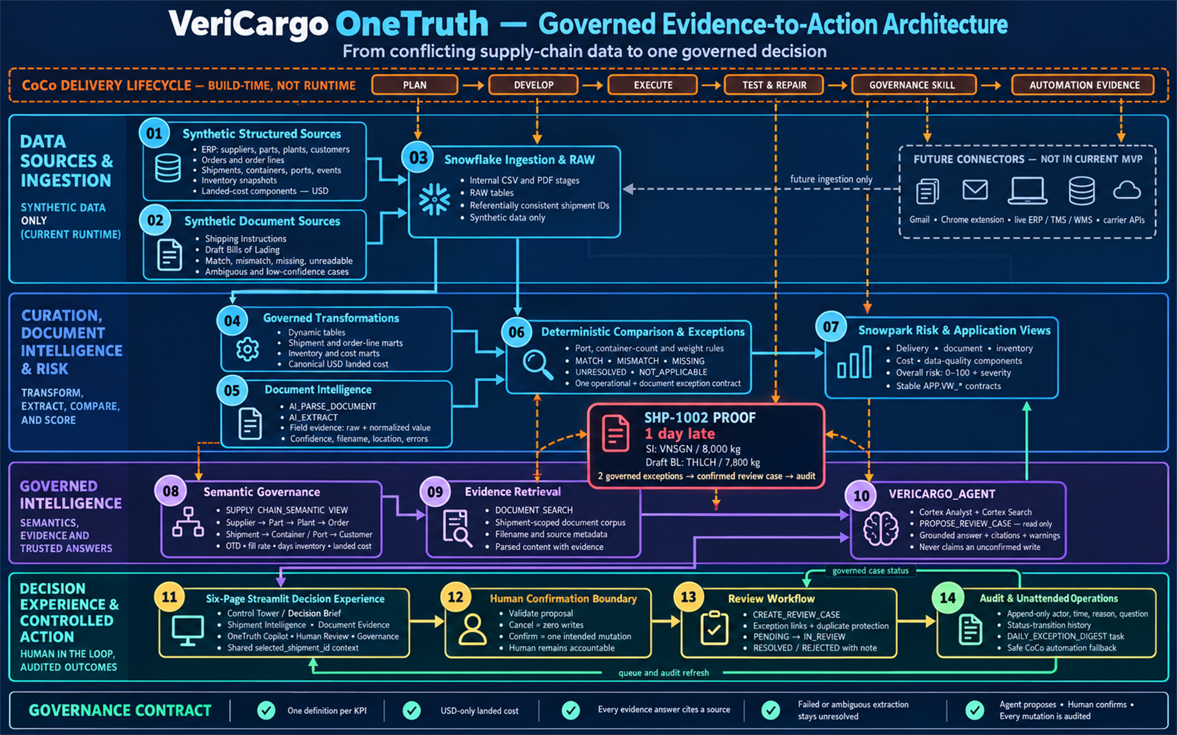
02 | SNOWFLAKE-NATIVE SYSTEM DESIGN
Connected evidence-to-action architecture
CoCo builds and verifies the solution; Snowflake runs the governed production workflow.
VeriCargo OneTruth
03

Slide 4
03 | GOVERNED CONVERSATIONAL ANALYTICS
One metric, three personas, one answer
OPERATIONS
PROCUREMENT
PLANNING
"What is our on-time delivery rate for completed shipments?"
"What is supplier delivery compliance against promised dates?"
"What percentage of delivered shipments arrived on or before promise?"
60.0%
3 on time / 5 delivered
Shipment grain | Same all-delivered window | Same governed definition
Canonical OTD = delivered shipments on or before promise / delivered shipments
Verified by three independent Agent questions; evidence query IDs are retained in COCO_USAGE.md.
VeriCargo OneTruth
04

Slide 5
04 | SHP-1002 END-TO-END PROOF
One shipment. Two destinations. One governed decision.
CONFLICTING SOURCE EVIDENCE
1
DETECT
Late delivery + document mismatch
Finding
Shipping Instruction
Draft BL / Actual
2
EVIDENCE
Destination
VNSGN
THLCH
Raw, normalized, confidence, filenames
Gross weight
8,000 kg
7,800 kg
3
EXPLAIN
Agent answer is cited and read only
Delivery
Promised
1 day late
4
CONFIRM
Sources
doc-shp-1002-si.pdf
Cancel = 0 writes; Confirm = 1 case
doc-shp-1002-bl.pdf
5
AUDIT
Result: two linked governed exceptions
RC-000201, 2 links, 3 lifecycle events
Agent proposes. Human confirms. Every mutation is audited.
VeriCargo OneTruth
05

Slide 6
05 | REQUIRED TOOLING AND INGENUITY
CoCo CLI across the complete delivery lifecycle
CoCo is the engineering copilot used to plan, build, execute, test and automate the solution - not a runtime dependency.
PLAN
DEVELOP
EXECUTE
TEST + REPAIR
AUTOMATE
Ontology, metrics, architecture, guardrails
Session 4ce0a356...
SQL/Python review + Korean port alias fix
Session b46b47a1...
Snowflake objects, Agent and Streamlit
Query IDs retained
30/30 local + 28/28 Snowflake
Failed -> fixed proof
Governance skill + daily digest Task
Query 01c762ea...
FAILED-THEN-FIXED EVIDENCE
Busan initially normalized incorrectly -> CoCo repaired SQL alias parity -> all aliases and six document outcomes passed regression.
VeriCargo OneTruth
06

Slide 7
06 | IMPACT AND SUBMISSION READINESS
Working MVP, measurable proof, scalable governed core
30/30
28/28
60.0%
2
3
Local tests
Snowflake checks
Consistent OTD
Linked findings
Audit events
WHAT THE MVP PROVES
HOW IT EXTENDS
- Structured metrics and unstructured documents share one shipment context
- Failed or ambiguous extraction stays unresolved
- Unknown IDs, duplicate cases and illegal transitions are blocked
- Six connected pages preserve investigation context
Replace synthetic ingestion with live ERP, TMS, WMS, carrier, Gmail or extension connectors. The ontology, semantic definitions, evidence model, Agent guardrails, review workflow and audit layer remain reusable.
Provenance: all submitted business data is synthetic. The prior Chrome extension is disclosed background IP and is outside this runtime.
VeriCargo OneTruth
07

Slide 8

VERICARGO ONETRUTH
Detected -> evidenced -> explained -> human-confirmed -> audited
Challenge: Supply Chain Ontology and Governed Conversational Analytics
Demo video: [PASTE FINAL 3-5 MINUTE LINK]

